Slide 1
Miombo network of Southern Africa: a platform for collaborative research for decision-making
Ribeiro, N.¹; Kamoto, J.²; Nhantumbo, I.³; Bandeira, R.¹; Jumbe, C.², Rija, A.⁵ and Archibald, S.⁶
¹ Faculty of Agronomy and Forest Engineering, Eduardo Mondlane University, Av Julius Nyerere, 3453, Main Campus, P.O.Box. 257, Maputo, Mozambique; email: joluci2000@yahoo.com.
²Lilongwe University of Agriculture and Natural Resources (LUANAR), P.O.Box 219, Lilongwe, Malawi
²
³International Institute for the Environment and Development, 80–86 Gray’s Inn Road London, WC1X 8NH United Kingdom
⁵ College of Forestry, Wildlife and Tourism, Sokoine University of Agriculture, Morogoro, Tanzania
⁶ School of Animal, Plant and Environmental Sciences, University of the Witwatersrand, 1 Jan Smuts Avenue, Braamfontein 2000Johannesburg, South Africa
Tbilisi, 2017
)

Slide 2
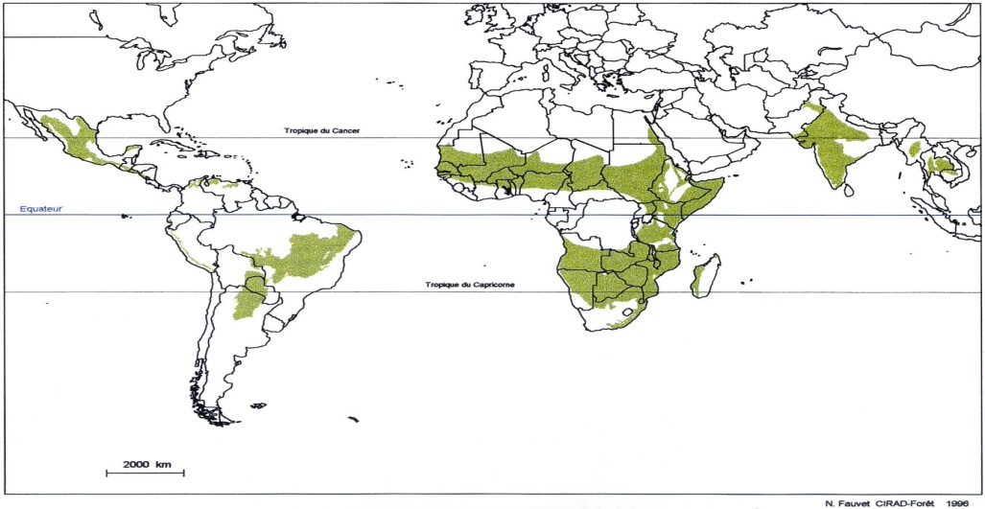
Miombo woodlands
The largest dry forest ecosystem
Occupies about 2.7 million km² in Southern Africa
Sources: http:// www.fao.org/DOCREP/005/W4442E/w4442e04.htm; http://mediasfrance.org/Reseau/Lettre/10/en/Dossiers/

Slide 3
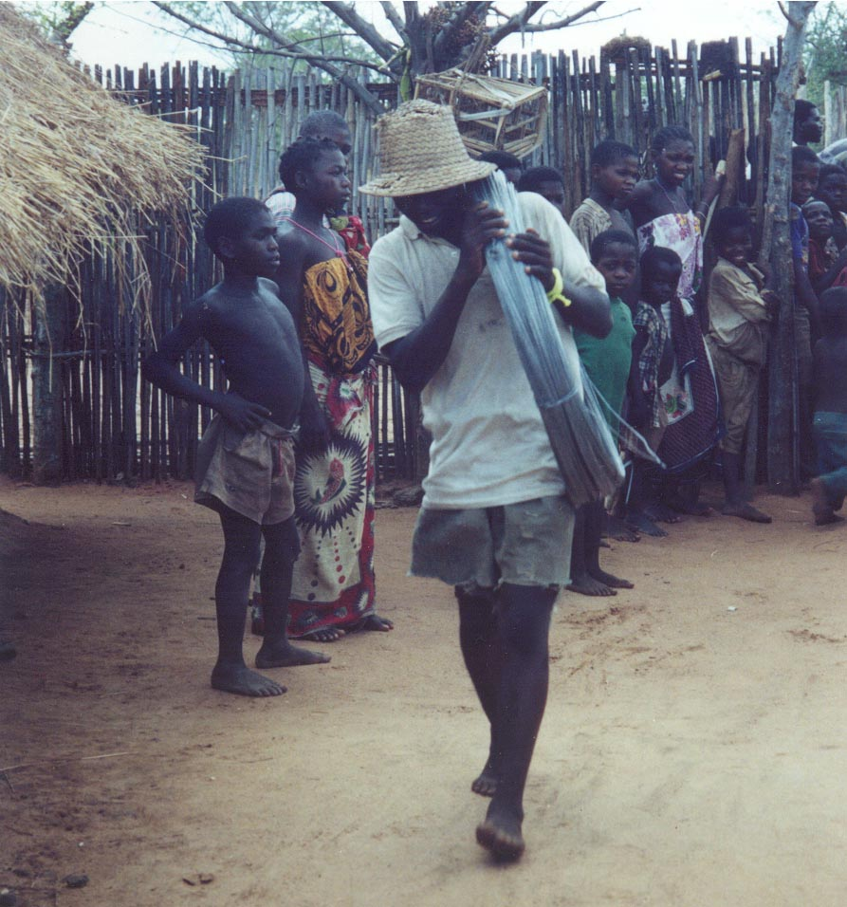
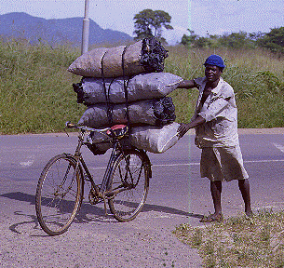
Socio-ecological importance of Miombo Woodlands
about 8500 plant species, half are endemic to the region.
dominated by: Julbernardia globiflora, Brachystegia spp. and Isoberlinia angolensis
Frequent fires and other disturbances (herbivory, slash and burn)
Provide goods and services for ca 40 million rural people and 15 million urban dwellers
Domestic

Slide 4
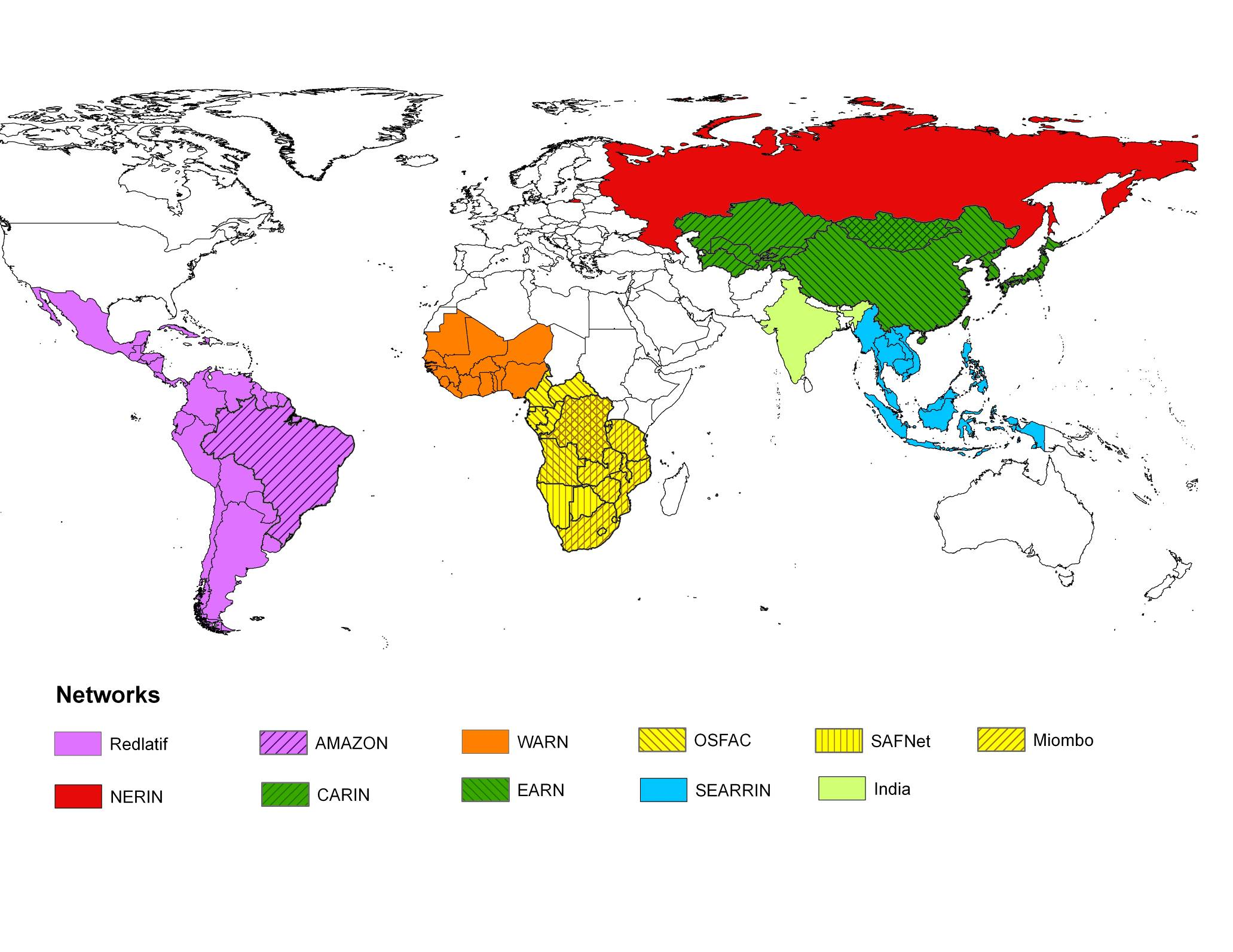
One of the Global Observation
of Forest and Land Cover Dynamics (GOFC-GOLD) Regional Networks;
Founded in 1995 by a group of regional and International scientists.
Focus: Land use and Land cover of miombo woodlands of southern Africa.
Inactive since ~2005 and re-launched in 2013.
)

Slide 5
Objectives of the network
To enhance the use of information from field observations and remote sensing of the miombo cover for management in southern Africa.
To execute and design projects, develop consensus algorithms and methodologies for product generation and validation
To bring together land cover data providers, users and researchers operating in a common geographic area, and represent a link between national agencies, user groups and the global user/producer.

Slide 6
Membership database
More than 100 people listed (MW countries, South Africa, Namibia, Botswana, USA, UK, Portugal, Brasil, New Zealand, others).
60% are from academia, 26% from conservation NGOs and/or institutions, 8% from private sector and 4% from government institutions.
=> good capacity for training and capacity building within the network.

Slide 7
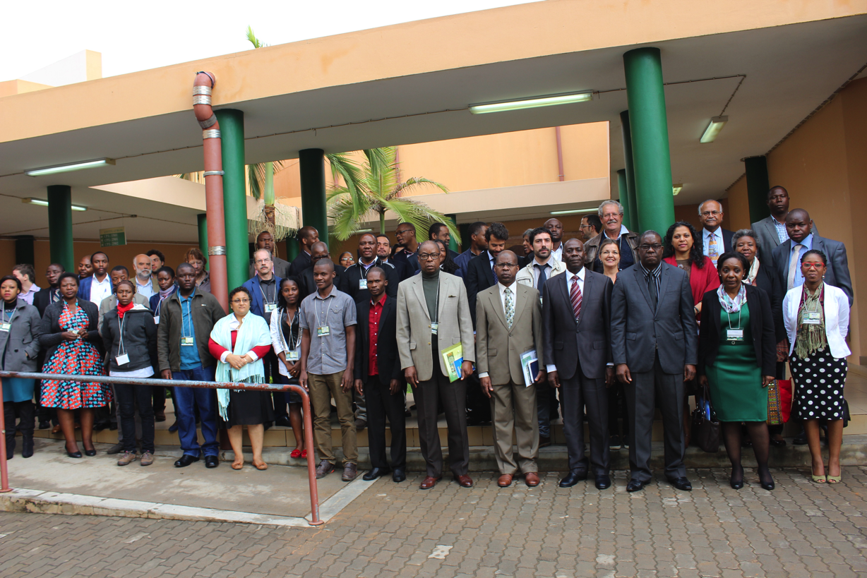
Restoring socio-ecological and socio-economic relationships in the miombo woodlands
MN meeting, July 2016, Maputo, Mozambique

Slide 8
Conceptual Framework of the MN

Slide 9
Policy brief Published
https://www.iucn.org/news/forests/201702/roadmap-protect-miombo-woodlands

Slide 10
MN Science Plan (Research Priorities)
Focal Area 1: Patterns and rates of land cover change.
Focal area 2: Land use change integrated analysis: Process and drivers of land use change
Focal area 3: Carbon and biomass in the miombo woodlaands
Focal area 4: Ecology of the miombo ecosystem
Focal areas 5: Miombo ecosystem management and adaptation to climate change
Focal area 6: Socio-ecological relationships in the miombo ecosystem

Slide 11
Collaborative Research projects:
Analysis of the regional legal and policy framework for miombo woodlands (on-going).
An integrated approach to maximize the use NTFP and to improve agricultural systems in the Miombo woodlands (submitted to the African Union).
Socio-Ecological Observatory of SA Woodlands (SEOSAW), collate and analyse existing plot data in the MW and associated woodlands (on-going)
Develop a restoration strategy for the region: geospatial analysis of miombo degradation, identification of restoration models and priorities and identification of implementation strategies .
Impact of migration due to climate change on miombo woodlands.

Slide 12
Miombo Book : Miombo woodlands in a changing global environment
Funding source: WWF Mozambique $20,000 but total Budget is $63,588
Editors: Ribeiro, N.; Gumbo, D. and Chidumayo, E.
Book outline:
Chapter 1: Biogeography of the Miombo Woodlands (Lead author: Professor E. Chidumayo)
Chapter 2: Socio-ecology of the miombo woodlands (Lead Author: N. Ribeiro)
Chapter 4: Sustainable management of miombo woodlands (Lead author: Almeida Sitoe)
Chapter 5: Miombo and global change ecology (Lead author: Davison Gumbo)
Chapter 6: Governance for sustainable management of miombo woodlands (Lead author: Isilda Nhantumbo and Charles Jumbe)
Notes:
WWF Mozambique =$20,000 funded us
Our Budget is $60,000. START can fund the rest. The total Budget for the book $63,588. If they could find us another source of funding that will be book

Slide 13
World Bank funding: $10000 for 1 Year June 2017-July 2018
Southern African Science Centre for Climate Change and Adaptive Land Management (SASSCAL ) to support MN to establish (strategic plan, science plan, webpage, fundraising strategy).
2 policy briefs underway (1 on sustainable wood management and 1 on large-scale agriculture expansion)
1 regional forestry policy analysis
Government focal points being established
Partial funding to the MN meeting 2018
Notes:
SASSCAL, Sustainable Wood Management Stephen, Large Scale Agricultural Expansion=Sally . Differences on policies in the region 25 Sept. to end. Select and 1 October she starts work. To be attached in any miombo country where he or she is coming from.
Making science for decision making our suggestion, the WB made a suggestion which is a good idea about The focal point in each country will be forestry dept headquarters.
WB Partial funding for the for 2018
$10,000 WB funding for one year contract July- June 2018

Slide 14
Communication and information sharing
A mailing list:
miombo-network@mlist.is.ed.ac.uk
joluci2000@yahoo.com
(Natasha Ribeiro)
Website:
http://www.fao.org/GTOS/gofc-gold/net-Miombo.html (to be updated soon)

Slide 15
Thank you!

