Slide 1
CARIN Way Forward
Solicit/Engage more/new regional leaders
RN capacity building through
Existing funding (Asia Hub)
New funding opportunities
Asia Water Hub, ADB/WB, One Belt One Road, EU etc.
Focus 1-2 specific pilot RN wide proposals (3rd slide)
Alignments of RN’s objectives with national priorities
Land as the nexus of WEF Systems

Slide 2
MekRIN Way Forward
Reach out to regional stakeholders (their perspectives and potential funding)
Phased /Targeted (theme-based) Training Programs
Phase I: RS Products/Information (Fire, LCLU.. GEE tools)
Phase II: Applications to address local issues (Tools, modeling, and demonstrations)
Phase III: Problems solving (hands-on case studies)
Location rotation among GMS countries
Link to other int’l programs, projects, RNs…
e.g. FE Asia, GLP, MAIRS, Asia Hub, WEF KAN and EU
Help RN’s members to achieve their goals (incentives) through publication and grant proposals

Slide 3
Network wide (or sub-network) Opportunities -- Leveraging START funding
SAVI – Science Across Virtual Institutions
RCN – Research Coordination Networks
PEER – Partnership for Enhanced Engagement in Research
APN – Asia Pacific Network
NSF International
NSF INFEWS
Propose an effort on a specific theme across RNs to target one of the above in the next year.

Slide 4
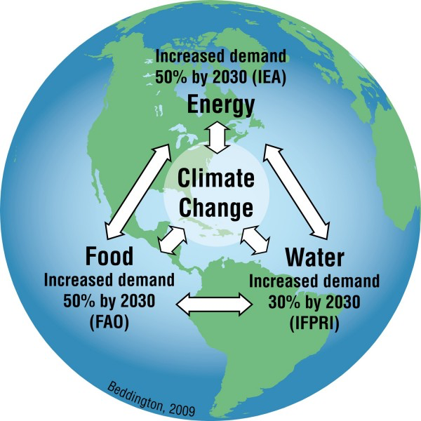
WEF NEXUS
Global Challenges
SDGs
Water: Support more with the same or less
Food: Produce more with the same
Energy: Generate more with the same resources
Land

Slide 5
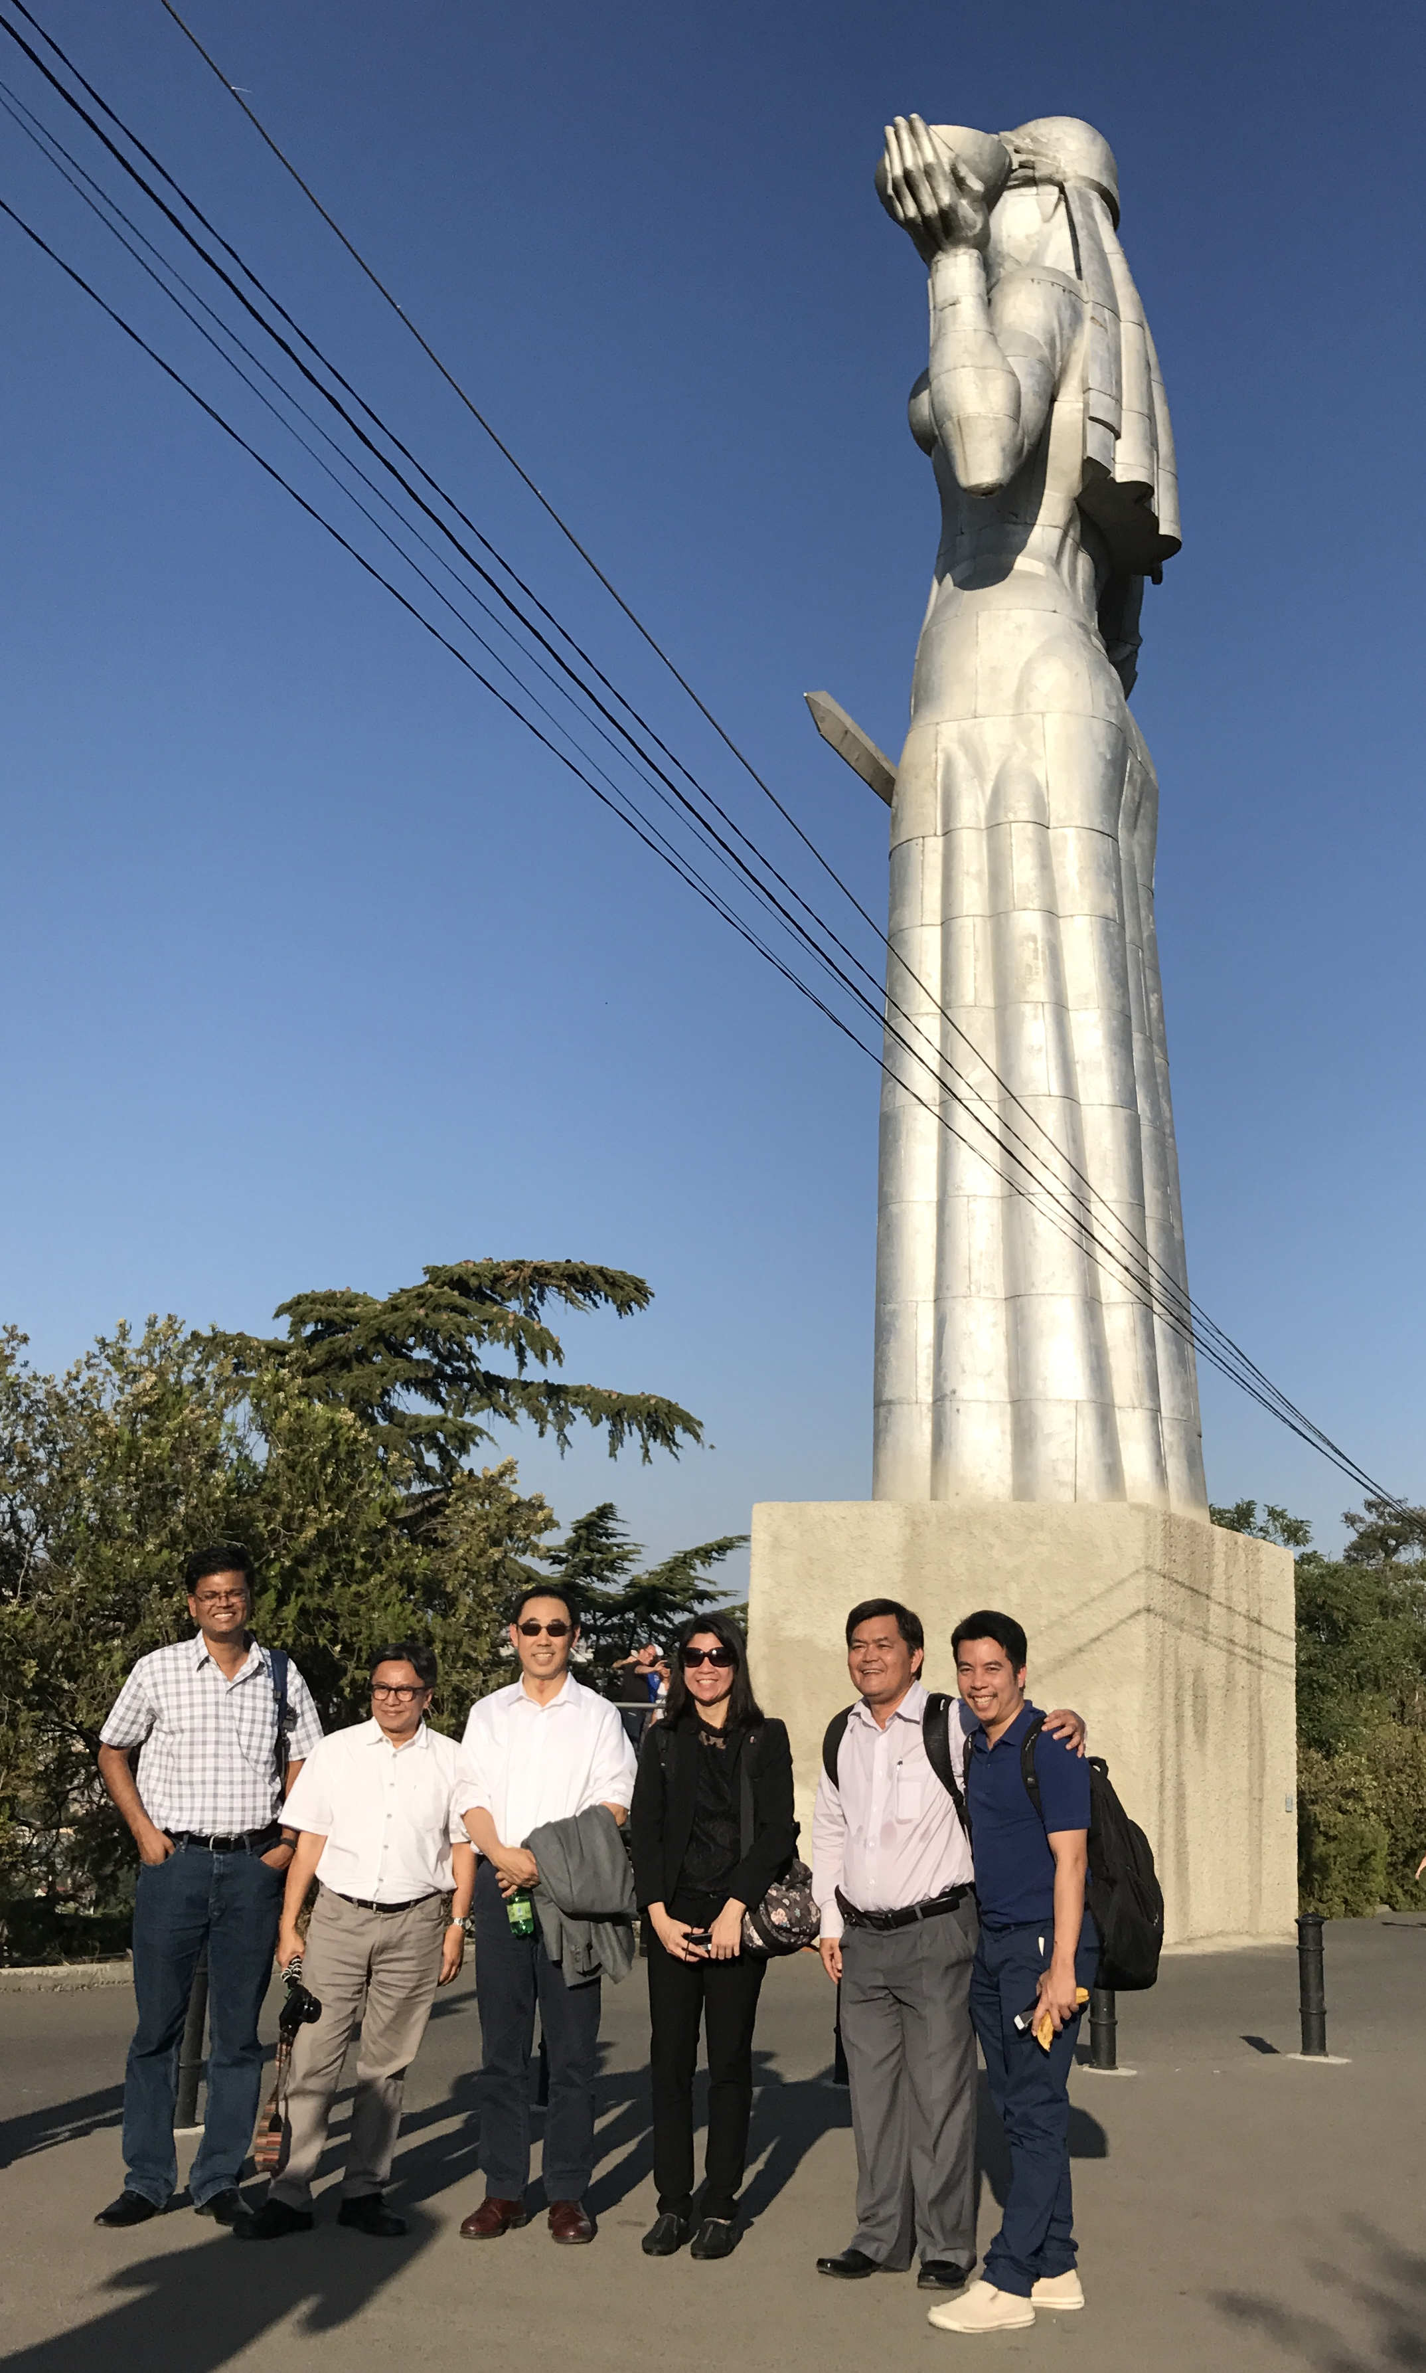
DAM MEKONG Group
THANK YOU

