Slide 1
GOFC-GOLD Regional Networks Summit Thursday September 14, 2017, Tbilisi, Georgia
GOFC-GOLD Land Cover IT priorities and Regional Networks opportunities
Pontus Olofsson (olofsson@bu.edu)
Martin Herold (martin.herold@wur.nl)

Slide 2
1. RNs and
“GFOI supports REDD+ countries to develop their national forest monitoring systems and associated emissions [MRV]”
Four pillars:
Capacity building (SilvaCarbon)
Methods & Guidance (J. Penman, now M. Sanz Sánchez)
Research & Development (GOFC-GOLD)
Data/Software (new)

Slide 3
1. RNs and
This work is often of direct relevance for RNs as evident by the START/NASA-funded RN workshops
GFOI/SilvaCarbon work with Gov’t agencies of partner countries; GOFC-GOLD RNs are mix of academia, NGOs and Gov’ts
Opportunities for linkage and coordination
between GFOI activities and RNs

Slide 4
2. Custodians of tools
The success of the transfer of remote sensing advancements to countries are open source tools, data and documentation
BEEODA, SEPAL, Open-Foris, GEE, etc.
RNs already using some of these tools in workshops
A new GFOI pillar responsible of Data/Software in creation
Opportunity to formalize use of software tools in RNs

Slide 5
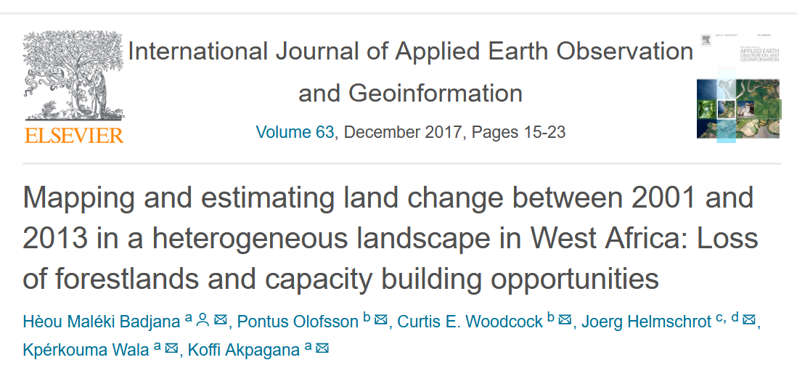

Slide 6
3. Global reference observations
Accuracy of maps is estimated by comparison to sample of reference observations of land cover
Requires local land cover expertise
Wageningen University will work with RNs to collect global sample data of land cover reference observations

Slide 7
4. New LC-IT priorities will be on the use of EO to report for SDGs
Land cover information needed for national reporting to several Indicators for SDGs:
http://www.gofcgold.wur.nl/documents/newsletter/Sustainable_Development_Goals-infobrief.pdf
More detailed demonstrations, best practices development will happen and requires community input
Role for RNs to work with their national focal points, statistical offices to improve capacities for SDG reporting

