Slide 1
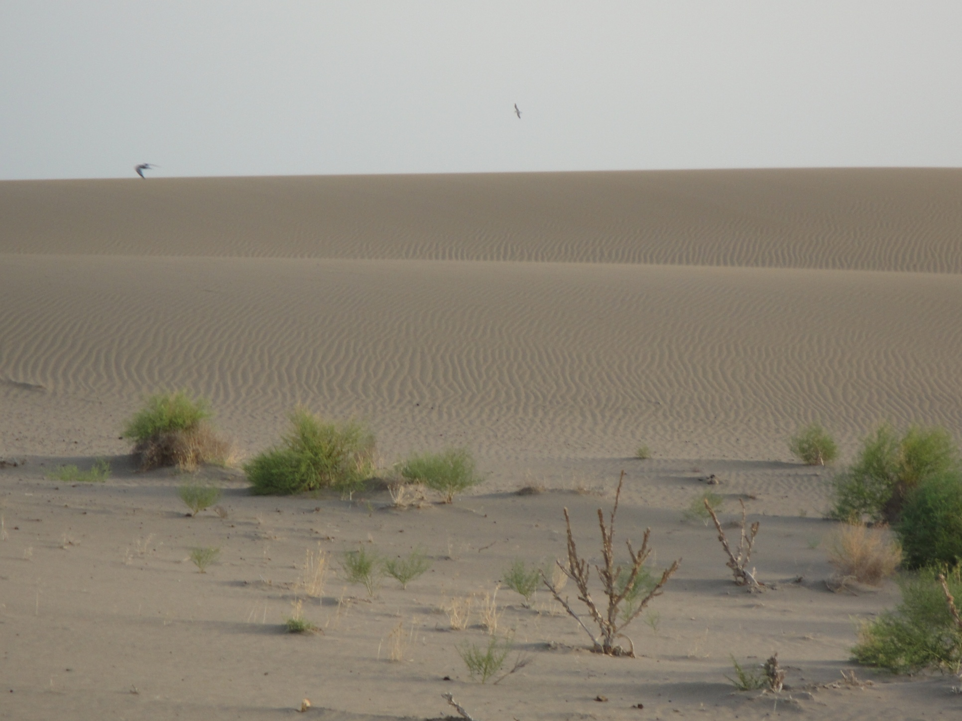
Dynamics of processes of desertification in landscapes of Azerbaijan
(Mammadov R.M., Institute of Geography ANAS)
(ramiz.mamedov@geo.ab.az)
GOFC-GOLD START Caucasus Network Kick-off Meeting
11-12 September, 2017-Tbilisi

Slide 2
Desertification – it is the destruction of the ecosystem of arid and semiarid territories, leading to the decrease of natural-economic potential of soil and creating the most severe ecological terms for the development of all forms of organic life.
Desertification also is extremely negative phenomena both in natural and socio-economic aspects.
In a word, all forms of human activity, in direct or indirect way, find its reflection in the consequences of the problem of desertification.
Two factors in high degree contribute to desertification process:
a) fluctuation in climate with its periodical droughts;
b) human activity with its irrational methods of soil tenure.
It was established by studies that 87 % of the 45 factor- stimuluses of desertification of landscape is anthropogenic and only 13 % is natural.
RAMIZ MAMMADOV
INSTITUTE OF GEOGRAPHY AZERBAIJAN ACDEMY OF SCIENCES

Slide 3
According UNEP:
More than 100 states undergoes the threat of desertification.
About 900 million people feel the negative impact of desertification and
About 10 million people are obliged to migrate from desertificated territories as ecological refugees.
In this meaning the territory of the Republic of Azerbaijan is not an exception
RAMIZ MAMMADOV
INSTITUTE OF GEOGRAPHY AZERBAIJAN ACDEMY OF SCIENCES

Slide 4
Mugan Lowland area - rather like to classic desertification

Slide 5
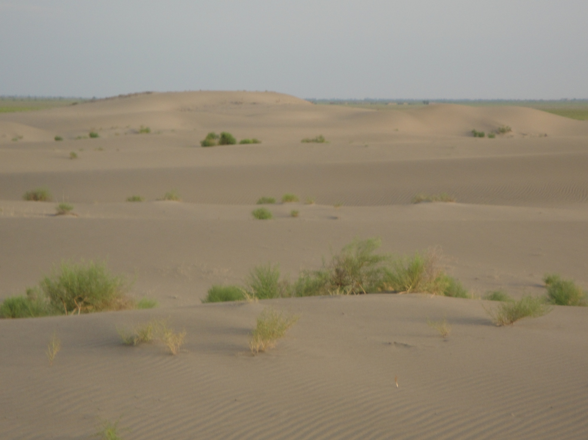

Slide 6
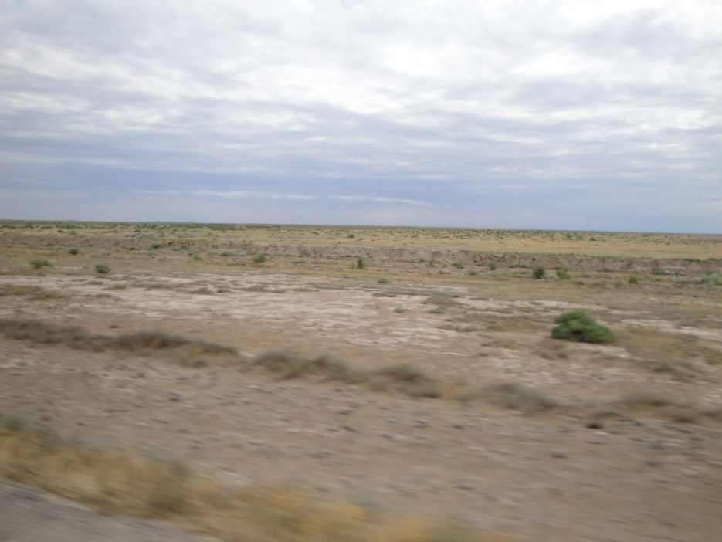
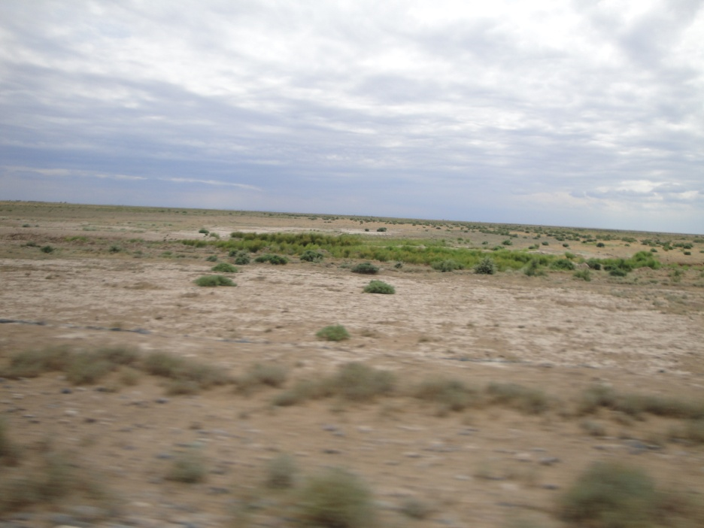
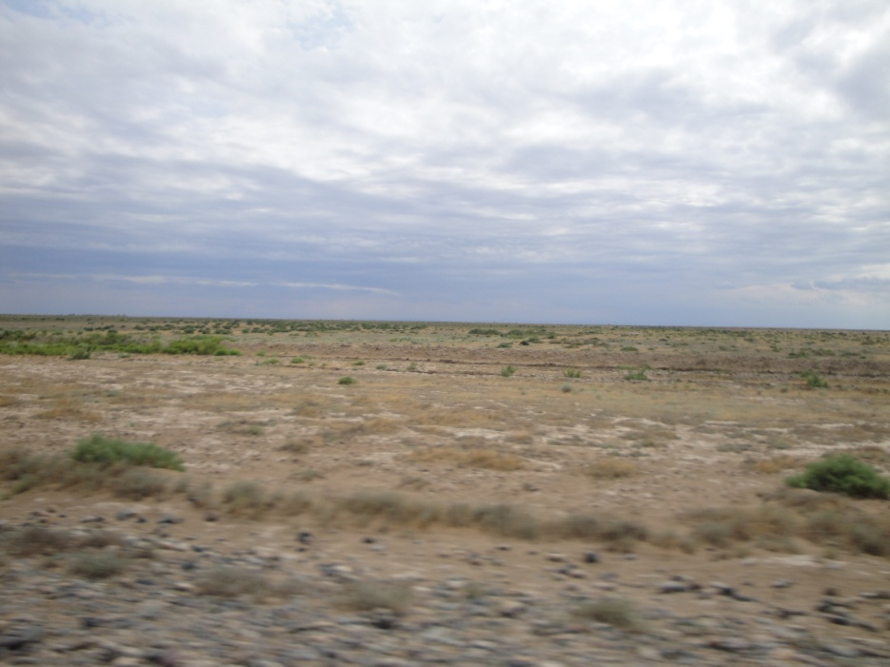
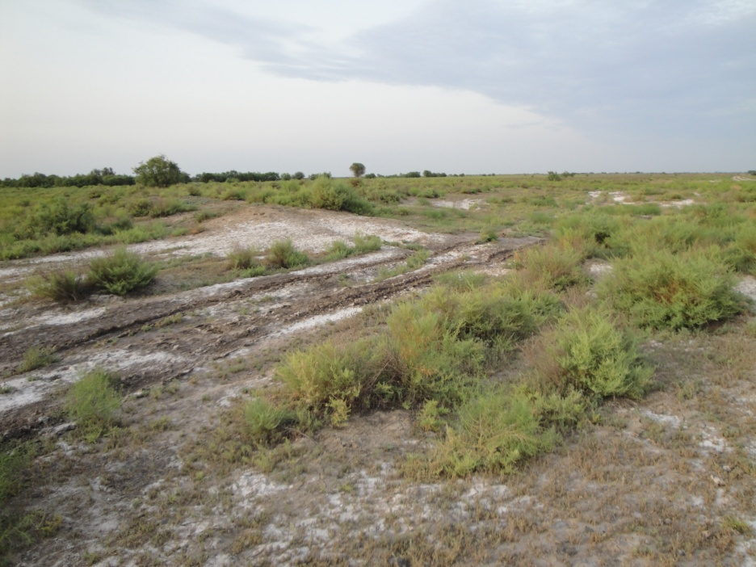
Stalinization in the Mugan Lowland of Azerbaijan

Slide 7
Development of the activity on international level on desertification problems
Strategy of development:
modernization»
-«Social revolution»
-«main resource»
Convention UNO on Desertification,
1977
Convention UNO on protection and development environmental, 1992
Convention on combating desertification , 26.12.1996
Plan combating on desertification
Program Man and Biosphere
National Program about Environmental Protection
Agenda 21, chapter 12, Combating dryland
Convention on biodiversity
Convention on Climate change
RAMIZ MAMMADOV
INSTITUTE OF GEOGRAPHY AZERBAIJAN ACDEMY OF SCIENCES

Slide 8
The indicators and classes of desertification
№ | Types of desertification | Degree of desertification | Reasons of desertification
1. | Wind erosion | No desertification | Nt - Natural
2. | Deflation | Weak | Ct - Agricultural
3. | Salinization | Moderate | PR - man-caused
4. | Man-caused | Strong | Og - Cattle breeding
5. | Degradation of flora | Too strong | Ag -Deforestation
RAMIZ MAMMADOV
INSTITUTE OF GEOGRAPHY AZERBAIJAN ACDEMY OF SCIENCES

Slide 9
Criteria for estimate of desertification by EU
Type of desertification | Category of desertification ( degree of desertification)
 | Not degradation geosystems | Weak degradation | Moderate degradation | Strong degradation | Very strong degradation
Degradation of vegetation
Decrease in biological productivity (%) | Without appreciable changes | 25 | 25-50 | 50 | > 50
Defilation
(1) Deflation of the top horizon of soil, (%) | Without appreciable changes | 25 | 25-50 | 50 | > 50
(2) Decrease in productivity of grain crops and other products (%) [for mastered territory] |  | 10 | 10-50 | 50 | > 50
Water erosion
(1) Washout of the top horizon of soil, (%) | Without appreciable changes | 25 | 25-50 | 50 | > 50
(2) Decrease in productivity of grain crops and other products (%) [for the mastered territories] |  | 10 | 10-50 | 50 | > 50
Salinization of soil
Decrease agricultural productivity (%) | Without appreciable changes | 10 | 10-50 | 50 | > 50
RAMIZ MAMMADOV
INSTITUTE OF GEOGRAPHY AZERBAIJAN ACDEMY OF SCIENCES

Slide 10
Statement of the task
The tasks of the given studies were:
Definition of the total geographic range of distribution of desertification processes in the eastern part of the Republic of Azerbaijan, the total area of which is 34 679, 75 km² and it consists 40 per cent (2/5) of the whole territory of the country;
Definition of the types and reasons of desertification;
Definition of the degree and intensity of desertification;
Carrying socio-economic studies in the region under investigation, as one of the main factors of desertification;
Analysis of the condition and utilization of water resources in the eastern part of country;
Preparation of predictions about desertification for 2025;
Mapping of the types, reasons and degrees of desertification, land tenure and prediction of the region under investigation, in the scale 1: 600 000;
Composition of the above-mentioned analogical maps separately for Absheron peninsula, in the scale 1: 100 000;
Working out recommendations on combatting desertification.
RAMIZ MAMMADOV
INSTITUTE OF GEOGRAPHY AZERBAIJAN ACDEMY OF SCIENCES

Slide 11
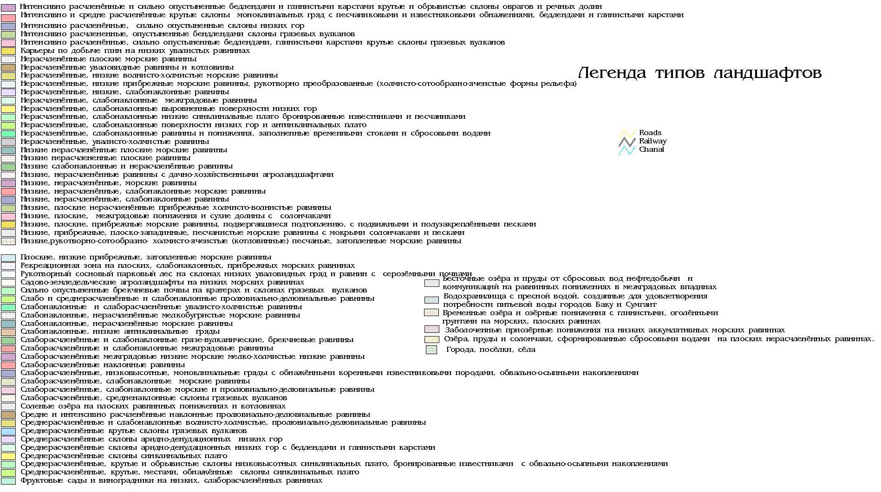
RAMIZ MAMMADOV
INSTITUTE OF GEOGRAPHY AZERBAIJAN ACDEMY OF SCIENCES

Slide 12
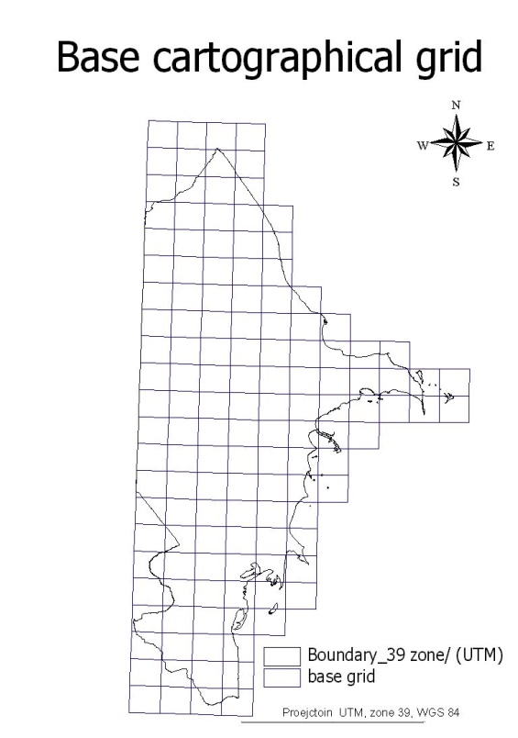
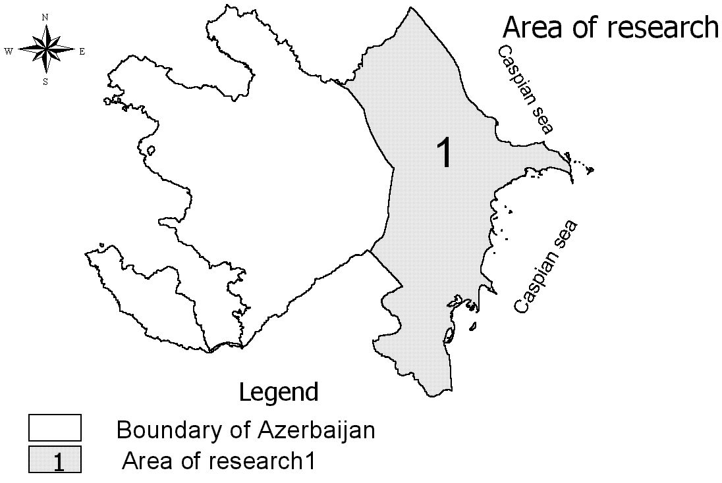
The total border of Azerbaijan and the scope of the inquiry
Baseline cartographic map
RAMIZ MAMMADOV
INSTITUTE OF GEOGRAPHY AZERBAIJAN ACDEMY OF SCIENCES

Slide 13
Used materials and methods:
1.Digital cosmic images were used for studying desertification processes in Azerbaijan, received with the help of space satellites LANDSAT and RESOURCEin 1982 and 2010.
The cosmic photograph received from the satellite LANDSAT TM with the resolution of 30 m was used separately for more detailed studying Absheron peninsula.
2. Topographic maps in the scale 1:100 000 were used as baselines. Besides this landscape, geomorphological, flora, soil maps, maps of social structure, subsurface water, water supply and others were used.
3. Software support contained:
ArcView - 3.2 version - software system of geoinformation system (GIS);
Chips - software system oriented to image processing;
Image Warp – the module ArcView oriented to the procedure of transforming bit-
mapped images into prescribed cartographic projection;
Shape Warp - the module ArcView oriented to the procedure of transforming data vectors into prescribed cartographic projection;
RAMIZ MAMMADOV
INSTITUTE OF GEOGRAPHY AZERBAIJAN ACDEMY OF SCIENCES

Slide 14
Fragments of the table of contours for each type of desertification with key parametres (degree and the reasons, the areas of contours, estimations).

Slide 15
Aeara(м) Azerbaijan 82 |  |  |  |  |  |  |  | Table square (km²) of natural Landscape on classification of (degree of desertification)
 | COUNTRY | AREA | PERIMETER | LANDSCAPE | REASON | TYPE | DegREe | NO_DESERTIFICA TION | SLIGHT | MODERATE | STRONG | V_STRONG | N
 | Azerbaijan 82 | 35832727,486 | 39261,305 | 5 | Ct | degveg | 4 |  |  |  | 35832,727 |  | 119
 | Azerbaijan 82 | 4120396,625 | 8902,412 | 5 | Ct | degveg | 4 |  |  |  | 4120,3966 |  | 40
 | Azerbaijan 82 | 6478423,057 | 10326,574 | 5 | Ct | degveg | 4 |  |  |  | 6478,4231 |  | 41
 | Azerbaijan 82 | 14576433,111 | 21265,060 | 20 | Nt | degveg | 1 | 14576,433 |  |  |  |  | 47
 | Azerbaijan 82 | 6903257,719 | 16044,429 | glasier | Nt | degveg | 1 | 6903,2577 |  |  |  |  | 0
 | Azerbaijan 82 | 2374057,990 | 8391,016 | glasier | Nt | degveg | 1 | 2374,0580 |  |  |  |  | 110
 | Azerbaijan 82 | 3041160,889 | 7058,811 | glasier | Nt | degveg | 1 | 3041,1609 |  |  |  |  | 111
 | Azerbaijan 82 | 4795031,674 | 8204,053 | 9 | Nt | water | 5 |  |  |  |  | 4795,0317 | 91
 | Azerbaijan 82 | 87277886,608 | 40629,994 | 28 | Nt | water | 3 |  |  | 87277,886 |  |  | 90
 | Azerbaijan 82 | 5090365,611 | 11697,635 | 34 | Nt | degveg | 4 |  |  | 0,0000 | 5090,3656 |  | 65
 | Azerbaijan 82 | 18152583,384 | 16760,909 | 32 | Nt | salinisation | 3 |  |  | 18151,413 |  |  | 64
 | Azerbaijan 82 | 10907595,122 | 34140,626 | 3 | Nt | wind | 4 |  |  |  | 10907,595 |  | 64
 | Azerbaijan 82 | 14961032,841 | 17787,854 | 29 | Nt | deswell | 3 |  |  | 14961,032 |  |  | 86
 | Azerbaijan 82 | 37117637,798 | 38150,168 | 22 | Ag | salinisation | 3 |  |  | 37117,637 |  |  | 88
 | Azerbaijan 82 | 9058358,943 | 11704,844 | 20 | Nt | salinisation | 5 |  |  |  |  | 9058,3589 | 47
 | Azerbaijan 82 | 4369178,140 | 10035,566 | 20 | Nt | salinisation | 5 |  |  |  |  | 4369,1781 | 47
 | Azerbaijan 82 | 115763847,30 | 101403,021 | 22 | Nt | salinisation | 5 |  |  |  |  | 115763,84 | 59
 | Azerbaijan 82 | 26762638,751 | 40199,649 | 3 | Nt | wind | 4 |  |  |  | 26762,638 |  | 38
 | Azerbaijan 82 | 43804373,301 | 49785,209 | 4 | Nt | salinisation | 4 |  |  |  | 43804,373 |  | 49
 | Azerbaijan 82 | 28103915,944 | 51165,415 | 3 | Nt | wind | 4 |  |  |  | 28103,915 |  | 51
 | Azerbaijan 82 | 182682603,69 | 83028,206 | 8 | Nt | water | 4 |  |  |  | 182681,28 |  | 16
 | Azerbaijan 82 | 28409121,666 | 35175,559 | 29 | Ag | salinisation | 3 |  |  | 28409,121 |  |  | 85
 | Azerbaijan 82 | 234554662,01 | 138486,162 | 27 | Ag | degveg | 3 |  |  | 234476,56 |  |  | 70
 | Azerbaijan 82 | 327182169,63 | 151185,911 | 23 | Nt | water | 1 | 327182,16 |  |  |  |  | 78
 | Azerbaijan 82 | 1392140916,3 | 478388,790 | 30 | Ag | salinisation | 2 |  | 1392322,4 |  |  |  | 83
 | Azerbaijan 82 | 4055288,134 | 9650,776 | 14 | Nt | water | 4 |  |  |  | 4055,2881 |  | 113
 | Azerbaijan 82 | 228642050,73 | 114192,549 | 9 | Nt | degveg | 4 |  |  |  | 228642,05 |  | 12
 | Azerbaijan 82 | 13080827,796 | 16678,609 | 5 | Ct | degveg | 4 |  |  |  | 13080,827 |  | 108
 | Azerbaijan 82 | 200788286,89 | 111622,611 | 5 | Ct | degveg | 4 |  |  |  | 200788,28 |  | 114
 | Azerbaijan 82 | 729577306,91 | 137827,246 | 17 | Nt | water | 4 |  |  |  | 729569,48 |  | 24
 | Azerbaijan 82 | 127542521,07 | 67460,175 | 9 | Nt | degveg | 4 |  |  |  | 127542,52 |  | 29
 | Azerbaijan 82 | 243745728,64 | 133931,838 | 6 | Nt | degveg | 3 |  |  | 243745,72 |  |  | 28
 | Azerbaijan 82 | 103237223,01 | 38930,935 | 1 | Ct | degveg | 3 |  |  | 103237,22 |  |  | 4
 | Azerbaijan 82 | 322614503,85 | 141529,393 | 1 | Ct | degveg | 3 |  |  | 322614,50 |  |  | 1

Slide 16
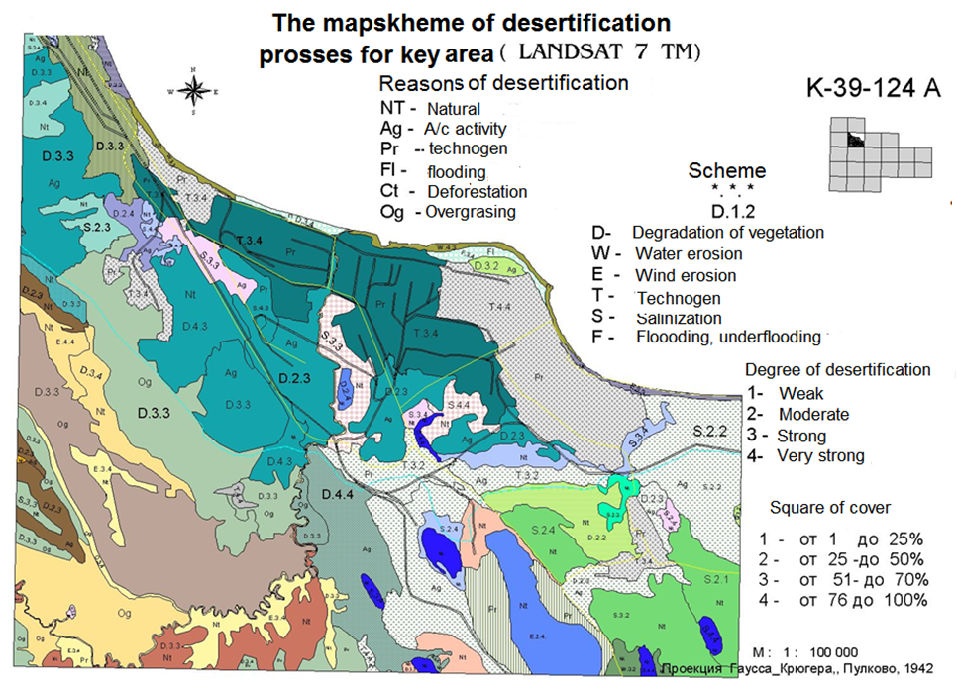
RAMIZ MAMMADOV
INSTITUTE OF GEOGRAPHY AZERBAIJAN ACDEMY OF SCIENCES

Slide 17
Map of the last condition of the east Azerbaijan,
Landsat 1982-1984
Map of the present condition of the east Azerbaijan, Resours 2010
RAMIZ MAMMADOV
INSTITUTE OF GEOGRAPHY AZERBAIJAN ACDEMY OF SCIENCES

Slide 18
Territory of expansion of desertification according to the type
Types of desertification | Area for 1982 | Area for 2010 | Changings during 1982-2010
Degradation of flora | 17323,178 | 19032,894 | Increased
Salinization | 10924,004 | 8792,037 | Decreased
Man-caused | 1174,088 | 1177,985 | Increased
Ablation | 4521,082 | 4632,824 | Increased
Wind erosion | 727,029 | 693,387 | Increased
Total area | 34669,38 | 34329,13+ area of flooded | Increased
Estimation of expansion of desertification processes according to degree
Degree | Area for 1982 | Area for 2010 | Changings during 1982-2010
No desertification | 372.875 | 32.269 | Extremely decreased
Weak | 7828,329 | 6485,113 | Increased
Moderated | 18311,259 | 12172,820 | Decreased
Strong | 7344,362 | 12175,019 | Increased
Too strong | 812,460 | 3747,513 | Increased
The total area by extracting territory with no desertification | 34296.410 (S_{T} =34679,2) | 34580.477 (S_{T} = 34679,75) | Increased
RAMIZ MAMMADOV
INSTITUTE OF GEOGRAPHY AZERBAIJAN ACDEMY OF SCIENCES

Slide 19
Map variability processes desertification of natural landscapes of the Azerbaijan for 14-16 years
Map risk of desertification of natural landscapes of the Azerbaijan by 2025y.
RAMIZ MAMMADOV
INSTITUTE OF GEOGRAPHY AZERBAIJAN ACDEMY OF SCIENCES

Slide 20
Absheron peninsula, in the scale 1: 100 000

Slide 21
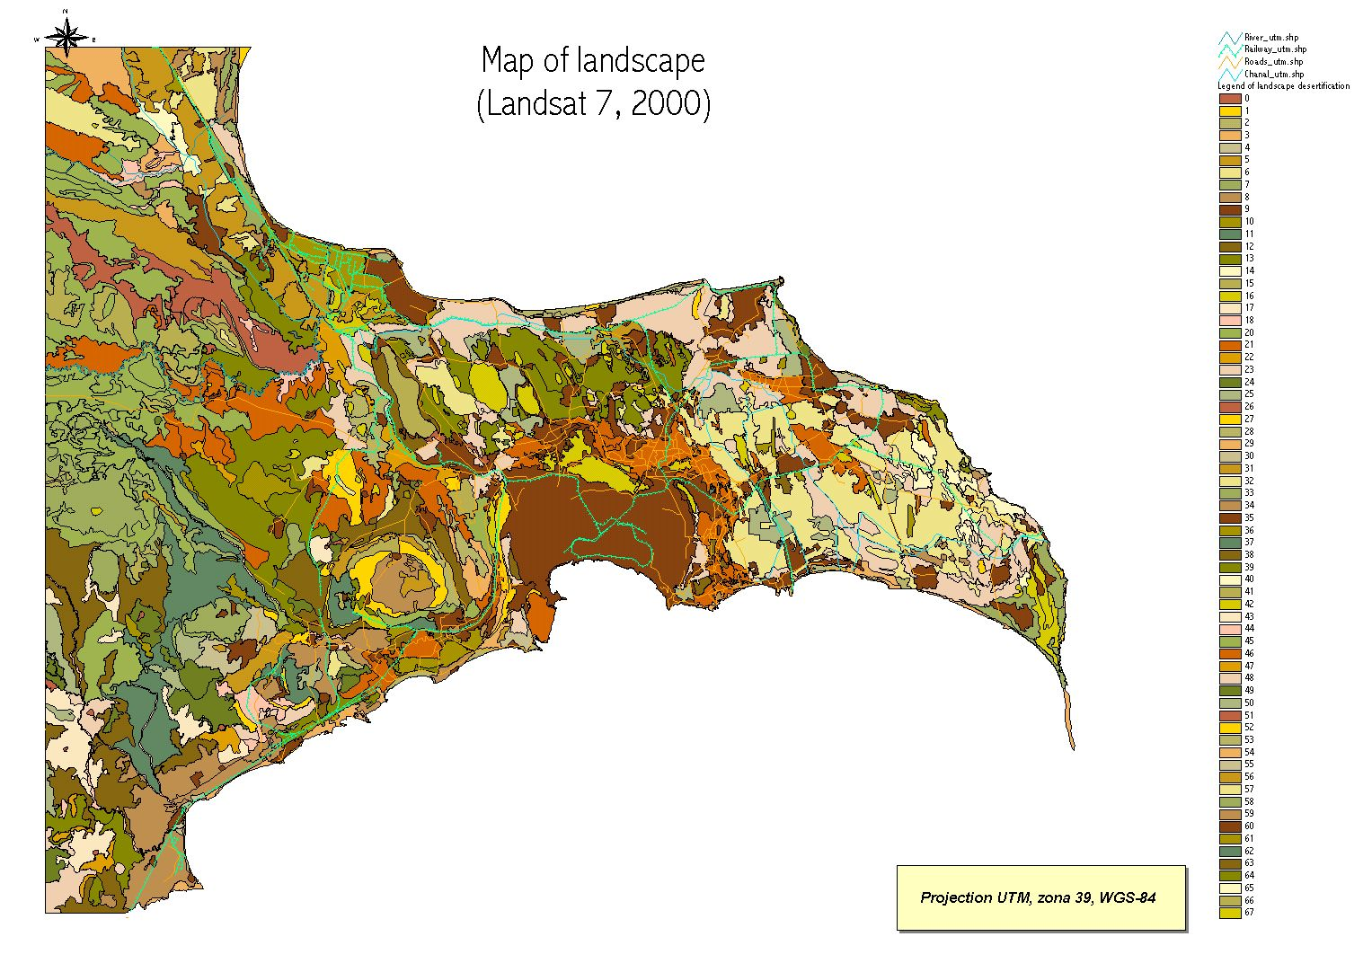
RAMIZ MAMMADOV
INSTITUTE OF GEOGRAPHY AZERBAIJAN ACDEMY OF SCIENCES

Slide 22
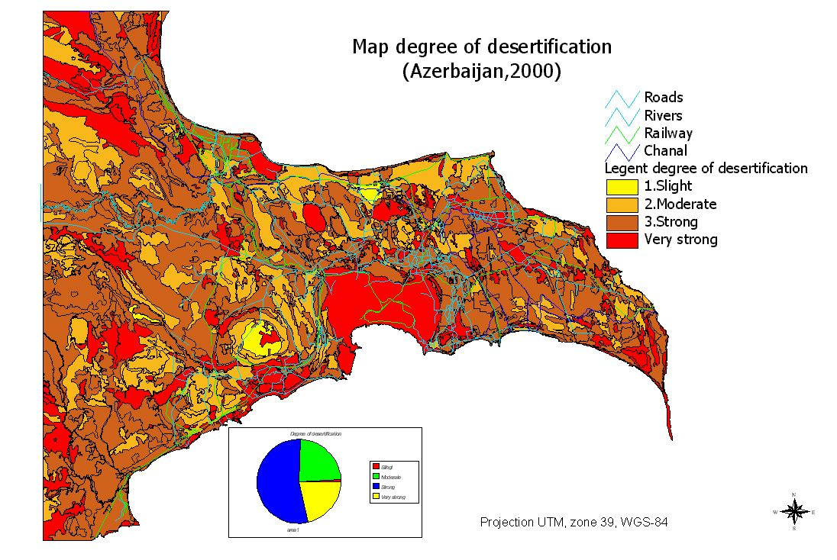
RAMIZ MAMMADOV
INSTITUTE OF GEOGRAPHY AZERBAIJAN ACDEMY OF SCIENCES

Slide 23
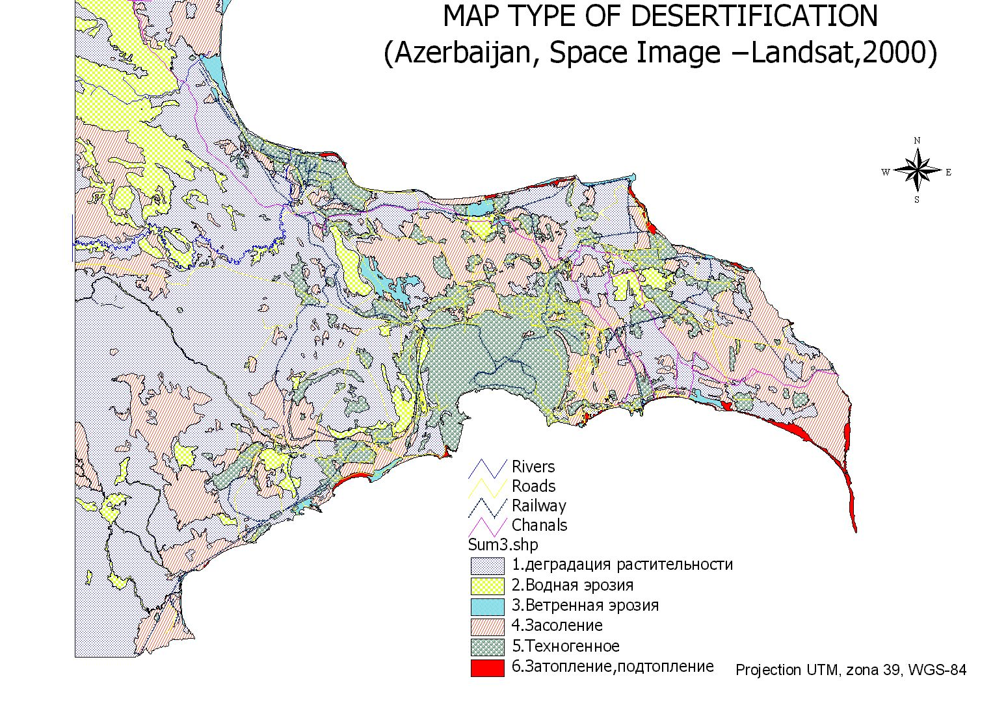
RAMIZ MAMMADOV
INSTITUTE OF GEOGRAPHY AZERBAIJAN ACDEMY OF SCIENCES

Slide 24
DEGREE OF DESERTIFICFTION
DEGREE OF DESERTIFICFTION
AREA, KM²
TO COMMON AREA, %
COUNT
Slight
26,638
1
3
Moderate
722,623
24
269
Strong
1659,243
54
528
Very strong
658,937
21
224

Slide 25
TYPE OF DESERTIFICATION
TYPE OF DESERTIFICFTION
AREA,
km²
TO COMMON AREA, %
COUNT
DEGRFDATION OF VEGETAL
1447,491
47
330
SALINITATION
789,208
26
378
TECHNOGENIC
458,758
15
176
WATER EROSION
306,870
10
72
WIND EROSION
43,247
1
33
FLOODED
21,621
1
35
RAMIZ MAMMADOV
INSTITUTE OF GEOGRAPHY AZERBAIJAN ACDEMY OF SCIENCES

Slide 26
Applied analysis of the results:
Territories under the danger of desertification under the impact of natural factors:
The northern part of the Caspian off-shore.
The middle part of off-shore
Territories situating far from the coastline .
Kura - Araz lowland, estuary of Kur.
Gizil-Agach bay and its southern part .
Desertification under the impact of anthropogenic factors:
The results of high density of population.
Degradation and desertification as the result of agricultural activity.
Degradation of plants in tourist bases and other recreation zones.
Degradation of plants and strengthening of the process of desertification in stone and sand pits.
Desertification under the impact of the construction of road networks and populated points.
Desertification of coastal zones under the influence of oil-gas exploration and production.
RAMIZ MAMMADOV
INSTITUTE OF GEOGRAPHY AZERBAIJAN ACDEMY OF SCIENCES

Slide 27
Results:
It was established that all spectra of mountainous and plain ecosystem of the territory of Azerbaijan are under the danger of degradation caused by the influence of different natural and anthropogenic factors, but these processes appear more severely in arid and semiarid geosystems.
In comparison with 1982 in 2010 the territory under the risk of desertification process increased to 340.606 km²in the region of an inquiry.
In the region of an inquiry the sites under the risk of moderated and strong desertification consist 70 %, but the sites under weak and very strong risk of desertification consist correspondingly 19 and 11 %.
The area of strong desertification has increased from 21 % in 1982 to 36 % in 2010. The area of moderated desertification has decreased from 54 % in 1982 to 35 % in 1998.
It means that the areas of moderated desertification has transformed into strong and very strong ones. During the above- mentioned period the areas of weak desertification increased only 1 per cent (from 18 % to 19 %).
In this way, the areas with weak and moderated desertification have decreased, as well as the areas, which are not under the risk of desertification, have decreased and the areas with strong and very strong degree of desertification have extremely increased.
RAMIZ MAMMADOV
INSTITUTE OF GEOGRAPHY AZERBAIJAN ACDEMY OF SCIENCES

Slide 28
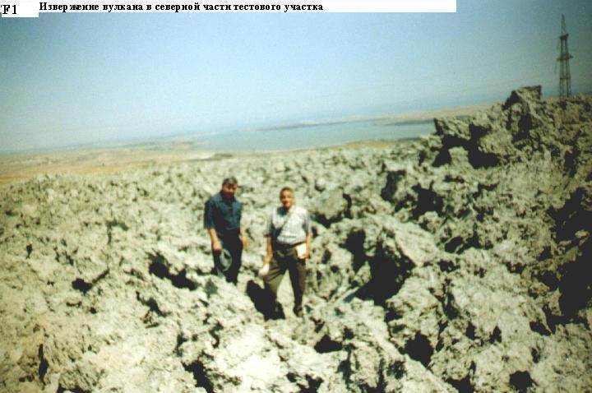
RAMIZ MAMMADOV
INSTITUTE OF GEOGRAPHY AZERBAIJAN ACDEMY OF SCIENCES

Slide 29
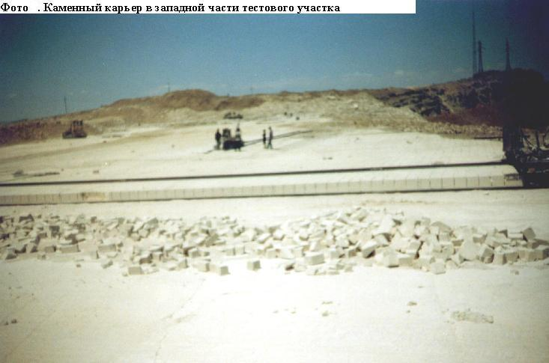
RAMIZ MAMMADOV
INSTITUTE OF GEOGRAPHY AZERBAIJAN ACDEMY OF SCIENCES

Slide 30
RAMIZ MAMMADOV
INSTITUTE OF GEOGRAPHY AZERBAIJAN ACDEMY OF SCIENCES

Slide 31
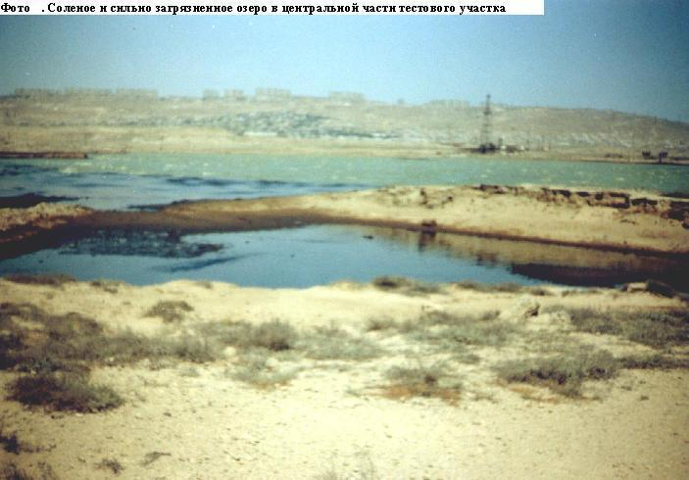
RAMIZ MAMMADOV
INSTITUTE OF GEOGRAPHY AZERBAIJAN ACDEMY OF SCIENCES

Slide 32
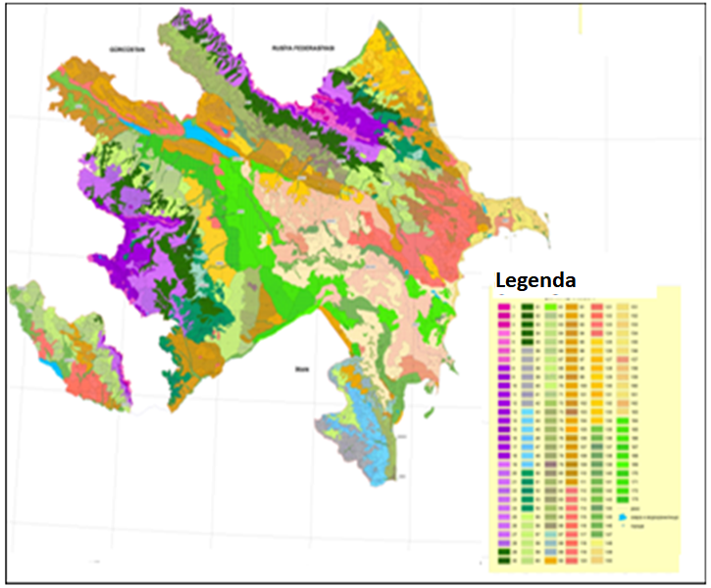
New Landscape map of the Azerbaijan Republic

Slide 33
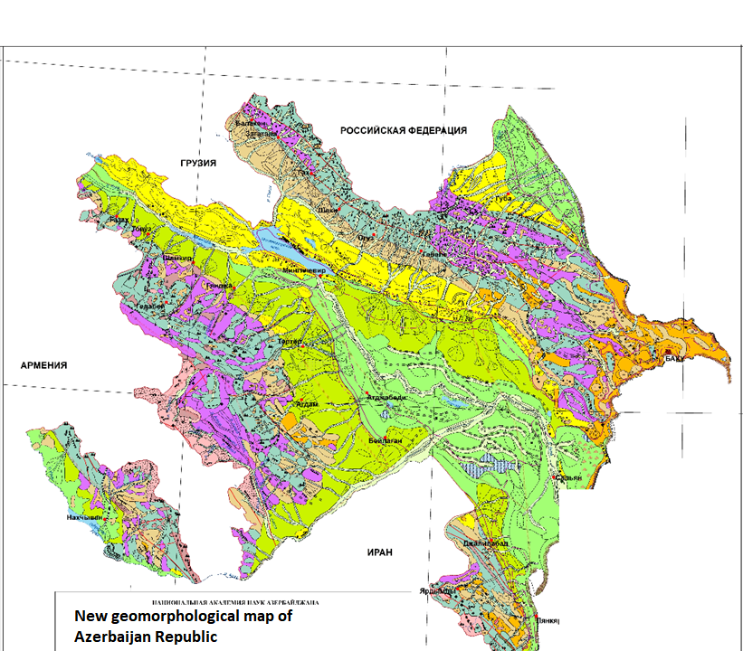

Slide 34
THANK YOU VERY MUCH!
RAMIZ MAMMADOV
INSTITUTE OF GEOGRAPHY AZERBAIJAN ACDEMY OF SCIENCES

