Slide 1





The GOFC-GOLD South Central and Eastern European Network (SCERIN)
SCERIN
overview, status update and accomplishments
Petya Campbell¹ and Jana Albrechtová²
¹Joint Center for Earth Systems Technology, University of Maryland Baltimore County, and NASA Goddard Space Flight Center, Greenbelt, Maryland, USA
²Charles University in Prague, Faculty of Science, Prague, Czech Republic
GOFC-GOLD RN Summit
13-16 September, 2017, Tbilisi, Georgia

Slide 2


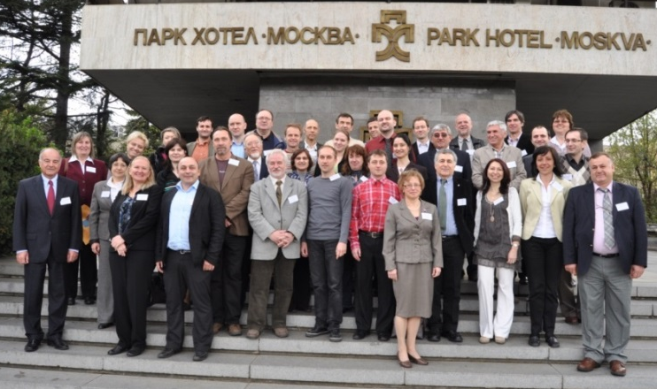

Initiation - Formulation Workshop, 2012 Sofia, Bulgaria
  Consensus: need of a regional network
  Identified:
    Geographic domain
    Common issues
    Network goals and objectives
    Network name ‘SCERIN’
    Capacity building activities
17 April 2012, Sofia, Bulgaria
GOFC-GOLD RN Summit
13-16 September, 2017, Tbilisi, Georgia

Slide 3
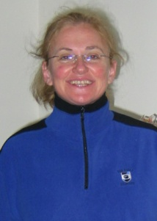


SCERIN Leadership
Network Coordinator U.S.:
Petya Campbell petya.campbell@nasa.gov
Joint Center for Earth Systems Technology (JCET)
University of Maryland Baltimore County
NASA Goddard Space Flight Center, Biospheric Sciences Laboratory Greenbelt, Maryland, USA
Network Coordinator E.U.:
Jana Albrechtova albrecht@natur.cuni.cz
Department of Experimental Plant Biology, Faculty of Science
Charles University, Prague, Czech Republic
Assistant Regional Coordinator, Czech Republic
Lucie Kupkova lucie.kupova@gmail.com
Charles University, Prague, Czech Republic
GOFC-GOLD RN Summit
13-16 September, 2017, Tbilisi, Georgia

Slide 4
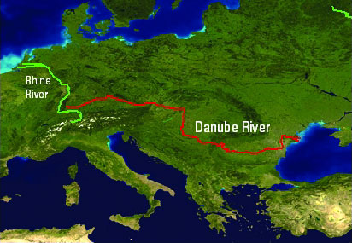
SCERIN Geographic Domain and Goals
Geographic Domain: Central & South Eastern Europe, the Danube Watershed & Western Black Sea coast
Goals:
Provide a platform for collaboration among remote sensing experts in SCE, through collaborative activities
Facilitate progress and consistent implementation of remote sensing and LCLUC methodology, in the region
Foster regional collaboration for monitoring the dynamics, stability, and vulnerability of the major ecosystems
Promote effective sustainable management and preservation, on the local, regional and pan-European level
GOFC-GOLD RN Summit
13-16 September, 2017, Tbilisi, Georgia
Notes:
We plan to work together with the regional forest and land management agencies to ensure continuous, high quality observations for operational and management applications, facilitating feasible and sustainable natural resources management practices.

Slide 5
SCERIN FOCI
SCERIN Structure (Focus Groups - FG)
FG1: Forest changes: disturbances, biomass production, forest LCLUC, driving forces
FG2: Land Cover Changes: climate change, agricultural land abandonment, urban expansion
FG3: Validation/verification of products, for support of current and future satellite missions [e.g. NASA´s LDCM and HyspIRI, and ESA´s Copernicus program – Sentinel 1, 2, and future 3]
FG4: New LCLUC water management and ENVIRONMENT (watersheds, catchments, dams)
GOFC-GOLD RN Summit
13-16 September, 2017, Tbilisi, Georgia

Slide 6
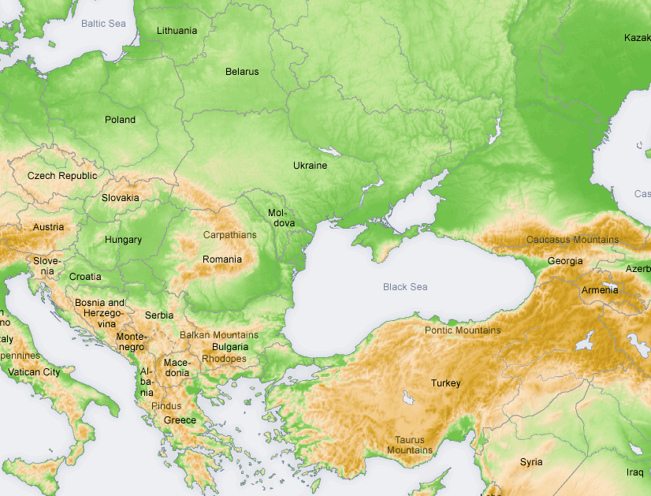
SCERIN Member Countries
  CZ, SK, PL, HU, UA, BG, RO, GR, TU
  and recent Serbia, Macedonia, Slovenia, Croatia
  Observers: Armenia, Georgia, Azerbaijan, Norway
*
*
*
*
*
*
*
*
*
☺
☺
*
*
*
*
*
*
*
☺
*
Participation status
* yes, * not yet, ☺ observer

Slide 7
Partnerships
    EnviroGRIDS
    IGU LCLUC
    EARSeL LCLUC
    Trans-Atlantic Training Initiative (ESA-NASA)
GOFC-GOLD RN Summit
13-16 September, 2017, Tbilisi, Georgia

Slide 8
SCERIN Critical Regional Issues
  Forest deterioration
  Changes in forest function and ecosystem diversity
  Urbanization
  Extreme Events increase (floods, droughts and fires)
  Major Driver: Transition to EU and open market after the breakup of the Soviet Union (changes in land ownership, population migration)
GOFC-GOLD RN Summit
13-16 September, 2017, Tbilisi, Georgia
Notes:
Global monitoring well adapted but regional scale changes might be overlooked

Slide 9
SCERIN Projects and Sponsorship
  P1: Global 30m land cover products validation in SCERIN (NASA; U. Thessaloniki; U. Brasov; Charles U.; Czech Globe; Forest Service: GR, RO, SK, SL; Academy of Sci. SK and BG)
  P2: SCERIN inventory of land use and land cover changes and their driving forces (Norwegian Forest Inst., Charles U.)
  P3: Trends of forest vegetation activity in SCERIN associated with climatic changes, as observed by 30 years of AVHRR (U. Zagreb, NASA)
  P4: Review of high resolution spetral data (satellite, airborne, field) collected for forest ecosystems in SCERIN, and their use for vegetation monitoring (Charles U., NASA, others)
GOFC-GOLD RN Summit
13-16 September, 2017, Tbilisi, Georgia
Notes:
SCERIN research projects in progress

Slide 10
SCERIN Achievements
  Active network collaborations, including:
  Joint 4 research projects in progress
  Joint manuscripts, published and in preparation
  Joint presentations, proposals and ongoing collaborative efforts
  SCERIN web resources
  Social media presence
      Facebook https://m.facebook.com/groups/1598067267142275
      LinkedIn https://www.linkedin.com/groups/8349564
http://www.fao.org/gtos/gofc-gold/net-SEERIN.html
www.csebr.cz/scerin
GOFC-GOLD RN Summit
13-16 September, 2017, Tbilisi, Georgia
Notes:
We plan to work together with the regional forest and land management agencies to ensure continuous, high quality observations for operational and management applications, facilitating feasible and sustainable natural resources management practices.

Slide 11
Thank You
GOFC-GOLD Leadership
RIN Summit Host - Agricultural U. Tbilisi Georgia (Giorgi Ghambashidze)
Sponsors
  NASA
  ESA
  Host University
  START
გმადლობთ
gmahd-lohbt
GOFC-GOLD RN Summit
13-16 September, 2017, Tbilisi, Georgia

Slide 12
Backup Slides

Slide 13
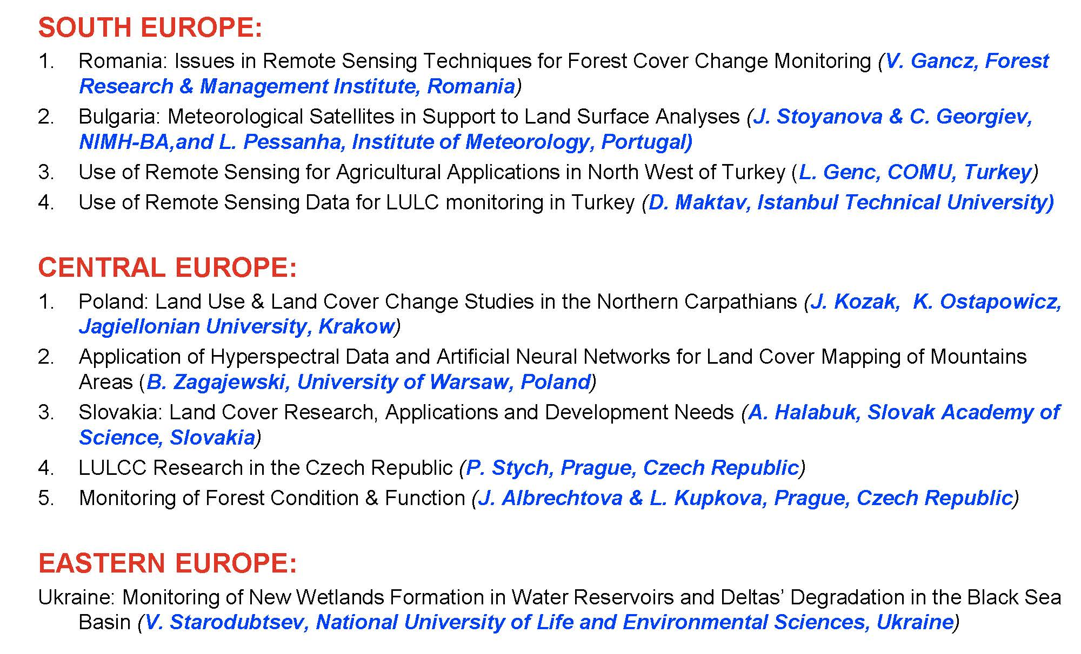
Examples of Regional Projects

Slide 14
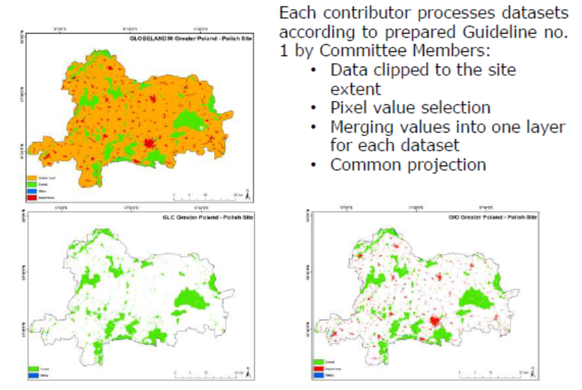
  P1: Global 30m Land Cover Products Validation in SCERIN (led by I. Manakos)
2) Selection of sampling points
3) GLC products evaluation
Data processing
Example 2 – issues:
border points
miss-registration
shadows and clouds
mosaicking of multi-date VHR data

Slide 15
  P3: Trends in SCERIN forest greenness as observed by 30 years of AVHRR (led by I. Pilas)
Objectives:
Estimation and interpretation of significant NDVI trends in SCERIN, using trend analysis and/or applicable forecasting methods
Evaluate the contribution of climatic drivers to the changes in NDVI on selected regional plots
Croatia pilot study: Examples of the trends in yearly average NDVI in various forest types, including: subalpine beech forests on highest altitudes (top left), mountainous beech forests on lower altitudes (top right), lowland oak and floodplain forests (bottom left) and Mediterranean Holm oak and Aleppo pine forests (bottom right)
Notes:
One of the longest chronological series of RS data with global coverage are products obtained with AVHRR (Advanced Very High Resolution Radiometer) which has been operational from 1981 to present. AVHRR products have been continuously gathered from fourteen National Oceanic and Atmospheric Administration (NOAA) polar orbiting platforms of the TIROS series. They are formed from two AVHRR instruments; AVHRR/2 – from July 1981 to November 2000 and AVHRR/3 from November 2000 to present. They obtain global coverage in two spectral channels, visible (0.58-0.68 μm) and near-infrared (0.725-1.1), from which NDVI are calculated. NDVI present a surrogate for photosynthetic potential, thus AVHRR NDVI data has become particulary relevant for continued long-term monitoring of land surface.

Slide 16
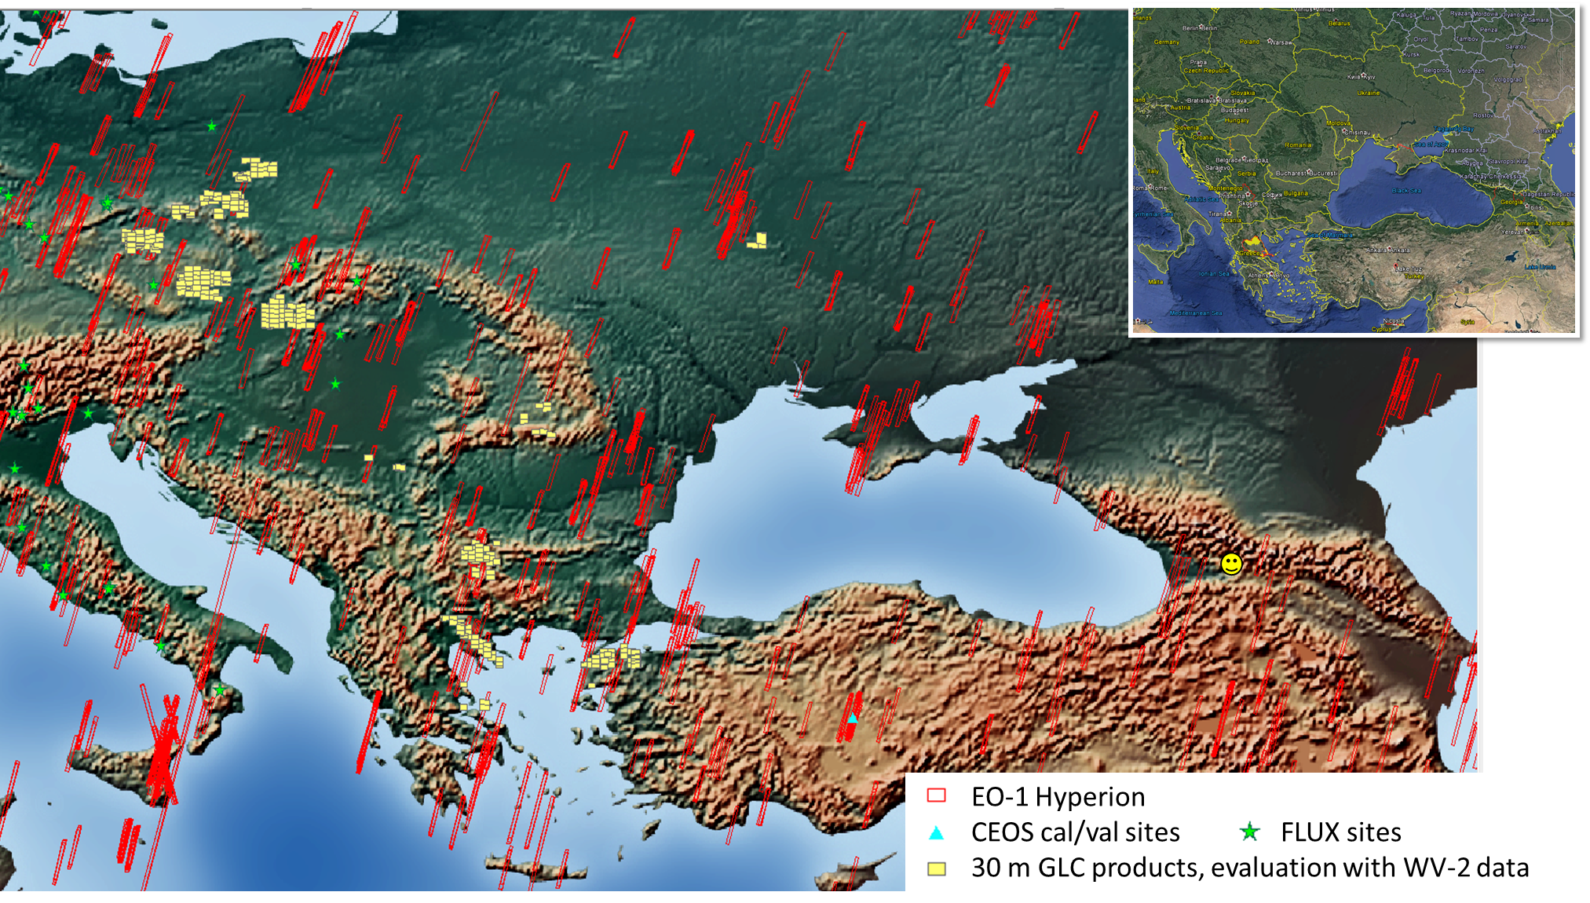
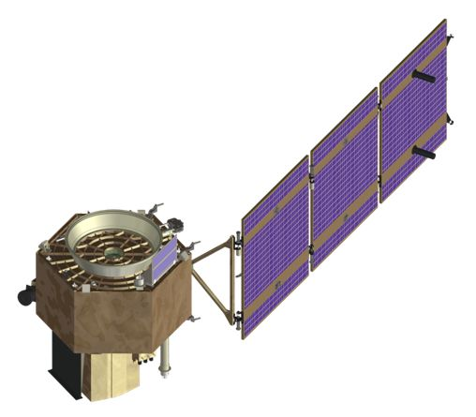
  P4: Review of high resolution spetral data (satellite, airborne, field) for forested ecosystems in SCERIN, and their use for vegetation monitoring (led by J. Albrechtova)
Satellite

Slide 17

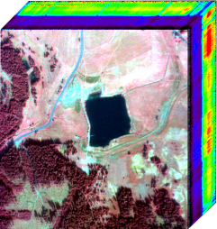
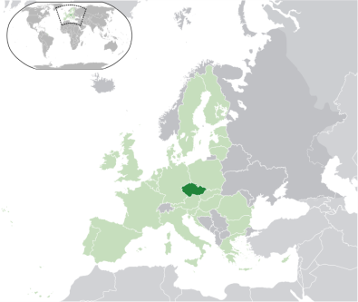
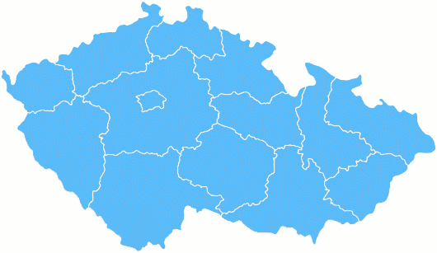
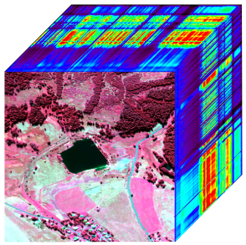
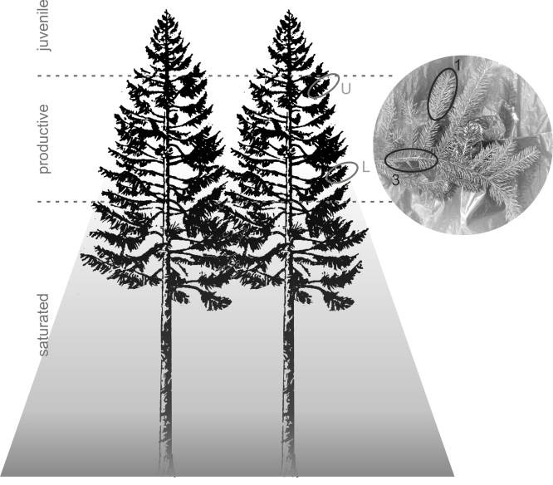
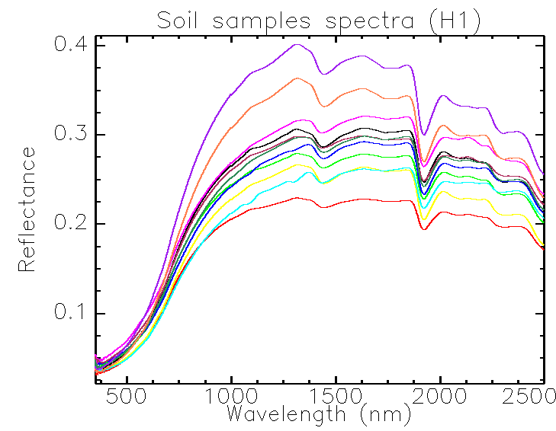
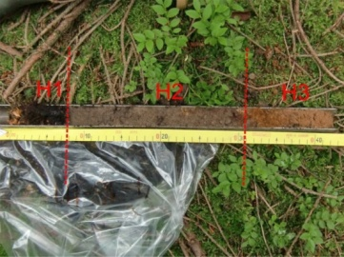
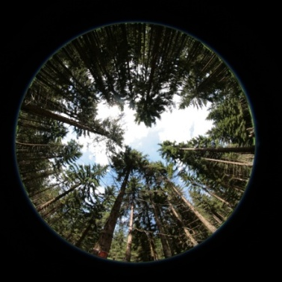
P4
AIRBORNE + FIELD: Hyperspectral data as a tool for assessment of temporal changes in Norway spruce physiological status in the mountaineous region affected by long-term acidic deposition.
Jana Albrechtová¹, Lucie Červená¹,Zuzana Lhotáková¹, Veronika Kopačková², Lucie Kupková¹, Jan Mišurec ², Markéta Potůčková¹, Pavel Cudlín³, Petya Entcheva-Campbell⁴
The main goal: assessment of the temporal changes in the physiological status of Norway spruce forests
in the Krušné Hory Mts. using two hyperspectral data sets acquired in 1998 and 2013.
Study area:
Hyperspectral data:
ASAS 1998:
Czech Republic
Reflectance (R%)
Krušné hory Mts.
725nm
580nm
825nm
R differences from 0 (%)
Wavelength (nm)
ASAS’98 images and spectra of healthy (DC0) and damaged (DC 1-4) canopies (Entcheva et al. 2004)
APEX 2013:
Groundtruth:
Needle sampling: Foliar chemistry – laboratory spectroscopy
Soil analyses:
LAI measurements
Charles University in Prague, Faculty of Science, Prague, Czech Republic, albrecht@natur.cuni.cz
Czech Geological Survey, Prague, Czech Republic
CzechGlobe, Academy of Sciences of the Czech Republic, České Budějovice, Czech Republic
Joint Center for Earth Systems Technology, University of Maryland Baltimore County and NASA Goddard Space Flight Center, Greenbelt, Maryland, USA

Slide 18
Regional Background
  Diversity of land forms and environmental conditions has produced a unique richness of species - highly sensitive and vulnerable to climate change.
  SCEE has undergone extensive land-use, which have rendered many of the natural processes of adaptation un-sustainable.
  Rich archive of long-term LULC data
  Archive of methodology for field observations
  LUCC research established
      tradition of 10-20 years in Central EU
      Tradition of 5-10 years in SE EU
    Availability of regional data
      from individual institutions or projects
      not always uniformly organized and consistent

Slide 19


Network Summaries – Day-1
- Year the network established; the leadership
Focus and research priorities
Membership (size); countries involved
Partnerships
Critical issues in the region
Related funding
Research projects accomplishments (Results; Publications, etc.)
GOFC-GOLD RIN Summit, Tbilisi
13-16 September, 2017

