Slide 1
Reflections on Land Management and Carbon Fluxes in Azerbaijan
Jan de Leeuw and Afag Rizayeva
Faculty of Ecology and Soil Science
Baku State University
Baku, Azerbaijan

Slide 2
Overview
While preparing for this presentation we considered to give
Overview of who we are and what we do
Reflection on objectives GOFC GOLD in Azerbaijan
Recommendations on focus of GOFC GOLD in Azerbaijan

Slide 3
Who we are and what we do
Afag Rizayeva and Jan de Leeuw
Working at Dept. Bioecology, Faculty of Ecology and Soil Science
Teaching GIS and Remote Sensing at Baku State University
Interest in conservation of wildlife and natural resources
Research on Carrying Capacity of Grasslands in Caucasus

Slide 4
Afag Rizayeva
Wildlife Conservationist, MSc in Bioecology, PgDip in Wildlife Conservation
Expertise in GIS and R applications in species habitat modelling and density estimation
Working at a local NGO – IDEA (International Dialogue for Environmental Action) Public Union as a Conservation Projects Manager
Managing projects reintroduction Caucasian leopard and European bison

Slide 5
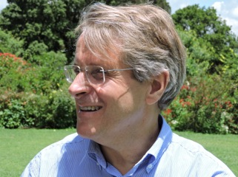
Jan de Leeuw
Plant Ecologist, PhD in Coastal Ecology in the Netherlands
Expertise in GIS and Remote Sensing applications in NRM
Previous worked ITC and CGIAR Livestock and Agroforestry Research
Moving to ISRIC Wageningen - Land Degradation and Land Restoration

Slide 6
How could we contribute to GOFC GOLD?
Global Observation of Forest and Land Cover Dynamics
Objectives of GOFC GOLD?
FAO website defines in terms of forest and land cover products
WUR Website narrower focus on data to provide understanding on terrestrial carbon budgets
We understand GOFC GOLD aims to provide forest and land cover products to generate understanding on global carbon budgets

Slide 7
Our knowledge on land cover change and carbon budgets in Azerbaijan
Prior to meeting reflection on what we know on carbon stocks and fluxes in the country
Limited insight in carbon stocks
Limited insight in land cover change, but we wish to share
Generalized scheme carbon fluxes related to land degradation and land cover change
What we know on land cover and ongoing land cover change in Azerbaijan
Speculate on the impact on carbon stocks in Azerbaijan
Reflect on priorities to address for GOFC GOLD

Slide 8
Land Cover in Azerbaijan
Difficult to get accurate information on land cover in Azerbaijan
Best map we know of produced by Humboldt University Berlin
Forest, Cropland, Grassland, Settlements, Water
Azerbaijan Statistical Yearbook 2017 estimates of land cover
Forest 12.0
Croplands 25.4
Annual 22.6
Perennial 3.5
Pastures 29.1
Water 4.5
Others 28.9

Slide 9
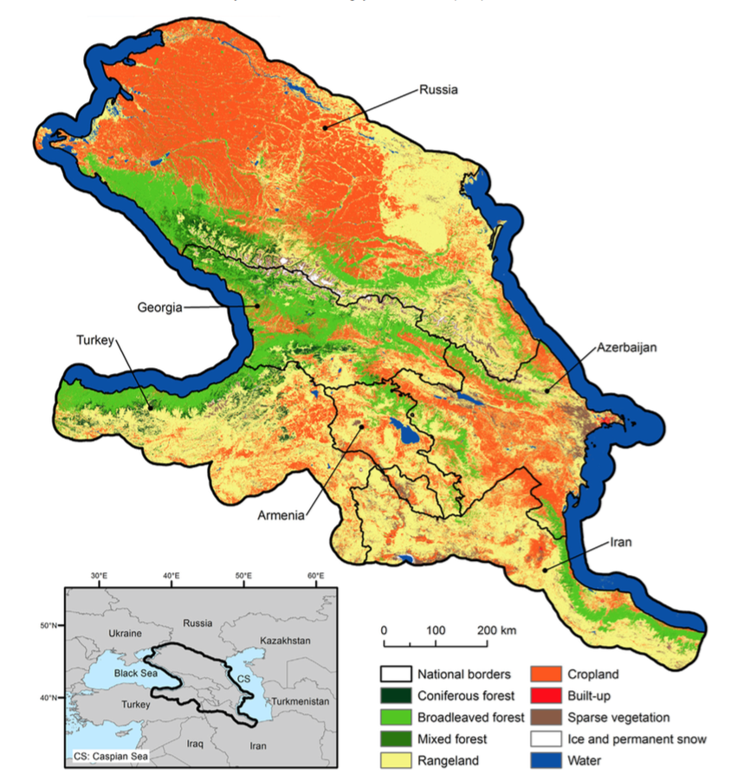
Map Land Cover Caucasus
Map produced by Bleyel et al.
Humboldt University Berlin
Based on four seasons of Landsat imagery
Study on wildlife habitat connectivity

Slide 10
Land Cover Change and Land Degradation
What do we know on the transitions and degradation of these land cover categories?
Forest – Past century conversion to grassland and cropland. Today area appears stable (GFW)
Croplands – Eroding. Area extending at expense of grazing lands
Grazing Lands – Highly overgrazed, severe erosion. Area shrinking due to conversion to croplands

Slide 11
Land cover change and degradation and carbon fluxes
What are the impacts of Land Cover Change and Land Degradation on Carbon Fluxes?
Difficult to assess quantitatively
However, possible to develop a narrative based on expert knowledge

Slide 12
Carbon fluxes from land cover change and degradation
Mountain ecosystems
Alpine Sub Alpine Footslopes
Lowland ecosystems
Steppe Wetlands
Grassland
Forest
Forest
Grassland
Grassland
Grassland
Cropland
Cropland
Cropland
Degraded grassland
Degraded grassland
Eroded cropland
Eroded cropland
Saline cropland

Slide 13
Overgrazing and carbon fluxes
Grasslands Azerbaijan severely overgrazed
Increase in livestock numbers due to reduction of pastures due to loss of territory and land use change
Stocking densities increased as a result of this
Overgrazing results in erosion and carbon emissions

Slide 14
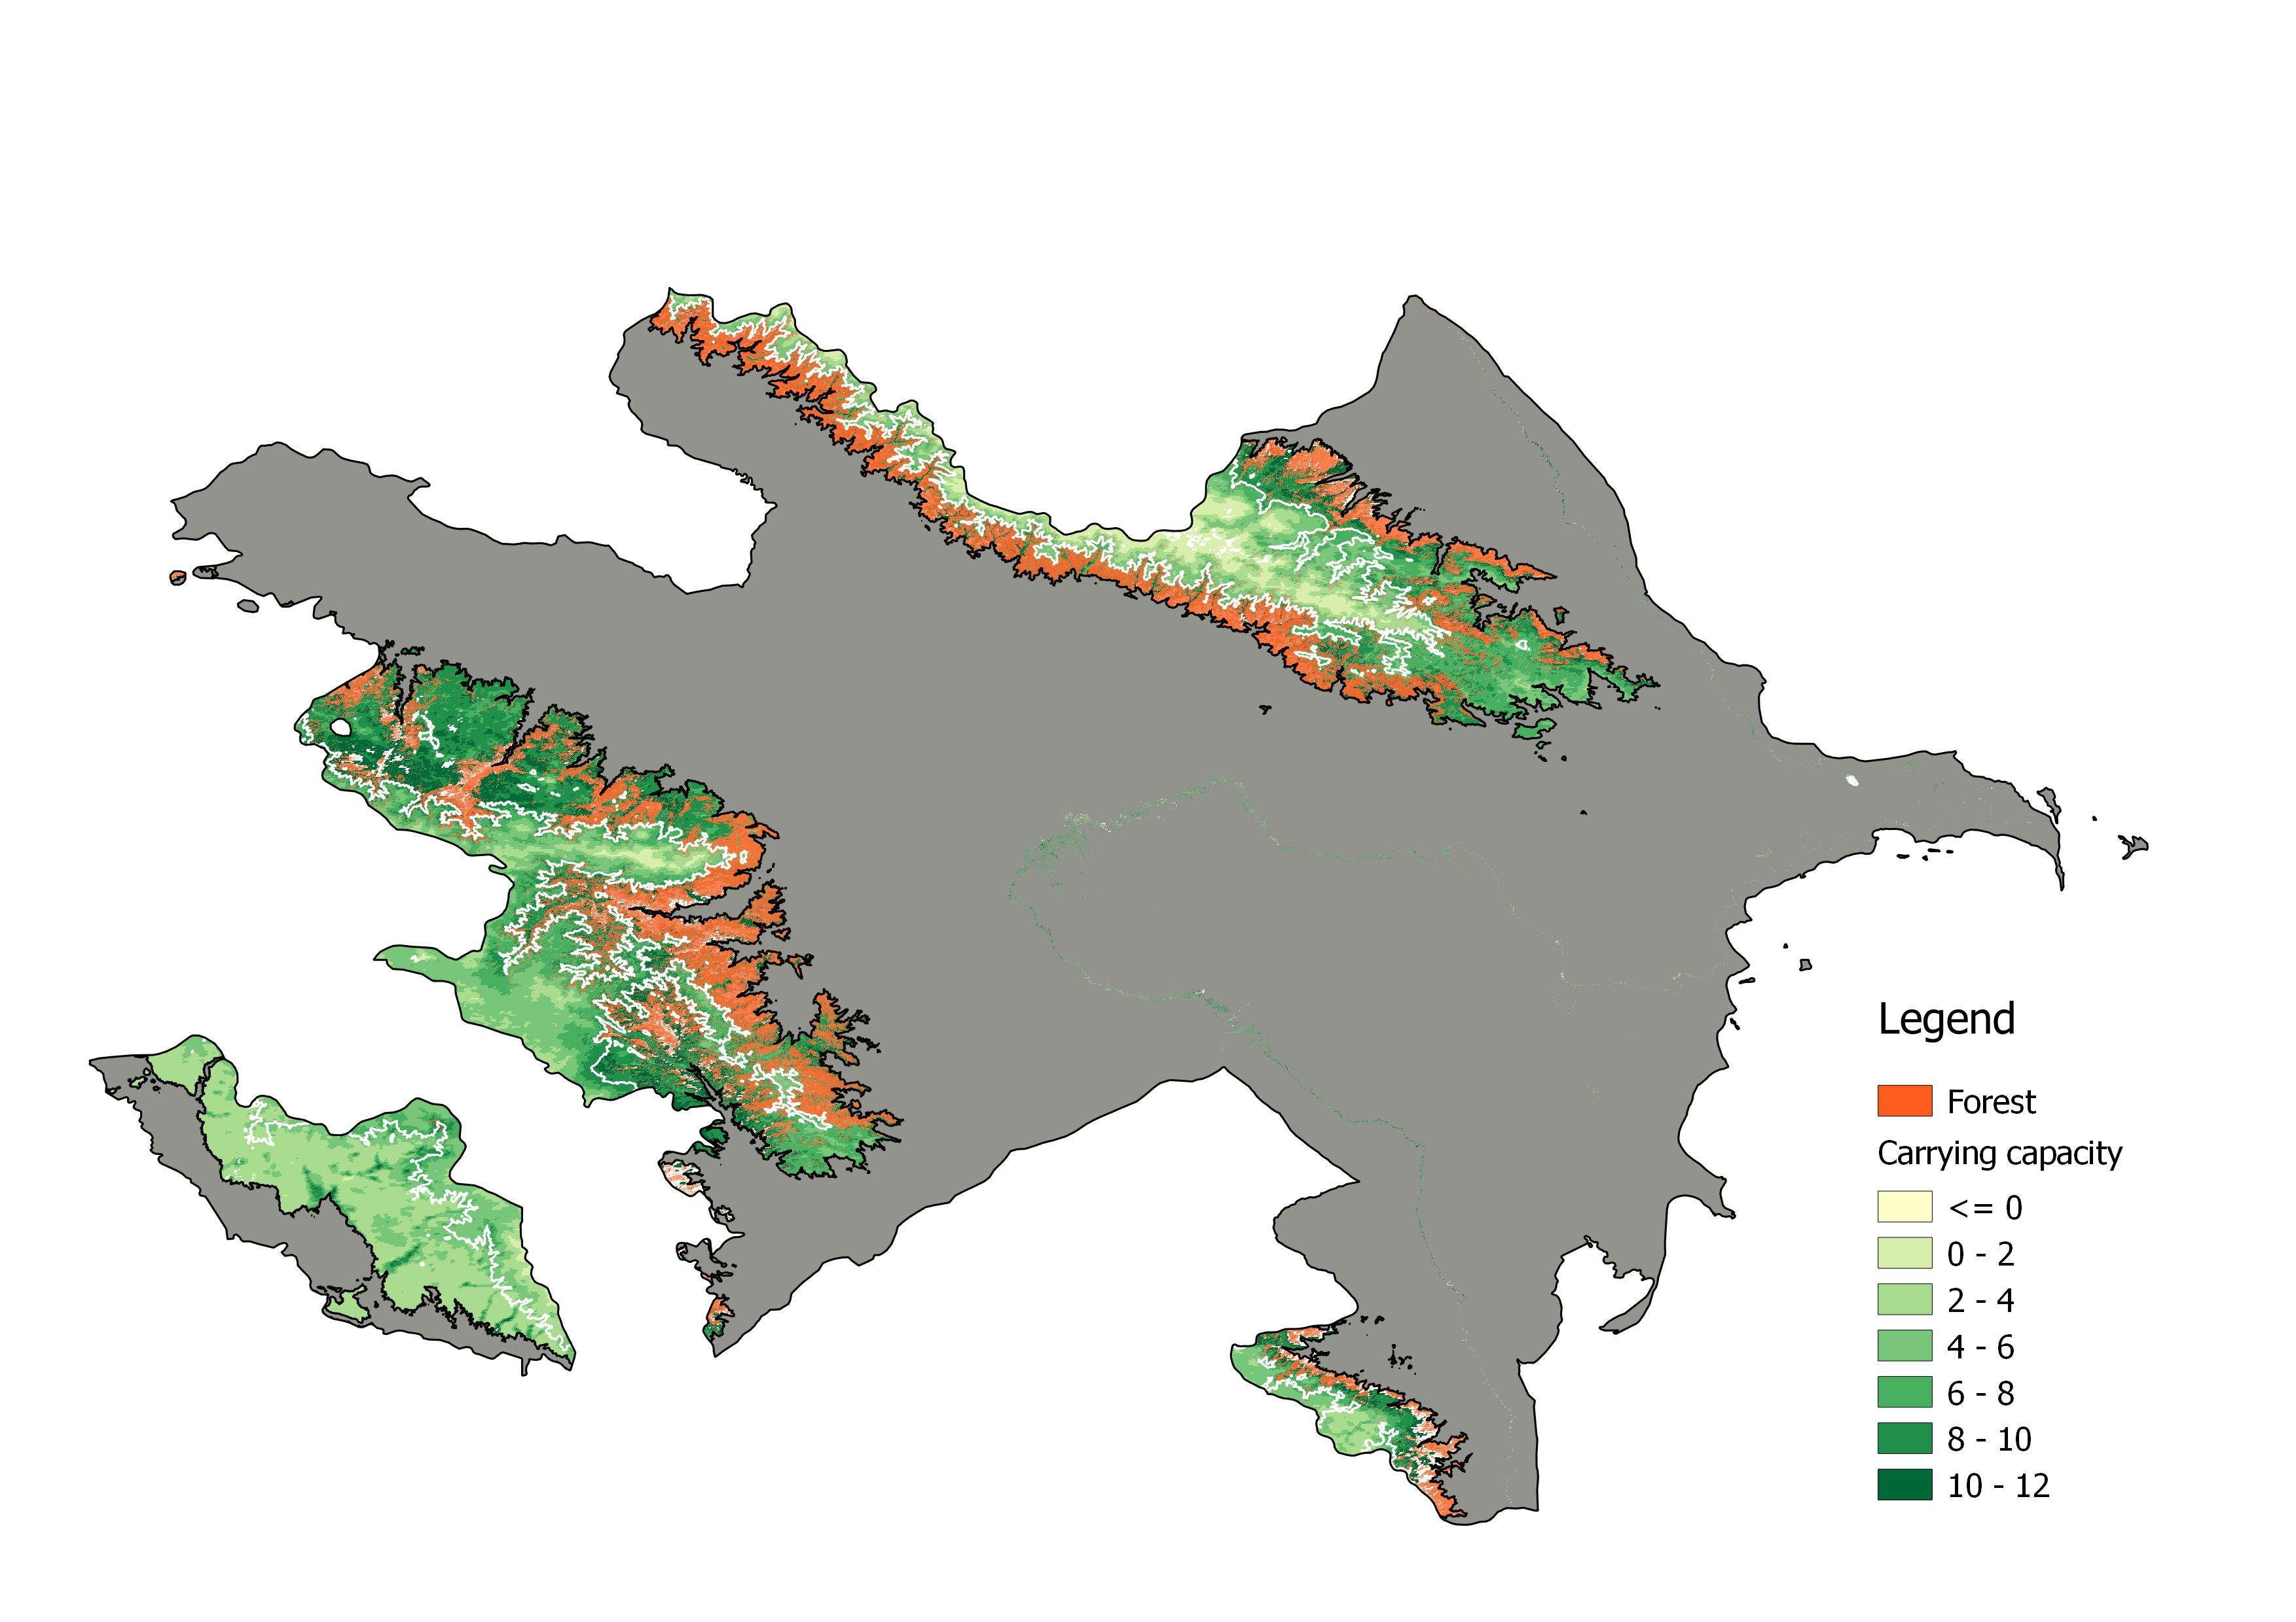
Carrying capacity mountain grasslands
Government prescribes 8 sheep maximum in summer grasslands
Irrespective of site productivity
Carrying Capacity Assessment based on MODIS NPP
Predicts NPP accurately
Stocking densities of 4 to 8 sheep / ha in alpine zone
Real density twice (?) as high

Slide 15
Carbon budget Impacts of Land cover Change
What are the key land cover processes that affect carbon budgets?
Which systems sequester and emit carbon?
Grasslands – Erosion and transformation to croplands leading to carbon emissions
Croplands – Plowing and erosion leading to emission of soil carbon
Forests – Relatively well protected, likely to sequester carbon.

Slide 16
Summary observations and recommendation
Observation: Azerbaijan has relatively little forest. Crop- and grazing lands are likely to contribute significantly to the carbon fluxes of terrestrial ecosystems of Azerbaijan
Recommendation: GOFC GOLD in Azerbaijan should assess the stocks and fluxes of carbon across all terrestrial ecosystems including crop and grazing lands

