Slide 1

SilvaCarbon collaboration with GOFC GOLD
Partnering to Measure Forest Carbon
GFOI Capacity building component
Sylvia Wilson, USGS

Slide 2
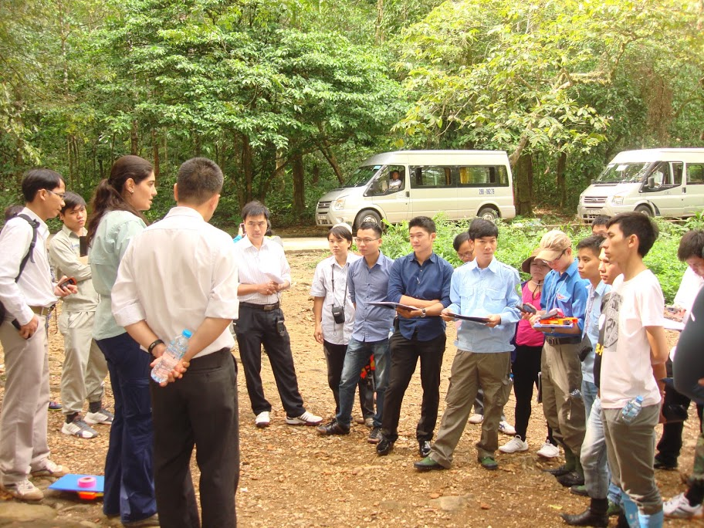
SILVACARBON PROGRAM OVERVIEW
A flagship program under U.S. fast start financing for REDD+
A U.S. contribution to the GEO Global Forest Observation Initiative (GFOI)
Improved Forest Inventories
Improved remote sensing
Integration of remotely sensed and ground data
GHG inventory and reporting
Advancing research

Slide 3







SILVACARBON PARTNERS
U.S. Agency for International Development
U.S. State Department
U.S. Geological Survey
U.S. Forest Service
NASA
U.S. Environmental Protection Agency
Smithsonian Institution
As well as U.S. universities, NGOs, donors and industry

Slide 4
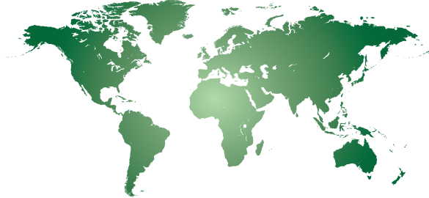
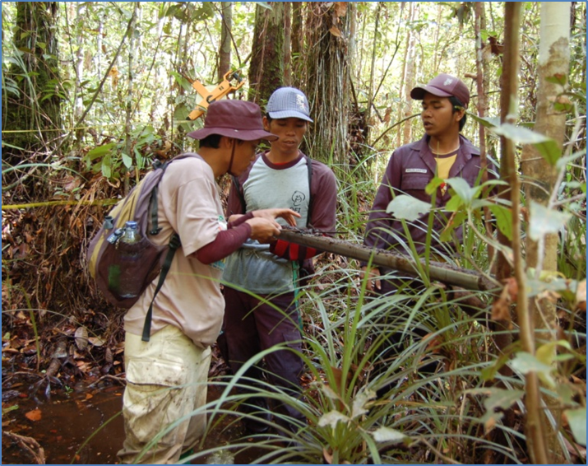
PARTNER COUNTRIES
Americas
Belize
Brazil
Colombia
Costa Rica
Ecuador
El Salvador
Guatemala
Honduras
Mexico
Nicaragua
Panama
Peru
Asia
Bangladesh
Cambodia
Indonesia
Lao PDR
Nepal
Philippines
Thailand
Vietnam
Bhutan
z
z
z
z
z
z
z
z
z
z
z
z
z
z
z
z
Africa
Cameroon
DR of Congo
Gabon
R of Congo
Zambia
z
z
z
z
z
z
z
z
z

Slide 5
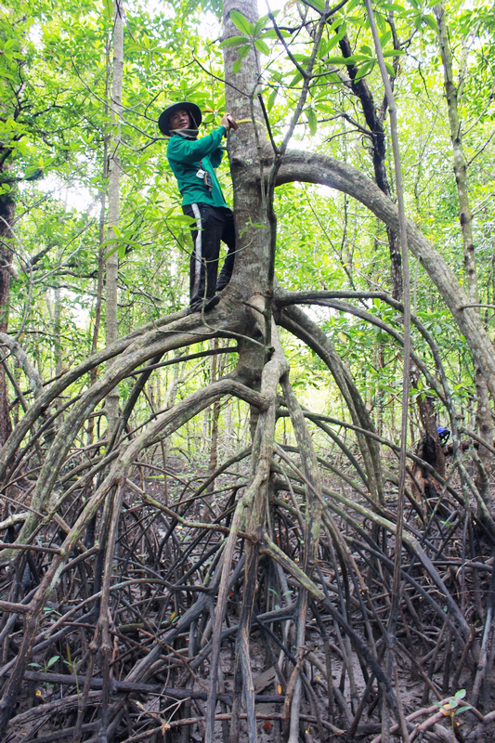
FOCUS OF CAPACITY BUILDING 2017-2019
By SilvaCarbon individual assessments, and in collaboration with others in GFOI
Capacity to set reference levels
Implementation of National Forest Monitoring Systems for multiple use
Integration of REDD+ projects into national systems
Monitoring of restoration activities
Support capacity transfer to meet NDCs goals
Governance (legal frameworks, mandates and
institutionalization of REDD+ processes)
Transparency
Dealing with emerging technologies
Notes:
Restoration of lands. This comes from the Paris agreement. Countries commit to certain amount of restoration of deforested and degraded lands by 2020
Governance - How the payments (for carbon) are distributing vertically in a country. Are the communities seeing the benefits of conserving their land? Are the payments for carbon done at national level? Those sort of things
Transparency comes out as a new area together with NDC in the last COP. Working with the countries to achieve their reporting with transparency (in all processes), transparency can be how they share and distribute data among sectors for example.

Slide 6
COLLABORATIon with GOFC GOld
Engage academia in developing countries
GFOI Regional workshops
Using the regional networks as a backup for supporting technical capacity (Ex. University of Maryland work as a country level.
Identifying research issues that require attention and are driven by developing countries needs. Ex (How to assist countries reaching their INDCs)
Use of REDD Compass to identified gaps

Slide 7

Upcoming activities
SERVIR and SilvaCarbon combined efforts to advance research
SilvaCarbon providing training at SERVIR hubs
UMD mapping efforts in Vietnam, Cambodia, Laos, Nepal, Bangladesh, and Guatemala
REDD Compass course at Universities
REDD Compass training in DRC/ROC, Cameroon, Nepal, and Latin America regional – governments

Slide 8
GFOI Capacity building summit
In collaboration with SERVIR and GFOI partners
Dates: second or third week of September
Location: ICIMOD (Centre for Mountain Development) – Kathmandu, Nepal
GFOI Partners: SilvaCarbon, FAO, UNREDD, GIZ, IFCL, FCPC, UK?, others?
Purpose:
Draft an strategy for coordinated work in capacity building
Understand how others are changing capacity building approaches that promote transparency
Use the MRV country assessments to determine a plan for selected countries
Notes:
MRV assessments- World bank, FAO, and silvacarbon made an assessment of each country for the Plenary based on the thematic areas of the MGD.

Slide 9
Challenges beyond 2018
Uncertainty in funding
Need to adjust the focus and still maintain the core purpose for GFOI and SilvaCarbon
Need to integrate into more established programs (already working with SERVIR and other GEO groups)

Slide 10

Sylvia Wilson – USGS
snwilson@usgs.gov
More information available at
www.SilvaCarbon.org

