Slide 1

Coordinating GOFC-GOLD Regional Networks: experience and lessons learned
Dr. Olga N. Krankina
Associate Faculty,
Oregon State University, USA
Former GOFC-GOLD Regional Networks Coordinator

Slide 2
What is GOFC-GOLD
A coordinated international effort to ensure a systematic and continuous program of space-based and on-the-ground observations of forest and land cover
A network of participants implementing coordinated research, demonstration and operational projects
A vision to share data, information and knowledge to inform decision making and address user needs

Slide 3
Regional Networks
a critical component of GOFC-GOLD
connecting ExCom, Implementation Teams, and Working Groups with data users in the regions
National Needs and
Users
GOFC-GOLD
Regional
Networks
National Needs and
Users
GOFC-GOLD
ExCom and ITs
National Needs and
Users
GOFC-GOLD
Regional
Networks
National Needs and
Users Within the Region
National Needs and
Users Within the Region
GOFC-GOLD
Regional
Networks
National Needs and
Users Within the Region

Slide 4
Tasks of Regional Networks in GOFC-GOLD
Formulate regional requirements
  Observations (measurements)
  Derived products and their accuracy
Facilitate regional use of remotely sensed data and products
  Establish regional data dissemination nodes
  Outreach and training for egional practitioners and decision makers
Promote technology transfer and collaborations within regions

Slide 5
Regional Networks
  RedLatiF – Latin America
  SAFNET – Southern Africa
  Miombo - Southern Africa
  OSFAC - Central Africa
  WARN – West Africa
  SEARRIN - South East Asia
  NERIN – Northern Eurasia
  CARIN – Central Asia
  SCERIN – South-Central Europe
  SARIN – South Asia
  BARIN – Baltic-Arctic
Notes:
9 functional networks and 2 networks were in the process of being established.

Slide 6
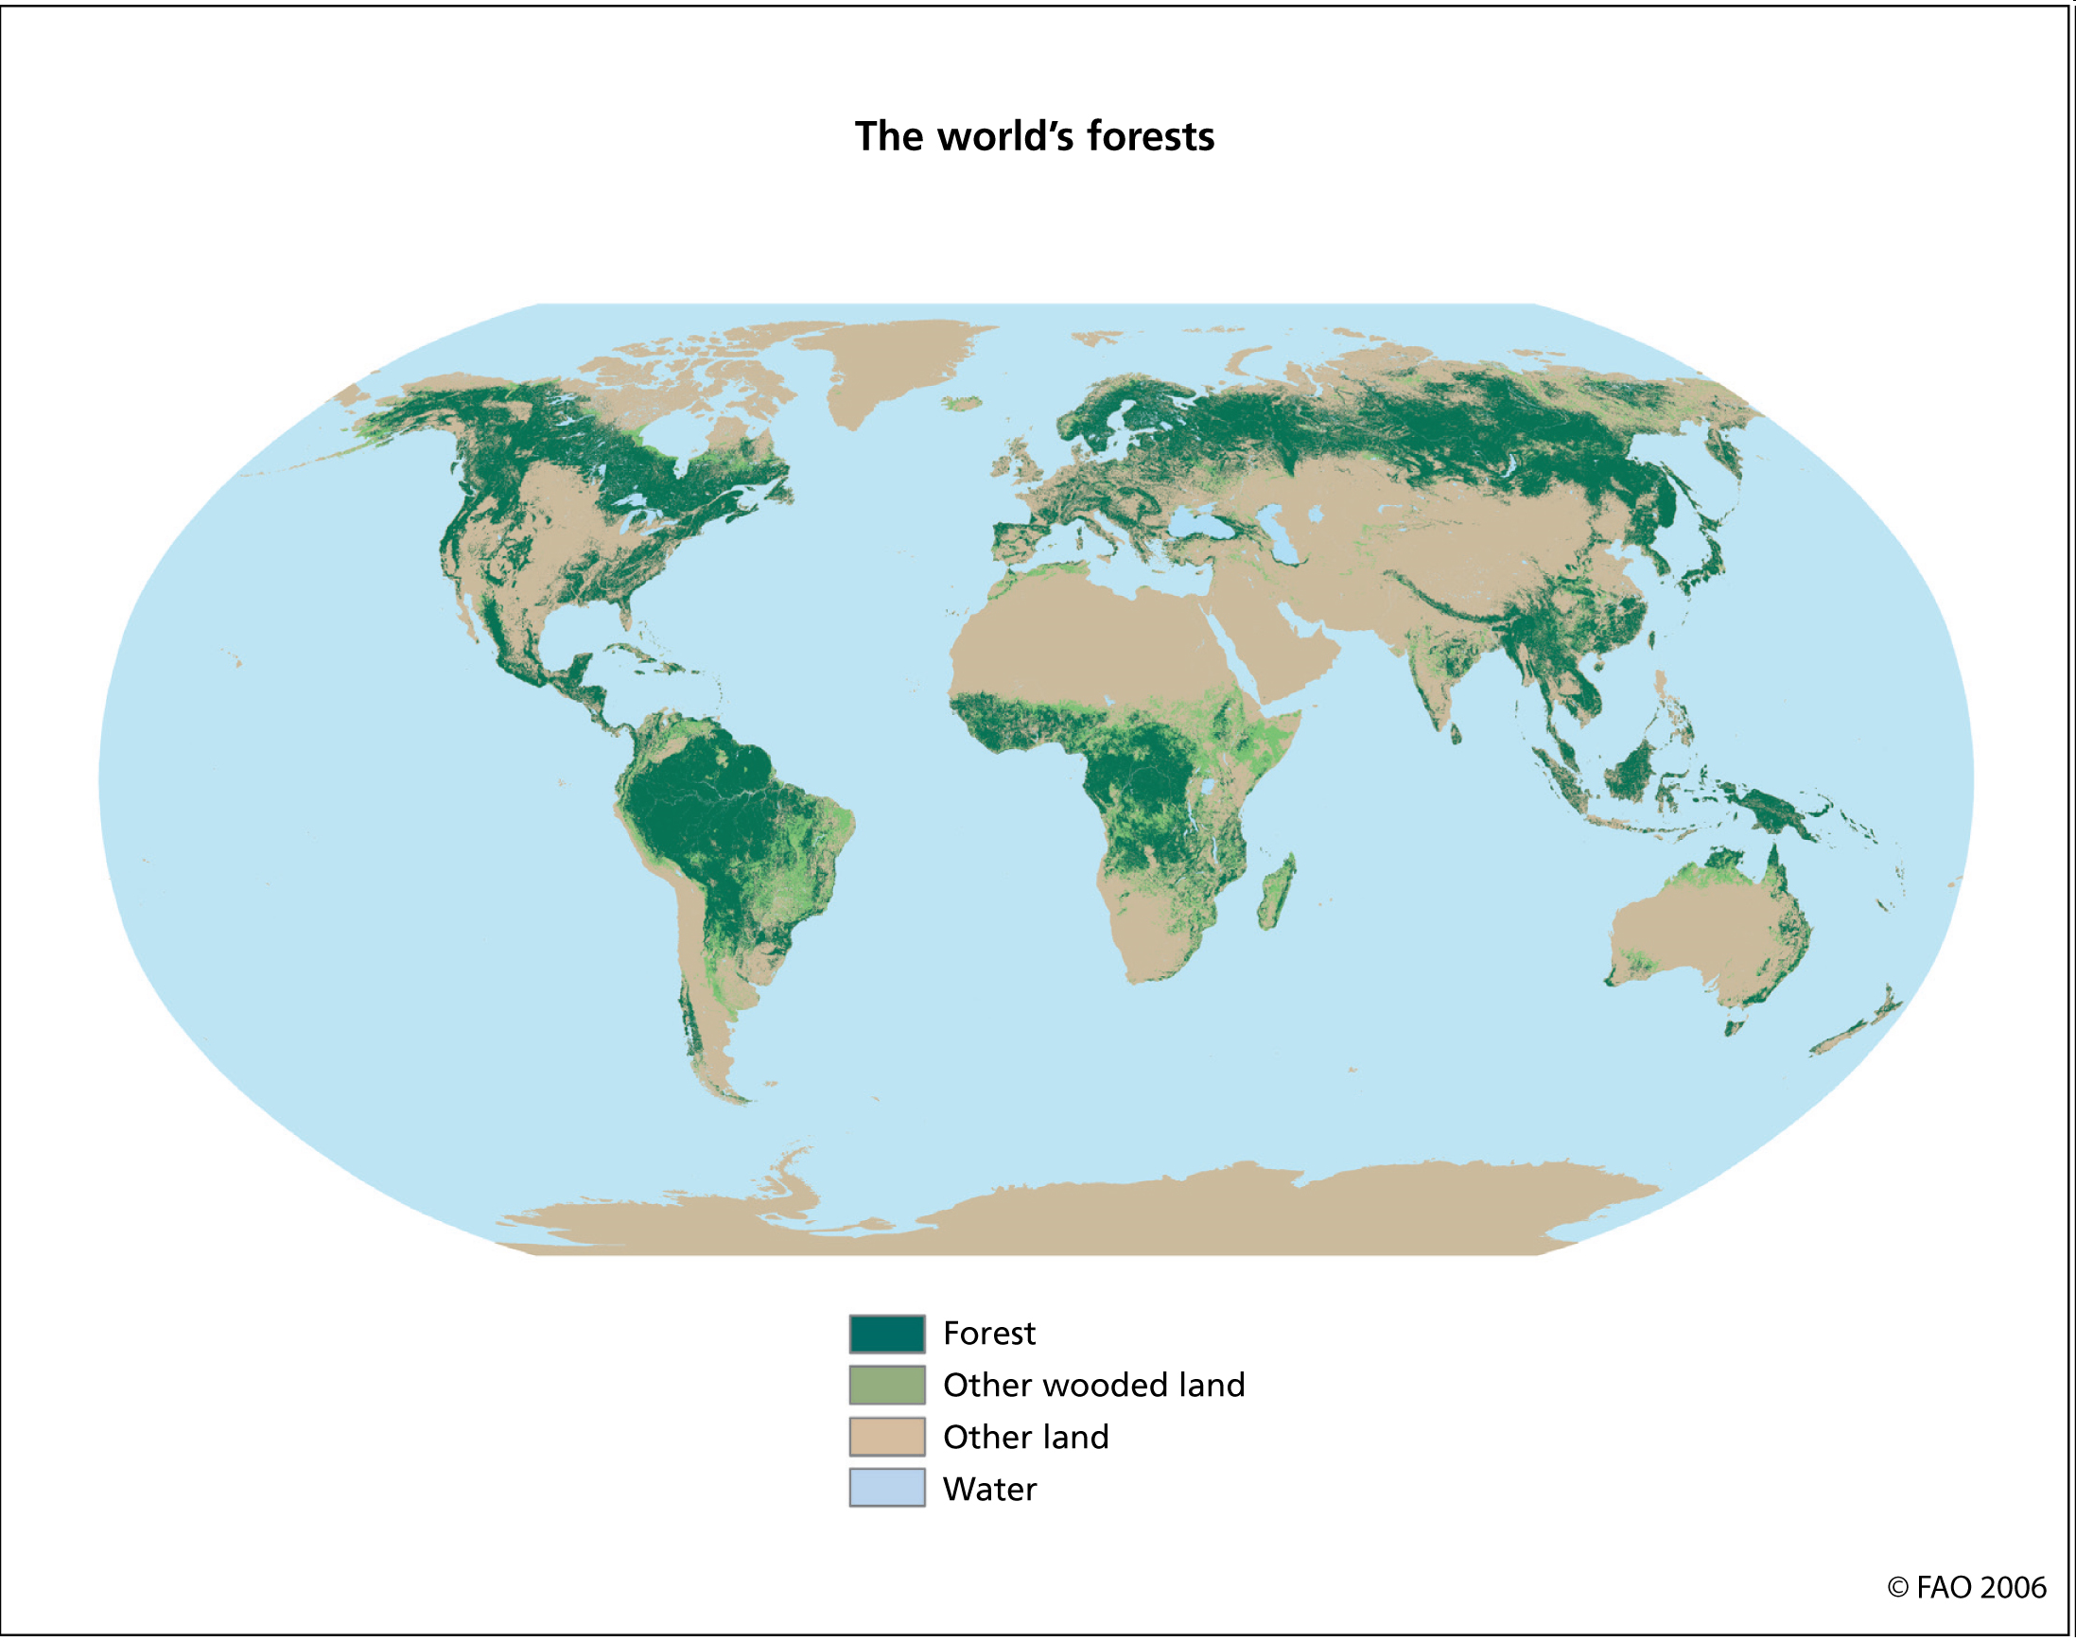
Notes:
Geogr domains are shown with ovals; overlapping. Fuzzy borders by design; networks interact and learn from each other. This fuzzy borders also facilitate the establishment of new regional networks and todays meeting is a good demonstration of how this idea works.

Slide 7
GOFC-GOLD Regional Networks
Self-organizing networks of
  Practitioners
  Scientists
  Organizations – Government agencies and NGOs
  Countries
People and organizations within the region and with interest in the region
GOFC-GOLD provides
  Initial support through START (NASA)
    FAO, CFS
  Coordination with ExCoM, Its, working groups
Varied sizes and structures
Notes:
Occasionally countries

Slide 8
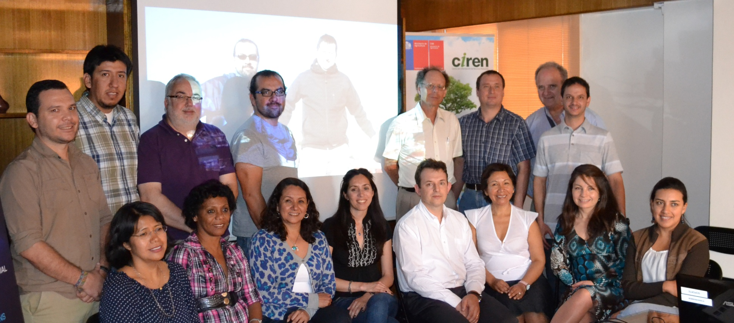
RedLatif MEETING
October 29th and 30th, 2012
Armando Rodriguez (Bolivia)
†
Sergio Opazo (Chile)
Federico Gonzalez (Spain)
Gerardo Lopez (Portugal)
Alberto Setzer (Brazil)
Hector del Valle (Argentina)
Carlos Pinto (Bolivia)
Ivan Csiszar (USA)
Jesus Anaya (Colombia)
Isabel Cruz
(Mexico)
Eva Majias
(Cuba)
Lilia Manzo
(Mexico)
Paula Blanco
(Argentina)
Fabiano Morelli
(Brazil)
Isabel Manta
(Peru)
Eliana Henriquez
(Chile)
Carolina Tapia
(Ecuador)

Slide 9

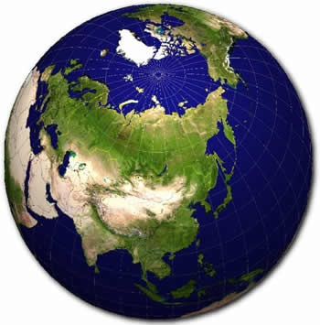
NERIN
Northern Eurasia Regional Information Network
Notes:
Presisded over establishment, development, care and feeding and eventual break-up

Slide 10
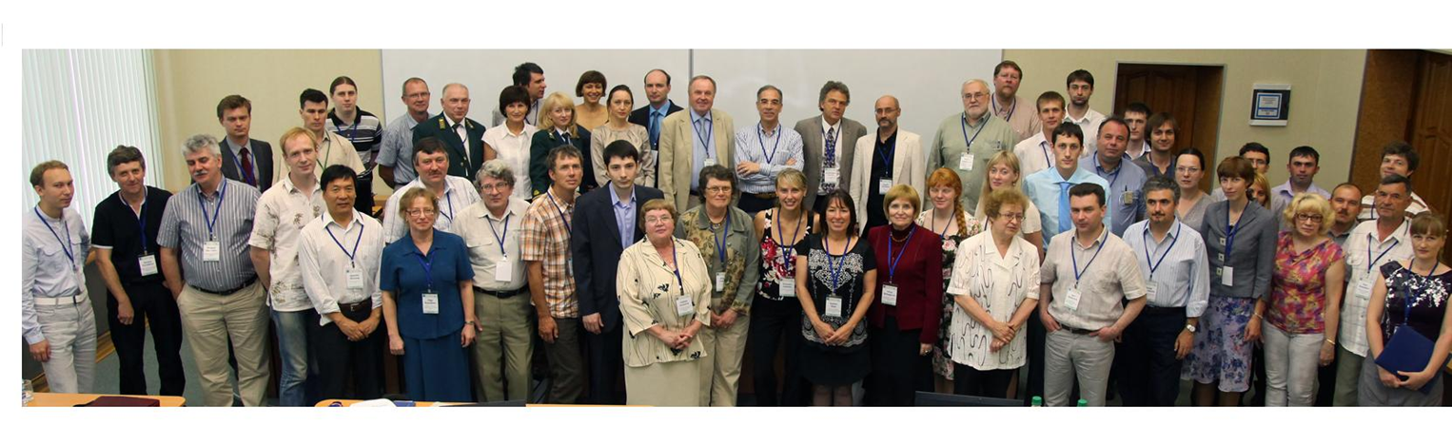
Notes:
Separate networks cover different regions of the world, NERIN is one of 7 established networks and covers perhaps the largest geographic domain
NERIN network emerged from a series of workshops that were conducted in the region since y2k. Several people present here attended all or nearly all of these workshops, many of your were at Urumqi workshop in China in 2007 where this current workshop was proposed. And while here in Kazakhstan we should start thinking of a good location and theme for the next workshop.

Slide 11
NERIN Workshops
Boreal Forest Workshop -Novosibirsk, Russia, August 2000
Regional workshop for Western Russia-Fennoscandia -- St. Petersburg, Russia, June 2001
Northern Eurasia Earth Science Partnership Initiative (NEESPI) workshops --Suzdal’, April 2003; Yalta, September 2003
“Observational Data in Support of NEESPI”, St. Petersburg, Feb. 23-26, 2004
“Observations of land cover and needs of research projects in Northern Eurasia”, June 18-19, 2005, St. Petersburg, Russia
“NELDA project” July 8, 2006, Tomsk, Russia
“Detection and Validation of Land-cover Change”, December 15-16, 2006, Moscow, Russia
“Requirements for Observations of Landcover Dynamics in Dryland Regions of Northern Eurasia”, September 20, 2007, Urumqi, China
“Land Cover Mapping at High Latitudes”, July 9-11, 2008, Syktyvkar, Russia
“Monitoring land cover, land use and fire in agricultural and semi-arid regions of Northern Eurasia”, September 15-21, 2009, Almaty, Kazakhstan
  CARIN – Central Asia Regional Information Network
Formulation Workshop - April 17, 2012, Sofia, Bulgaria
Volga Workshop, June 17 – 22, 2012, Yoshkar-Ola
Notes:
NERIN network emerged from a series of workshops that were conducted in the region since y2k. Several people present here attended all or nearly all of these workshops. At Urumqi workshop in China in 2007 where CARIN was proposed. And while here in Kazakhstan we should start thinking of a good location and theme for the next workshop.

Slide 12
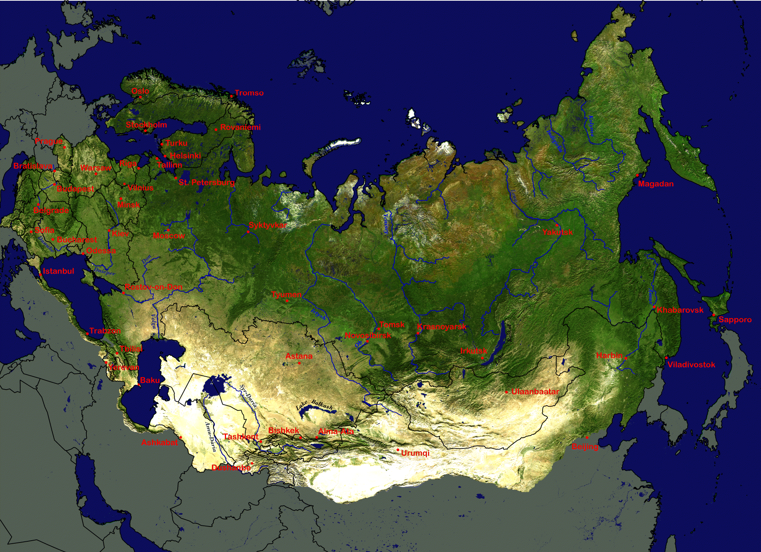
GOFC-GOLD Networks
in Northern Eurasia
BARIN
SCERIN
SibRIN
VolRIN
FERIN
CauRIN
CARIN
MODIS 1-km true color composite: August 20-28 2004.
Shaded relief adjustment using SRTM GTOPO30 elevation data.
Produced by Mutlu Ozdogan, NASA GSFC

Slide 13
Network Activities
Regional Workshops
Network Projects
Training and capacity building
Validation of global and regional data products
Notes:
Workshops are the main activity of regional networks and these workshops proved very effective in accomplishing many of the network goals.

Slide 14
Regional Workshops
Major activity, especially at early stages of network development
Critical for participant to accept the distinction between workshop and science conference
  Listening, discussing and planning are as important (or more important?) than science presentations
Short training sessions are often included
  Careful planning and realistic expectations are essential
Opportunity for networking, planning, learning about diversity of interests and expertize, identifying community-minded players

Slide 15
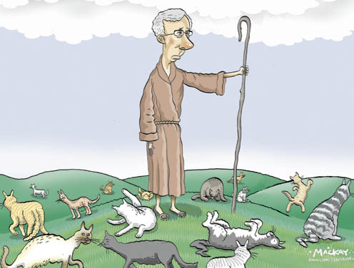
Notes:
independent brilliant minds of scientists and leading professional at the top of their fields are not easy to coordinate. And similar challenges are at play in NETwork projects. While workshops seem critical for establishing networks, projects seem very important for sustaining the networks over long term.

Slide 16

NELDA
(Northern Eurasia Landcover Dynamics Analysis)

Slide 17
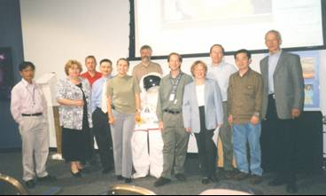
The Team
  US
    Oregon State University - Olga N. Krankina
    NASA Goddard Space Flight Center – Jeff Masek and Jeff Morisette
    Boston University - Mark Friedl and Curtis Woodcock
    University of Maryland - Ivan Csiszar, Guoqing Sun, and Tatiana Loboda
    USDA FS Pacific Northwest Research Station – Warren Cohen
  Eurasia
    Center for Information Technologies Development, Moscow – Alexander Maslov
    Institute of Monitoring of Climatic and Ecological Systems, Tomsk – Evgeny Gordov
    V.N. Sukachev Institute of Forest, Krasnoyarsk – Slava Kharuk
    Institute of Biology, Komi Scientific Center, Syktyvkar – Vladimir Elsakov
    Humboldt Universität Berlin, Germany - Patrick Hostert and Tobias Kuemmerle
    Astrophysical Research Centre, Almaty, Kazakhstan – Lev Spivak and Alexey Terekhov
    Mongolia?
Notes:
И включает большую группу исполнителей: по моему последнему подсчету их 19 человек из 5 разных организаций в США и 5 в россии и несколько дополнительных участников находятся в процессе примыкания к нашему дружному трудовому коллективу. Кординация деятельности блестящих творческих умов, включая лучшие умы в этой области и их организация вокруг выполнения обшей задачи – задача не из простых, вы пала она на мою долю и напоминает мне.

Slide 18
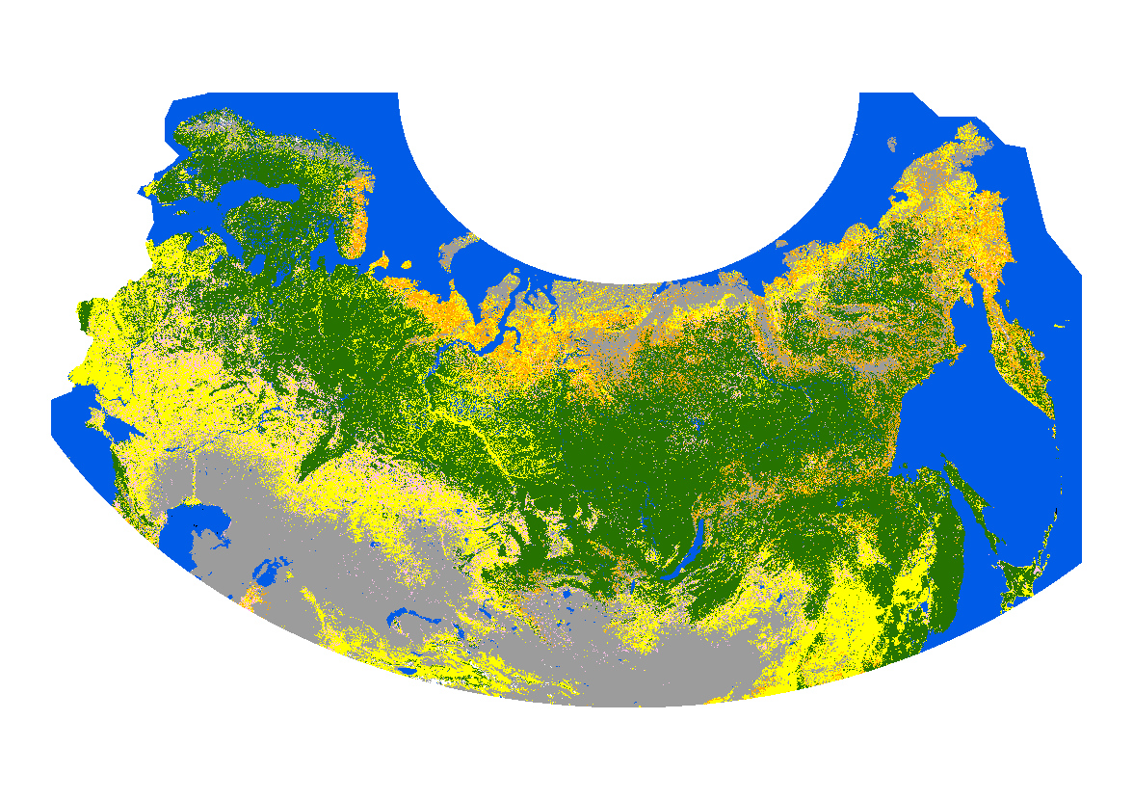
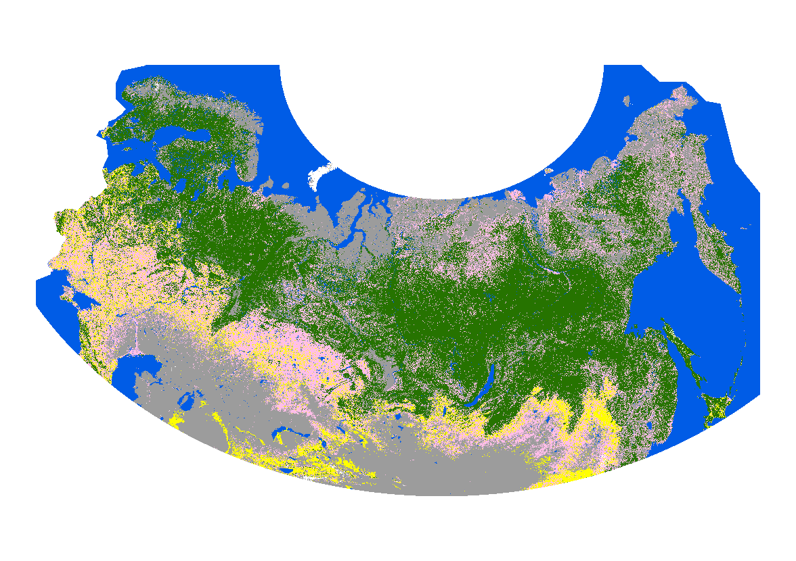
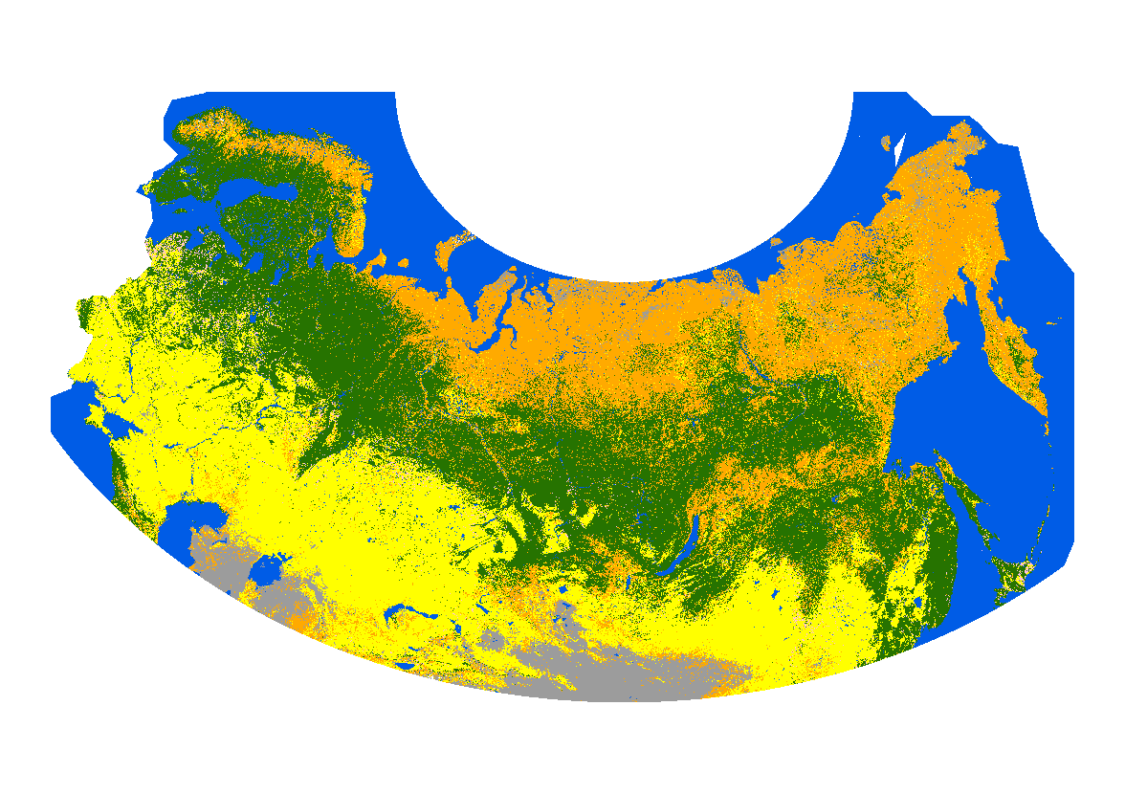
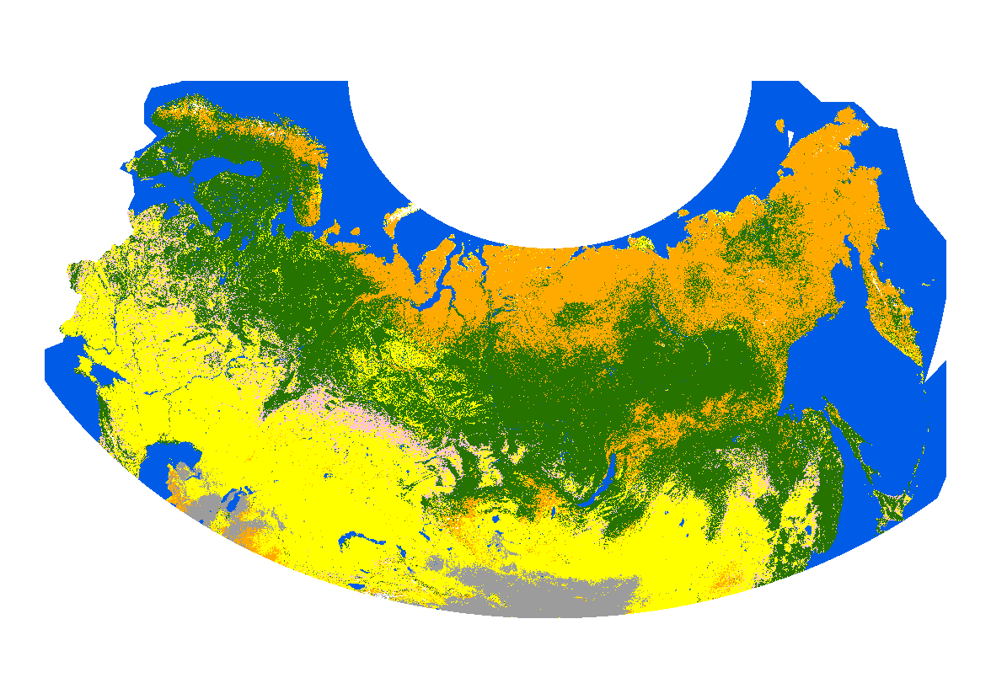
GLC2000
GlobCover
2005
MODIS V4
MODIS V5
Tree
Shrub
Herbaceous
Mosaic
Bare
Ice
Water
Notes:
<<PN Added>>

Slide 19
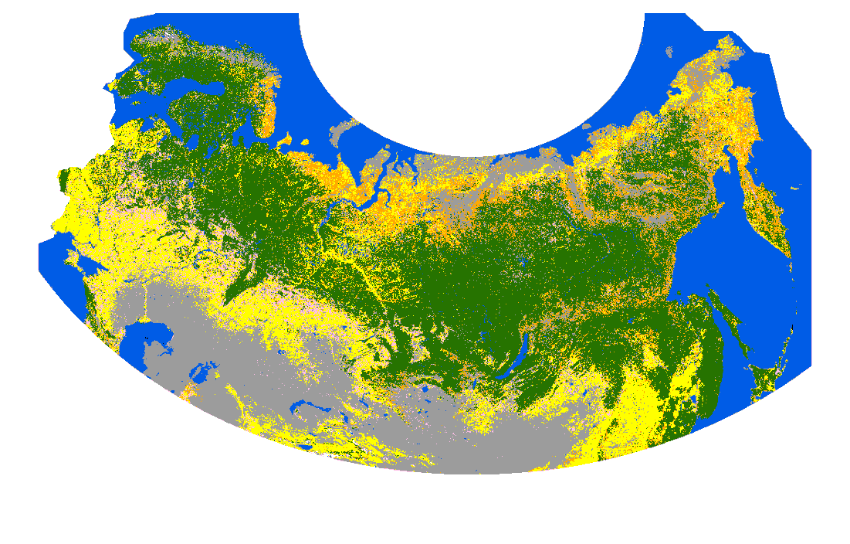
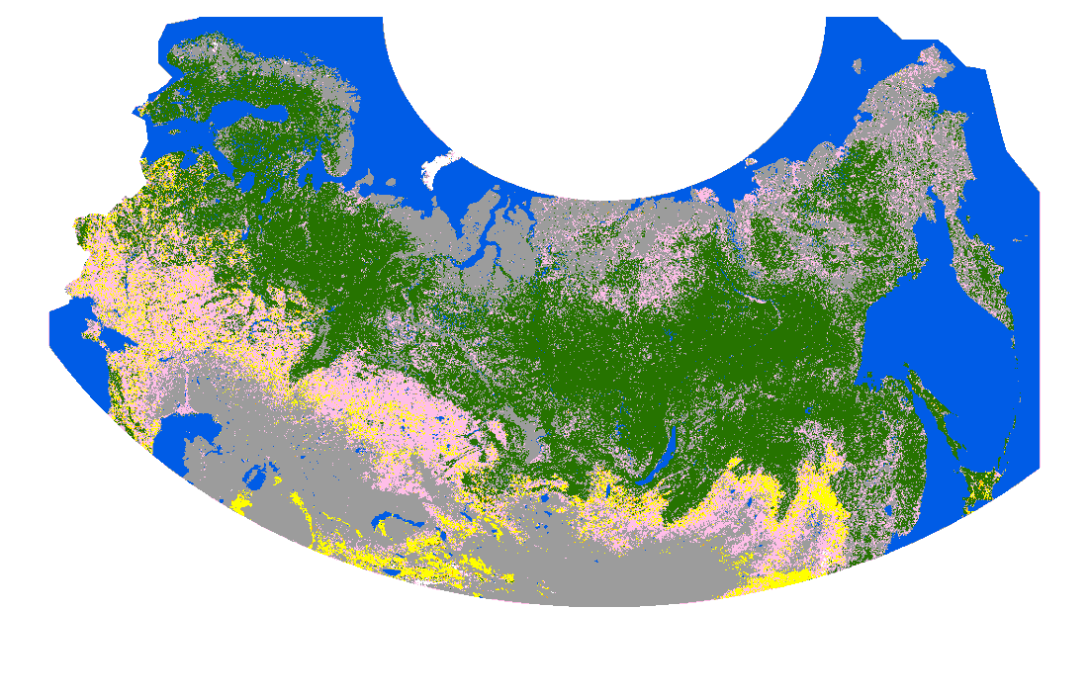
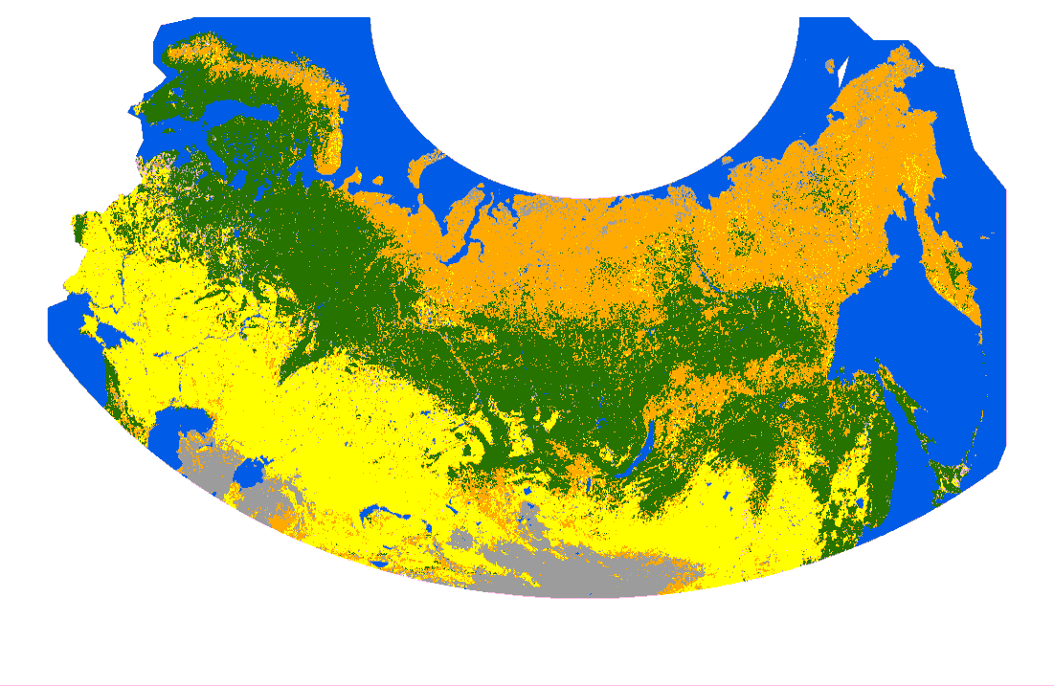
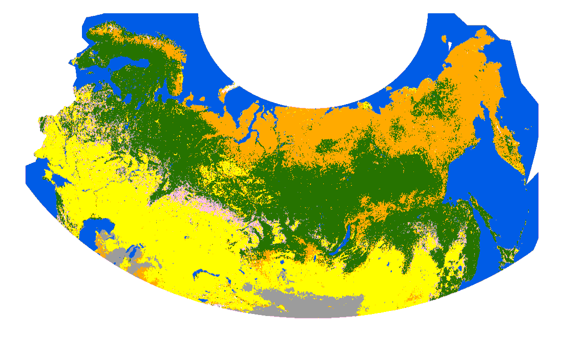
GLC2000
GlobCover
2005
MODIS V4
MODIS V5
Tree
Shrub
Herbaceous
Mosaic
Bare
Ice
Water
Notes:
<<PN Added>>

Slide 20
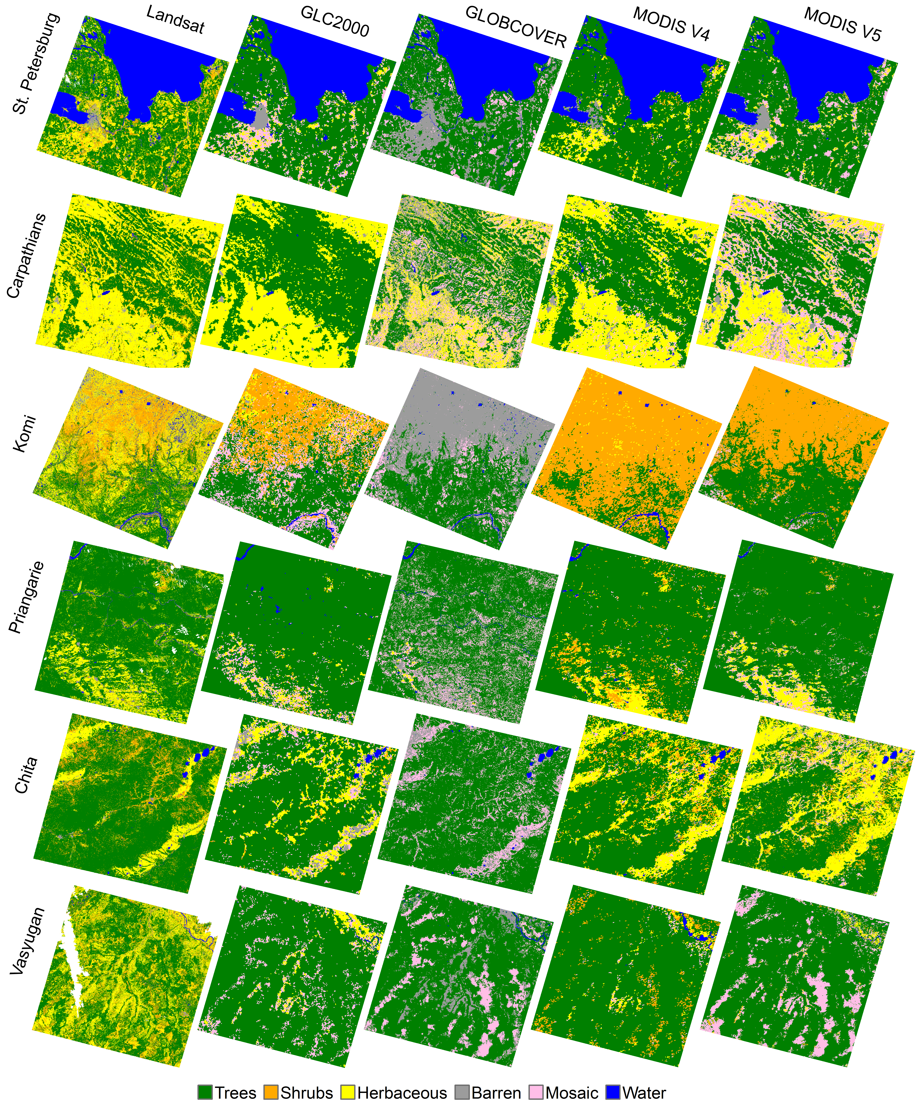

Slide 21
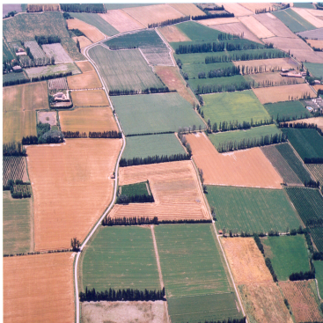
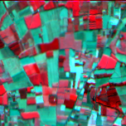
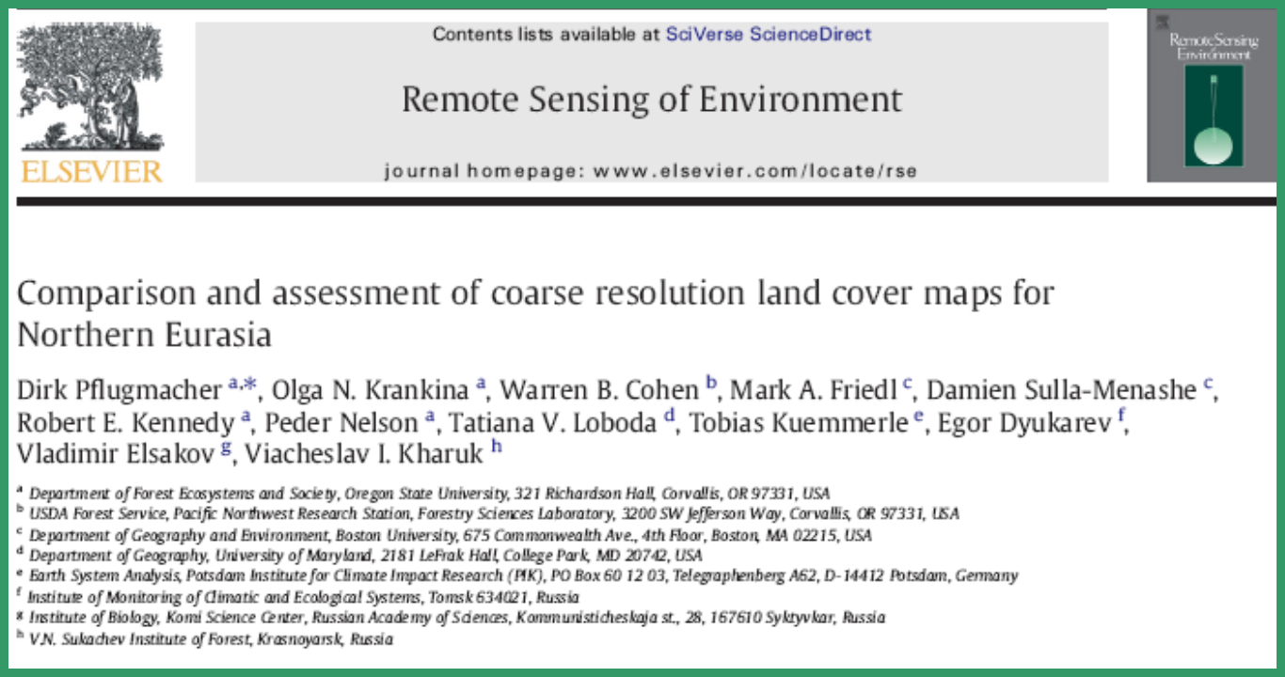
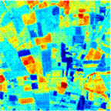

Field data
High resolution imagery
A
B
Transfer
function
T
Aggregate
&
Relate
C
R
D
High resolution
“Product”
Moderate resolution
“Product”
Accuracy Assessment
for one product, at one site, at one point in time

Slide 22
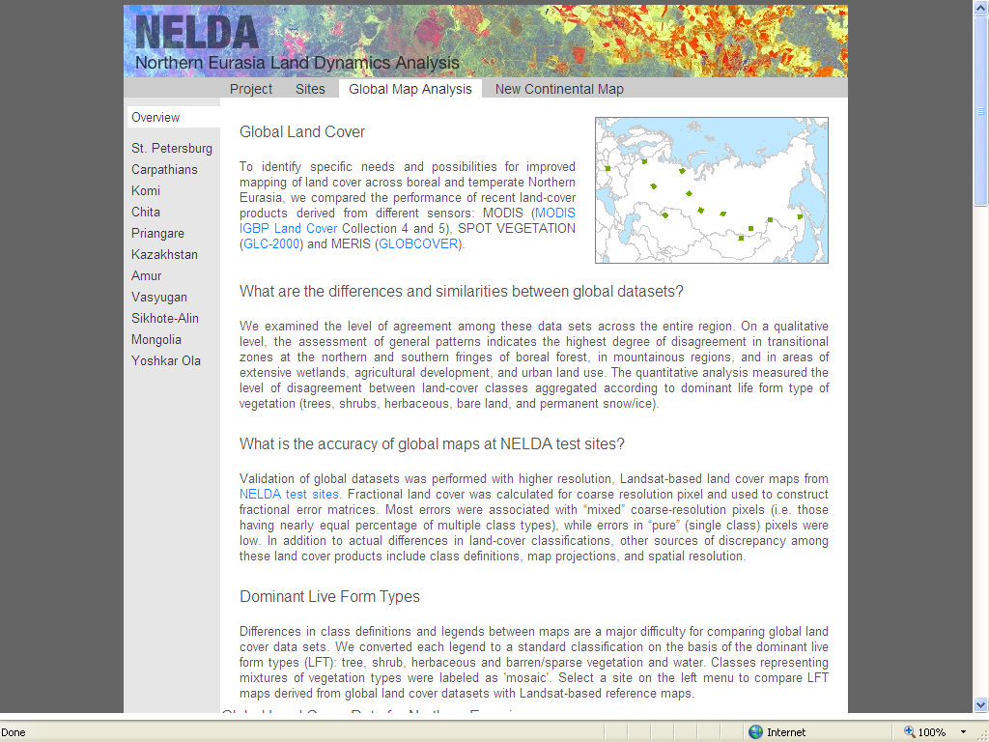
http://www.fsl.orst.edu/nelda/index.html
Notes:
info still on the web, Project ended 3 years ago, so did NERIN; fulfilled its objectives so it effectively broke up into smaller more focused networks. SERIN – one example.

Slide 23
NERIN is dead
Long live
  CARIN
  SCERIN
  BARIN
  CauRIN
Notes:
Widhing Caurin long and successful life in line with famous Caucasian longevity. I am happy to help you guys,

Slide 24
Thank You !

