Slide 1
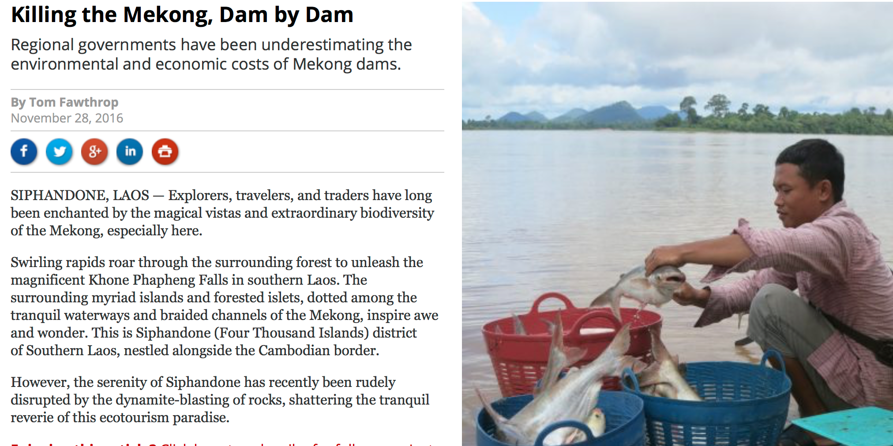
Dam Mekong!
Jiaguo Qi
Michigan State University
MAIRS WEF Nexus WG
Pariwate Varnakovida
KUST, Thailand
Krishna Vadrevu (SARI)
Israr Alabar (SEARRIN)
Trung Levan (SEARRIN)
……..

Slide 3


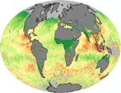
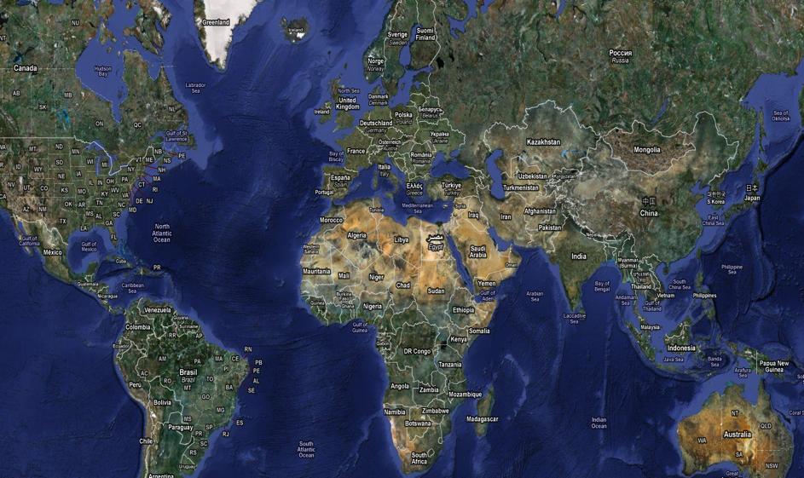
Innovative International partnership
Europe Node
Central Asia Node
North American Node
Asia Node
Southeast Asia Node
South American Node
East Africa Node

Slide 4
Future Earth
&
GLP
ASIA HUB
A New IDS Project → Program
Cutting across all
Supporting their missions
Addressing specific local issues
MAIRS
- WEF WG
NASA LCLUC
SARI

Slide 5
An Interdisciplinary Approach

Slide 6
MekRIN – Building up existing network

Slide 7
Moving Project → Programs
China
India
Central Asia
Southeast Asia
South Asia
Africa
Alim Pulatov (CARIN)
SAFNET?
Israr Alabar (SEARRIN)
Trung Levan (SEARRIN)
Krishna Vadrevu (SARI)
Notes:
In July 2016, ISP in collaboration with colleges and units initiated the MSU Asia Hub (MAH).
Will include innovative partner-hubs in China and India that link to multilateral collaborations in priority countries in South Asia, Central Asia, Southeast Asia, and Africa as well as other strategic world regions.
The goal is to enhance coordination and synergy among programs in Asia that can also leverage our opportunities and impacts in key North-South and South-South corridors.
Where appropriate, the Asia Hub platform will be linked with the Africa Alliance Partnership (AAP).
Positioning Asia in Global context and perspective and exploring Africa’s relationships with other world regions
The programs will be interdisciplinary and built around strategic areas of MSU’s international engagement.
Potential Initiative – MSU/NAU

Slide 8
MSU
NAU
NPU
KU
ZJU
MFL
MU
YU
YAU
VAAS
CTU
NUL
RUNP
Potential MekRIN?
Coordinators
IPOs
Regional Nodes
Thailand
Vietnam
Myanmar
Laos
Cambodia
China

Slide 9
Moving Project → Programs
MSU-NAU Initiative
Research
(Joint projects)
($5M) committed)
Integrated research learning model
Academics
($10M)
Training ($??)
MAIRS-FE
WEF KANs
Future Earth Asia
SEARRIN
NASA-LCLUC
FE – GLP
SARI
Mahidol Uni.
Mae Fah Luang Uni.
AIT
Can Tho Uni.
NPU
Majeo Uni.
…..
Network of Networks in Asia and International Programmes
Multi-partners
Multi-modules
International learners

Slide 10
Moving Project → Programs
Focus on local issues
Food, Energy and Water Nexus (land)
  Members are being assembled
  Asia WEF Nexus workshops (July 11-15, 2017 and Feb. 2-5, 2018)
Natural Disaster
  Members are being assembled
Human Health
  Members are being assembled

Slide 11
Upcoming Activities –
Networks: SERRIN, SARI and MAIRS
Sino-USA WEF Nexus; due Oct. 15
  WEF Nexus in SEA (Qi leads) with Zhejiang University, Nanjing Agricultural University and South China Normal University focusing on Food Security in the region

Slide 12
Upcoming Activities -
Networks: SERRIN, SARI and MAIRS
NSF INFEWS Call, due March, 2018
  Trade offs and synergies
Regional workshops / Training and Capacity Building
  Asia Hub / WEF Nexus Food Security, Nov. 27-30, 2017, Nanjing, China
  Asia WEF Nexus, Vientiane, LAOS, Date under consideration: May – June or Early August, 2018
  Faculty and student exchange as a way of capacity building

Slide 13
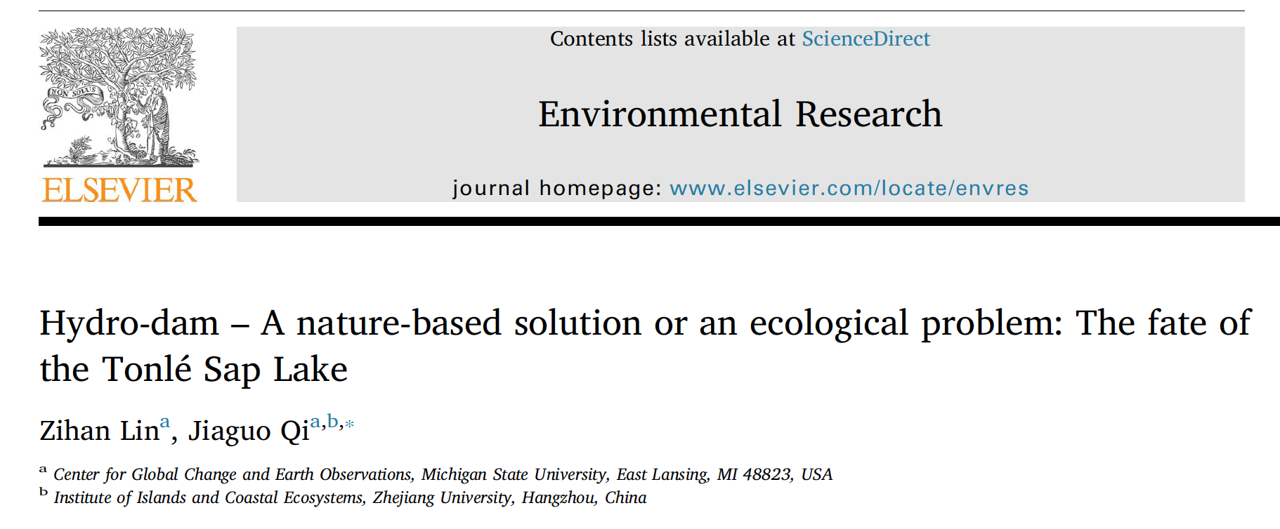

Slide 14
Thank you!

