Slide 1
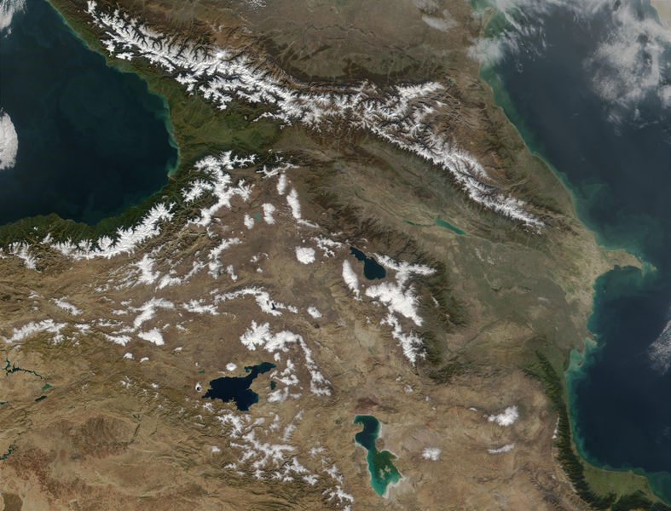
GOFC-GOLD Regional Networks Summit
CaucRIN
Giorgi Ghambashidze and Volker Radeloff

Slide 2
Way Forward Highlights – Day-2
3 most important research goals
Land cover map for the entire Caucasus
Degradation of forests, pastures and agriculture
Whole basin assessment for the Kura River
3 most important teaching goals
CaucRIN website with geoportal
How to monitor fires
How to do topographic correction
…

Slide 3
Way Forward Highlights – Day-2
Stake holders/audience – Research outputs
National ministries and agencies
NGOs
Stake holders/audience – Training
Scientists, and graduate students, maybe K-12
Realistic and potential funding sources
NASA/START for network meetings
National science agencies for research, e.g. National Science Foundation, Georgia
Maybe GIZ
Will need to establish network funding

Slide 4
Way Forward Highlights – Day-2
Way forward: vision for the coming years
Next CaucRIN meeting in 2018
Grow the network (regionally + new LCLUC teams)
Work jointly on land cover classification and paper
Write more proposals
Next year
Land cover map for the entire Caucasus
Next two years
Degradation of forests
Degradation of pastures and agriculture
Next 3-5 years
Whole basin assessment for the Kura River

Slide 5
Thank you!

