Slide 1
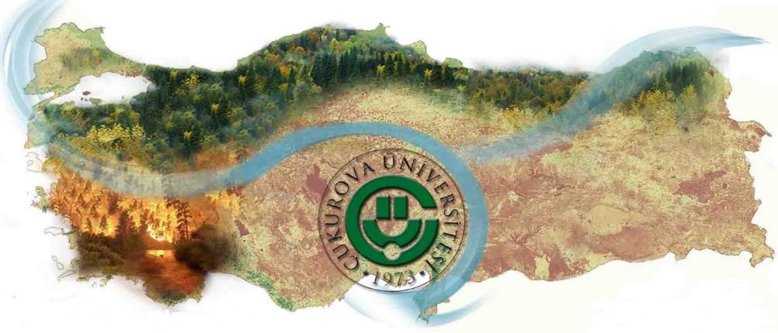
ENVIRONMENTAL RISK ANALYSIS ON LANDSCAPE OF TURKEY UNDER THE CLIMATE CHANGE
Thomas HICKLER
Matthew FORREST
Onur ŞATIR
Süha BERBEROĞLU
Selim KAPUR
Fatih EVRENDİLEK
Cenk DÖNMEZ
M.Akif ERDOĞAN
Anıl AKIN
Ahmet CİLEK
Mike KIRKBY
Brian IRVINE
Merve ERSOY
Merve ŞAHİNGÖZ
Müge ÖZTÜRK
Coşkun ÖZKAN
Ömer KÜÇÜK
YUZUNCU YIL UNIVERSITY
ARCHITECTURE & DESIGN FACULTY

Slide 2
CONTENTS
Objectives
Modelling works
Climate data
Modelling and mapping NPP
Erosion
Forest fire risk
Aridity index
3. Results & Conclusions

Slide 3
Objectives
The major objectives of this research are
to model the current and future spatial distribution of:
Net Primary Productivity (NPP);
Erosion;
Forest fire risk
Aridity index
under the climate change scenarios

Slide 4
Climate data
5th Assessment Report of IPCC
RCP (Representative Concentration Pathways)
Scenario | Atmospheric carbon dioxide concentrations in 2100 | Temperature increase in 2081-2100
 |  | Average | Likely range
RCP2.6 | 421ppm | 1.6°C | 0.9-2.3°C
RCP4.5 | 538ppm | 2.4°C | 1.7-3.2°C
RCP6.0 | 670ppm | 2.8°C | 2.0-3.7°C
RCP8.5 | 936ppm | 4.3°C | 3.2-5.4°C

Slide 5
Climate data
Climate Data (2000-2010)
derived from State Meteorological Works (DMI)
Temperature, Precipitation, Solar Radiation
Monthly Basis
Climate Data (2070-2080)
derived from WorldClim
IPCC Scenarios (RCP2.6, RCP 4.5, RCP 6.0,RCP 8.5)
Monthly Basis
Temperature Changes
(up to 2-3 Celcius)
Precipitation Changes

Slide 6
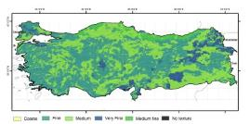
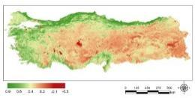
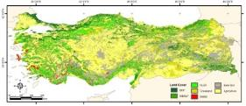
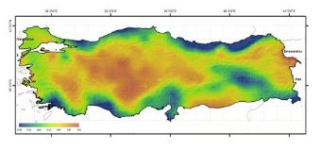
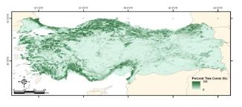
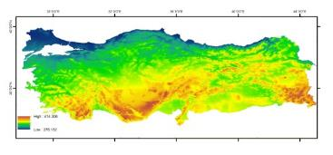
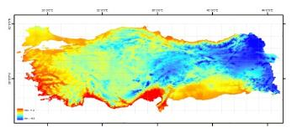
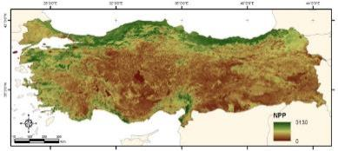
Net Primary Productivity (NPP)
NASA – CASA (Carnegie-Ames-Stanford Approach )
Soil texture
Land cover
NDVI
Precipitation
Percent tree cover
NASA-CASA Model
Solar radiation
Temperature
Present NPP
Future NPP
(under four IPCC scenarios)

Slide 7
Net Primary Productivity (NPP)
Estimation of percent tree cover
IKONOS and Geoeye images 4m-1m)
Multi- Temp. MODIS dataset (81 images)
(250m)
MODIS products
EVIs
NDVIs
Std. Of NDVIs
Max.NDVIs
Min. NDVIs
Mean NDVIs
Mean EVIs
Percent tree cover
Training dataset (80%)
Testing dataset (20%)
Stepwise linear Regression
(Variable selection)
Accuracy analyses
Regression tree model
Percent tree cover prediction
Regression tree model has 5 stages;
i. Creating the reference percent tree cover
ii. Pre-processing of the multi-temporal MODIS
dataset,
iii. Selecting the predictors by SLR,
iv. Application of the regression tree model and
validation
Mapping the percent tree cover by regression
tree model
Flow diagram of the regression tree
model

Slide 8
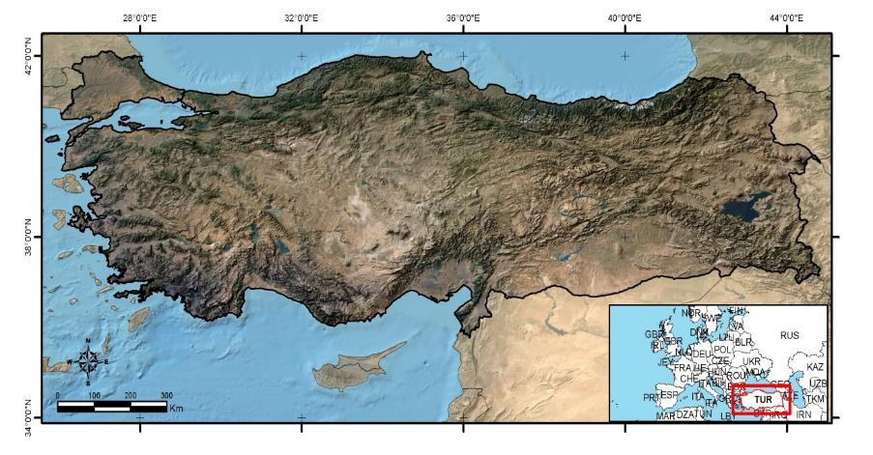
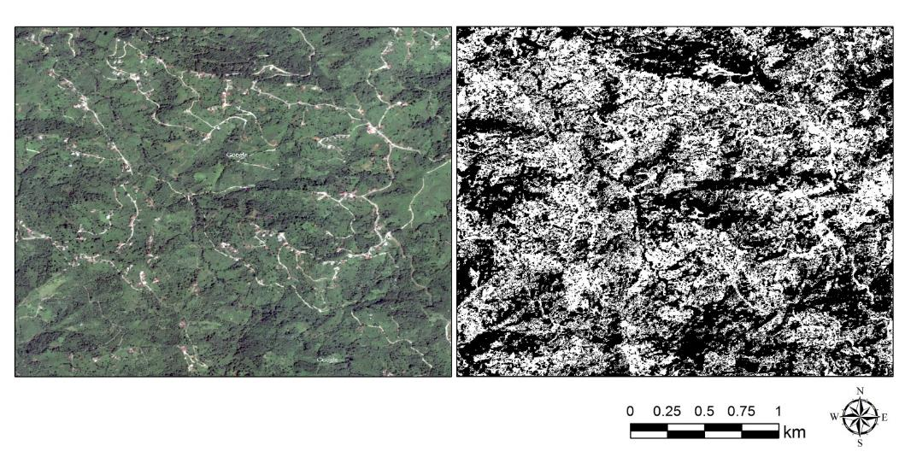
Net Primary Productivity (NPP)
Estimation of percent tree cover
Classified GeoEye-1 Image
9 GeoEye-1 Scenes were used
as training data
A sample GeoEye-1 Scene

Slide 9
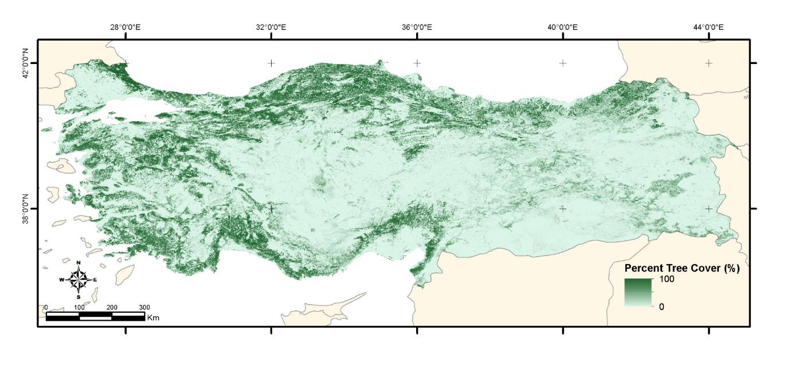
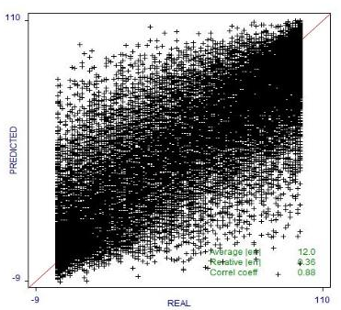
Net Primary Productivity (NPP)
Estimation of percent tree cover
Target attribute `dep'
Read 1109 cases (16 attributes) from tr10per_str.data
Model:
Rule 1: [424 cases, mean 26.6, range 0 to 89, est err 15.1]
if
band03 > 4448
band12 <= 31650
then
dep = 66.2 - 0.1033 band02 + 0.0509 band03 + 0.0388 band01
+ 0.0014 band07 - 0.0009 band06 + 0.0012 band04 - 0.0014 band08
+ 0.00012 band12 - 0.0007 band09 + 0.002 band05
Rule 2: [672 cases, mean 55.1, range 0 to 96, est err 16.5]
R = 0.88

Slide 10
Net Primary Productivity (NPP)
Mapping Land Cover
MODIS dataset, Topographic Maps, Geographic position, Cover Records/Ground Truth were utilised
The productive forest lands cover around 21 percent of the total study area. Decidious forestlands are dominant in norhtern part of Turkey and Conifers are dominant in southern and eastern part of Turkey.

Slide 11
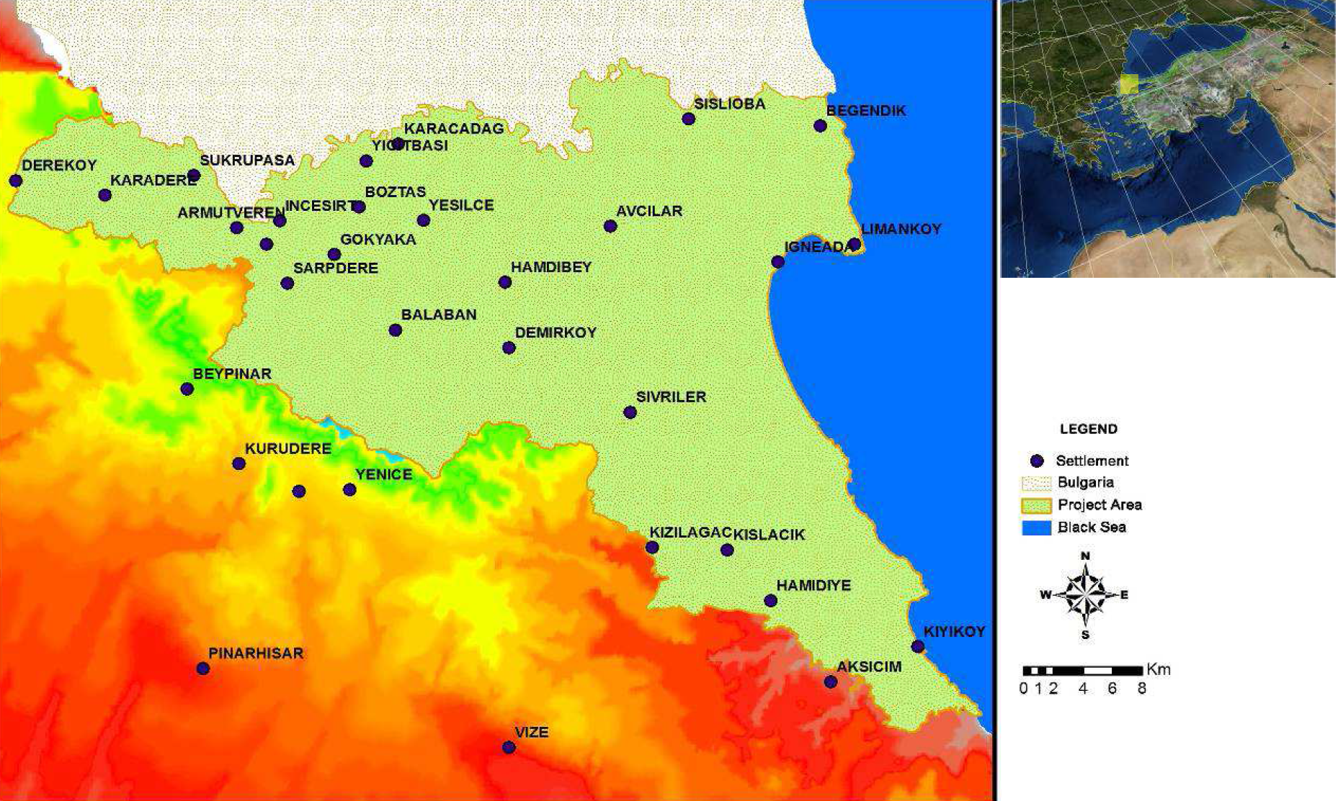
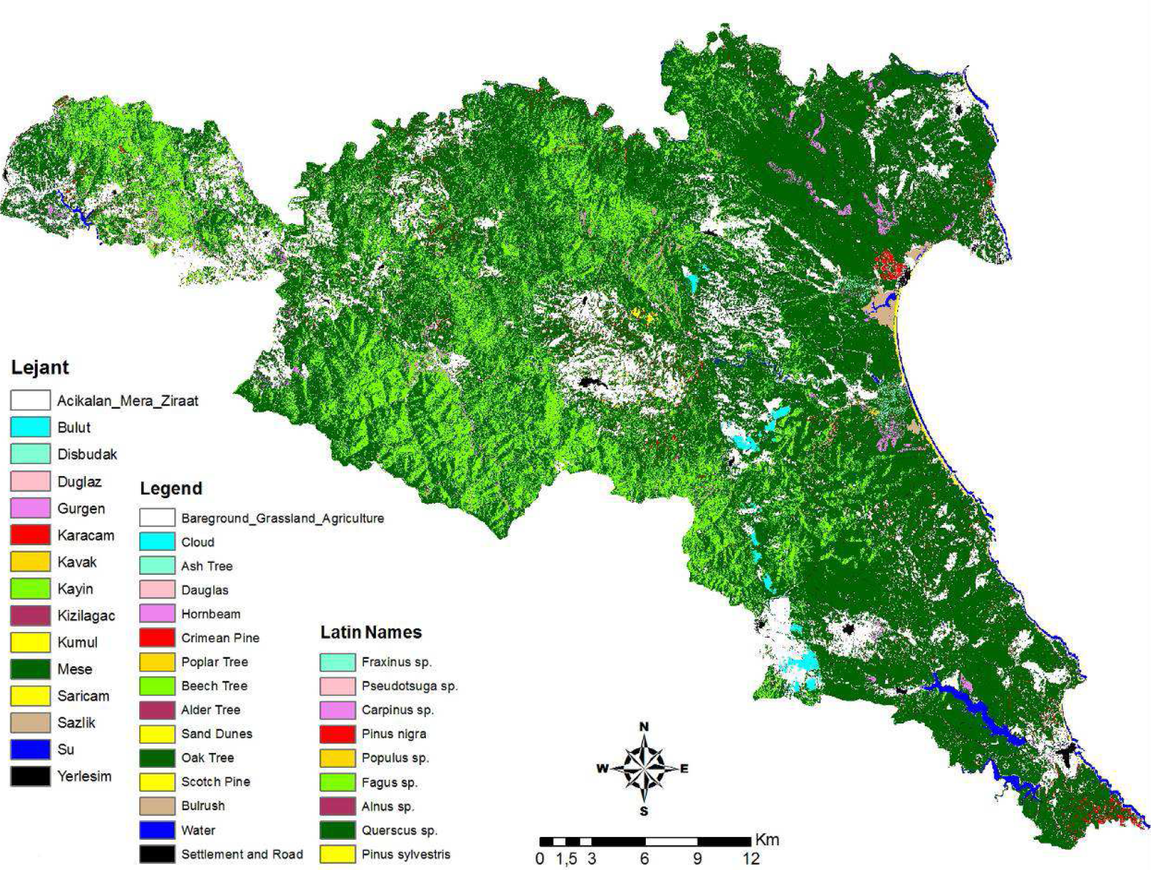
Net Primary Productivity (NPP)
Typical Northern Forest Trees (Black Sea forest types)in 4m resolution

Slide 12
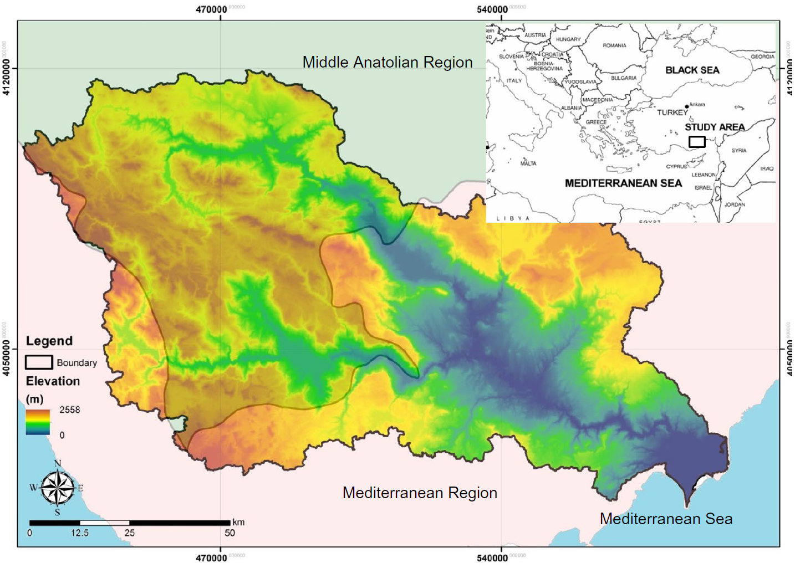
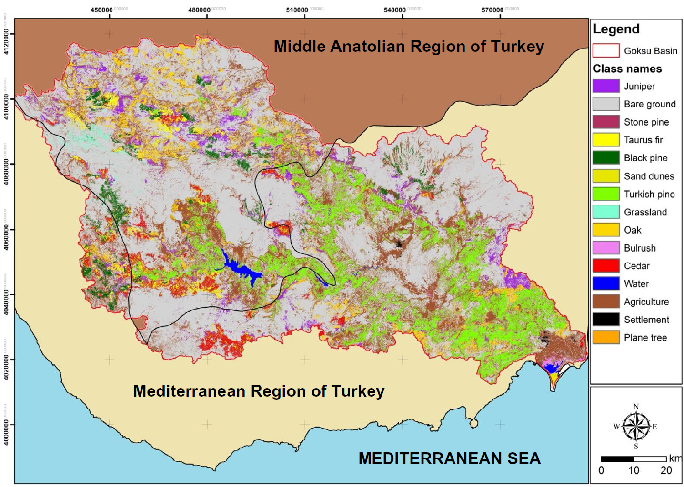
Net Primary Productivity (NPP)
Typical Southern Forest Trees (Mediterranean forest types)in 10m resolution

Slide 13
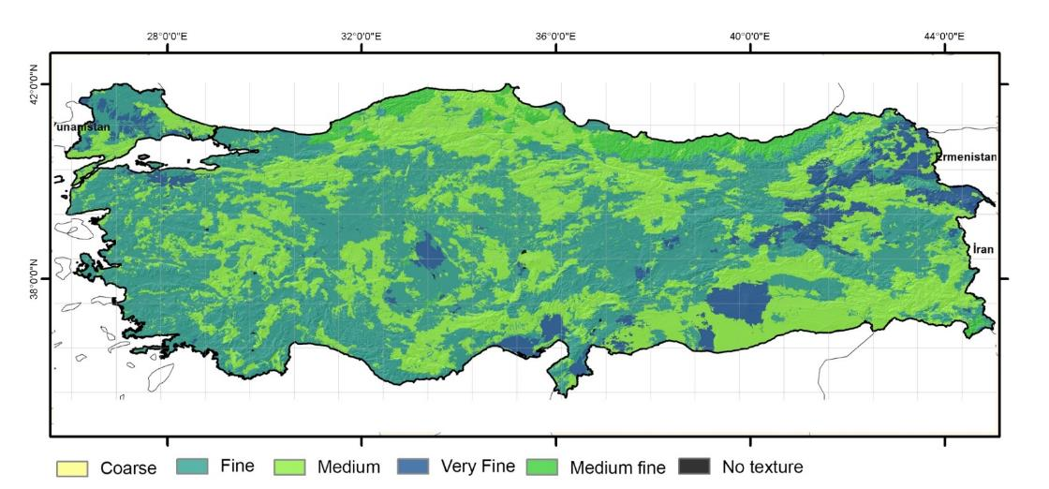
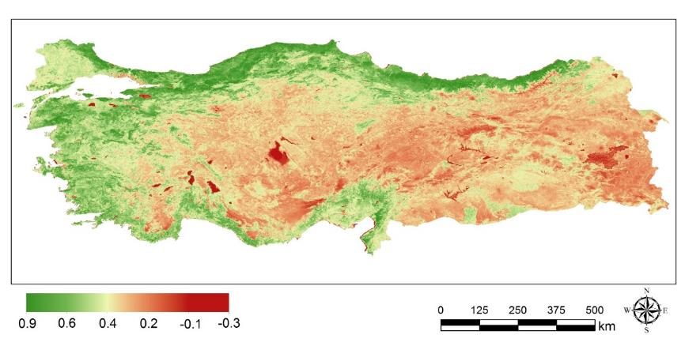
Net Primary Productivity (NPP)
Soil Texture Map
Normalised Differences Vegetation Index (NDVI)

Slide 14
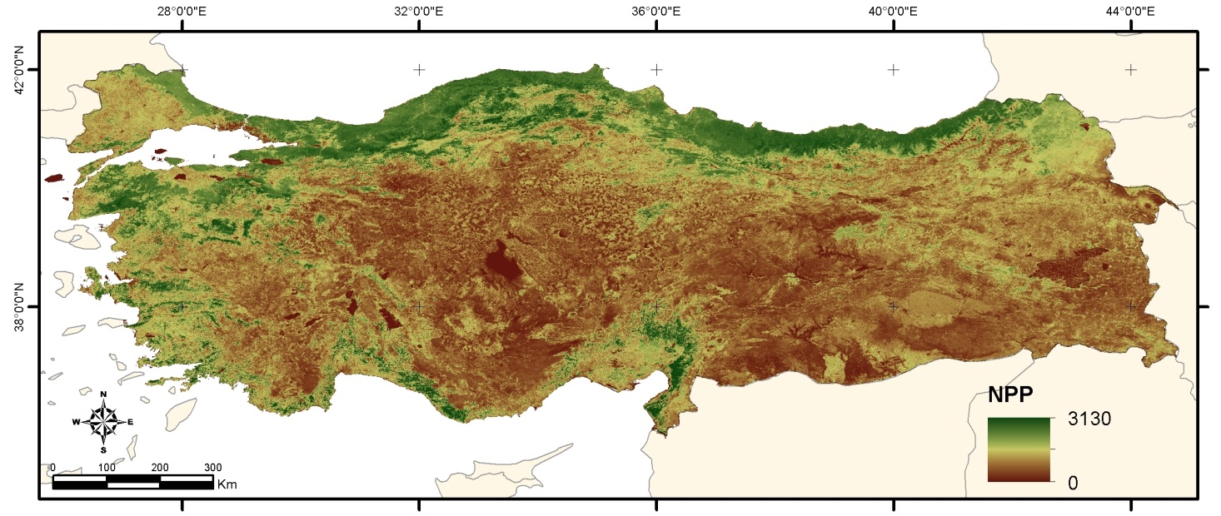
Net Primary Productivity (NPP)
Total Net Primary Production Map for 2001-2011

Slide 15
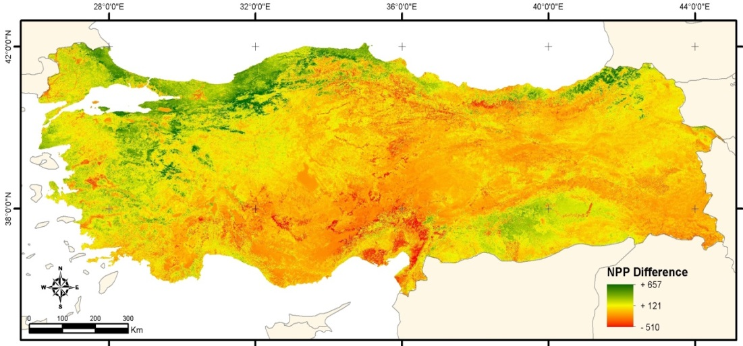
Net Primary Productivity (NPP)
Current – Future Difference NPP Maps from
2001-2011 to 2070-2080 simulation (RCP 4.5)

Slide 16
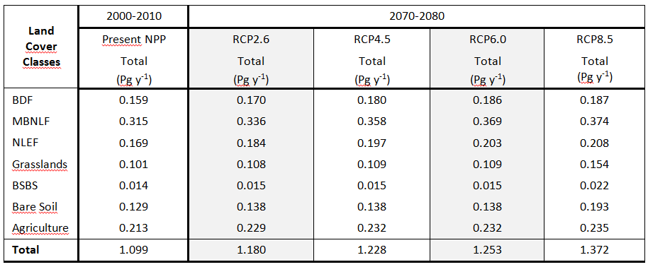
Net Primary Productivity (NPP)
Total Annual Forest NPP (2001-2011): 0.64 Pg y-1 (Pg = Petagram = 10¹⁴ g)
Annual Total NPP Estimations and their responses to different climate scenarios for Turkey:
(Pg y-1) | RCP2.6 | RCP4.5 | RCP6.0 | RCP8.5
Total NPP Changes | +0.081 | +0.048 | +0.025 | +0.12

Slide 17
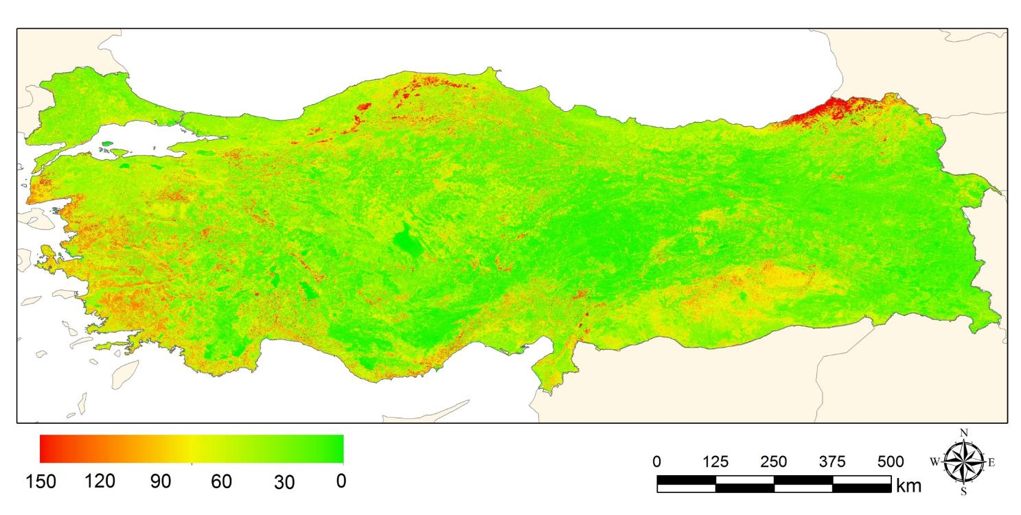
Net Primary Productivity (NPP)
Standard Deviation Map of the 2001-2011 to 2070-2081 simulations
NPP (g C m-2 y-1

Slide 18
Modelling works
EROSION- Pan-European Soil Erosion Risk Assessment (PESERA)
PESERA Model; is integrated climate, vegetation, topography and soil datasets to calculate the surface runoff and soil erosion in one platform. More than 100 variables are needed.
Discription | Unit
Co-efficient of monthly precipitation variation of the rainy days. | -
Monthly potantial Evapotranspiration (pet) | mm
Annual precipitation | mm
Annual pricipitation for each days. | mm
Monthly mean temp. | °C
Monthly mean temp. Difference | °C
Future temp (Scenario) | °C
Future precipitation (Scenario) | mm
Monthly canopy for various LULCs | %
Dominant crop pattern | -
Secondary crop pattern | -
LULC | -
Corn crop pattern | -
Planting time and harvest time of the dominant crops | -
Planting and harvest times of the secondary crops | -
Planting and harvest times for the corn | -
Surface water capasity | mm
Monthly surface roughness co-efficiency | %
Plant rooth depth | mm
Drying time | mm
Erodibility | mm
Efficient water capasity | mm
Water quantity (0-30 cm) | mm
Water quantity for plants (30-100 cm) | mm
DEM | mm

Slide 19
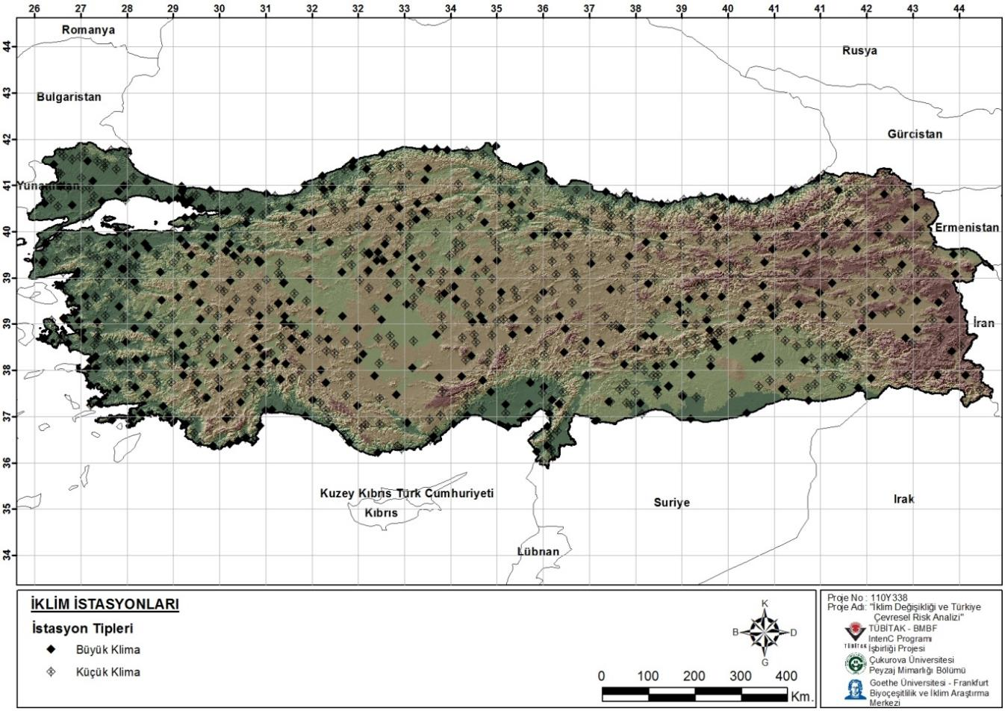
EROSION - Pan-European Soil Erosion Risk Assessment (PESERA)
Climate stations
Big climate stations
Small climate stations

Slide 20
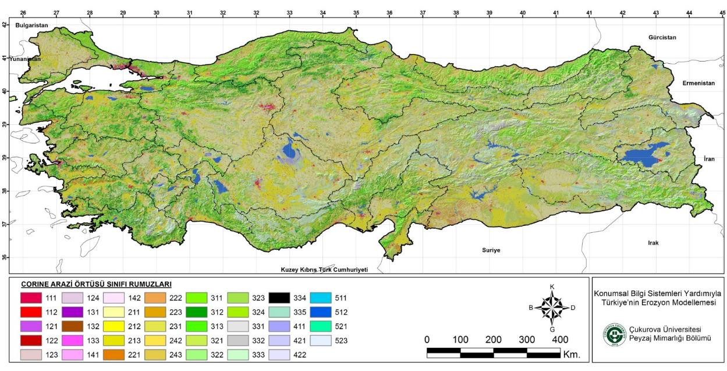
Pan-European Soil Erosion Risk Assessment (PESERA)
CORINE (2006) Land cover

Slide 21
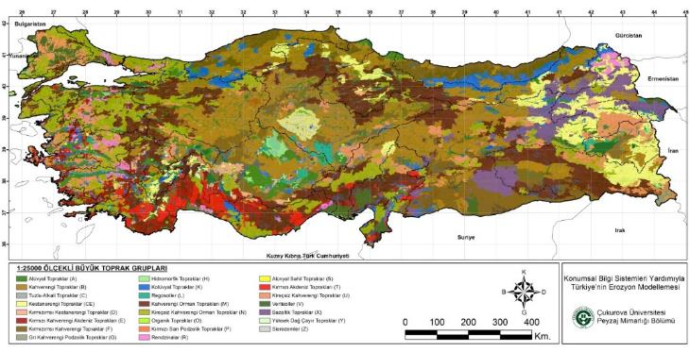
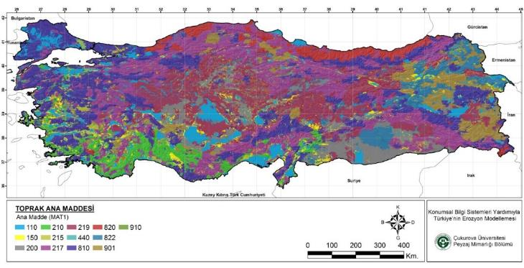
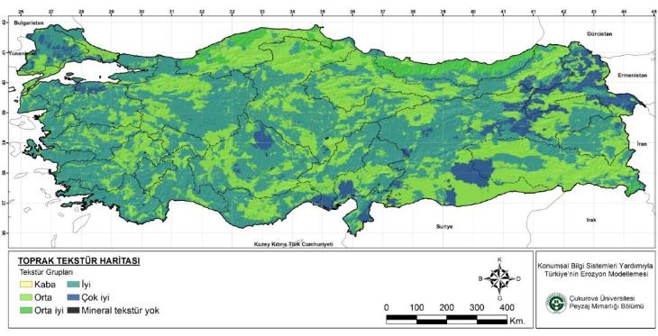
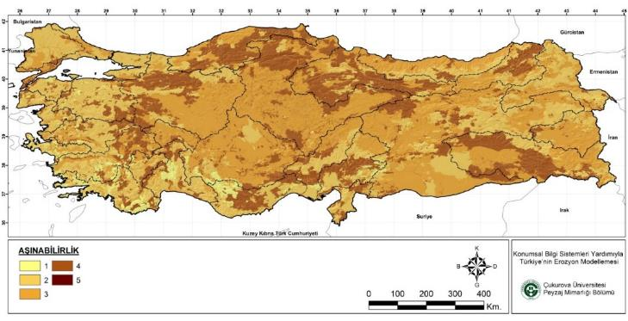
Pan-European Soil Erosion Risk Assessment (PESERA)
Soil Map
Parent Material
Soil Texture
Erodibility

Slide 22
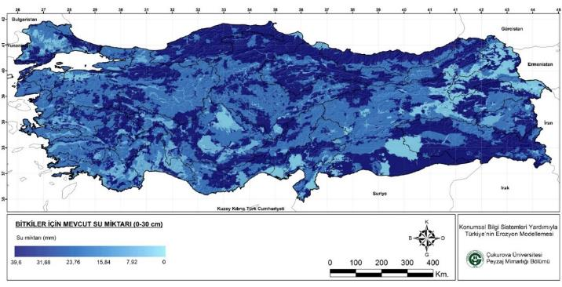
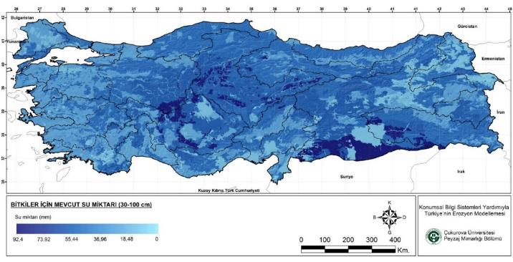
Pan-European Soil Erosion Risk Assessment (PESERA)
Soil water available to plants : (300mm and 1000mm depth)
Soil water available to plants in top 300mm
Effective soil water storage capacity

Slide 23
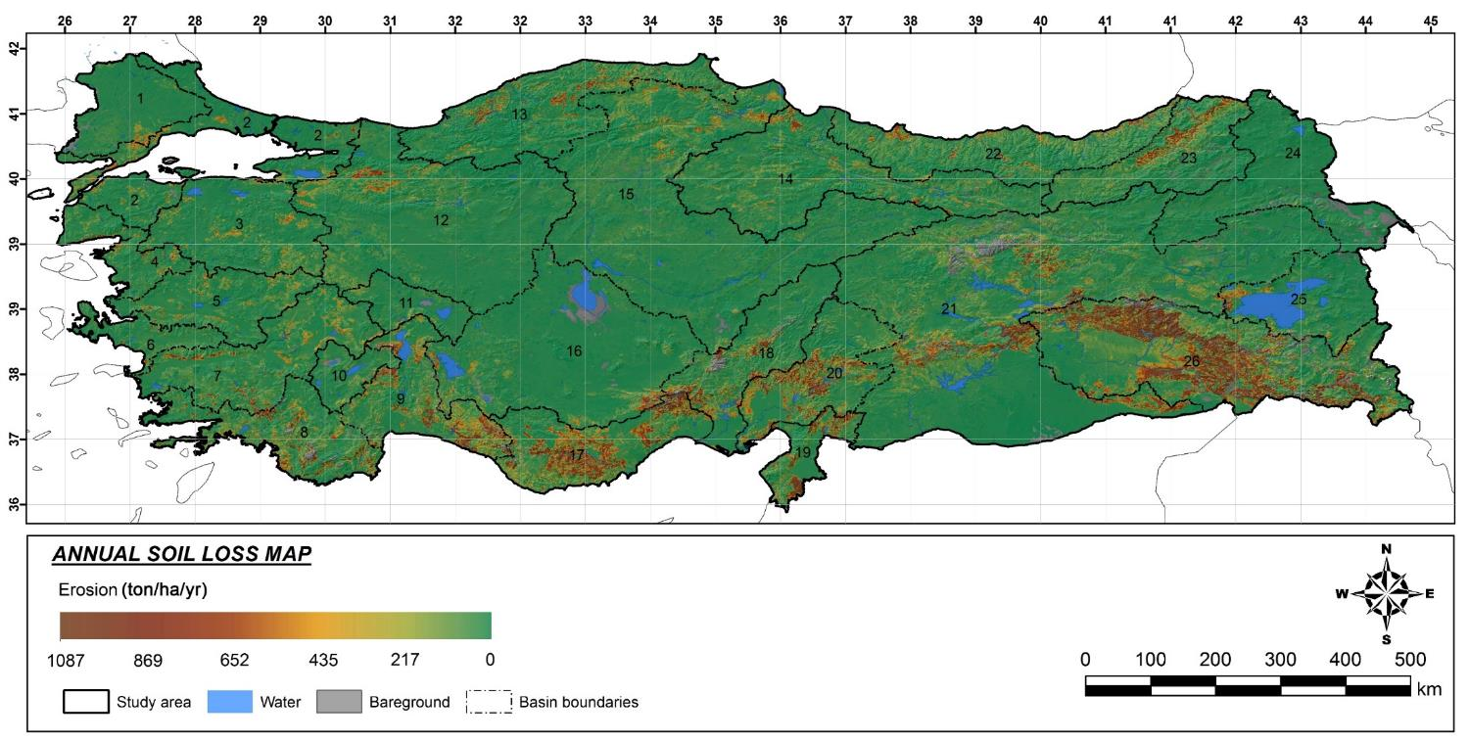
EROSION - Pan-European Soil Erosion Risk Assessment (PESERA)
YILLIK TOPLAM EROZYON

Slide 24
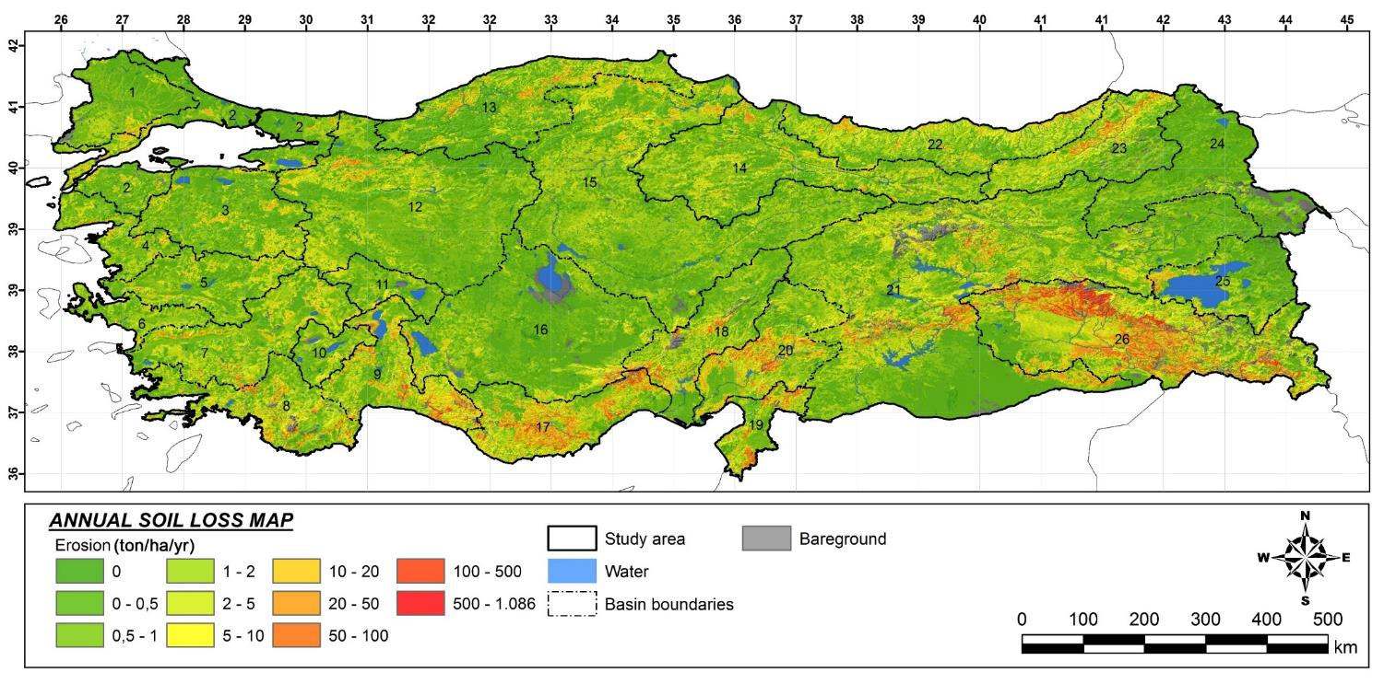
EROSION- Pan-European Soil Erosion Risk Assessment (PESERA)

Slide 25
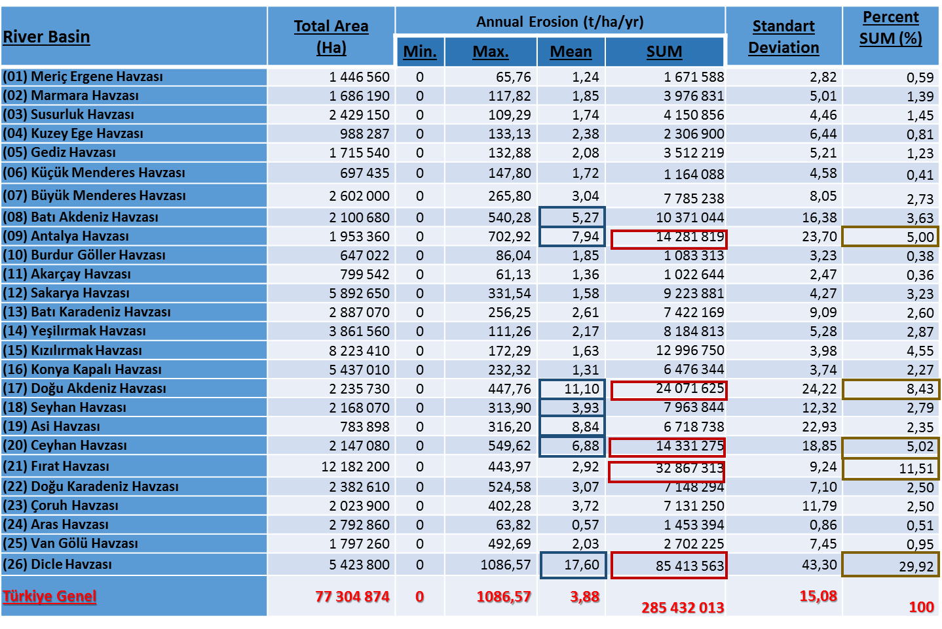
EROSION - Pan-European Soil Erosion Risk Assessment (PESERA)
The amount of soil loss 285.5 millions tonnes
The mean soil losses are 3.88 t/ha/yr

Slide 26
EROSION-Pan-European Soil Erosion Risk Assessment (PESERA)
Soil loss According to PESERA Land Use
PESERA Land Use Code | Area (ha) | Total Erosion (t/ha/yr) |  | Standart Deviation
 |  | Mean | SUM
100 / Cultural lands | 1199460 | 0,99 | 1 187 969 | 3,13
210 / Agriculture | 17807600 | 3,12 | 55 472 688 | 8,14
221 / Vineyards | 267594 | 5,90 | 1 578 919 | 14,66
222 / Fruit gardens | 405713 | 3,06 | 1 241 663 | 8,68
223 /Olive lands | 362650 | 10,06 | 3 648 850 | 18,33
231 / Grasslands | 10418500 | 0,25 | 2 655 225 | 1,01
240 / Heterogen agricultural fields | 12331600 | 1,58 | 19 505 563 | 5,20
310 / Forestlands | 12112700 | 0,29 | 3 556 431 | 0,73
320 / Shrublands | 8355550 | 11,36 | 94 921 875 | 27,29
334 / Degraded natural lands | 10227400 | 9,95 | 101 721 250 | 27,06

Slide 27
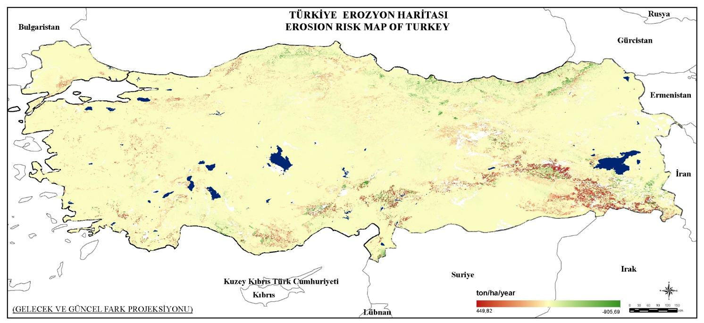
EROSION- Pan-European Soil Erosion Risk Assessment (PESERA)
FUTURE – CURRENT EROSION DIFFERENCE

Slide 28
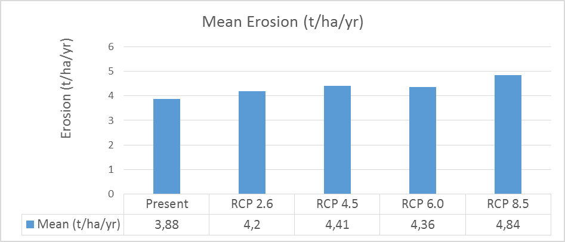
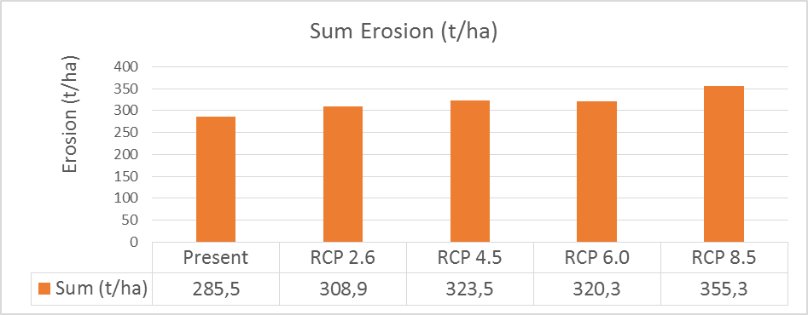
EROSION- Pan-European Soil Erosion Risk Assessment (PESERA)
EROSION CHANGE

Slide 29
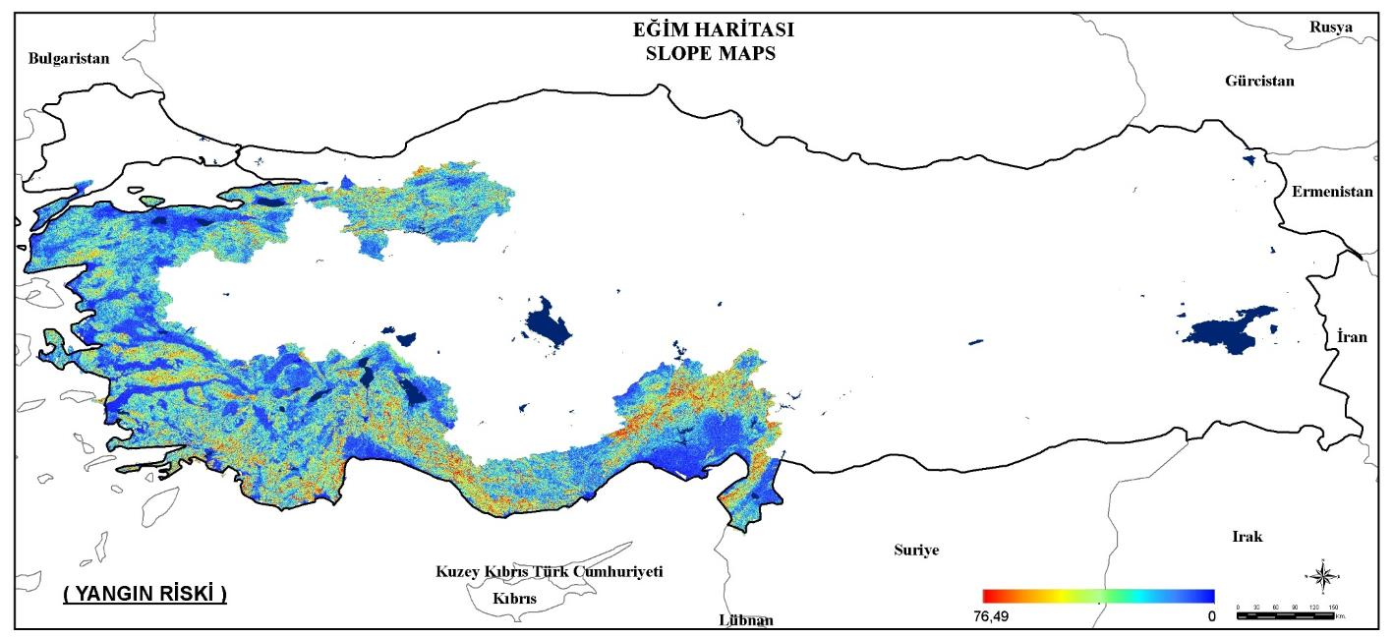
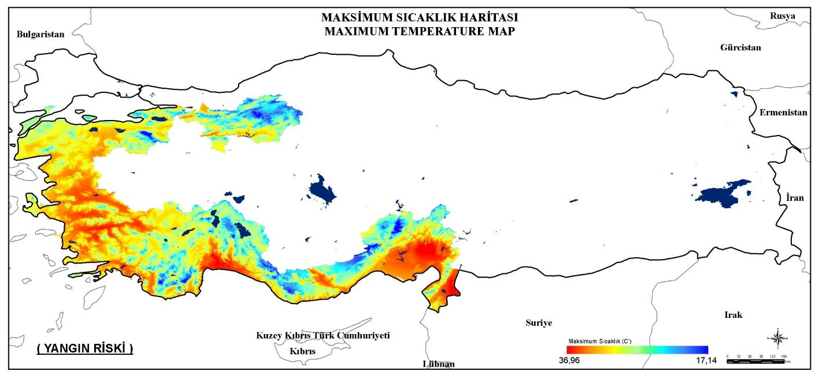
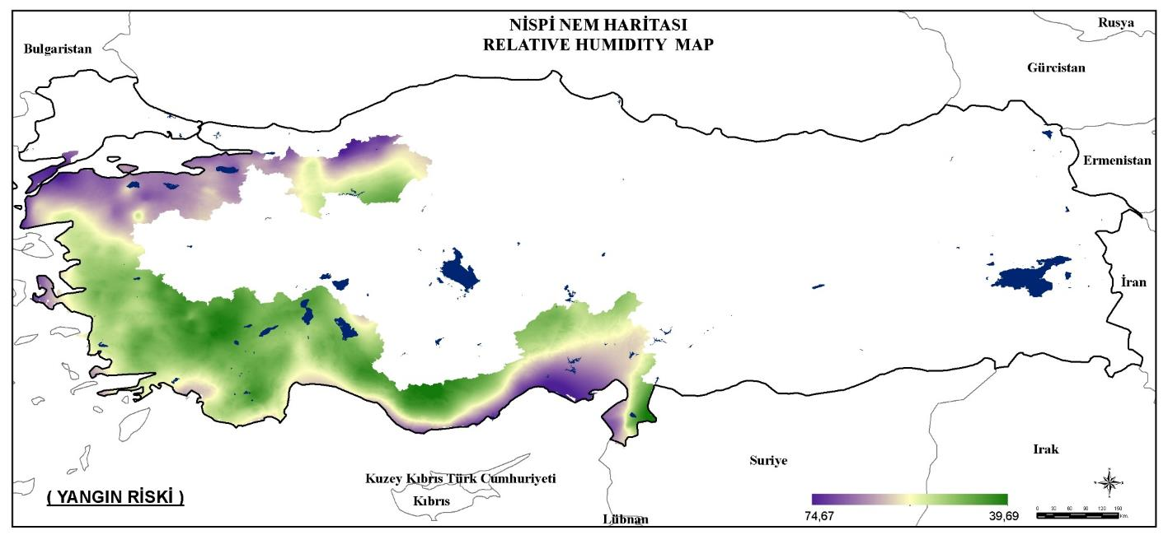
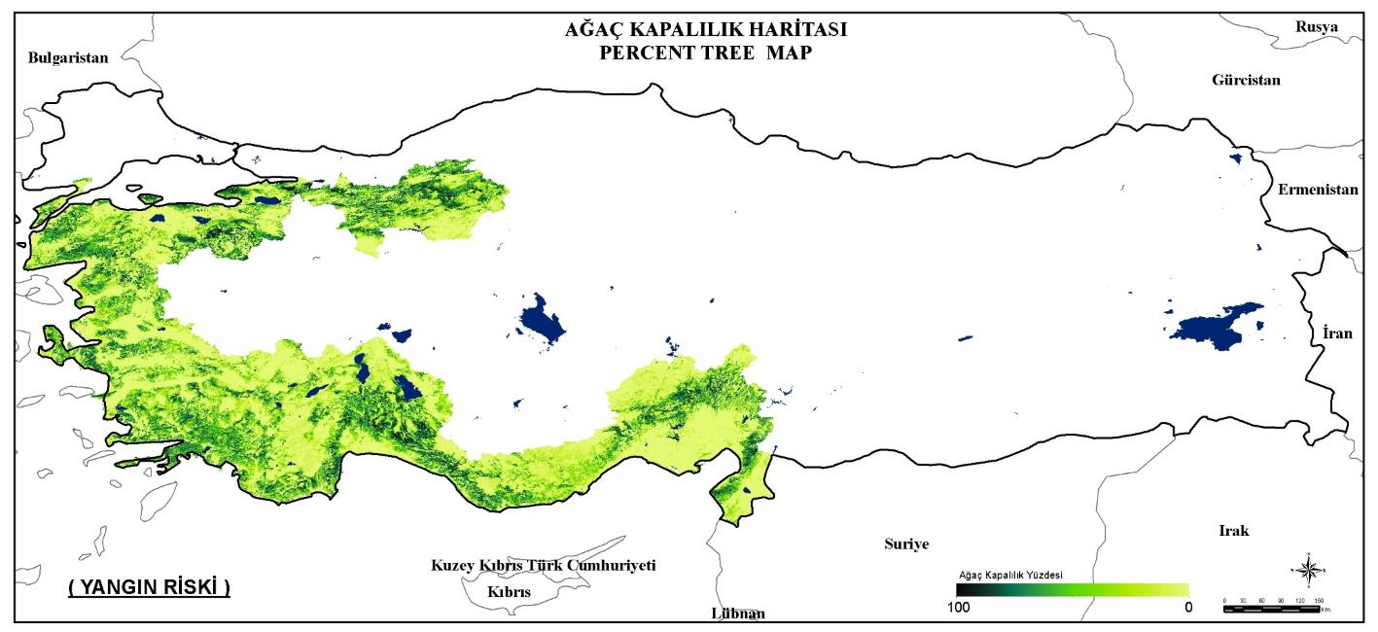
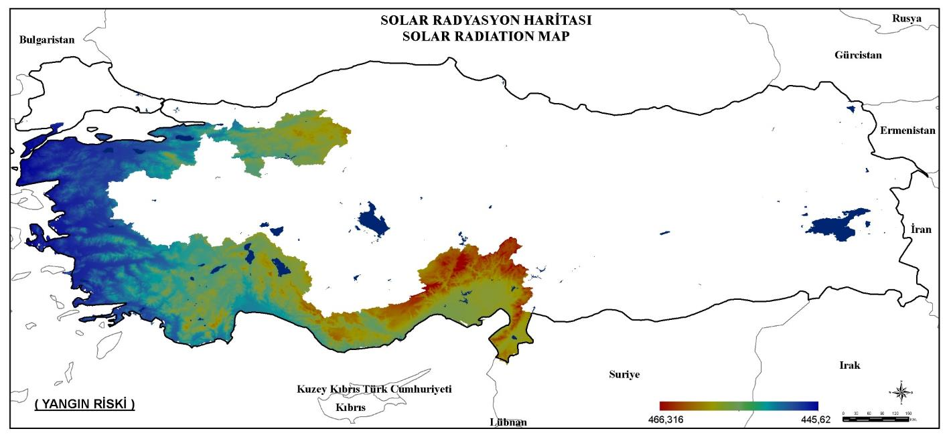
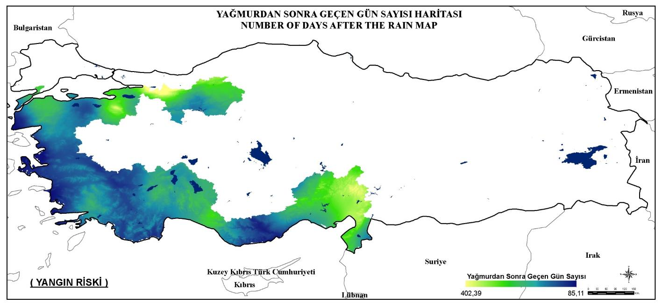
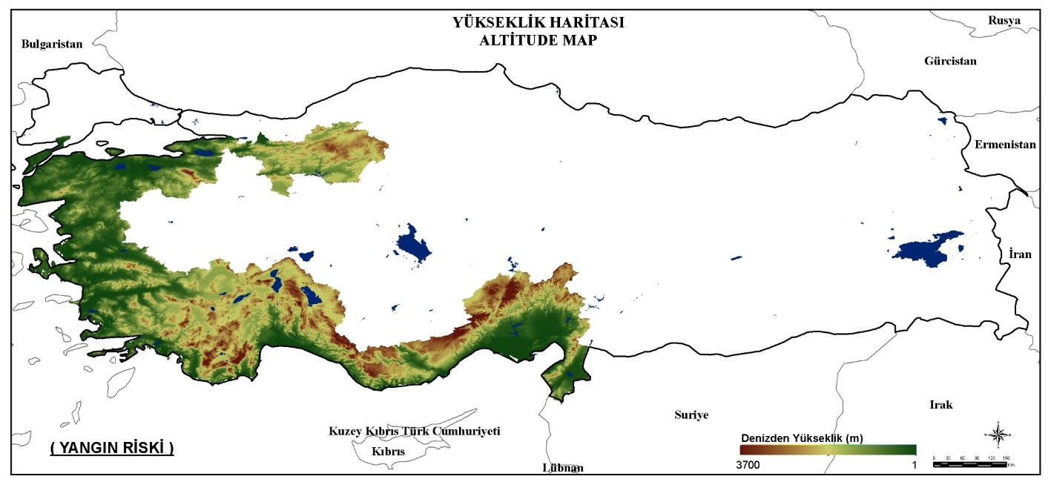
Forest fire risk
14 variables were evaluated using Multi-criteria evaluation approach
DEM
Distance from farmlands
Energy lines
Slope
Population density
Dis. From roads
Amount of Fuel
Fuel type
Max Temperature
Tree cover
Wind speed
Arid days
Solar Radiation
Relative humudity

Slide 30
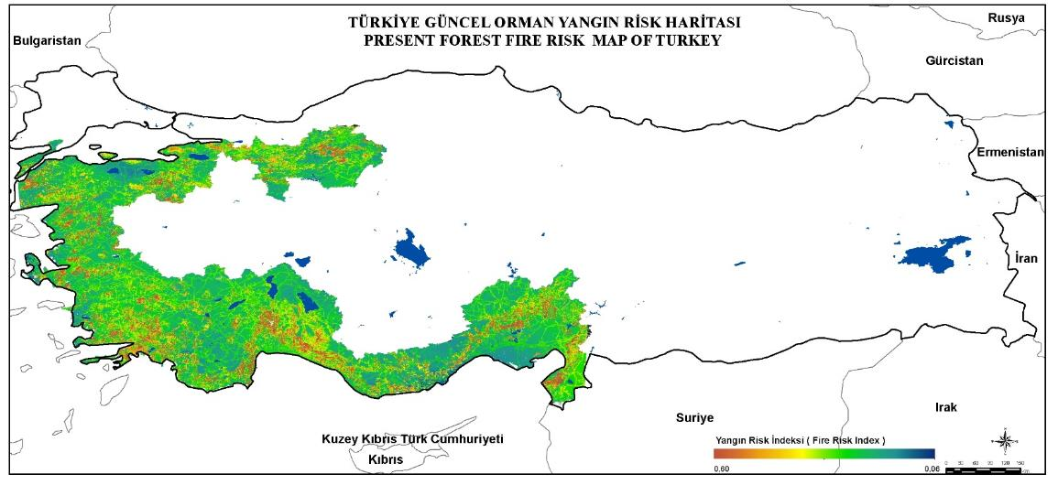
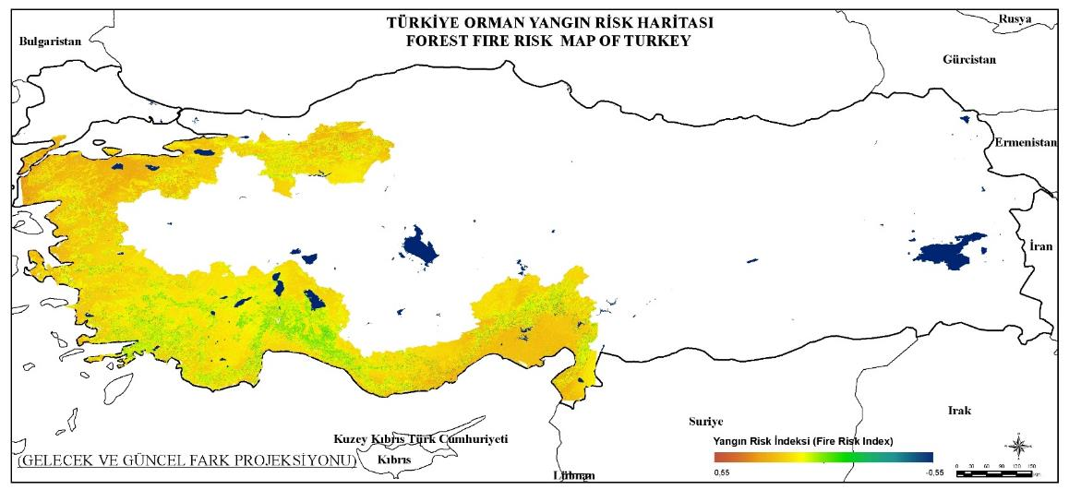
Orman Yangın riski – Forest fire risk
CURRENT FIRE RISK
FUTURE-CURRENT FIRE RISK

Slide 31
Aridity index
UNESCO (1979)
potential evapotranspiration - Penman–Monteith
Hyper-arid Zone |  | P/ETo < 0.9
Arid Zone | 0.9 ≤ | P/ETo < 6.0
Semi-arid Zone | 6.0 ≤ | P/ETo < 15.0
Sub-humid Zone | 15.0 ≤ | P/ETo < 22.5
Humid Zone | 22.5 ≤ | P/ETo

Slide 32
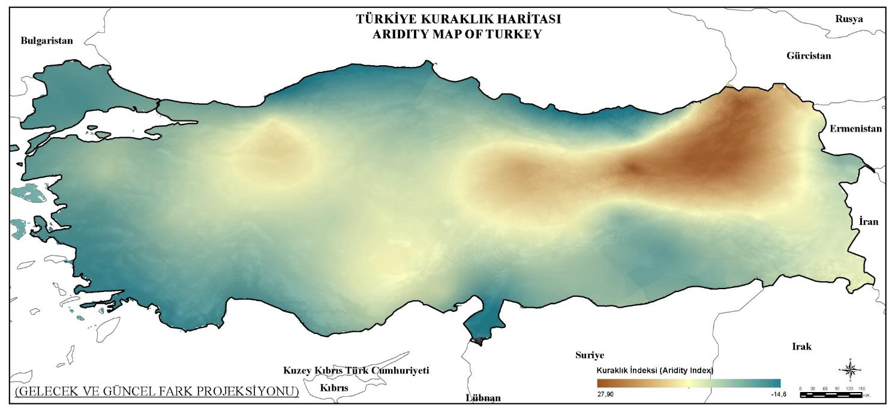
Aridity index
CURRENT – FUTURE ARIDITY
Increases in temperature resulted in a higher evaporative demand of the atmosphere in the future Thus, an increase in aridity was recognized for whole Turkey except the north-eastern part.

Slide 33
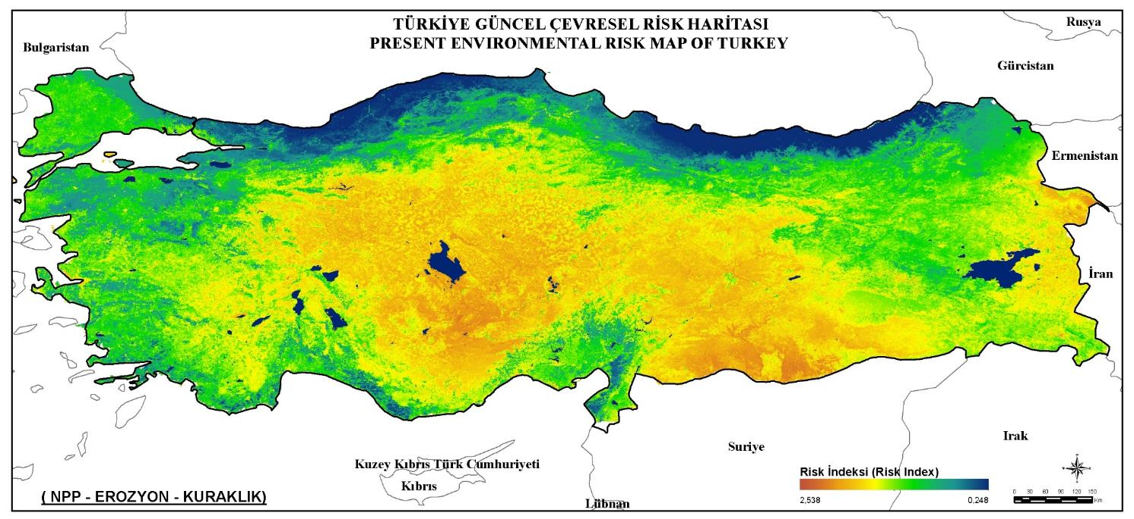
Results & Conclusions
Integration of standardized risk maps
NPP + Erosion + Aridity

Slide 34
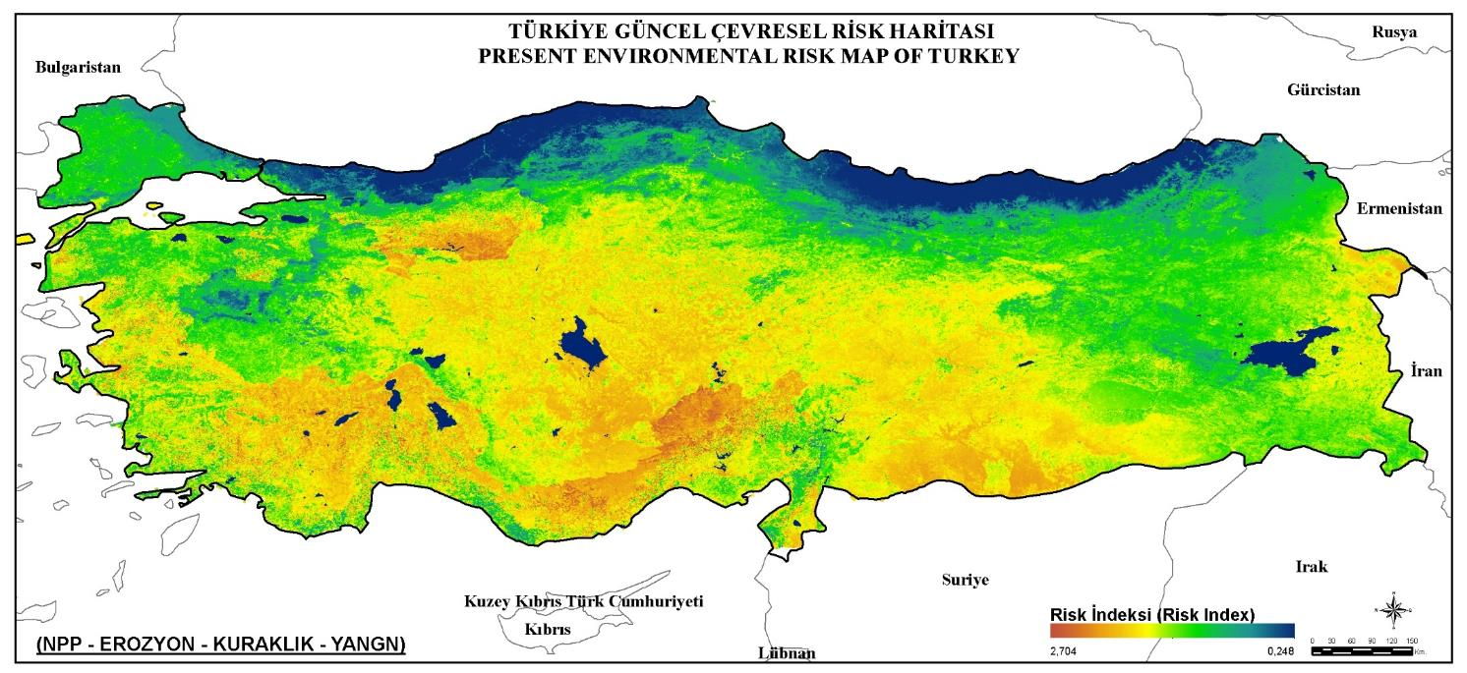
Results & Conclusions
Integration of standardized risk maps
NPP + EROSION + ARIDITY + FIRE RISK

Slide 35
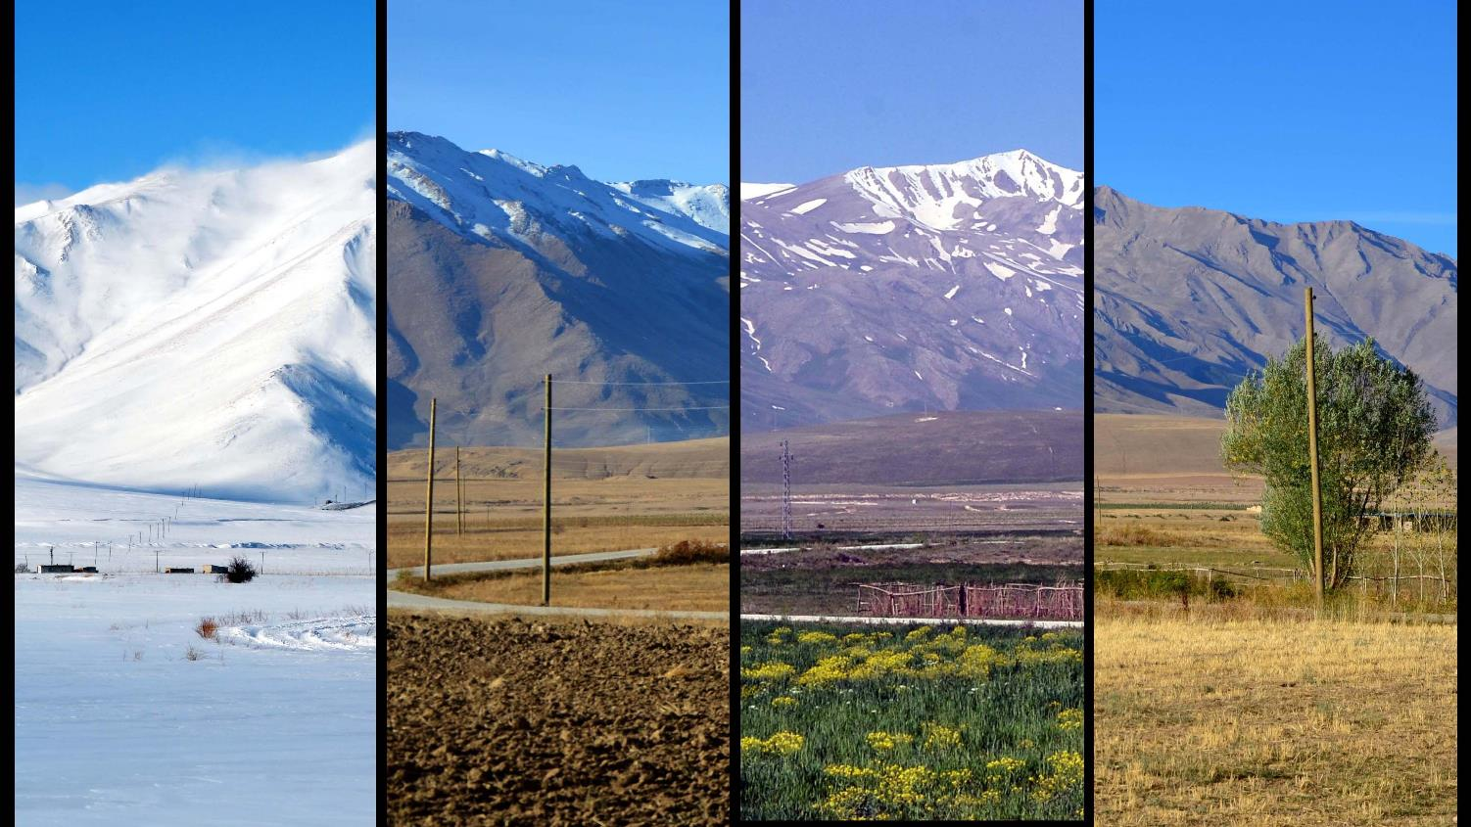
Four seasons from the Van Sub-alpine region of Turkey.
THANK YOU VERY MUCH FOR YOUR ATTENTION
ASSIST.PROF. ONUR ŞATIR
Yuzuncu Yil (Centennial) University
Department of Landscape Architecture
Landscape Planner E-Mail: osatir@yyu.edu.tr
YUZUNCU YIL UNIVERSITY
ARCHITECTURE & DESIGN FACULTY

