Slide 1
GOFC-GOLD Land cover team activities and the regional networks:
Some experiences and prospects
Martin Herold
Wageningen University

Slide 2
GOFC-GOLD: active support of UN Conventions, Global Assessment, Users & Monitoring Programs
Coordinate land cover community ECV input to the WMO Global Climate Observing System (UNFCCC, GCOS)
Community consensus guidance (i.e. validation, REDD+ Sourcebook, Biodiversity)
Coordinate R&D of Global Forest Observations Initiative (GFOI)
Develop Worldbank Forest Carbon Partnership training materials / eLearning tools
Support to space agencies and global land monitoring programs (user needs, standards)
Promote transparency and free & open source data and tools
http://www.gofcgold.wur.nl/

Slide 3
GOFC-GOLD: R&D coordination for the GFOI
Advocacy role for novel data and approaches: potential and limitations
Assessing country needs to define R&D priorities and stimulate research and funding
Data access
R&D teams addressing priorities in dedicate projects
Space Data
Country needs / capacities
Funding
Research
Capacity building
R&D coordination
Development of training materials and joint capacity building activities
Methods & Guidance
Research synthesis (expert workshops) on key issues (countries, donors) and regular updates of guidance documents (GFOI MGD)

Slide 4
Training materials for REDD+ monitoring
14 modules: lectures, country examples, exercises
3 languages (English, French, Spanish)
30+ authors, regular updates incl. scientific synthesis
Regional workshops (Asia, Africa, Latin America)
Recorded lectures and E-learning tools and webinars
http://www.gofcgold.wur.nl/redd/training-materials/ https://www.forestcarbonpartnership.org/redd-training-material-forest-monitoring

Slide 5
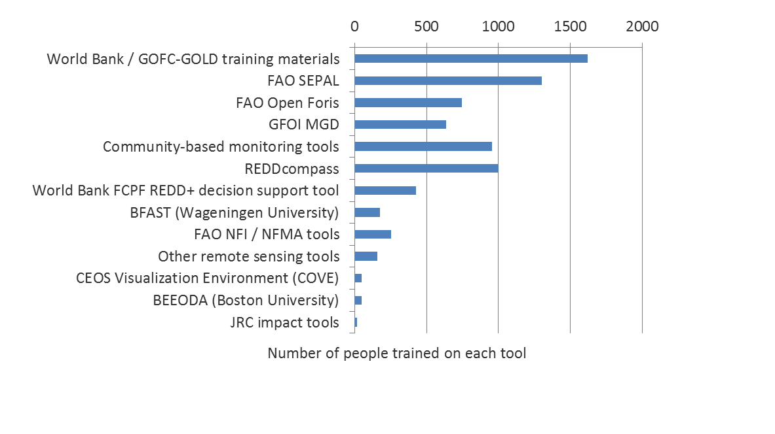
4 training the trainers workshop – multiplier effect
Notes:
6 months later...
These are assuming that the respondents are representative of all the participants (so are for the entire cohort who participated in the workshops)
Most training sessions (which the participants did) had women in... Although not many women

Slide 6
Land monitoring, transparency and the Paris Agreement
Forests strong in Paris agreement (Art. 5) versus efforts should not harm food production (Art.2)
Land use sector is unique, i.e. in its large negative emissions potential (1,5-2 degree target):
Forests - only proven Carbon Capture & Storage
Key issues:
Enhancing transparency framework
Regular stock-taking by countries
Global stocktake
Stimulating and implementing activities (bottom up)

Slide 7
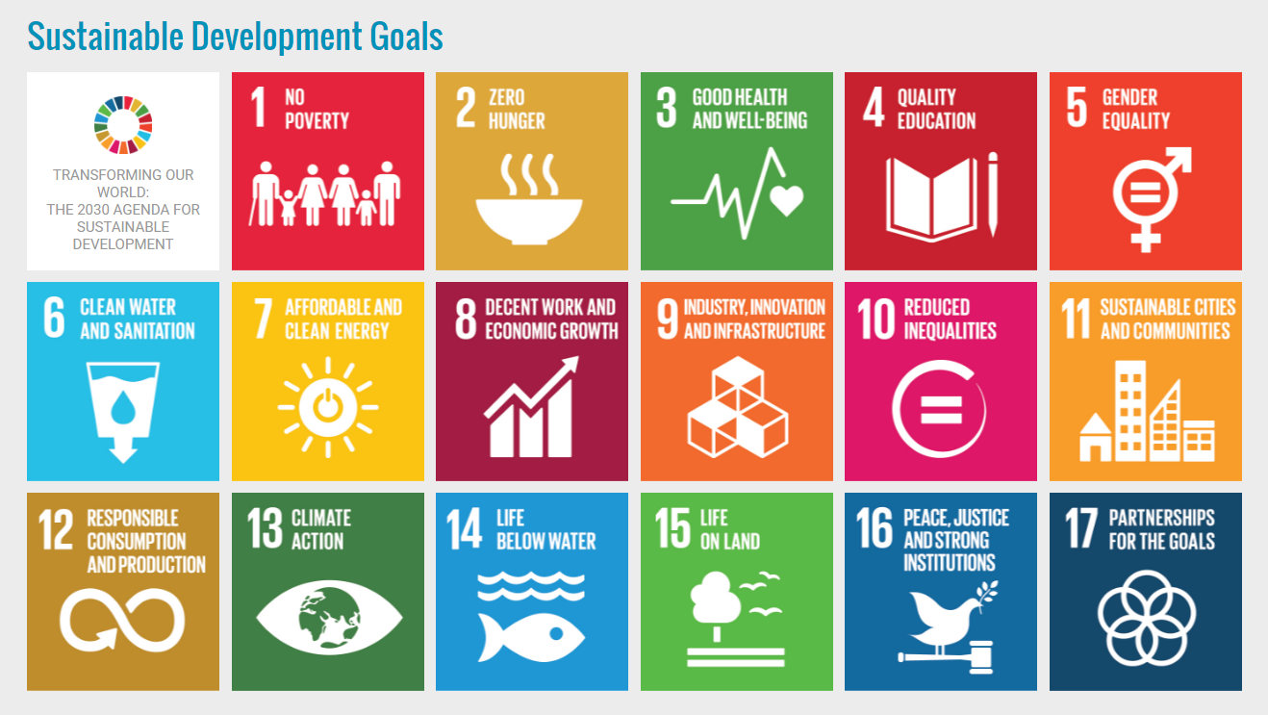
Land cover/use for Sustainable Development Goals
17 goals, 169 targets, 230 indicators
Land use / land cover datasets essential
Land use / land cover datasets complementary
GOFC-GOLD SDG assessment:
http://www.gofcgold.wur.nl/documents/newsletter/Sustainable_Development_Goals-infobrief.pdf
Notes:
Green circle: direct contribution of land monitoring: use land use/land cover datasets as essential datasets
Blue circle: additional contribution of land monitoring: use of land use/land cover datasets as complementary datasets

Slide 8
Land Cover Data for Sustainable Dev. Goals
SDGs |  | Land Use data | Land Cover data | Land Cover Change data | Biomass data (AGB) | Fire data (Active fires, burnt areas)
 | Zero hunger
 | Clean water
 | Industry
 | Cities
 | Consumption & production
 | Climate action
 | Life below water
 | Life on land
Importance of data for indicators in place to monitor targets/goals:
Essential | essential / complementary | Complementary | Not relevant
GOFC-GOLD SDG assessment: http://www.gofcgold.wur.nl/documents/newsletter/Sustainable_Development_Goals-infobrief.pdf

Slide 9
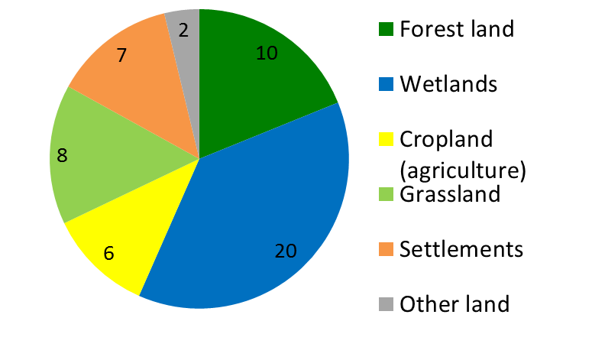
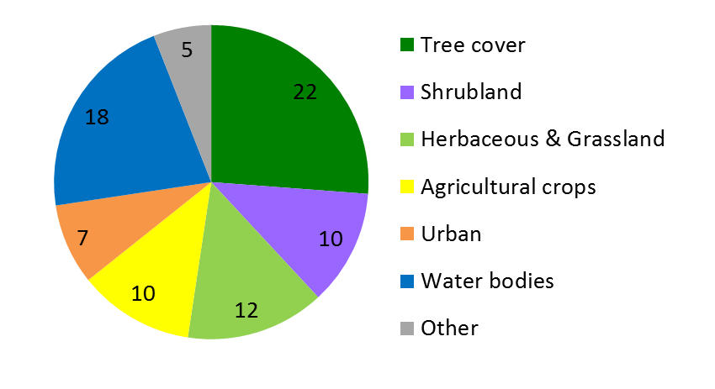
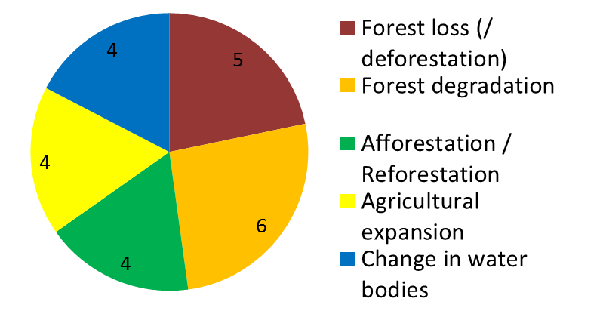
Data requirements for land sub-categories LU / LC monitoring provides important data to monitor 8 goals, 29 targets, and 33 indicators
Land Use data
Land Cover data
Land Cover Change data
GOFC-GOLD SDG assessment: http://www.gofcgold.wur.nl/documents/newsletter/Sustainable_Development_Goals-infobrief.pdf
# The numbers in the pie charts refer to the number of indicators for which the spatial data requirements apply.
Notes:
# The numbers in the pie charts refer to the number of indicators for which this type of data is needed.

Slide 10
CGLOPS: Copernicus global land monitoring service
100m dynamic global land cover
Serving multiple user needs
2015 onwards operational service with annual updates
Reference data collection and continuous improvements as integral part

Slide 11
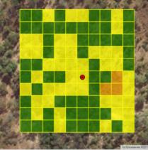
CGLOPS: Copernicus global land monitoring service
Operational validation (CEOS WGCV stage 4):
Flexible sampling design and reference data collection
Using GEO-WIKI interface
2015 onwards operational service with annual updates
Continuous reference data collection and continuous improvements as integral part
Reference data interpretation by regional experts
Role for RNs
Africa 2015 – Miombo network
Aim to go global within the next year

Slide 12
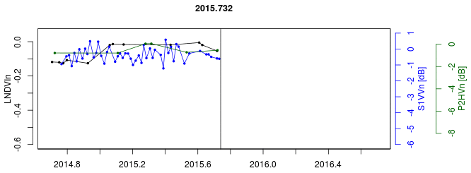
Near-real time monitoring example
Landsat
Sentinel-1
PALSAR-2
Credit: Johannes Reiche

Slide 13
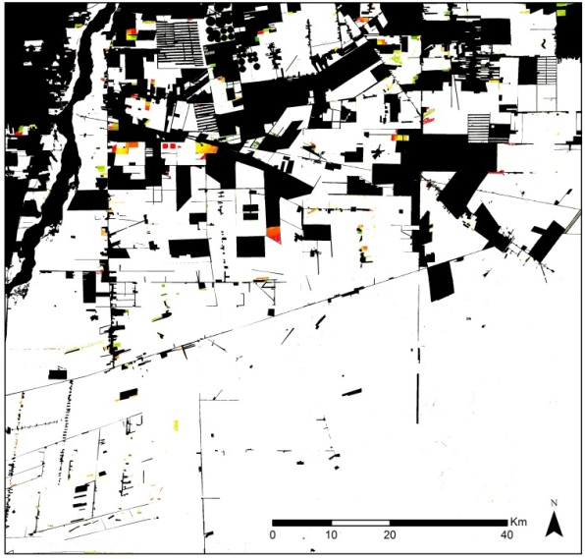
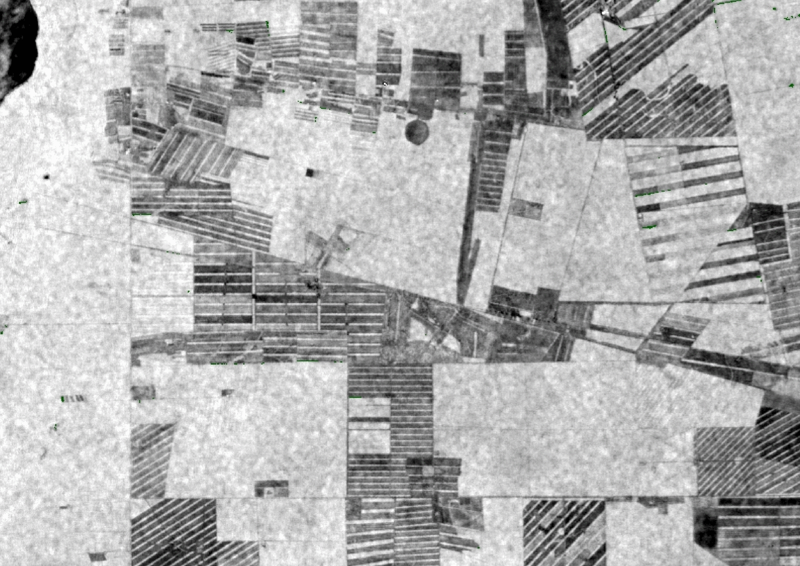
Detected deforestation
(10/2015 - 09/2016)
Temporal accuracy (Mean time lag of detected changes)
Landsat = 60 days
Sentinel-1 = 27 days
Multi-sensor = 19 days

Slide 14
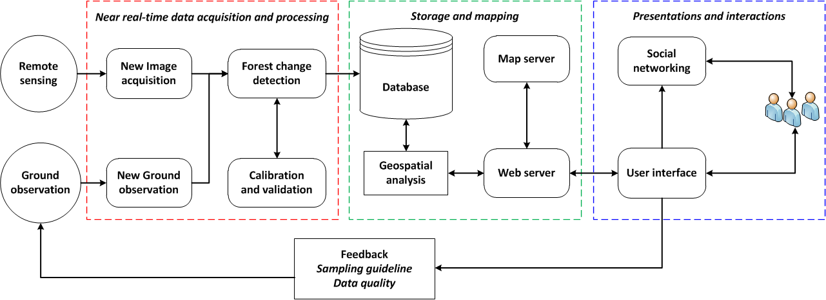
Interactive forest monitoring system
http://www.wageningenur.nl/cbm
Operational forest change monitoring in Kafa Biosphere Reserve, Ethiopia in near-real time mode since Oct. 2014
Inception for system at national and local level in Peru – joint research incl. multi-level governance
New PLOS-One collection of 12 research papers on feasibility and case studies:
http://collections.plos.org/redd

Slide 15
Some open source Landsat/Sentinel time series tools
bfast (/ bfastmonitor) - http://bfast.r-forge.r-project.org/
strucchange - http://cran.r-project.org/web/packages/strucchange/index.html
bfastSpatial - http://github.com/dutri001/bfastSpatial
timeSyncR - http://github.com/bendv/timeSyncR
rgrowth - http://github.com/bendv/rgrowth
MulTiFuse - http://github.com/jreiche/multifuse

