Slide 1
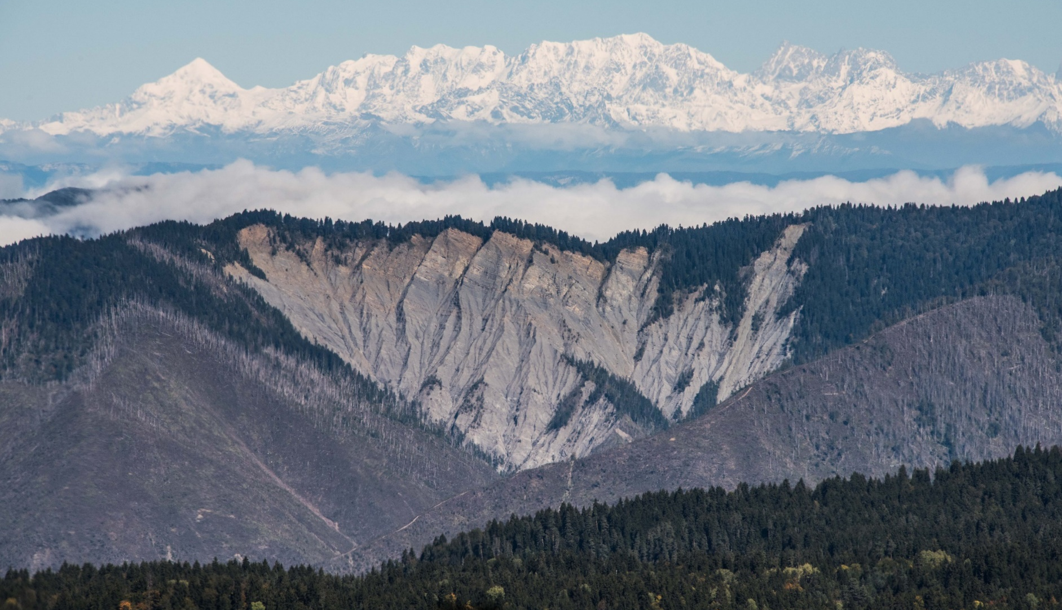
Johanna Buchner – University of Wisconsin-Madison
Tbilisi – September 12th
Caucasus Regional Network Kick-off Meeting
Effects of Armed conflicts and other Socio-economic Shocks on Land Use Change in the Caucasus
SILVIS Lab
buchner2@wisc.edu
Spatial Analysis for Conservation and Sustainability

Slide 2
Background
SILVIS Lab
buchner2@wisc.edu
Spatial Analysis for Conservation and Sustainability

Slide 3
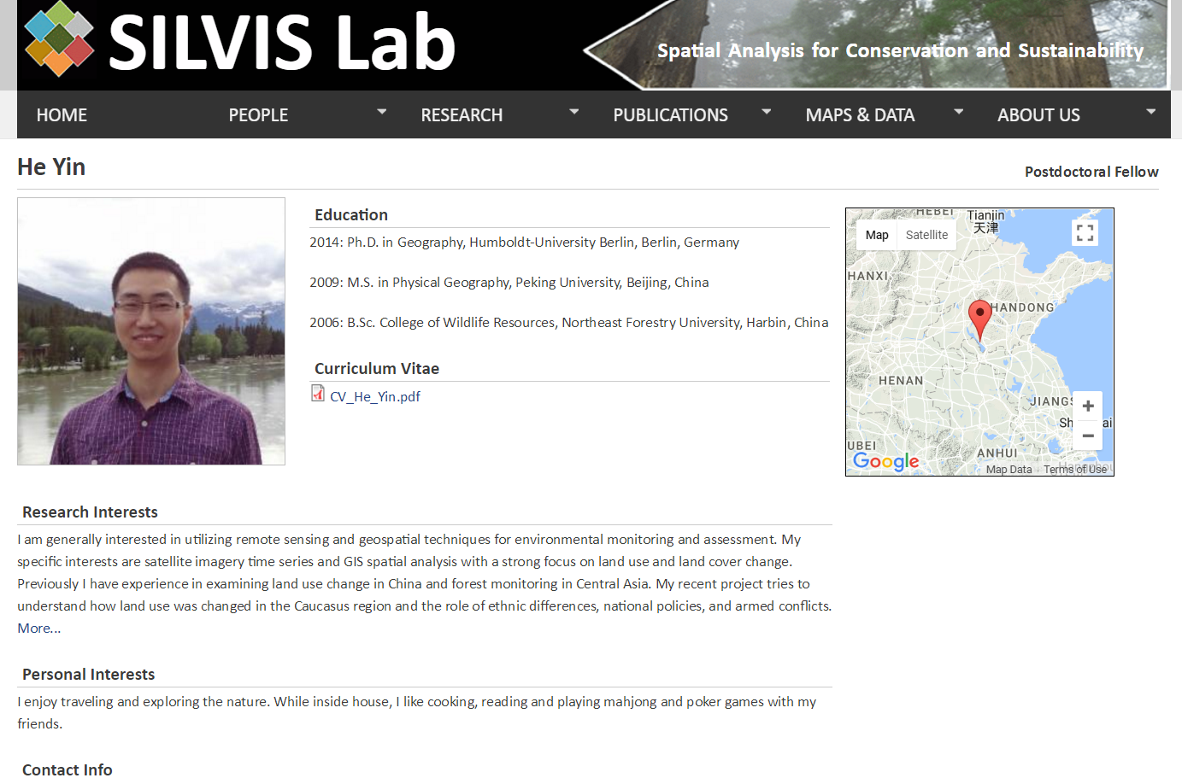
Background
hyin39@wisc.edu
SILVIS Lab
buchner2@wisc.edu
Spatial Analysis for Conservation and Sustainability

Slide 4
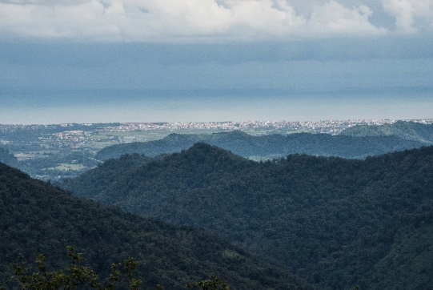
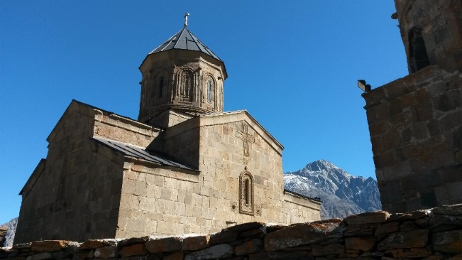
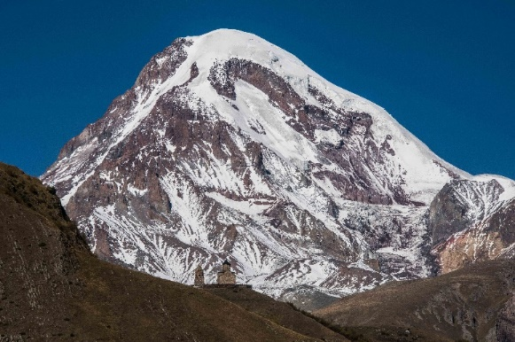
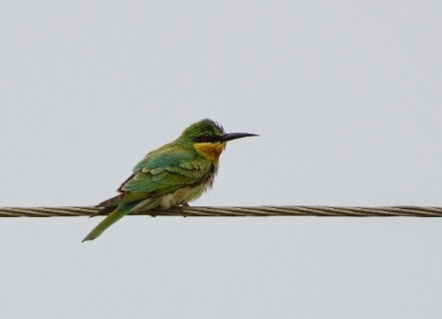
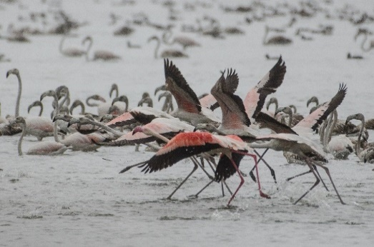
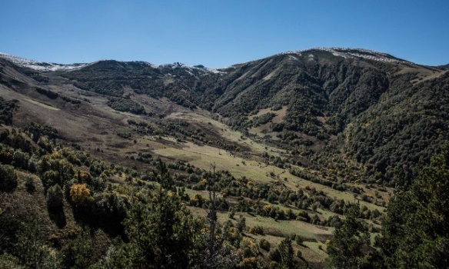
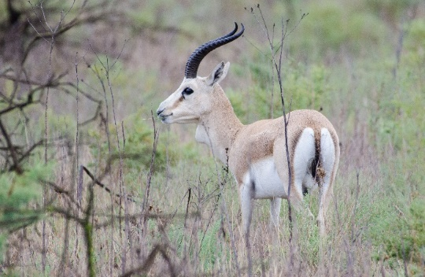
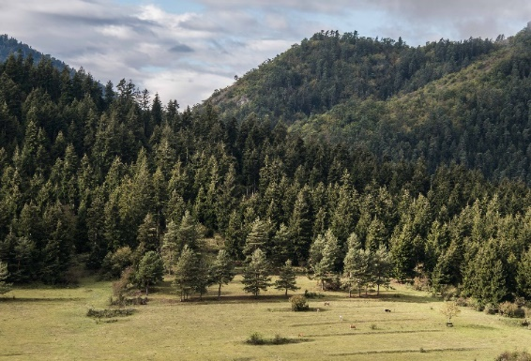
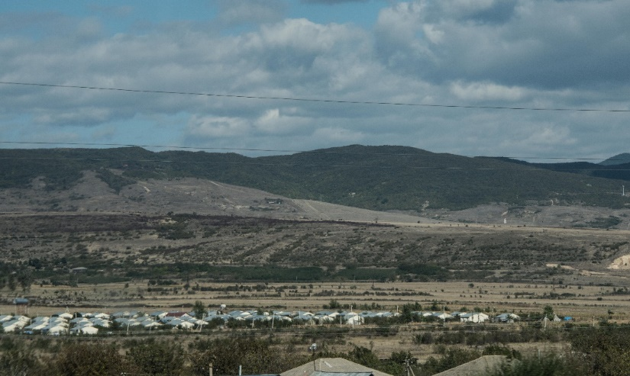
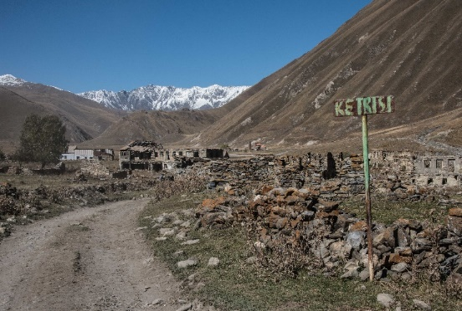
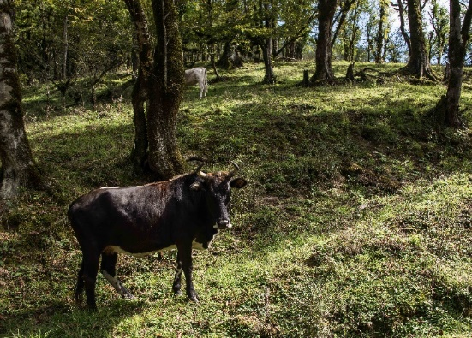
Background
SILVIS Lab
buchner2@wisc.edu
Spatial Analysis for Conservation and Sustainability

Slide 5
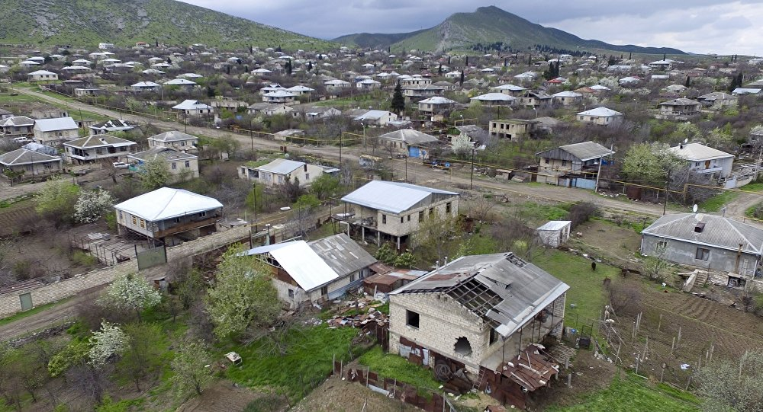
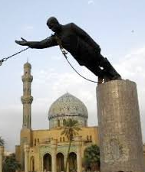
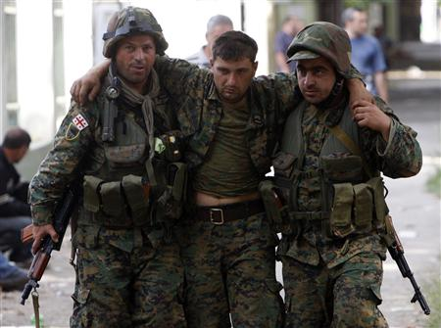
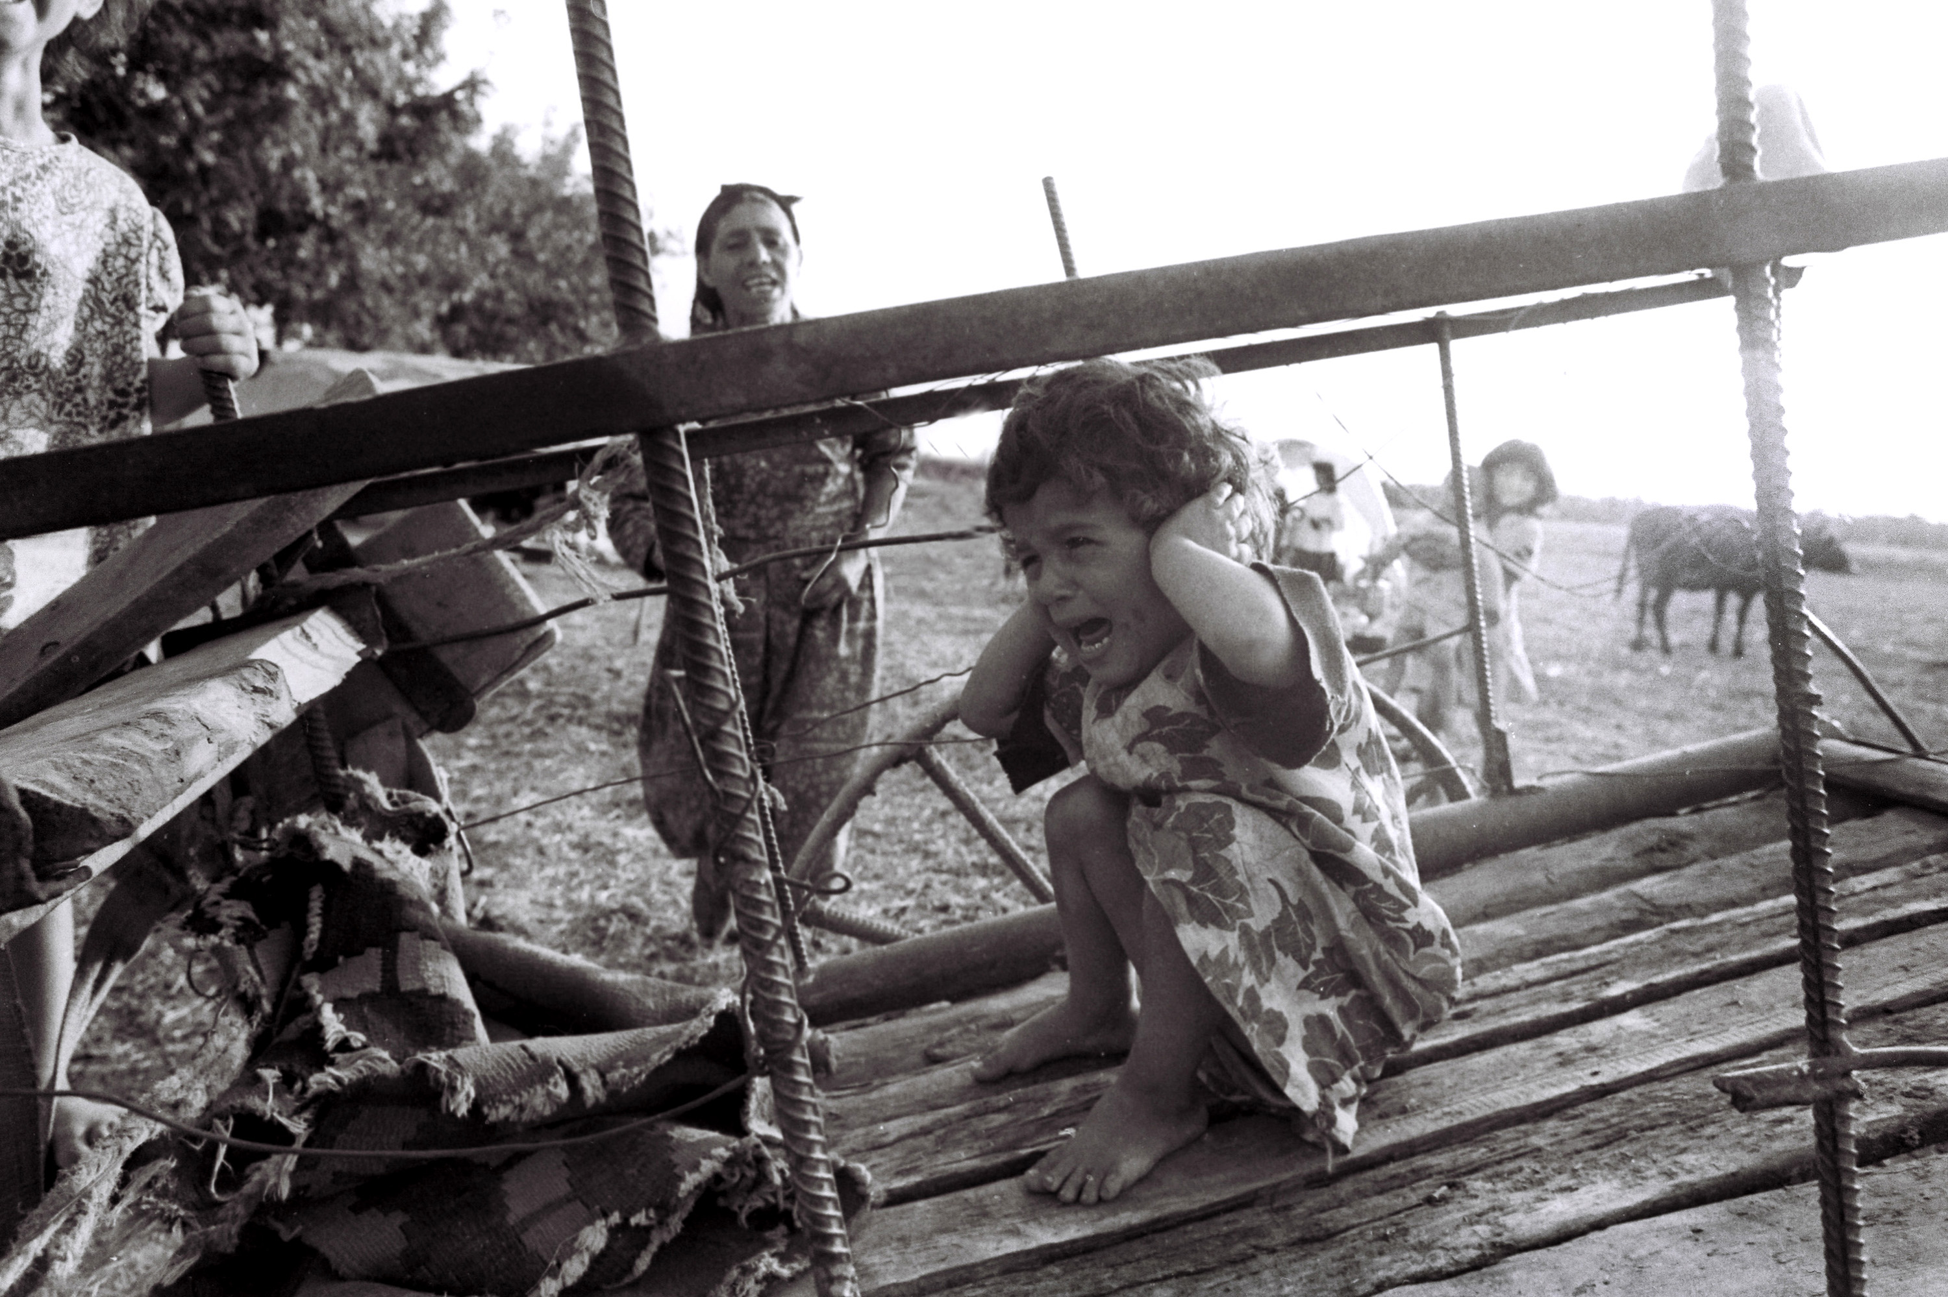
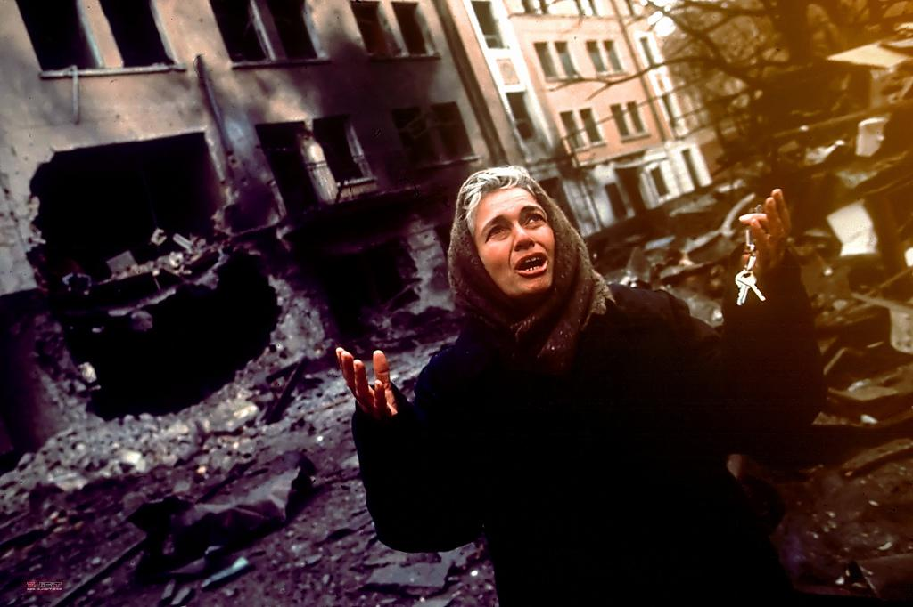
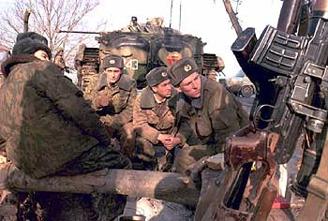
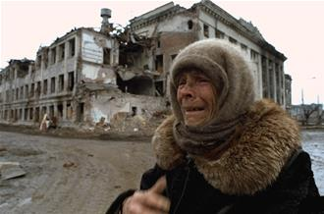
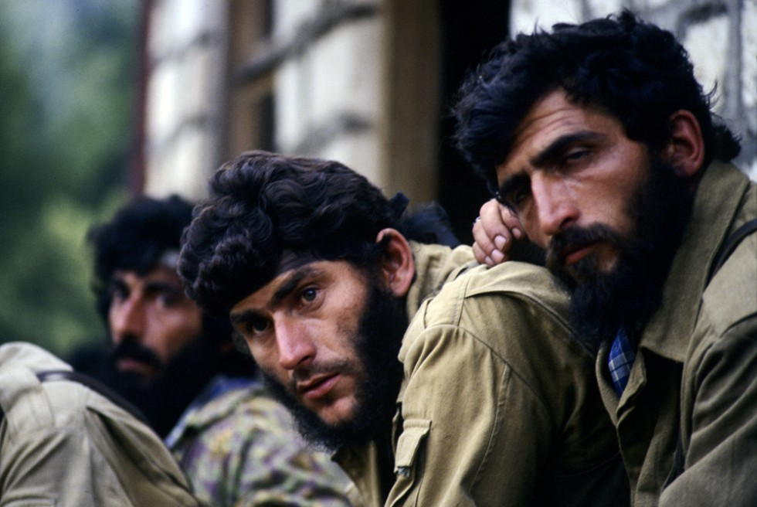
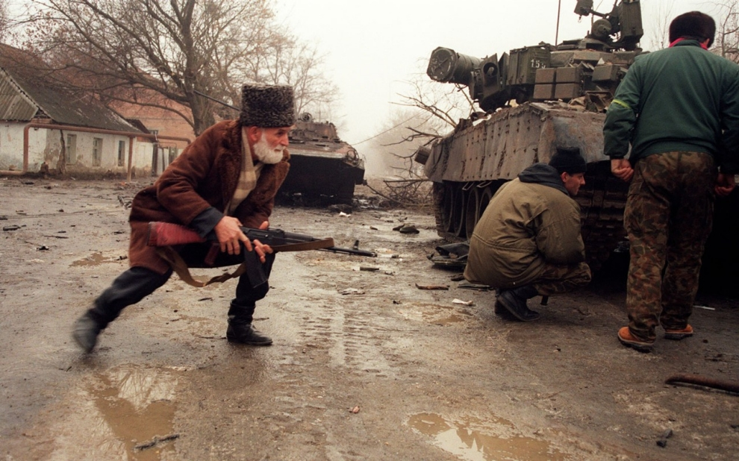
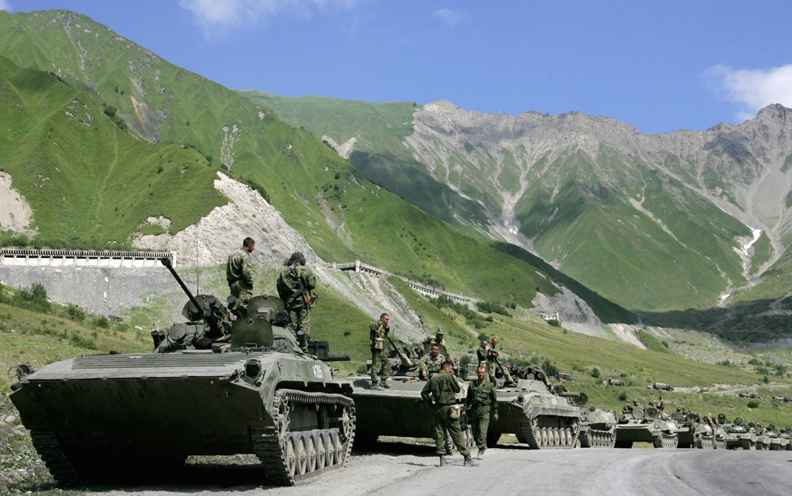
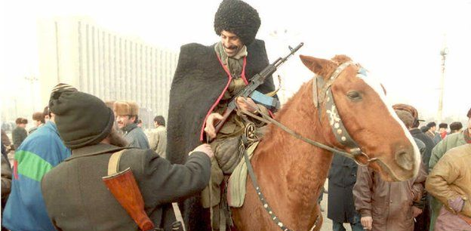
Background
SILVIS Lab
buchner2@wisc.edu
Spatial Analysis for Conservation and Sustainability

Slide 6
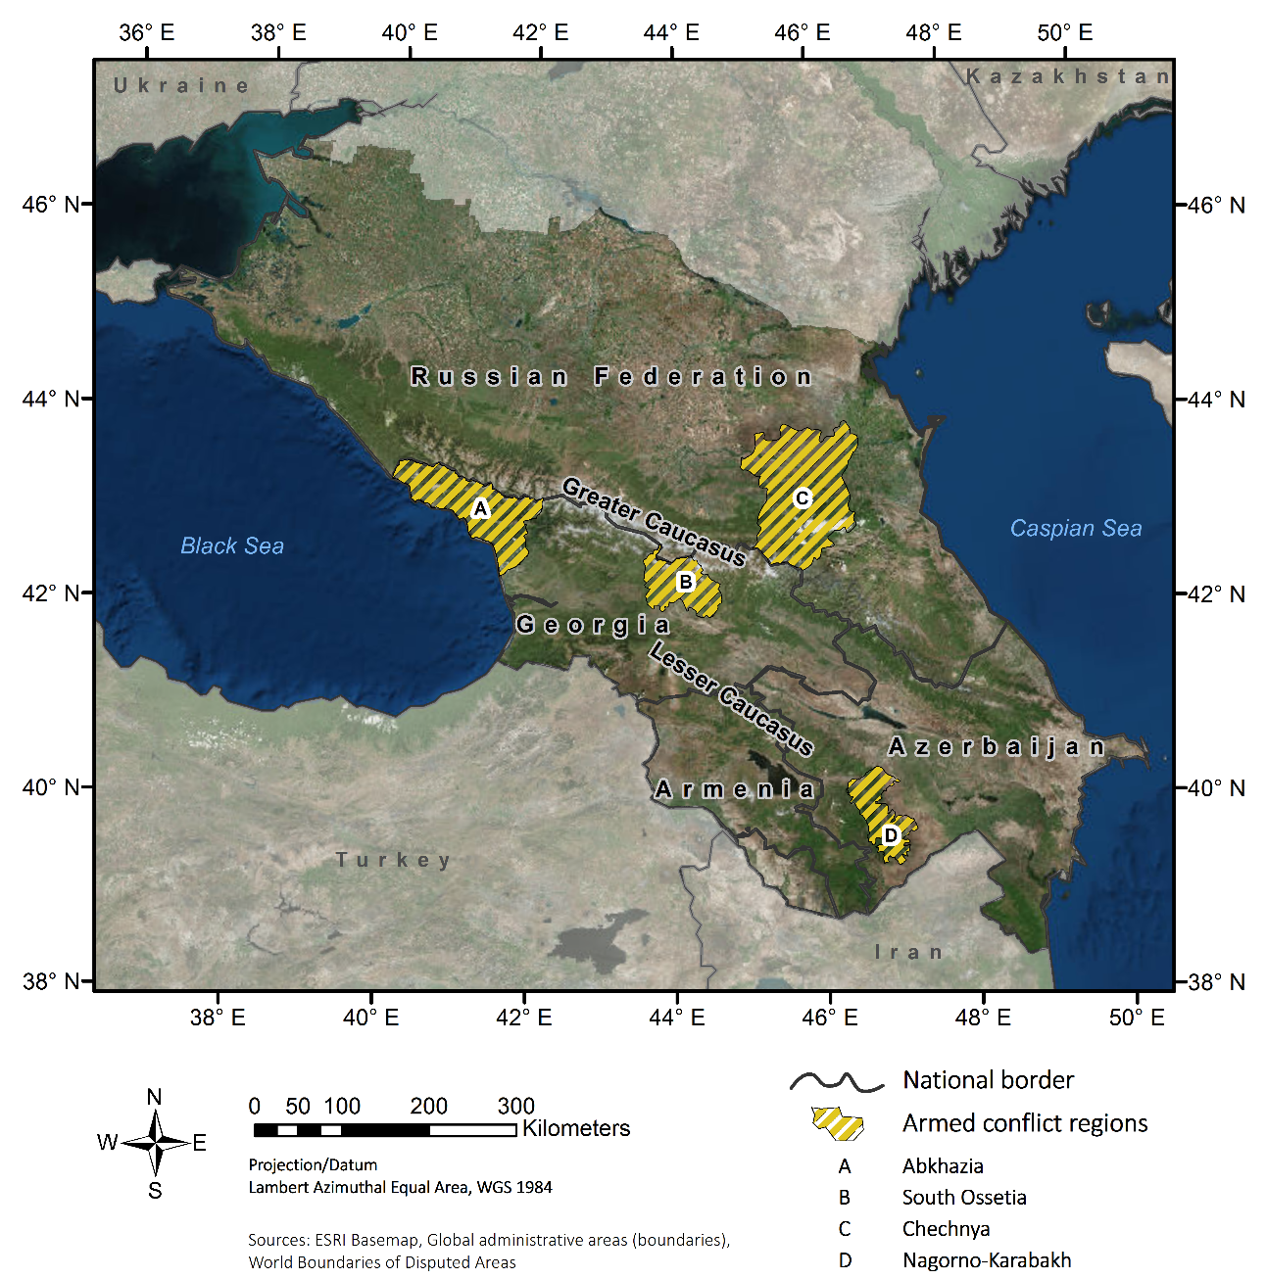
Armed conflicts
SILVIS Lab
buchner2@wisc.edu
Spatial Analysis for Conservation and Sustainability

Slide 7
Background
Socio-economic
shocks
Collapse of Soviet Union
Armed conflicts
Land use change
SILVIS Lab
buchner2@wisc.edu
Spatial Analysis for Conservation and Sustainability

Slide 8
Background
To advance the understanding of the effect of armed conflicts and other of socio-economic shocks on land use change
SILVIS Lab
buchner2@wisc.edu
Spatial Analysis for Conservation and Sustainability

Slide 9
Landsat
Does topographic correction of Landsat imagery improve classification accuracy?
How was forest and agriculture distributed since 1985 and how did it change over time?
What are the spatial patterns and the rates for each country over time?
SILVIS Lab
buchner2@wisc.edu
Spatial Analysis for Conservation and Sustainability

Slide 10
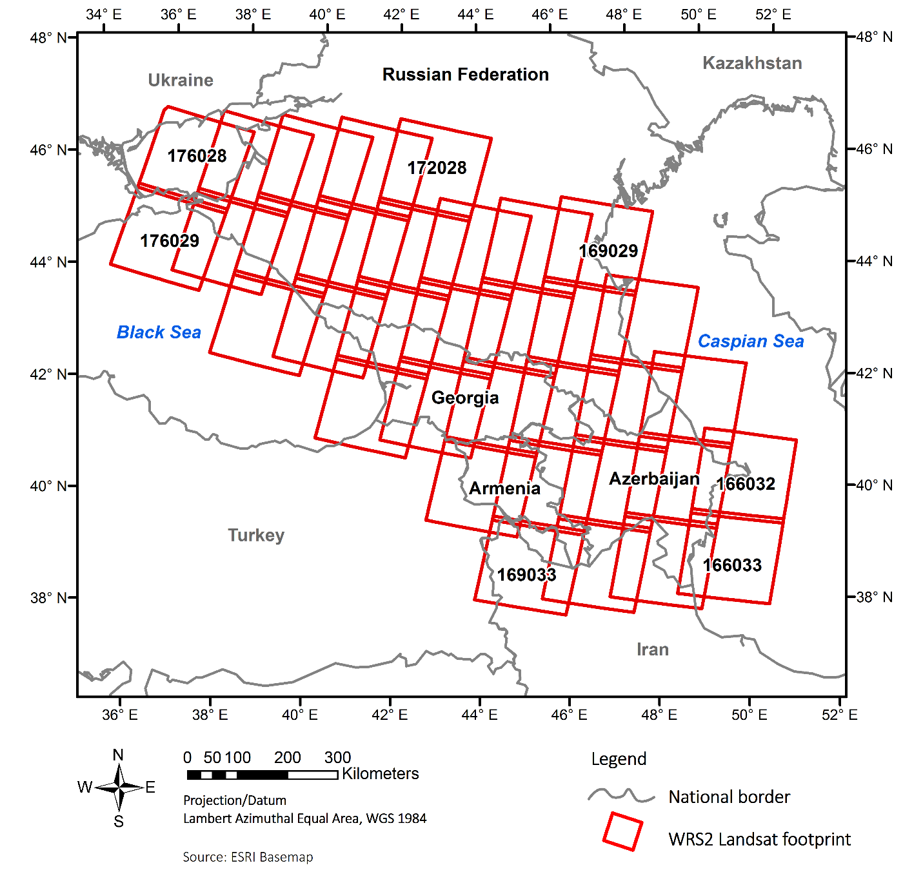
Landsat
Landsat pool
35 footprints
10891 images
1985-2015
SILVIS Lab
buchner2@wisc.edu
Spatial Analysis for Conservation and Sustainability

Slide 11
Landsat
Landsat pool
1985-2015
Cloud + shadow module
Radiometric correction
Geometric correction
Atmospheric correction
Topographic correction
Pre-processed Landsat data
SILVIS Lab
buchner2@wisc.edu
Spatial Analysis for Conservation and Sustainability

Slide 12
Landsat
SILVIS Lab
buchner2@wisc.edu
Spatial Analysis for Conservation and Sustainability

Slide 13
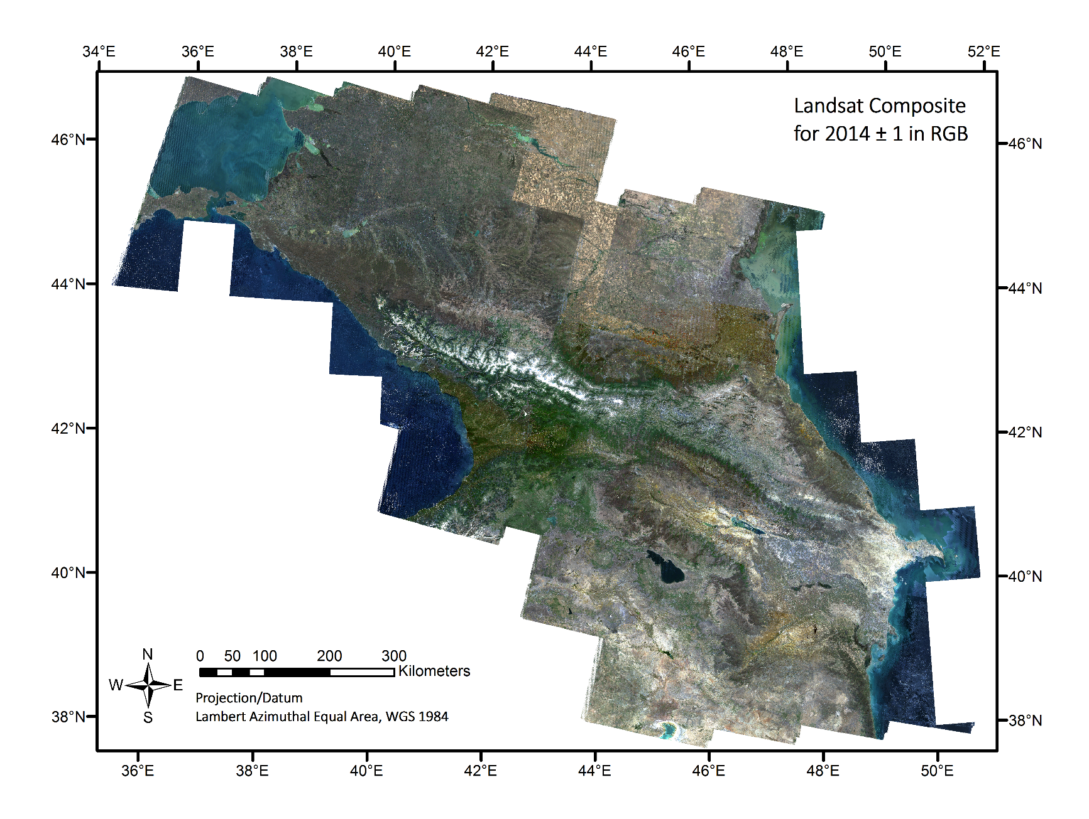
Landsat
SILVIS Lab
buchner2@wisc.edu
Spatial Analysis for Conservation and Sustainability

Slide 14
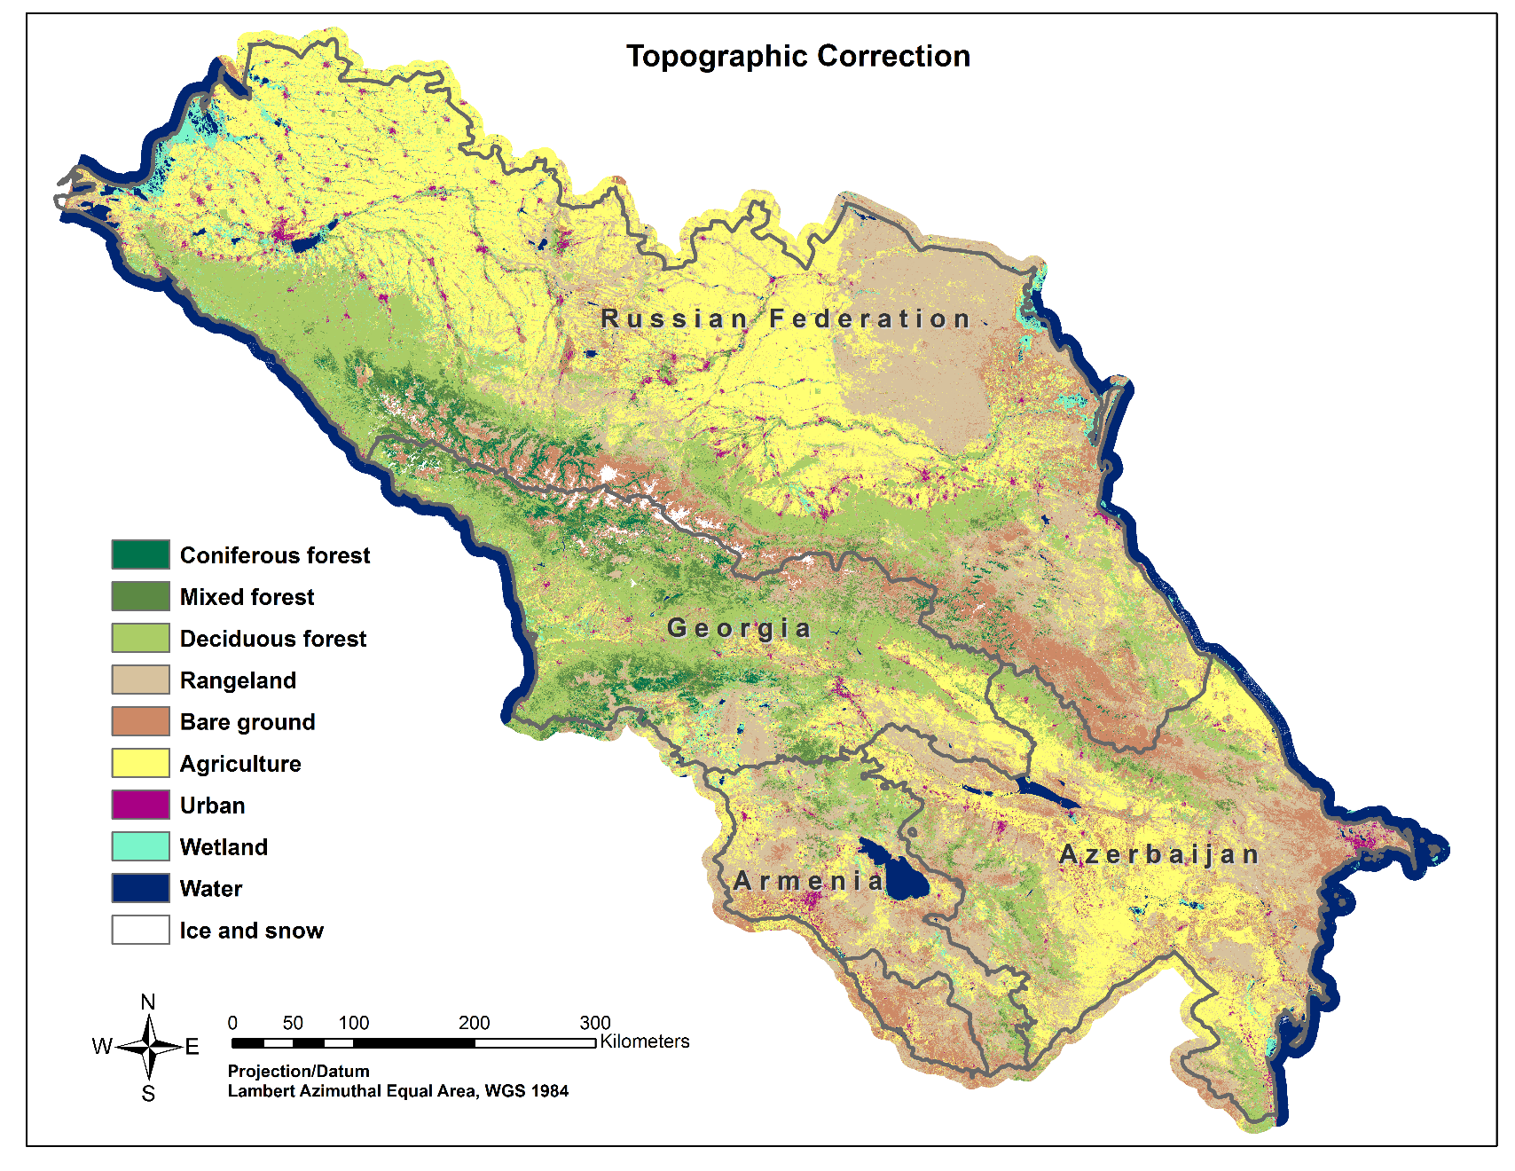
Landsat
Change detection
Forest loss/gain
Agricultural abandonment/ expansion
1985/1990, 1990/2000, 2000/2005, 2005/2010, 2010/015
SILVIS Lab
buchner2@wisc.edu
Spatial Analysis for Conservation and Sustainability

Slide 15
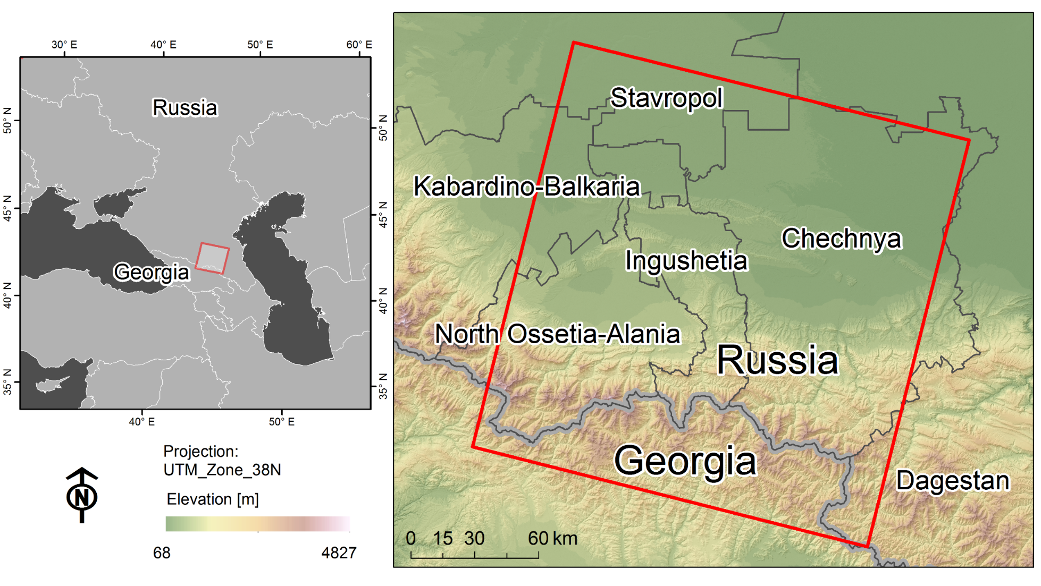
Land abandonment
He Yin et al. in review
SILVIS Lab
buchner2@wisc.edu
Spatial Analysis for Conservation and Sustainability

Slide 16
Land abandonment
He Yin et al. in review
Spatial and temporal segmentation of Landsat time series to detect extant and timing of agricultural land abandonment
Agricultural land image objects
Probability for each object that agri. land was used each year
Identification of time when agricultural abandonment occurred
SILVIS Lab
buchner2@wisc.edu
Spatial Analysis for Conservation and Sustainability

Slide 17
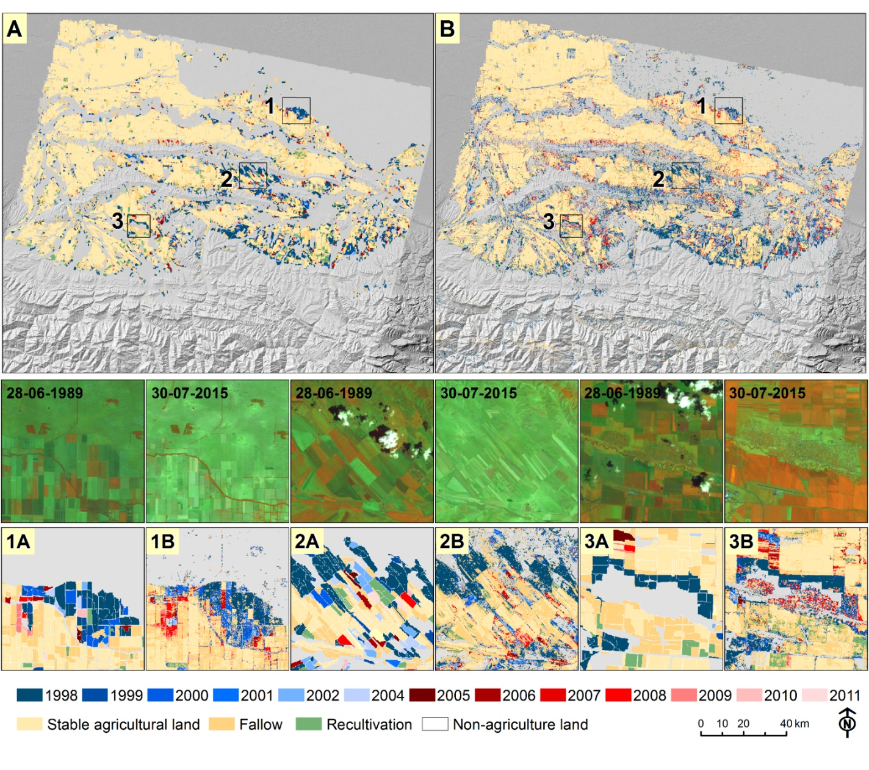
Land abandonment
Low rates of land abandonment compared to Eastern Europe
12% of agricultural land was abandoned in our study area during 1989-2015
Highest rates in Chechnya and Ingushetia
He Yin et al. in review
SILVIS Lab
buchner2@wisc.edu
Spatial Analysis for Conservation and Sustainability

Slide 18
Chechnya – armed conflict
SILVIS Lab
buchner2@wisc.edu
Spatial Analysis for Conservation and Sustainability

Slide 19
Chechnya – armed conflict
Abandoned fields much closer to conflicts
Difference significant at p < 0.001
Abandoned fields much closer to conflicts
Difference significant at p < 0.001
SILVIS Lab
buchner2@wisc.edu
Spatial Analysis for Conservation and Sustainability

Slide 20
Armed conflicts
What were the local effects of armed conflicts on land use change and how far did the effects spill over into adjacent and father away areas?
How did the effects of armed conflicts differ among the four countries Armenia, Azerbaijan, Georgia and Russia?
SILVIS Lab
buchner2@wisc.edu
Spatial Analysis for Conservation and Sustainability

Slide 21
Armed conflicts
Econometric method - Difference-in-differences
A
A
100 %
Land use change
Conflict
effect
T1
10 %
T1
Pre-conflict
Armed
conflict
T2
Post-conflict
T2
Forest
Agriculture
No conflict (control)
Agricultural abandonment
Conflict (treatment)
Forest loss
Conflict zone
Land use change
A
Unit of interest:
37.5% land use change
SILVIS Lab
buchner2@wisc.edu
Spatial Analysis for Conservation and Sustainability

Slide 22
Protected areas
Were protected areas effective in preventing forest disturbance?
Were protected areas established before the collapse of the Soviet Union more effective than protected areas thereafter?
Were protected areas with a higher protection categories more effective than protected areas with a lower one?
SILVIS Lab
buchner2@wisc.edu
Spatial Analysis for Conservation and Sustainability

Slide 23
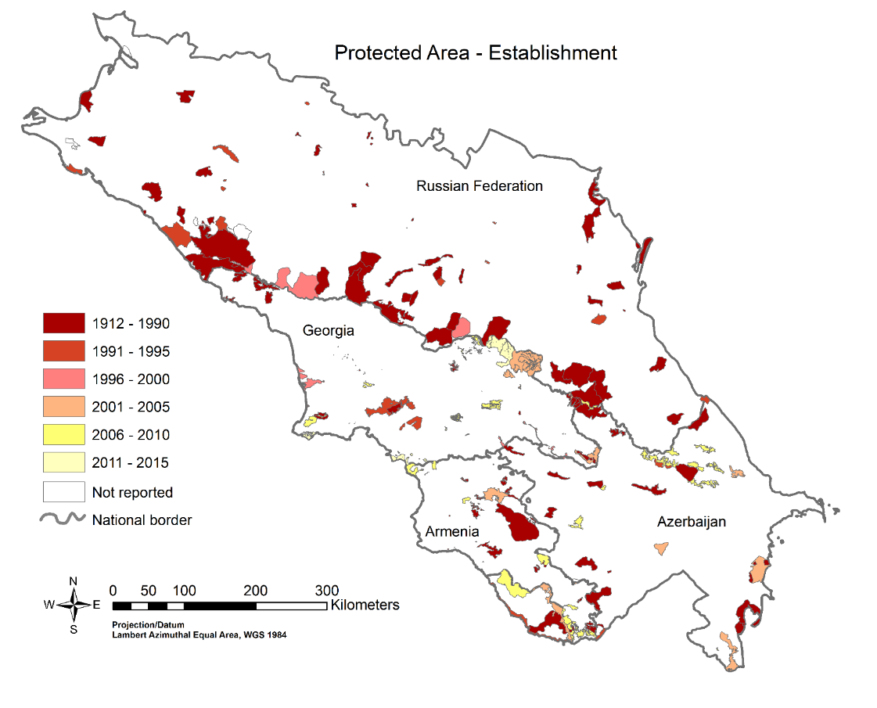
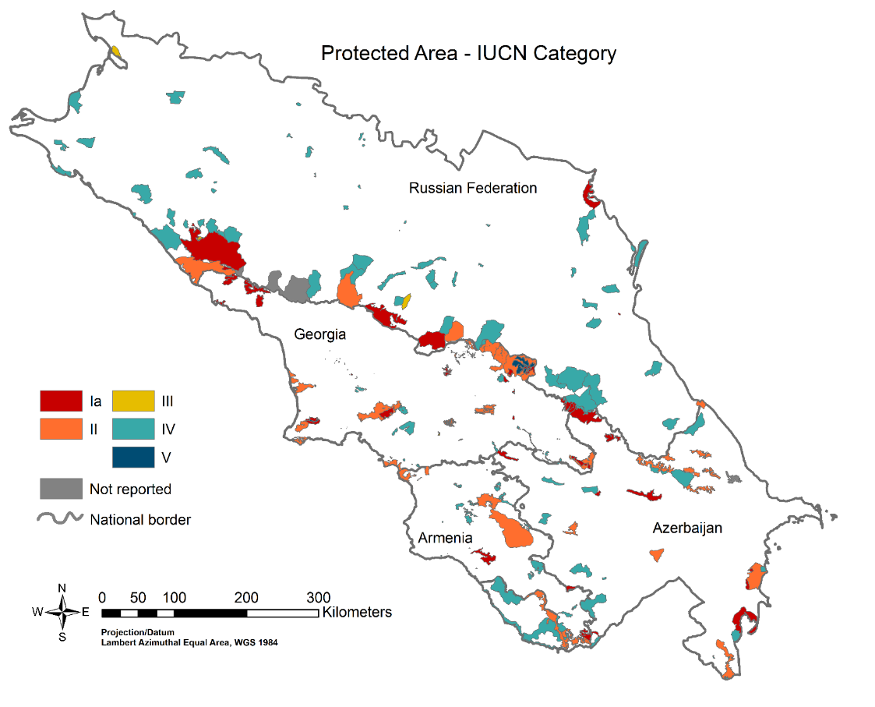
Protected areas
Econometric method - Matching statistics
SILVIS Lab
buchner2@wisc.edu
Spatial Analysis for Conservation and Sustainability

Slide 24
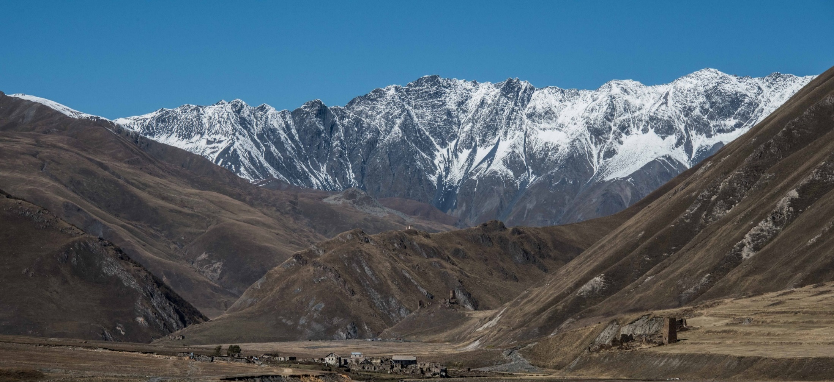
SILVIS Lab – University of Wisconsin-Madison
Volker Radeloff – radeloff@wisc.edu
He Yin – hyin39@wisc.edu
Johanna Buchner – buchner2@wisc.edu
Thank you for your attention!
SILVIS Lab
buchner2@wisc.edu
Spatial Analysis for Conservation and Sustainability

