Slide 1
The GOFC-GOLD South Central and Eastern European Network (SCERIN)
SCERIN
Experience from SCERIN (South, Central and East European RI network)
Jana Albrechtová¹, Petya Campbell²
¹Charles University in Prague, Faculty of Science, Prague, Czech Republic
²Joint Center for Earth Systems Technology, University of Maryland Baltimore County, and NASA Goddard Space Flight Center, Greenbelt, Maryland, USA

Slide 2
Charles University, Prague, Czech Republic
founded in 1348 Charles IV.
In 1348 - 4 faculties:
Theology
Law
Medicine
Arts
Nowadays
17 Faculties
3 University Institutes
7 Scientific centers
http://www.cuni.cz/

Slide 3
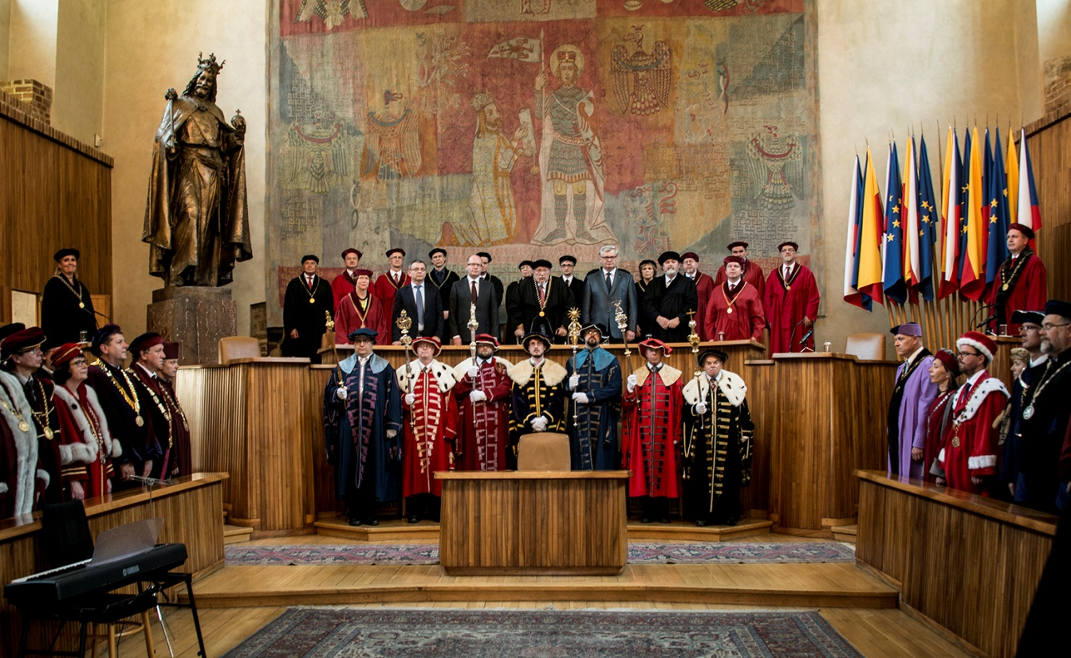
Charles University, Prague, Czech Republic
Charles University in Prague Ranking - CWUR 2016
http://cwur.org/2016/Charles-University-in-Prague.php
Ranking among the world´s 2 % top universities
World Rank: 266
National Rank: 1
Quality of Education Rank: 251
Quality of Faculty Rank: 187
Publications Rank: 230
Influence Rank: 235
Citations Rank: 171
Broad Impact Rank: 222
Overall Score: 46.49
42,000 students,
270 accredited study programs

Slide 4
SCERIN
GOFC-GOLD South/Central/Eastern European Regional Information Network
Outline:
SCERIN: case example how to build a functional network
II. SCERIN Milestones
III. SCERIN Achievements
IV. SCERIN Lessons learned and Challenges: How to build a functional network
http://www.fao.org/gtos/gofc-gold/net-SEERIN.html
www.csebr.cz/scerin
CAUCrin Kickoff Meeting, Tbilisi
2017, 11 September
Notes:
We plan to work together with the regional forest and land management agencies to ensure continuous, high quality observations for operational and management applications, facilitating feasible and sustainable natural resources management practices.

Slide 5
SCERIN
GOFC-GOLD South/Central/Eastern European Regional Information Network
I. SCERIN: case example how to build a functional network
geographic domain
members and observers
participants
coordination
goals
activities
CAUCrin Kickoff Meeting, Tbilisi
2017, 11 September
Notes:
We plan to work together with the regional forest and land management agencies to ensure continuous, high quality observations for operational and management applications, facilitating feasible and sustainable natural resources management practices.

Slide 6
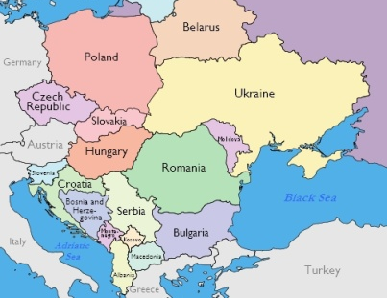
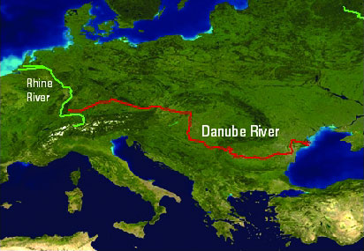
About SCERIN: Geographic Domain
GOFC-GOLD South/Central/Eastern European Regional Information Network
South, Central and East Eastern Europe
Danube Watershed
NASA LCLUC Spring Science Team Meeting 2014, 23-25 April
CAUCrin Kickoff Meeting, Tbilisi
2017, 11 September

Slide 7
About SCERIN: Geographic Domain
GOFC-GOLD South/Central/Eastern European Regional Information Network
SCERIN countries
Current:
CZ, SK, PL, HU
UA, BG, RO,
Serbia, Macedonia, Slovenia, Croatia, Moldovia
GR, TU
NASA LCLUC Spring Science Team Meeting 2014, 23-25 April
CAUCrin Kickoff Meeting, Tbilisi
2017, 11 September

Slide 8
About SCERIN: Geographic Domain
GOFC-GOLD South/Central/Eastern European Regional Information Network
SCERIN countries
Current:
CZ, SK, PL, HU
UA, BG, RO,
Serbia, Macedonia, Slovenia, Croatia, Moldovia
GR, TU
Intended:
Belarus, Montenegro, Albania, etc…
NASA LCLUC Spring Science Team Meeting 2014, 23-25 April
CAUCrin Kickoff Meeting, Tbilisi
2017, 11 September

Slide 9
About SCERIN: Members and observers
GOFC-GOLD South/Central/Eastern European Regional Information Network
SCERIN members – permanent, new coming
CZ, SK, PL, HU
UA, BG, RO,
Serbia, Macedonia, Slovenia, Croatia
GR, TU
SCERIN observers – can change
U.S.
Norway
Netherland
Georgia
etc….
NASA LCLUC Spring Science Team Meeting 2014, 23-25 April

Slide 10
Participants
SCERIN: participants
GOFC-GOLD South/Central/Eastern European Regional Information Network
Informal network of scientists and other professionals based in the region or with scientific interests in the region.
SCERIN’s participants work together with the regional forest and land management agencies to ensure continuous, high quality observations and information products for operational and management applications, to facilitate feasible and sustainable natural resources management practices.
NASA LCLUC Spring Science Team Meeting 2014, 23-25 April

Slide 11
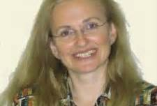
About SCERIN: coordination
GOFC-GOLD South/Central/Eastern European Regional Information Network
Network Coordinator in U.S.: Petya Campbell petya.campbell@nasa.gov Joint Center for Earth Systems Technology (JCET), University of Maryland Baltimore County NASA Goddard Space Flight Center, Biospheric Sciences Branch, Greenbelt, Maryland 20771, USA
Regional Contacts in Europe, Czech Republic:
Jana Albrechtova albrecht@natur.cuni.cz Charles University, Prague, Czech Republic
Faculty of Science, Department of Experimental Plant Biology,
Lucie Kupkova lucie.kupova@gmail.com
Charles University Prague, Czech Republic
Faculty of Science, Department of Applied Geoinformatics and Cartography
CAUCrin Kickoff Meeting, Tbilisi
2017, 11 September

Slide 12
About SCERIN: Goals
GOFC-GOLD South/Central/Eastern European Regional Information Network
Goals :
To promote and coordinate the production and provision of Earth System observations, adapted and/or designed for the user communities in South, Central and Eastern Europe
2. To focus on regional and local issues related to satellite data products, methodologies, and end users
3. SCERIN contribution to GOFC-GOLD, linkages with regional networks, e.g. IGU LUCC workgroup
CAUCrin Kickoff Meeting, Tbilisi
2017, 11 September
Notes:
We plan to work together with the regional forest and land management agencies to ensure continuous, high quality observations for operational and management applications, facilitating feasible and sustainable natural resources management practices.

Slide 13
SCERIN: issues, needs, aims
South/Central European Regional Information Network
Main processes in present: forest deterioration, changes in forest ecosystem functions, suburbanization, afforestation,
Driving forces: transitional processes, EU accession and open market, changes in land preservation and restitutions, private land ownership, nature preservation, changes in pollution
Aims:
Network of field validation sites (including land management data) at regional SCERIN scales
Developing archives of long-term RS, LCLUC data , meteorology and field observations
Developing techniques for up-scaling between sites, networks of sites for detecting and interpreting key indicators of land use and land cover change
Designing a system for a cost effective monitoring that enable frequent, repeated, regionally coordinated assessment of landscape and ecosystems: distribution, status and trends of change
Needs: LCLUC regional modeling predictions, International cooperation for sharing of data and experience, and for comparative studies
CAUCrin Kickoff Meeting, Tbilisi,
11 September 2017
Notes:
Global monitoring well adapted but regional scale changes might be overlooked

Slide 14
Formulation of Work Groups: based on regional interests
About SCERIN: Activities
GOFC-GOLD South/Central/Eastern European Regional Information Network
FG1: Forest biomass production; decline, disturbance and driving forces
FG2: Land Cover Changes: climate change, agricultural land abandonment, urban expansion
FG3: Validation/verification network for support of current and future satellite missions [e.g. NASA´s LDCM and Sustainable Land Imaging (SLI), and ESA´s GMES program]
FG4 – newly established: Watersheds, catchments, dams – LCLUC water management and ENVIRONMENT
CAUCrin Kickoff Meeting, Tbilisi
2017, 11 September

Slide 15
SCERIN
GOFC-GOLD South/Central/Eastern European Regional Information Network
II. SCERIN Milestones
Meetings
Connection with regional efforts
SCERIN capacity building initiative: TAT
http://www.fao.org/gtos/gofc-gold/net-SEERIN.html
www.csebr.cz/scerin
CAUCrin Kickoff Meeting, Tbilisi
2017, 11 September
Notes:
We plan to work together with the regional forest and land management agencies to ensure continuous, high quality observations for operational and management applications, facilitating feasible and sustainable natural resources management practices.

Slide 16
SCERIN: Meetings
South/Central European Regional Information Network
Meeting – only a tool for networking
Important organizational activities
Network Capacity Building
Continuous inventory and statistics
Updating milestones
Summary of achievements published periodically
CAUCrin Kickoff Meeting, Tbilisi
2017, 11 September
Notes:
We plan to work together with the regional forest and land management agencies to ensure continuous, high quality observations for operational and management applications, facilitating feasible and sustainable natural resources management practices.

Slide 17
SCERIN: Meetings
South/Central European Regional Information Network
2012:
SEERIN (now SCERIN) Formulation Workshop, Sofia, Bulgaria
2013:
SCERIN-1 Meeting & Trans-AtlanticTraining, Prague, Czech Republic
2014
SCERIN-2 Meeting and Trans-AtlanticTraining, Krakow, Poland
2015
SCERIN-3 Meeting and Trans-AtlanticTraining, Brasov, Romania
2016
SCERIN-4 Meeting and Trans-AtlanticTraining, Zvolen, Slovakia
2017
SCERIN-5 Meeting and Trans-AtlanticTraining, Pecs, Hungary
CAUCrin Kickoff Meeting, Tbilisi
2017, 11 September
Notes:
We plan to work together with the regional forest and land management agencies to ensure continuous, high quality observations for operational and management applications, facilitating feasible and sustainable natural resources management practices.

Slide 18
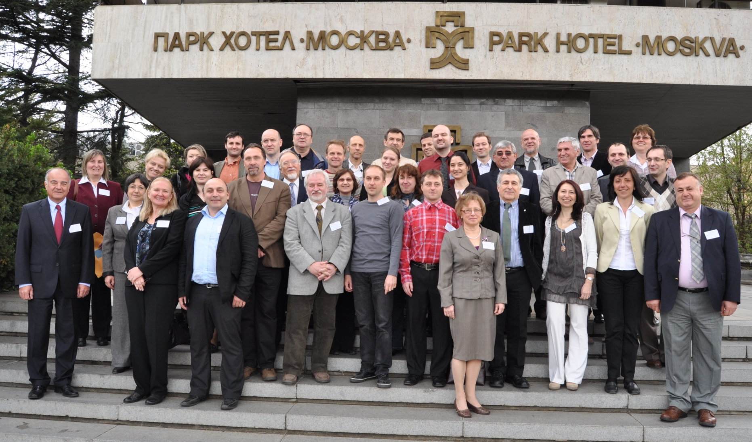
SCERIN: Meetings: Kickoff
GOFC-GOLD South/Central/Eastern European Regional Information Network
2012: SCERIN Formulation Workshop, Sofia, Bulgaria
17 April 2012, Sofia
Jana Albrechtova
Lucie Kupkova
Petya Campbell
Olga Krankina
CAUCrin Kickoff Meeting, Tbilisi
2017, 11 September

Slide 19
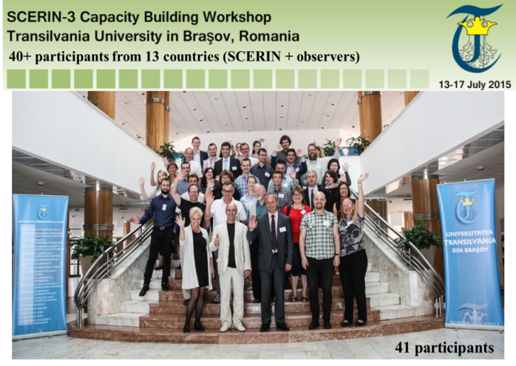
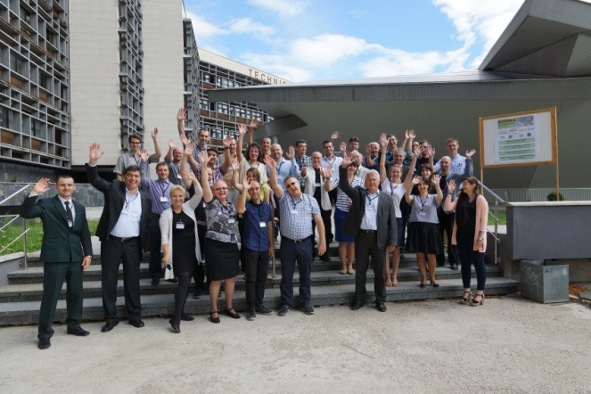
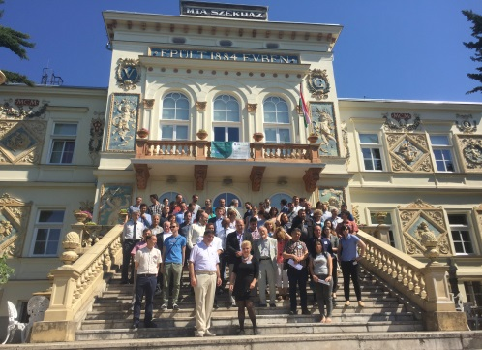
SCERIN: Meetings
GOFC-GOLD South/Central/Eastern European Regional Information Network
3
2
4
5
CAUCrin Kickoff Meeting, Tbilisi
2017, 11 September

Slide 20
SCERIN: Meetings
GOFC-GOLD South/Central/Eastern European Regional Information Network
Hosts for coming meetings already allocated:
2018
SCERIN-6 Meeting and Trans-AtlanticTraining,
Zagreb, Croatia
2019
SCERIN-5 Meeting and Trans-AtlanticTraining,
Novi Sad, Serbia
CAUCrin Kickoff Meeting, Tbilisi
2017, 11 September

Slide 21
SCERIN
GOFC-GOLD South/Central/Eastern European Regional Information Network
II. SCERIN Milestones
Meetings
Connection with regional efforts
SCERIN capacity building initiative: TAT
http://www.fao.org/gtos/gofc-gold/net-SEERIN.html
www.csebr.cz/scerin
CAUCrin Kickoff Meeting, Tbilisi
2017, 11 September
Notes:
We plan to work together with the regional forest and land management agencies to ensure continuous, high quality observations for operational and management applications, facilitating feasible and sustainable natural resources management practices.

Slide 22
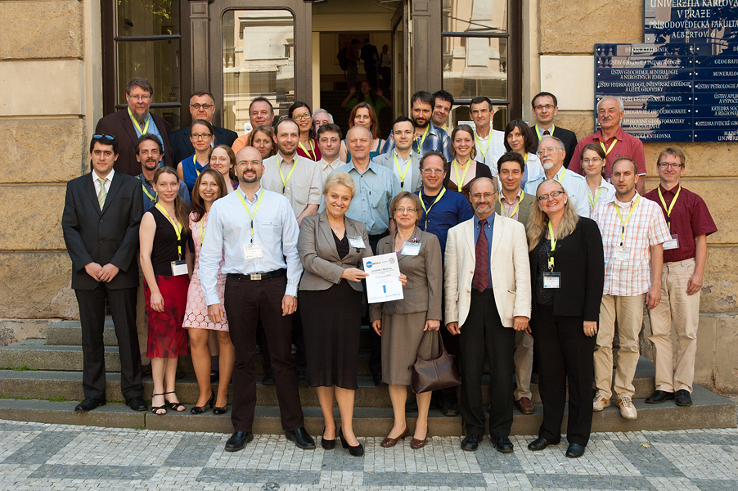
SCERIN: Meetings
GOFC-GOLD South/Central/Eastern European Regional Information Network
CAUCrin Kickoff Meeting, Tbilisi
2017, 11 September

Slide 23
SCERIN: Meetings
GOFC-GOLD South/Central/Eastern European Regional Information Network
collaboration between the existing networks in the region
1. SCERIN-1 Meeting: 17-19 June 2013
“"Monitoring Land Cover Changes & Forest Condition"
2. Scientifc Field Trip in coordination with IGU LUCC : 19 June 2013
„ LCLUC in Sokolov Region in Northwestern Bohemia affected by mining activties“ (scientific trip)
3. Trans-Atlantic Training in collaboration with ESA: 20-21 June 2013 “Classification methods in Land-Use/Land-Cover Change”
4. IGU LUCC meeting: 20-22 June, 2013, Prague
„International Geographical Union LUCC workgroup meeting“
CAUCrin Kickoff Meeting, Tbilisi
2017, 11 September

Slide 24
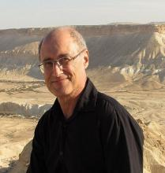
SCERIN: Meetings
GOFC-GOLD South/Central/Eastern European Regional Information Network
Trans-Atlantic Training in collaboration with NASA and ESA:
2013 “Classification methods in Land-Use/Land-Cover Change”
Premysl Stych Department of Applied Geoinformatics and Cartography, Faculty of Science Charles University Prague
Francesco Sarti – ESA
Garik Gutman - NASA
CAUCrin Kickoff Meeting, Tbilisi
2017, 11 September

Slide 25
SCERIN: Meetings
GOFC-GOLD South/Central/Eastern European Regional Information Network
Initial Capacity Building Goal Achieved
TAT organized annually as joined activity to a SCERIN Meeting
CAUCrin Kickoff Meeting, Tbilisi
2017, 11 September

Slide 26
SCERIN: Achievements
GOFC-GOLD South/Central/Eastern European Regional Information Network
III. SCERIN Achievements
Manuscripts in preparation: P1-P4
Joint presentations/efforts
Research projects:
Joint projects and regional projects
Publicity: Web page, FB
http://www.fao.org/gtos/gofc-gold/net-SEERIN.html
www.csebr.cz/scerin
CAUCrin Kickoff Meeting, Tbilisi
2017, 11 September
Notes:
We plan to work together with the regional forest and land management agencies to ensure continuous, high quality observations for operational and management applications, facilitating feasible and sustainable natural resources management practices.

Slide 27
SCERIN: Achievements
GOFC-GOLD South/Central/Eastern European Regional Information Network
SCERIN: Manuscripts in preparation: P1-P4
joint research papers in progress
P1: Global 30m land cover products validation in SCERIN (Ioannis Manakos)
P2: SCERIN inventory of land use and land cover changes and their driving forces (Gregory Taff and Premek Stych)
P3: Trends of forest vegetation activity in SCERIN associated with climatic changes, as observed by 30 years of AVHRR (Ivan Pilas)
P4: Review of high resolution spetral data (satellite, airborne, field) collected for forest ecosystems in SCERIN, and their use for vegetation monitoring (Jana Albrechtova, Petya Campbell and Lucie Kupkova)
CAUCrin Kickoff Meeting, Tbilisi
2017, 11 September
Notes:
SCERIN research projects in progress

Slide 28
SCERIN: Achievements
GOFC-GOLD South/Central/Eastern European Regional Information Network
III. SCERIN Achievements
Manuscripts in preparation: P1-P4
Joint presentations/efforts
Research projects:
Joint projects and regional projects
Publicity: Web page, FB
http://www.fao.org/gtos/gofc-gold/net-SEERIN.html
www.csebr.cz/scerin
CAUCrin Kickoff Meeting, Tbilisi
2017, 11 September
Notes:
We plan to work together with the regional forest and land management agencies to ensure continuous, high quality observations for operational and management applications, facilitating feasible and sustainable natural resources management practices.

Slide 29
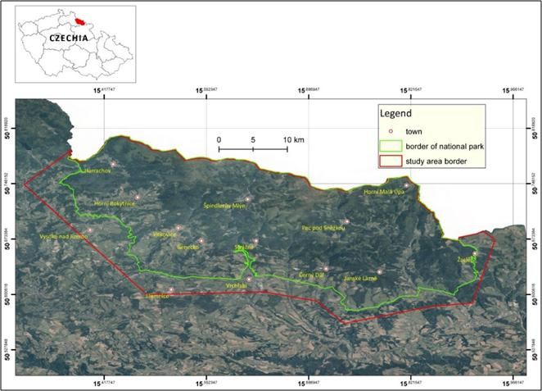
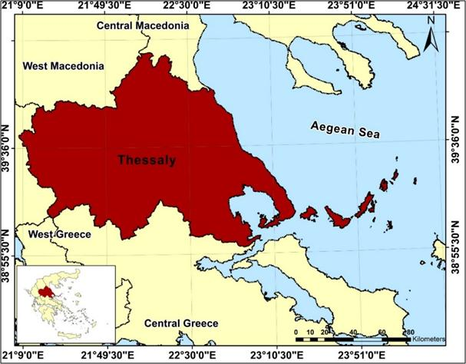
SCERIN: Achievements
GOFC-GOLD South/Central/Eastern European Regional Information Network
Poster Presentation of P1:
World Cover 2017, ESA, Frascati, March
2017 US-IALE, Baltimore, Maryland, April 9-13
Jana Albrechtová¹, Ioannis Manakos², Petya Campbell³, Mihai Nita⁴,
Lucie Kupková¹, Konstantinos Karantzalos⁵ and Garik Gutman⁶
Global Land Cover Products Validation and Inter-Comparison in South Central and Eastern Europe (SCERIN)
Prototype Objectives:
To develop prototypes of the validation products, and provide preliminary findings using case studies from Greece and Czechia.
o assess the specifics of land cover in study areas in terms of land cover classification and its validation.
The effort is an initiative of the SCERIN.
Validated Maps: Global LC maps (GLC) : 1) the Copernicus CORINE Land Cover 2012 (CLC) - ETRS89 / ETRS-LAEA CRS; and 2) the GlobeLand30 (GL_30) 2010 raster files (30m) - WGS 84 / TMzn34-35N
Conclusions: Very similar, rather good, accuracies were reached for both study areas and for both CORINE 2012 and GLOBALAND30 products. Slightly better accuracy (4%) for CORINE in Greece and almost the same accuracies for both products in Czechia.

Slide 30
SCERIN: Achievements
GOFC-GOLD South/Central/Eastern European Regional Information Network
III. SCERIN Achievements
Manuscripts in preparation: P1-P4
Joint presentations/efforts
Research projects:
Joint projects and regional projects
Publicity: Web page, FB
http://www.fao.org/gtos/gofc-gold/net-SEERIN.html
www.csebr.cz/scerin
CAUCrin Kickoff Meeting, Tbilisi
2017, 11 September
Notes:
We plan to work together with the regional forest and land management agencies to ensure continuous, high quality observations for operational and management applications, facilitating feasible and sustainable natural resources management practices.

Slide 31
SCERIN: Examples of Regional Projects
Regional research projects: examples
SOUTH EUROPE:
Romania: Issues in Remote Sensing Techniques for Forest Cover Change Monitoring (V. Gancz, Forest Research & Management Institute, Romania)
Bulgaria: Meteorological Satellites in Support to Land Surface Analyses (J. Stoyanova & C. Georgiev, NIMH-BA,and L. Pessanha, Institute of Meteorology, Portugal)
Use of Remote Sensing for Agricultural Applications in North West of Turkey (L. Genc, COMU, Turkey)
Use of Remote Sensing Data for LULC monitoring in Turkey (D. Maktav, Istanbul Technical University)
CENTRAL EUROPE:
Poland: Land Use & Land Cover Change Studies in the Northern Carpathians (J. Kozak, K. Ostapowicz, Jagiellonian University, Krakow)
Application of Hyperspectral Data and Artificial Neural Networks for Land Cover Mapping of Mountains Areas (B. Zagajewski, University of Warsaw, Poland)
Slovakia: Land Cover Research, Applications and Development Needs (A. Halabuk, Slovak Academy of Science, Slovakia)
LULCC Research in the Czech Republic (P. Stych, Prague, Czech Republic)
Monitoring of Forest Condition & Function (J. Albrechtova & L. Kupkova, Prague, F. Zemek & O. Brovkina, Czech Globe, Czech Republic)
EASTERN EUROPE:
Ukraine: Monitoring of New Wetlands Formation in Water Reservoirs and Deltas’ Degradation in the Black Sea Basin (V. Starodubtsev, National University of Life and Environmental Sciences, Ukraine)
CAUCrin Kickoff Meeting, Tbilisi
2017, 11 September

Slide 32
SCERIN: collaborative projects
GOFC-GOLD South/Central/Eastern European Regional Information Network
Joint Project Proposal 2013
COST Action
as a platform for future SCERIN Network activities
PI: Jana Albrechtova
CAUCrin Kickoff Meeting, Tbilisi
2017, 11 September

Slide 33
Towards balanced water regime of Central European landscape
SCERIN: collaborative projects
GOFC-GOLD South/Central/Eastern European Regional Information Network
Intended
Joint Project Proposal 2018
INTERREG
PI: František Zemek
Motivation
Main threats of European landscape –
shortage of water and inbalanced water regime
CAUCrin Kickoff Meeting, Tbilisi
2017, 11 September

Slide 34
SCERIN
GOFC-GOLD South/Central/Eastern European Regional Information Network
III. SCERIN Achievements
Manuscripts in preparation: P1-P4
Regional research projects:
Publicity: Web page, FB
http://www.fao.org/gtos/gofc-gold/net-SEERIN.html
www.csebr.cz/scerin
CAUCrin Kickoff Meeting, Tbilisi
2017, 11 September
Notes:
We plan to work together with the regional forest and land management agencies to ensure continuous, high quality observations for operational and management applications, facilitating feasible and sustainable natural resources management practices.

Slide 35
SCERIN: Publicity
GOFC-GOLD South/Central/Eastern European Regional Information Network
Publicity: Web page, FB
http://www.fao.org/gtos/gofc-gold/net-SEERIN.html
www.csebr.cz/scerin
CAUCrin Kickoff Meeting, Tbilisi
2017, 11 September
Notes:
We plan to work together with the regional forest and land management agencies to ensure continuous, high quality observations for operational and management applications, facilitating feasible and sustainable natural resources management practices.

Slide 36
SCERIN: Publicity
GOFC-GOLD South/Central/Eastern European Regional Information Network
Publicity: Web page, FB
CAUCrin Kickoff Meeting, Tbilisi
2017, 11 September
Notes:
We plan to work together with the regional forest and land management agencies to ensure continuous, high quality observations for operational and management applications, facilitating feasible and sustainable natural resources management practices.

Slide 37
SCERIN
GOFC-GOLD South/Central/Eastern European Regional Information Network
IV. SCERIN Lessons learned and Challenges: How to build a functional network
http://www.fao.org/gtos/gofc-gold/net-SEERIN.html
www.csebr.cz/scerin
CAUCrin Kickoff Meeting, Tbilisi
2017, 11 September
Notes:
We plan to work together with the regional forest and land management agencies to ensure continuous, high quality observations for operational and management applications, facilitating feasible and sustainable natural resources management practices.

Slide 38
SCERIN: lessons learned
GOFC-GOLD South/Central/Eastern European Regional Information Network
How to build a functional network?
1) Achieve a consensus: the regional network is needed
Regional experts discuss the recent research accomplishments in the LCLUC, GOFC-GOLD and GEOSS research areas
Define the regional/national research and application issues
2) Identify coordination, support, collaboration
3) Identify common goals, participants, activities
Formulate the specific regional/national research & application objectives
4) Outline next steps (pilot projects and capacity building initiatives to be conducted by the network)
5) Formulate a new capacity building initiatives
CAUCrin Kickoff Meeting, Tbilisi
2017, 11 September
Notes:
We plan to work together with the regional forest and land management agencies to ensure continuous, high quality observations for operational and management applications, facilitating feasible and sustainable natural resources management practices.

Slide 39
SCERIN: lessons learned
GOFC-GOLD South/Central/Eastern European Regional Information Network
RIN Capacity building initiatives
Collaboration with other regional networks:
SCERIN example: IGU LCCLU (Lucie Kupkova and Ivan Bičík), EARSeL (2015: meeting in Prague)
Regional forest service and universities
Support and sponsorship of RIN Meetings
Sponsorship by GOFC-GOLD/START and NASA/LCLUC
Proposal to EU, or other regional agencies
Host sponsorships for the RIN Meetings
Capacity Building effort aimed to young scientists – in case of SCERIN the Trans Atlantic Training (NASA/ESA)
Plan of future activities: establish coordination
CAUCrin Kickoff Meeting, Tbilisi
2017, 11 September

Slide 40
SCERIN: lessons learned
GOFC-GOLD South/Central/Eastern European Regional Information Network
Visibility is wanted
Through AGU, EGU, etc.
Think about inviting reps not only from funding agencies but also from big private companies – Google appearance was good!
External outreach
Need more links to and involvement with funding agencies
Try to involve stakeholders, political scientists, decision makers (with invited lectures)
CAUCrin Kickoff Meeting, Tbilisi
2017, 11 September
Notes:
We plan to work together with the regional forest and land management agencies to ensure continuous, high quality observations for operational and management applications, facilitating feasible and sustainable natural resources management practices.

Slide 41
SCERIN: lessons learned
GOFC-GOLD South/Central/Eastern European Regional Information Network
Continuity of networking, collaboration
CAUCrin Kickoff Meeting, Tbilisi
2017, 11 September
Notes:
We plan to work together with the regional forest and land management agencies to ensure continuous, high quality observations for operational and management applications, facilitating feasible and sustainable natural resources management practices.

Slide 42
Thank you
Good luck and be persistent and patient
CAUCrin Kickoff Meeting, Tbilisi
2017, 11 September

Slide 43
Thank you
Good luck and be persistent and patient
If advice wanted - do not hesitate to contact me:
albrecht@natur.cuni.cz
CAUCrin Kickoff Meeting, Tbilisi
2017, 11 September

