Slide 1


GOFC-START Capacity:
Using satellite data to close the information gap
Tbilisi 14-16, Sept 2017
Cheikh Mbow

Slide 2
Reaping the achievements of GOFC for a new bearing
Baseline for evaluating progress: sustaining a dynamics, not just a footprint reflected by numbers of meeting.
Not just academic approaches: but priority oriented focus (alignment with national priorities, update on that)
Funding strategy: Leverages and opportunities to be shared and pursued in RN
Collaboration with other networks: minimize duplication and increase impact.

Slide 3
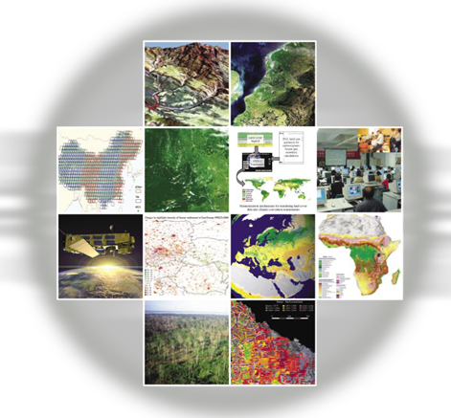
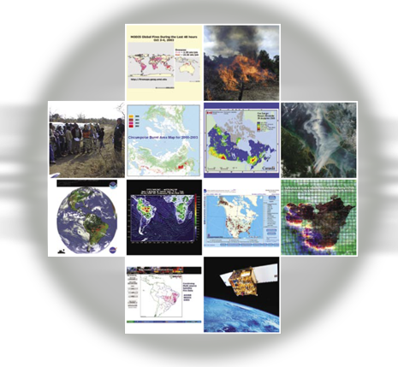
Leveraging from GOFC-GOLD primary themes
Forest Cover Characteristics and Changes
Forest Fire Monitoring and Mapping
Forest Biophysical Processes
Level-changes
Connect themes with development needs
Other focal areas: e.g. Disaster Risk, food
Inter-networking: within/outside GOFC

Slide 4
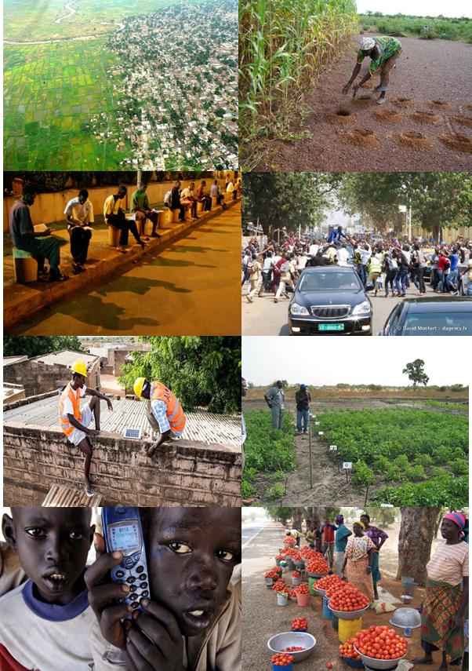
Justification: Sustainability challenges
Land use: rural/urban interfaces
Land degradation/Disaster risks
Energy supply
Youth & jobs/entrepreneurship
Sustainable production and consumption
Food Security
Technology and innovation
Gender and discrimination/equity

Slide 5
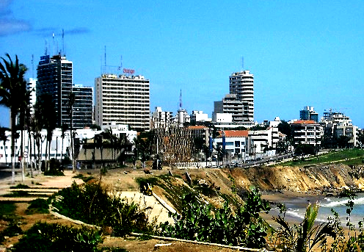
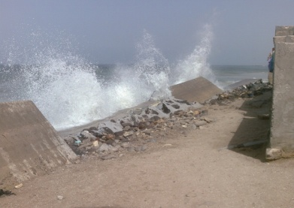
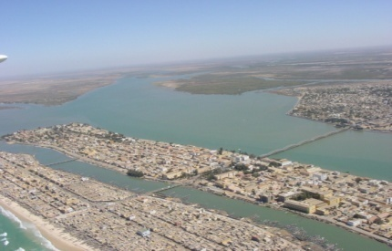
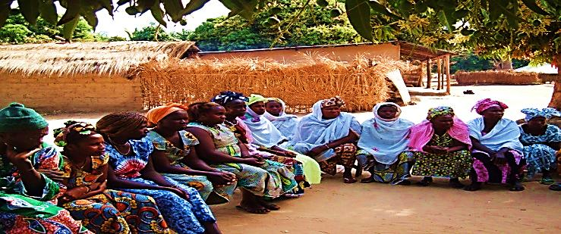
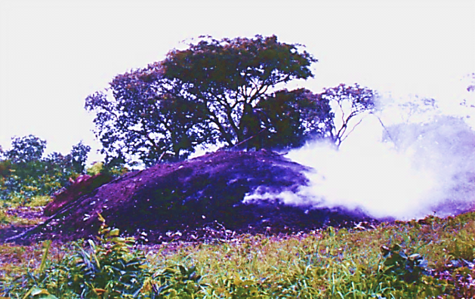
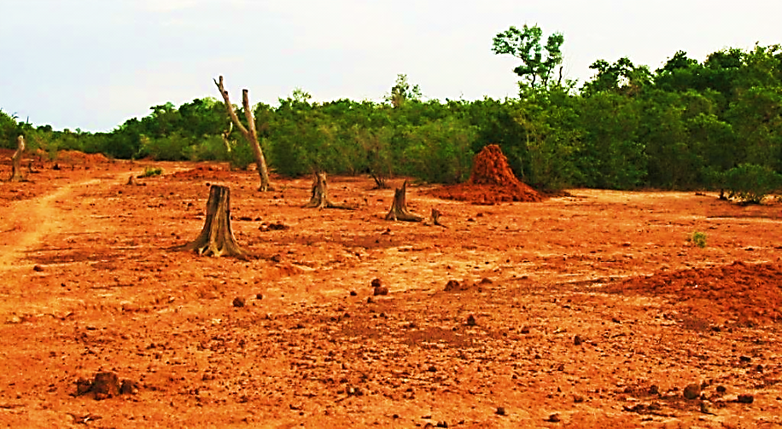
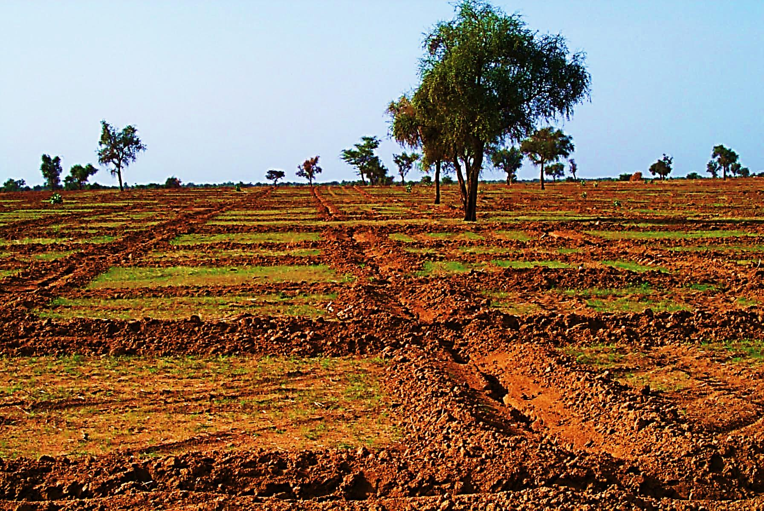
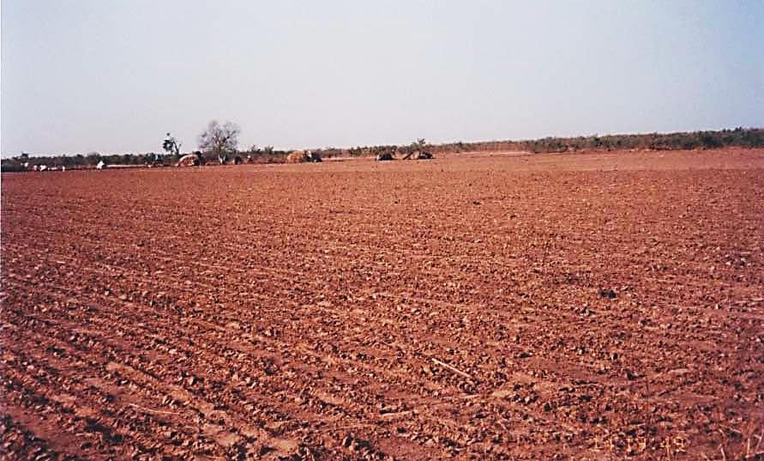
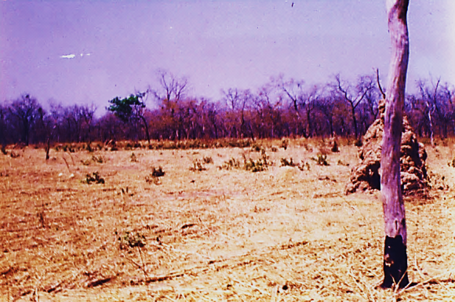
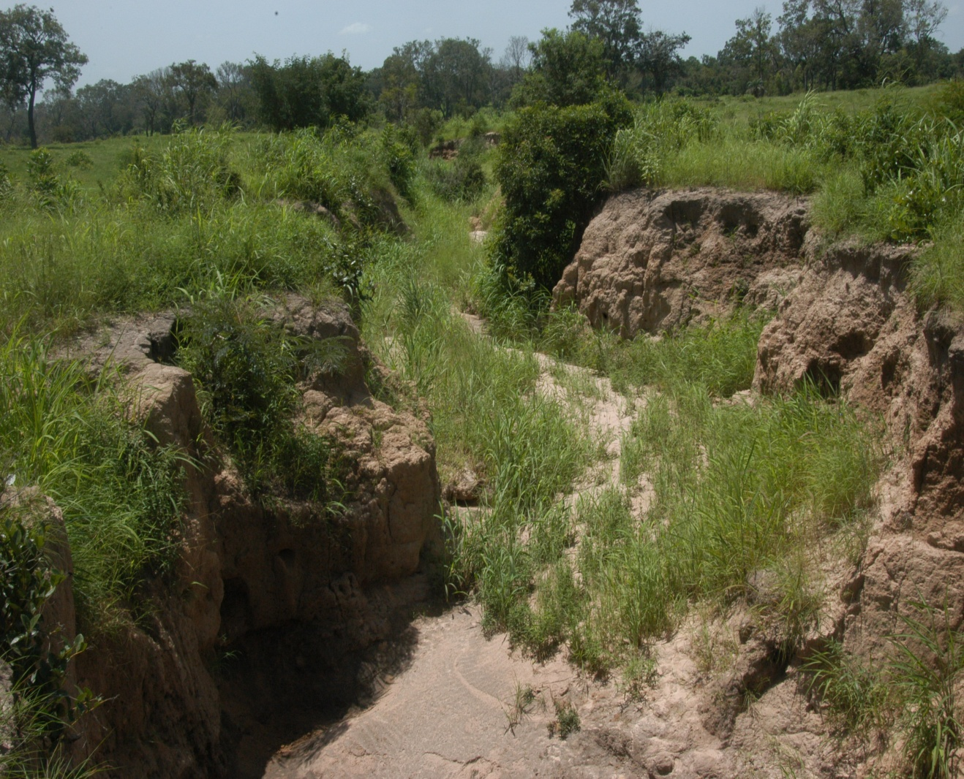
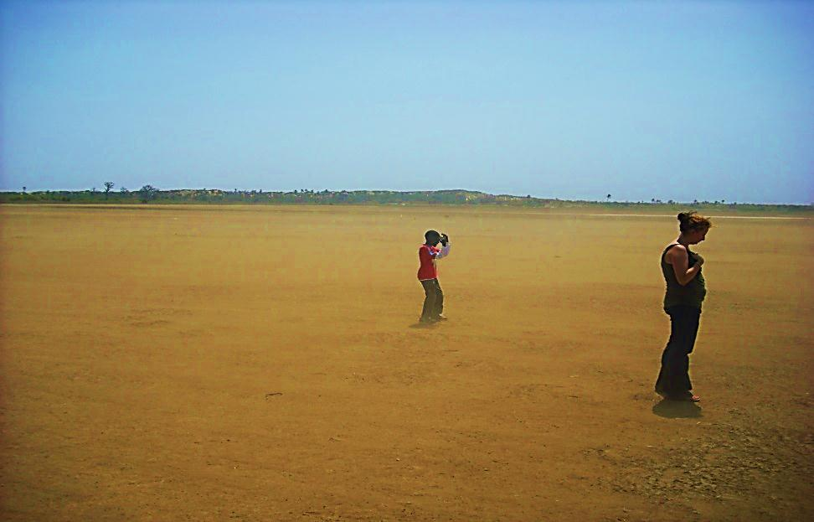
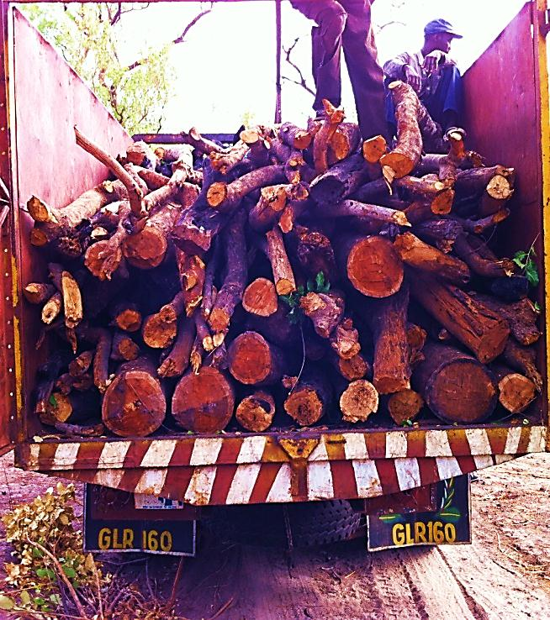
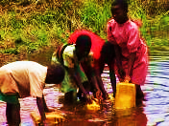
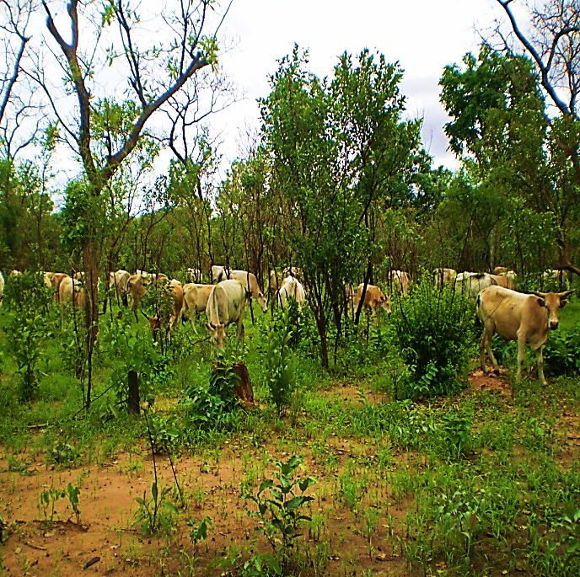
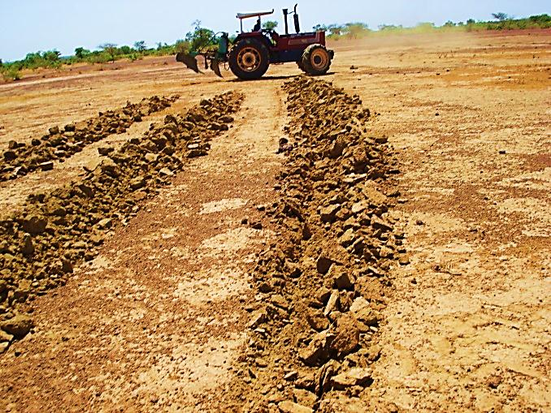
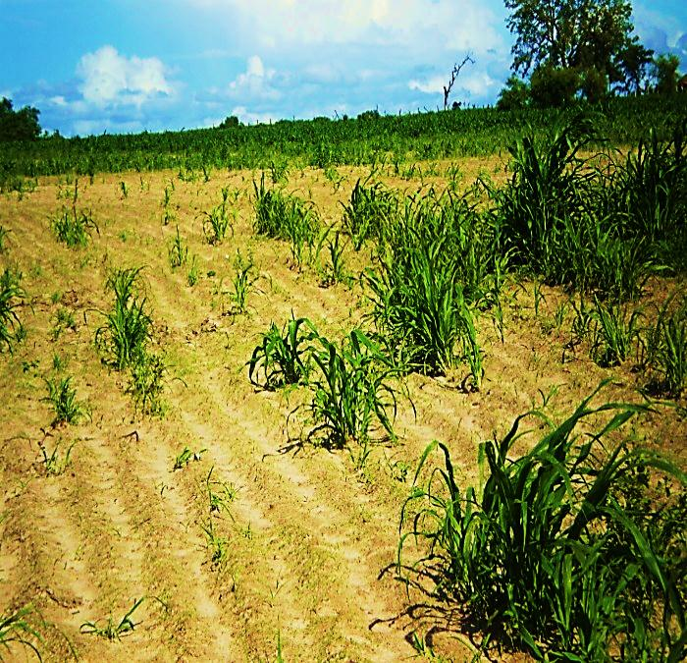
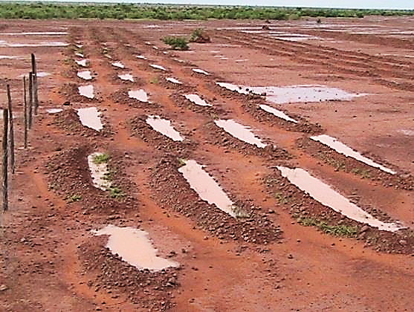
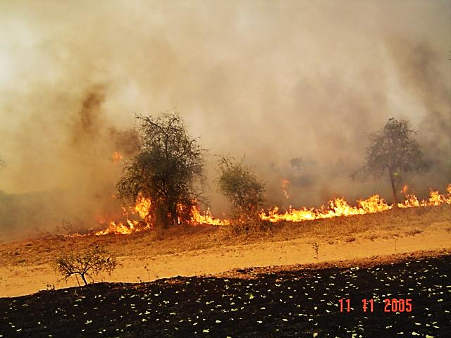
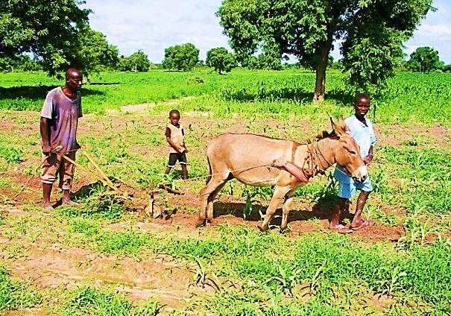
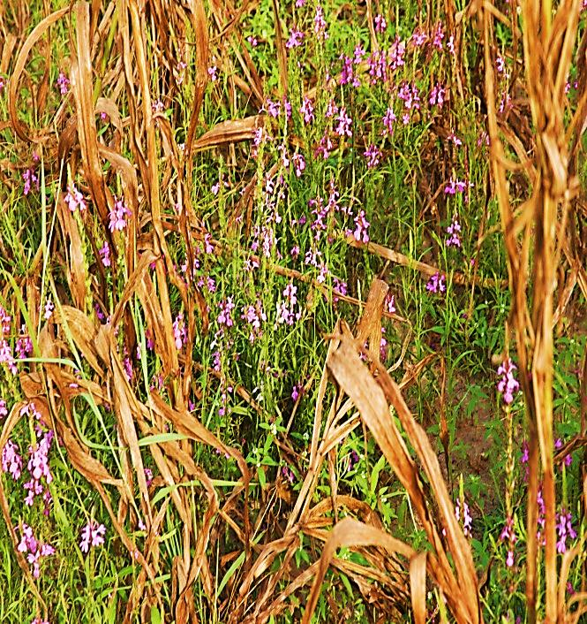
Plurality and overlapping GEC challenges
Coastal erosion
Flooding
Governance, NR
Wood energy
Urbanization
Deforestation
Land leasing
Monocropping
Shifiting cultivation
Erosion
Drought and
Fresh water loss
Wood/timber
Competition
Pastoralism
Restoration
Soil fertility
Water harvesting
Bush fires
Familly farming
Pests, parasites

Slide 6
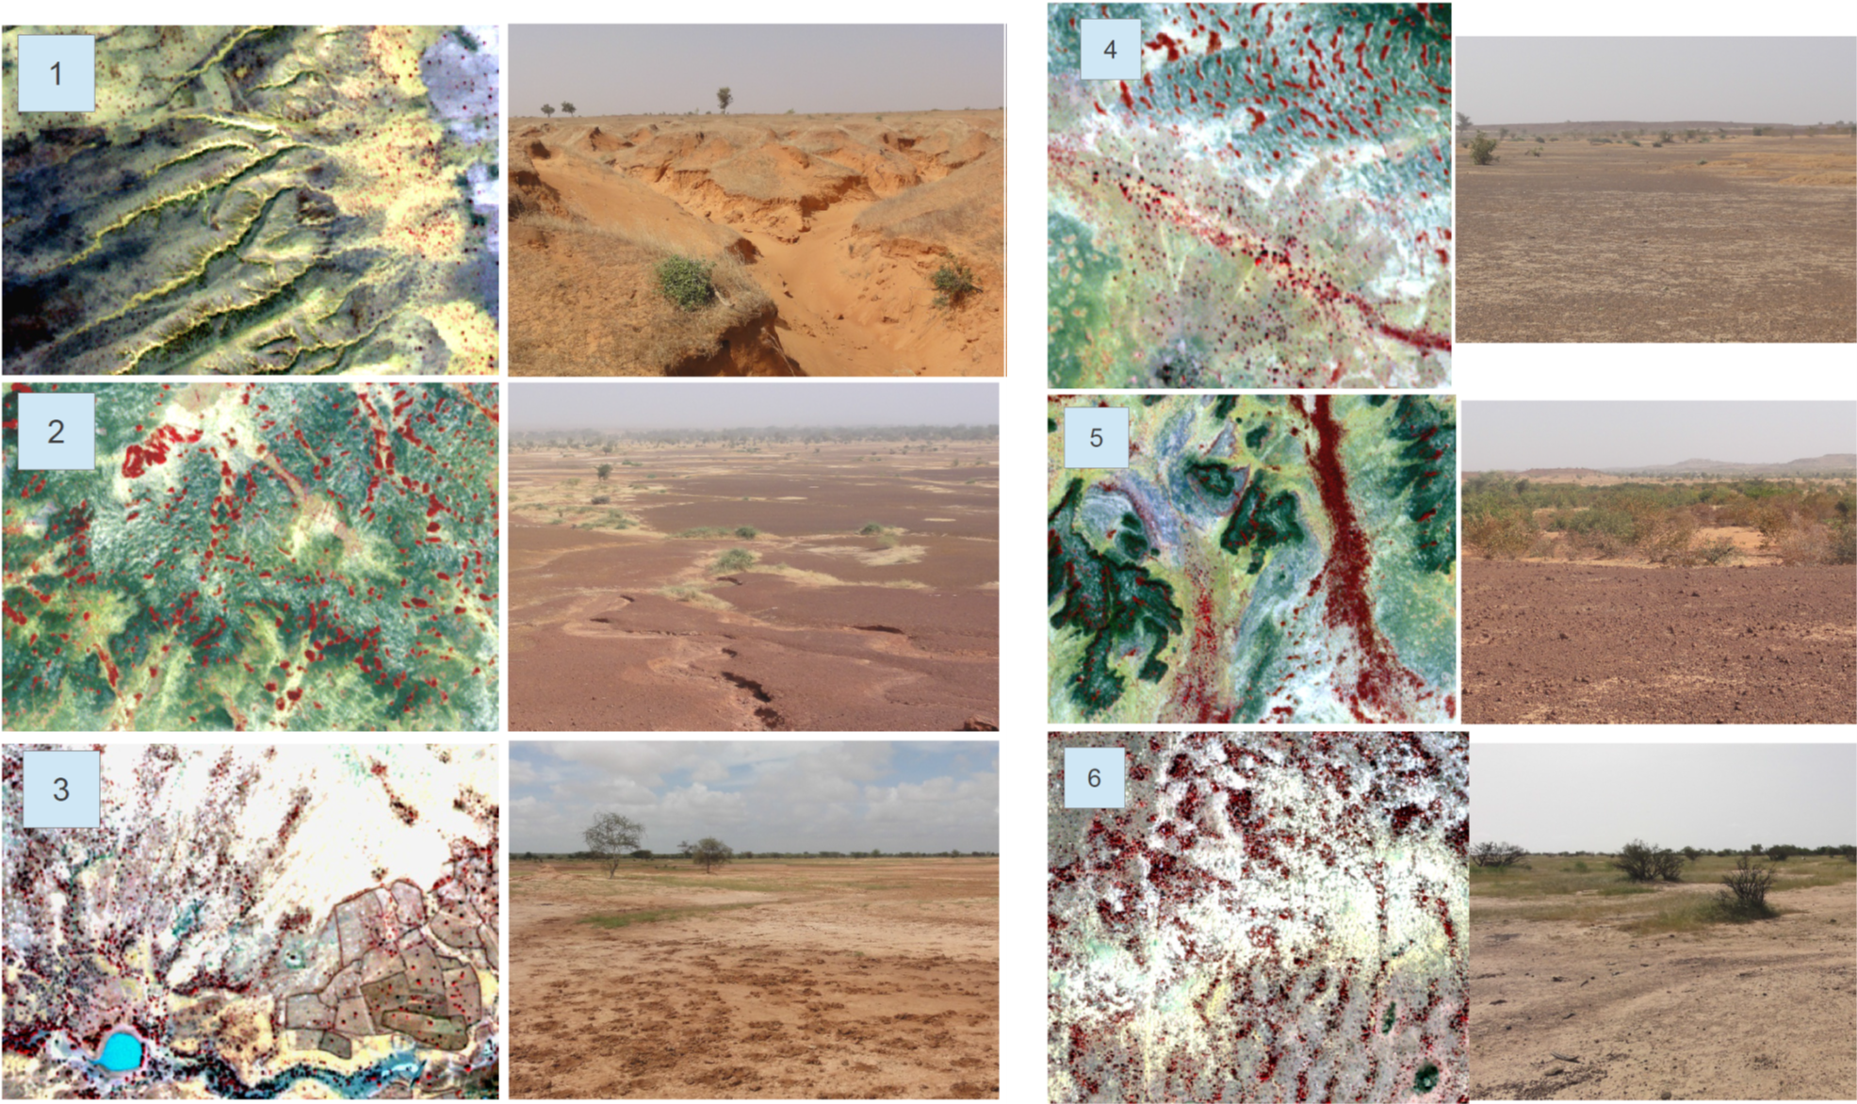

Slide 7
Example: Decision on land use requires multiple integrated information
Development of new EO applications relevant to current and future needs.
Strengthen the Regional Networks for action-research
Explore new funding sources for the regional network

Slide 8
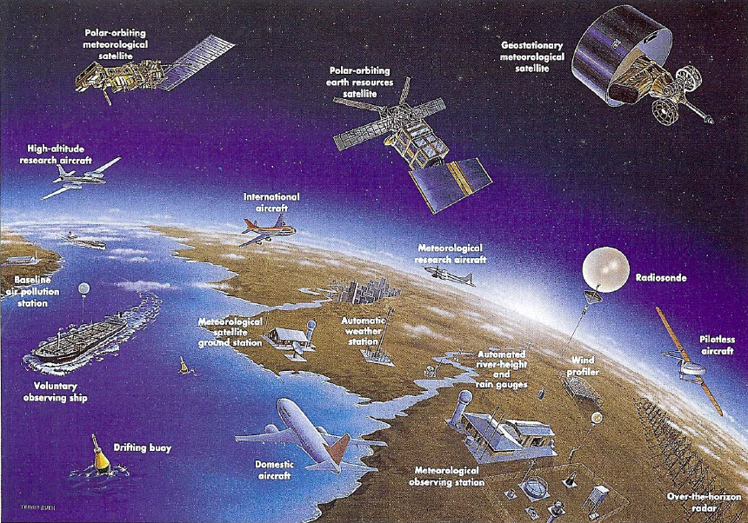
Diversity of EO data:
- not only satellite images
- not only developed countries data

Slide 9
1970-1980
1980-1990
1990-2000
2000-2010+
New opportunity to better monitor Land dynamics
Now with Sentinel data
Visual interpretation of Aerial Photography, analogic analysis, manual mapping |  | Vegetation indices (NDVI), digital image processing, classification, manual vectorization |  | Vegetation Indices, Spectral transformation (Tasseled Cap, ACP), LAI, |  | Vegetation Indices, WUE, FAPAR, LAI, Spectral transformation
Aerial Photos, CORONA, LANDSAT MSS, |  | LANDSAT, SPOT, NOAA |  | LANDSAT, SPOT, ASTER, NOAA |  | RapidEye, GeoEye, IKONOS, Quickbird, SPOT, LANDSAT, ASTER, MODIS
Aerial photos about 2—5 m; Landsat=80m | Panchromatic, 4 band multispectral including NIR bands | From 20-30m to 1 km for NOAA | Multispectral with NIR, thermal and panchromatic | Better spatial resolution of optical data down to 5-15 m | Increase in the number of bands including SWIR | Sub-meter resolution and increase in medium resolution to 250 m | From 3 to more than 10 bands
Mbow, C., M. Brandt, I. Ouedraogo, J. d. Leeuw and M. Marshall (2015). Remote Sensing 7: 4048-4067.

Slide 10
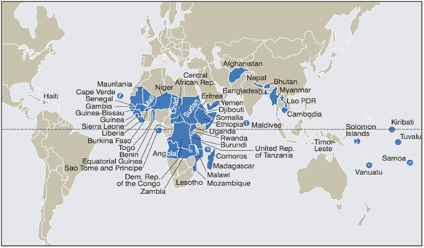
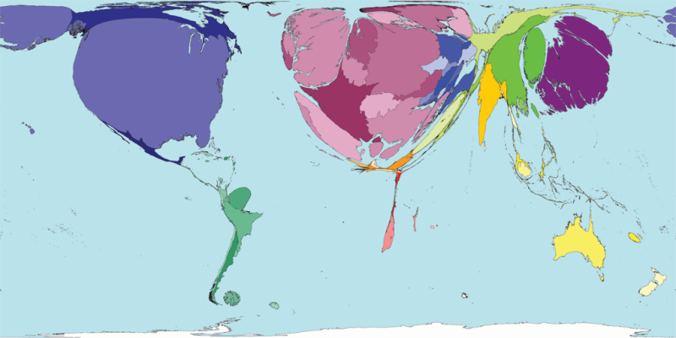
Justification for where START works
Uneven geographies of knowledge production
Global inequalities in knowledge production and exchange. So what is driving this inequality and how can it be corrected?
Least Developed Countries
  Funding + Infrastructure
  Values and practices (Journals and other communication pathways
  Invisible (un accounted) research. Language, Accessibility
Scientific Papers/country

Slide 11
Criteria for achieving impacts using EO
From Impact Factor to Impact Actor
Appraisal of barriers to innovation and need for RS application
Understanding the data needs for improved resources governance
Policy relevant science, demand driven EO products
Promoting learning systems to achieve impact
Knowledge and methodologies sharing and technical support

Slide 12
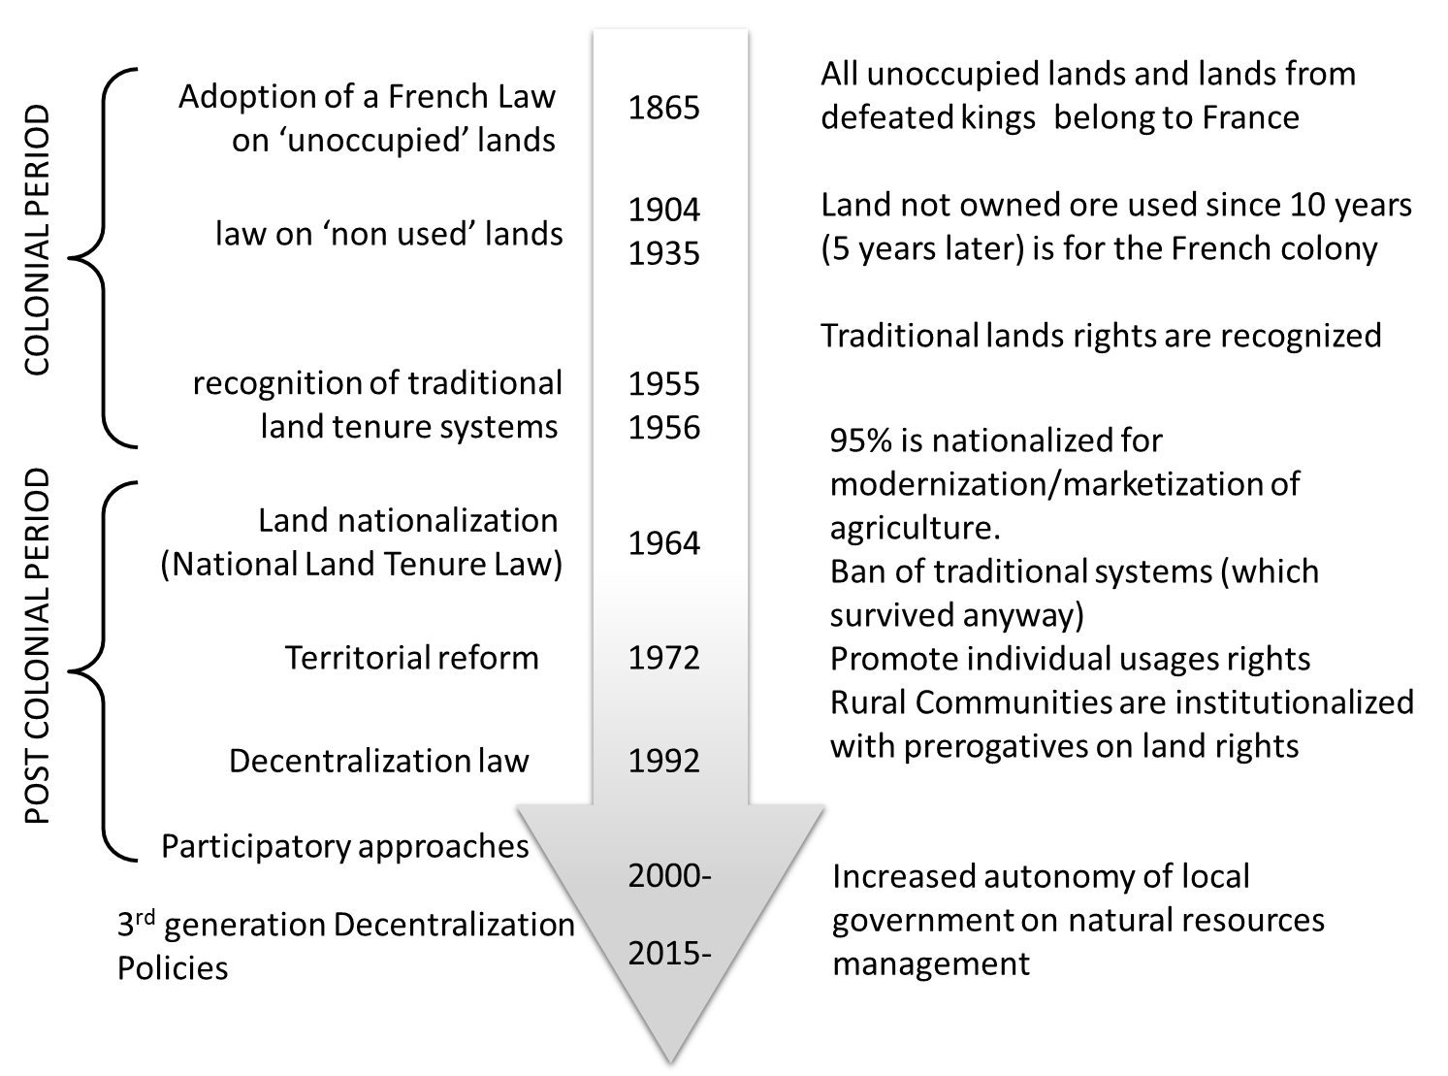
Land use policy trajectory in Africa: down to local
Mbow (2017, Oxford Encyclopedia, forthcoming)

Slide 13
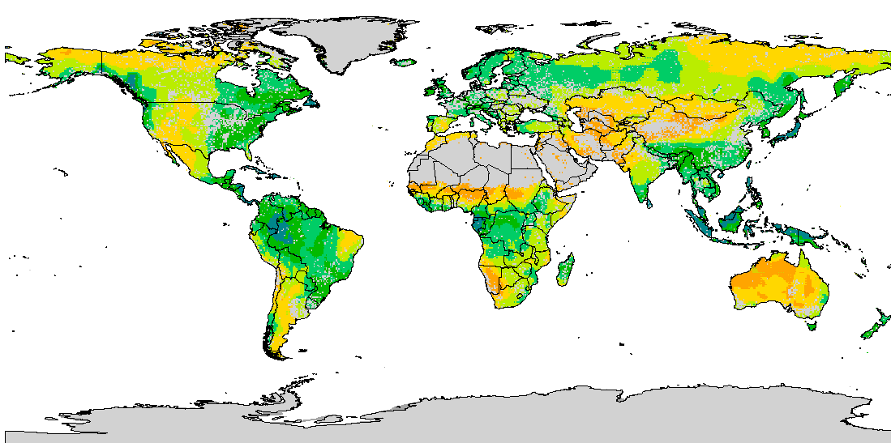
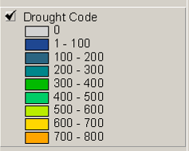
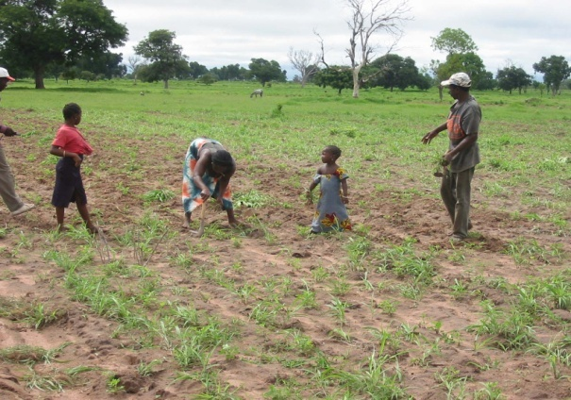
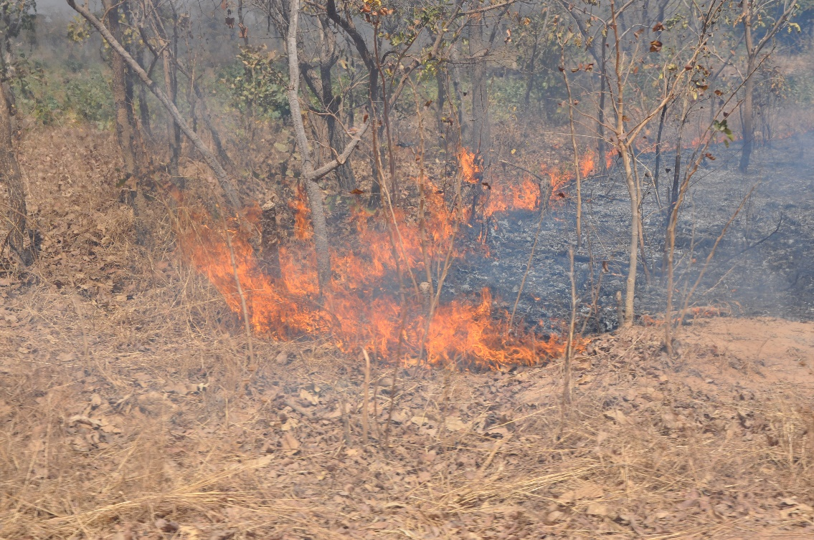
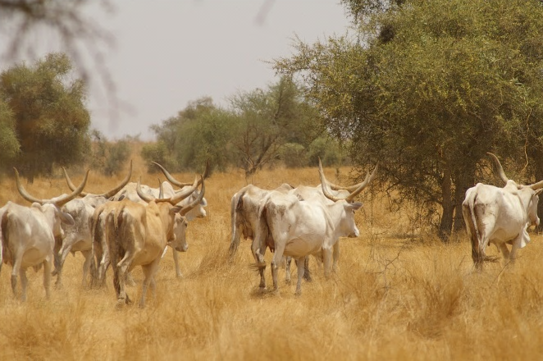
From global products to local practices

Slide 14
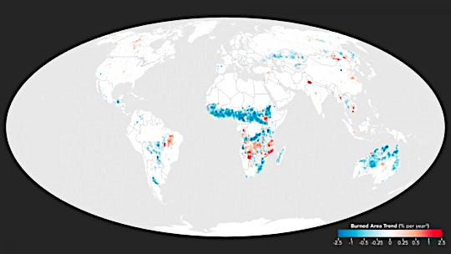
e.g. NASA detects drop in global fires
The global area of land burned each year declined by 24 percent between 1998 and 2015
What does it means to National fire control policies and CC

Slide 15
NOAA AVHRR
Terra/Aqua MODIS
SPOT Vegetation
LANDSAT (MSS, TM, ETM+)
MSG SEVIRI
ERS-1 Windscatterometer
Field spectroradiometer
SPOT (HRV, HRVIR, HRG)
Airborne spectroradiometer
Others: HR images
0
10
20
30
40
50
60
70
80
90
100
Number of studies
Knauer, K., Gessner, U., Dech, S., Kuenzer, S. (2014). International Journal of Remote Sensing, 35:17, 6357-6396

Slide 16
Service to community
Availability of data and products
Promote products through adoption by excellence centers or GOFC “affiliates” (e.g. WASCAL, AGRHYMET)
Need an outreach strategy beyond capacity building: Who do we need to influence? How?
Expand the science sphere towards policies that needs data and RS products (e.g. SDGs, NDCs)
Engage with other stakeholders: local NGOs, local research centers to have a more bottom up flavor in our work

Slide 17
Framework for capacity building
Individuals, Institutions and informal groups
Strategic (GEC) partnerships (e.g. regional centers)
Community of practice (E.g. Core projects in GEC, GOFC/GOLD)
Early career
Stakeholder engagement, targeted groups
Transdisciplinarity
Enable Research
Inform Society
Build capacity

Slide 18
Proposed clusters for GOFC Capacity Building
Remote sensing for e.g. agriculture+current—Bringing Satellite data to Farmer.
Targeting soil fertility interventions
EO for better planning of resource uses
Facilitate science - policy interactions START can develop capacity-building for national technical services
Institutional capacities, framework for data application
Use EO as input to inform policy
Dissemination of satellite based indicators on land performance
Simplified EO products for general public
Policy Briefs on EO applicability in development goals

Slide 19
Other Functions
Scientific synthesis: annual 3 p highlights on scientific results from IT, WG and RN
Use IT to scale-up and to influence transformation (e.g. MOOC)
Work on a better web page (source of information and platform for sharing achievements)
Rethink structure and functions of RN (explore what aspect of each RN that should be replicated in others),
Bottom-up : from local use to global products and vice versa

