Slide 1
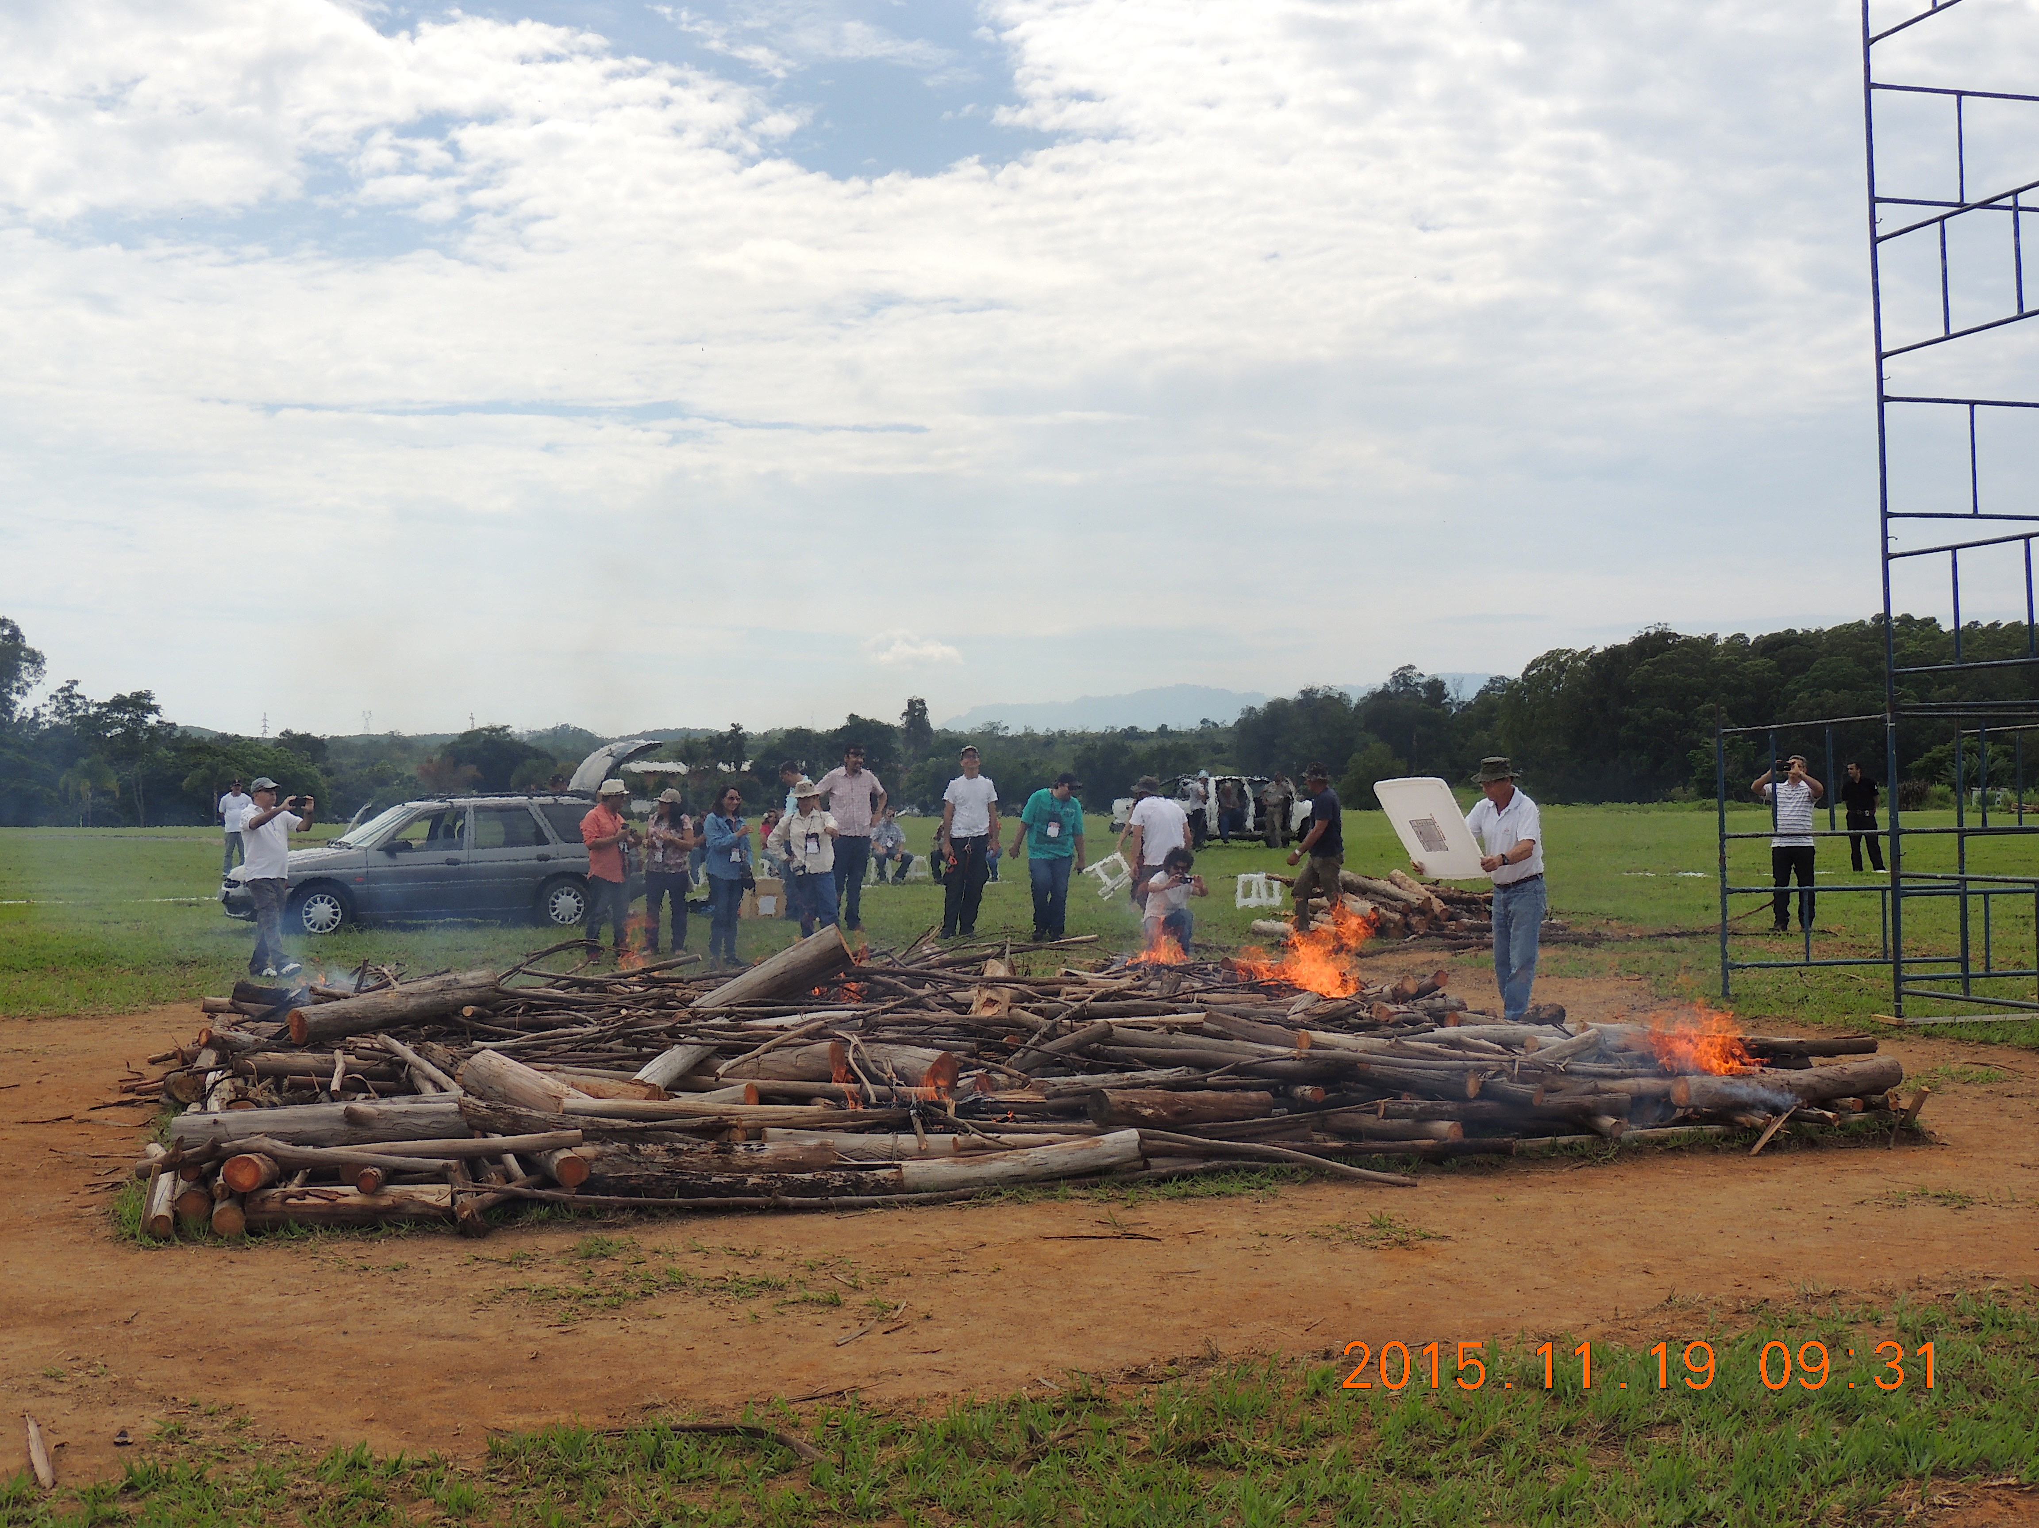
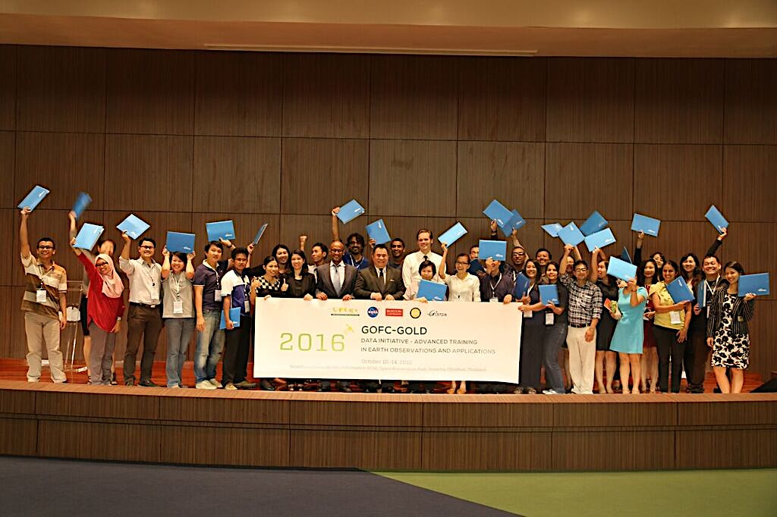
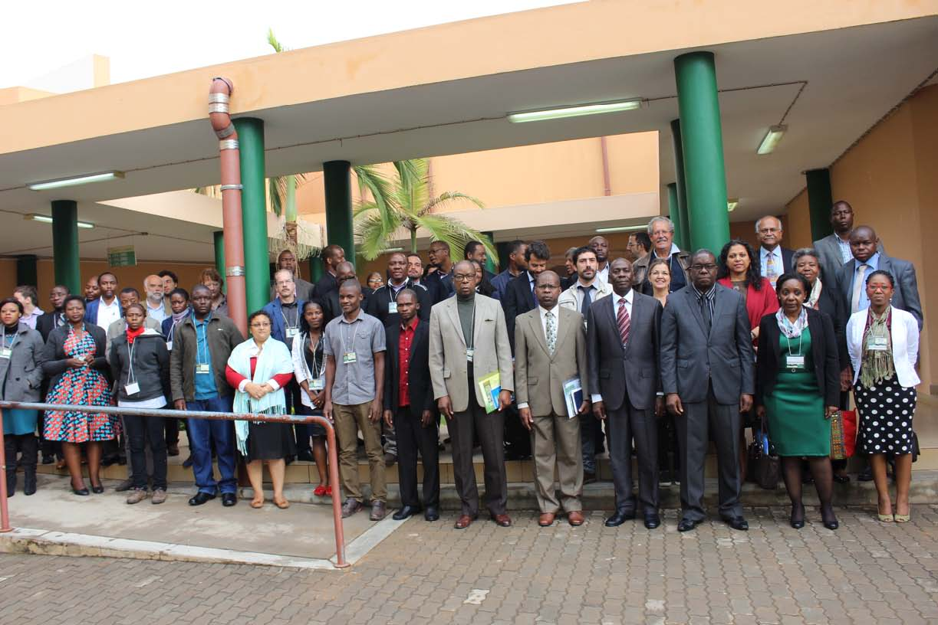
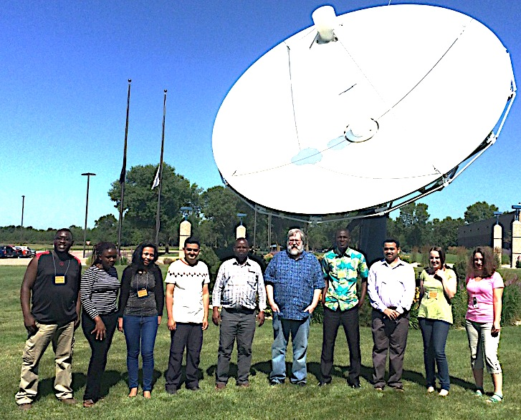
START-GOFC update
Tbilisi 14-16, Sept 2017
Cheikh Mbow

Slide 2
START’s Role in GOFC-GOLD
Cooperative agreement with NASA - START for GOFC-GOLD capacity building since 1997
START contributes to the overall GOFC-GOLD effort to improve developing country
Access to existing data,
Increase scientists’ capacity to utilize and produce information
Regional and international networks of scientists

Slide 3
START’s role
Training on the use of historical archives, global products
Develop capacity building activities on the use of the tools and methods for application of EO on NRM: e.g. biomass assessment, LUC and Fire products, etc.
Bringing regional expertise to address geographically differentiate EO needs

Slide 4
START-GOFC Strategy (Specifics on CB)
REQUIREMENTS/NEEDS
GOFC networks
Source of Funding (NASA)>>+
Regional: GISTDA, WASCAL
GOFC expert groups (LULC, FIRE)
May be new thematic areas
START Capacity Building
Regional Networks
Thematic areas
Data
“producer”
Science
Data
“users”
APPLICATIONS

Slide 5
Capacity Building Modalities
Data Initiative, Advanced Institutes on data and analysis
Partners: EROS, BU
Partnership Enhancem-ent Awards (visiting scientists)
Partners: MD
RN-Regional Network Workshops
NASA; NOAA; UMD; Universities in host countries.
Support for Scientists (RNs) to attend Intl. Conferences
GOFC/Non-GOFC Science meetings
More south-south

Slide 6
START support for RN and GOFC Meetings in 2016
GFOI R&D and GOFC-GOLD Land Cover Science Meeting (Hague, Netherlands, 31 Oct – 4 November 2016)
SCERIN-4 on LCLUC challenges (Slovakia July 19-22, 2016 )
International Meeting on Land Use and Emissions (Oct 17-19 2016, Ho Chi Minh City, Vietnam)
REDD+ Monitoring, and Measurement, Reporting and Verification workshop (19-23 September 2016, Addis Ababa, Ethiopia)
GOFC GOLD Fire IT Implementation Team and JRC, European Commission Meeting (November 15-17, 2016, Santiago, Chile)
REDD+ Monitoring, and Measurement, Reporting and Verification workshop (February 6-10 2017, Abidjan, Cote d’Ivoire)
Miombo Woodlands - Restoration To Sustain Socio-Ecological And Socio Economic Relationships (July 27-29 2016, Maputo, Mozambique)

Slide 7
START support for RN and GOFC Meetings in 2016
SCERIN 5 – Land cover changes and natural hazards - integrated watershed and forest management for environmental, economic and political stability: Pecs, Hungary (20-23 June 2017)
SARI International Operational Mapping/Monitoring of Agricultural Crops in South/Southeast Asian Countries – Research Needs and Priorities (Chennai, India, May 2-4 2017)
Regional Science Meeting in South/Southeast Asia Chiang Mai, Thailand (July 17‐19 2017)
Caucuses Regional Network kick off (September 11-12 2017)
2017 GOFC-GOLD Regional Networks Summit (September 13-15 2017)
RedLATIFF: Burned Area Estimation in Latin America using a Collaborative Virtual Environment (Mexico city, August 1-3 2017)
WARN/WASCAL/START (possibly SERVIR-Niger) event (Nov 29-31 2016)

Slide 8
Data Initiative - Advanced Training in Earth Observations
Activities:
First training outside USA: October 10-14, 2016 with GISTDA, in Sriracha, Thailand
10 countries; 30 fellows
Engage with Department of Earth and Environment, Boston University (Prof. Pontus Olofsson)
Regional expertise: Prof. Le Van Trung (Vietnam University Institute of Technology) and 3 additional trainers from GISTDA
Outcomes
Continuous use of EO data
Inform the community about new products and new application
Move to higher level products and address local environmental challenges
Engage regional expertise by transferring the data initiatives in the region.

Slide 9
Partnership Enhancement Awards
Activities
Visiting Scientist Award Washington DC July 22-29, 2016 (University of Maryland and the International START Secretariat )
3 from Vietnam and Thailand: helped prepared the data initiative training and subsequent activities in Asia.
Outcomes
Agreement on future activities and engagement of regional partners
2 Regional Activities in Asia (HCM City and Sriracha)
South-South Collaboration within GOFC to create more knowledge exchange amid networks
2016 Data Initiative: 10 countries; 30 fellows, a significant increase from past trainings in the US (average 6-8 fellows.

Slide 10
Cross-program collaboration
START has Supported other activities
12th International Workshop on Greenhouse Gas Measurements from Space (IWGGMS-12), which took place in Kyoto University, Japan, during 7-9 June 2016
Building Sustained Capacity to Use Earth Observations to Enhance Environmental Management Decisions, AGU meeting; San Francisco, CA (December 12, 2016)
Visits to ESA in June 2017th : Explore new Collaboration with other spatial agencies

Slide 11
Outcomes of the regional workshops
Outcomes
Develop critical mass: About 400 direct participations (387p in 2016)
Trigger engagement: Engage with 20 organizations including: Universities, International Organizations, national institutions and All regional networks
Connect with regional stakeholders: need more local stakeholders, users of data and EO information (e.g. WASCAL, Vital Signs, Agrhymet)
Mapping with GOFC strategic objectives
Forest and Land Observations, Carbon dynamics and management, Biodiversity and ES
Climate Impacts (NDCs), land use based GHG
Long term Sustainability issues

Slide 12
Food for thoughts
New opportunities for cross-network knowledge exchange
Reinvigorate existing RNs
Connect GOFC-GOLD local policy agendas such as SDGs, NDCs
Joint Calendar on EO & Capacity development
Local data and information from EO
Annual activity plan and resource mobilization

