Slide 1
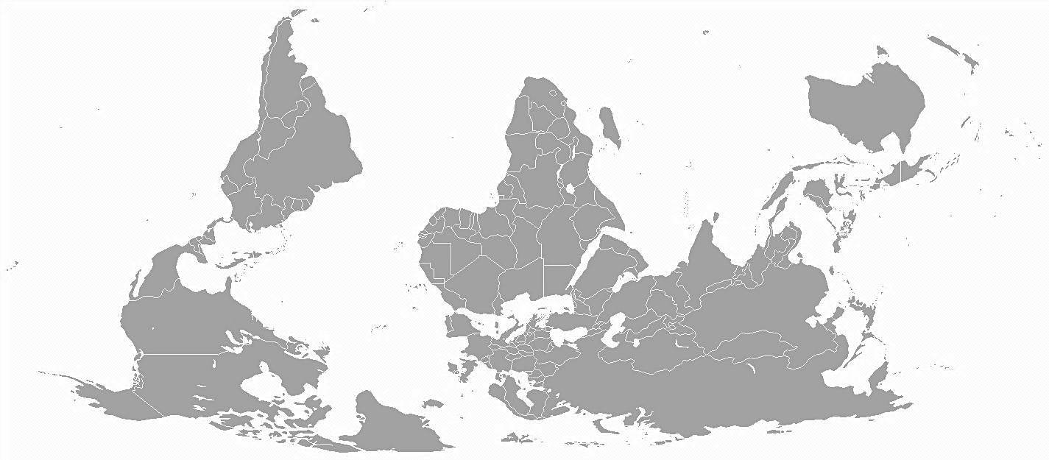
Regional Networks under GOFC-GOLD
Senay Habtezion
GOFC-GOLD Caucasus Network Kick-off Meeting
Tbilisi, Georgia,
11-12 September 2017

Slide 2
Outline
GOFC GOLD functions – CB function
START’s role in GOFC-GOLD
CB modalities for RN support
START support to recent RN & related events
Lessons for the CaucRiN RN

Slide 3

GOFC-GOLD – Fast facts
A coordinated international effort to ensure a systematic and continuous program of observations of forest and land cover
Information and knowledge sharing is a core objective
The objective is realized through a vast web of collaborations and partnerships – RNs key in such collaborattion

Slide 4
Fast facts …
Among GOFC functions
Assessing algorithms and data assimilation procedures
Ensuring the availability of observations
Harmonization and the development of protocols and standards
Capacity building
Supporting international assessments
Advocacy for continuity of observations and validation
GOFC-GOLD
Regional Networks
Land Cover IT
Fire IT
Biomass WG
REDD WG
Executive Com

Slide 5


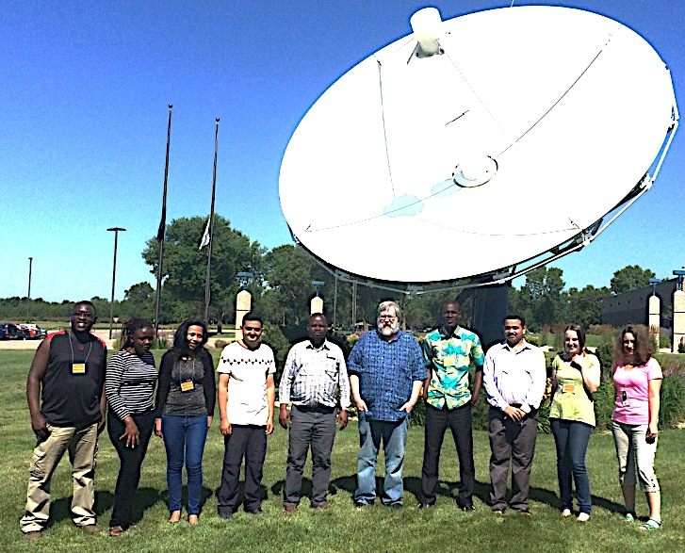
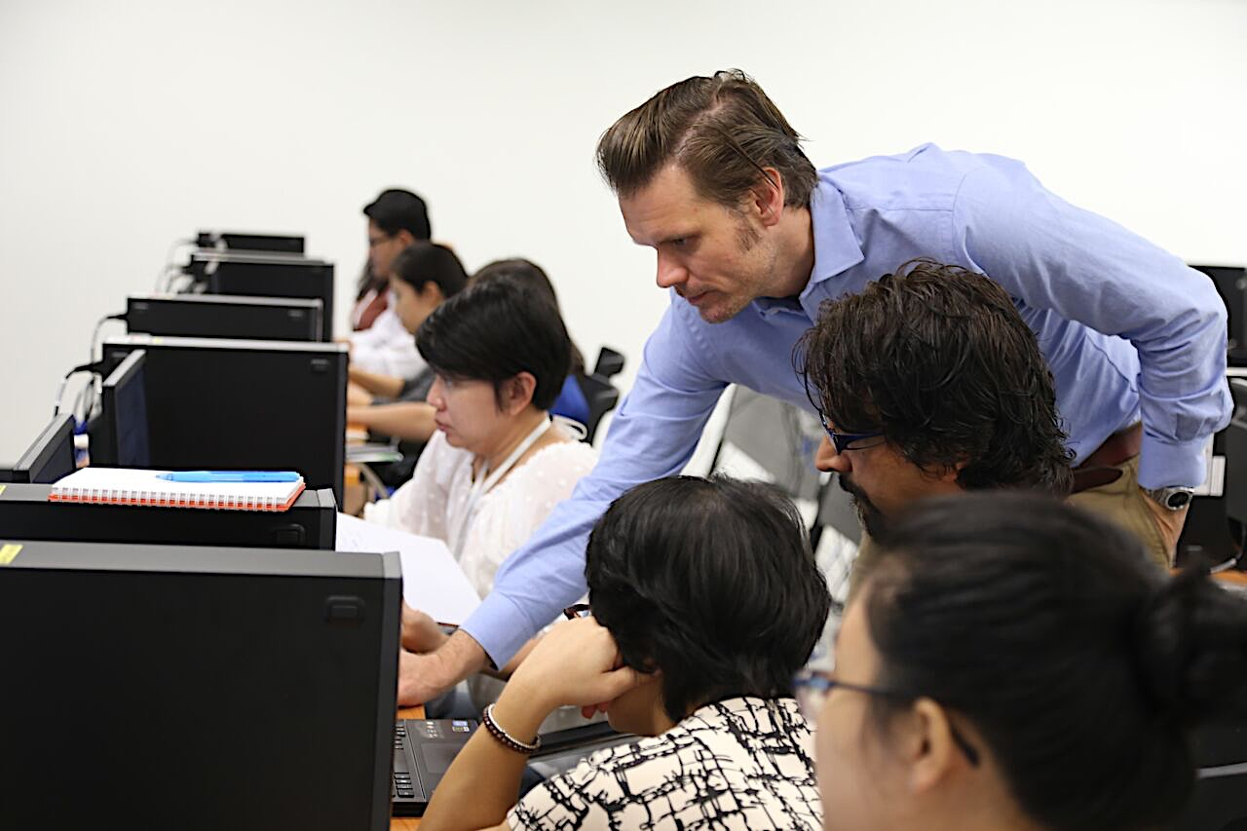
START - GOFC-GOLD
Part of GOFC-GOLD capacity building since 1997; currently implementing a 3 year cooperating agreement with NASA
Contributes to overall GOFC-GOLD CB function (main focus on support for RNs)
Iterative and Integrative approaches to CB (e.g. GOFC RN reps engaged and reengaged in other START programs – e.g. GEC grants in Africa; IDRR Asia)

Slide 6
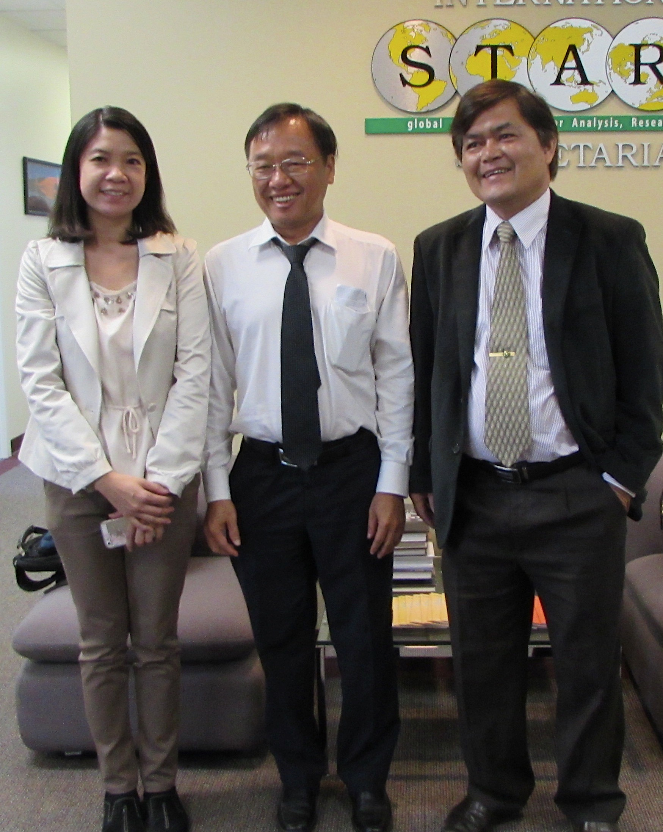
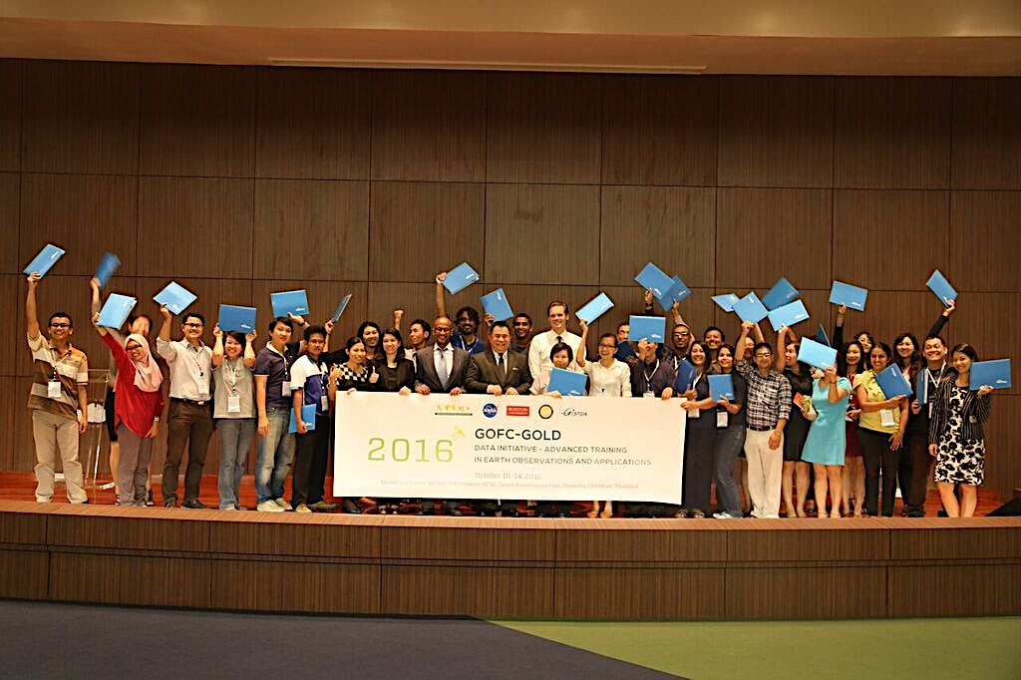
GOFC-GOLD CB Modalities
Regional Networks Workshops (usually with a built-in training event for young scientists)
  Data Initiative (1-2 week training) (may include data distribution)
Visiting scientists program
Small opportunity grants: Support RN in GOFC IT, WG or other key Intl meetings
GOFC-GOLD Conference / Regional Networks Summit

Slide 7
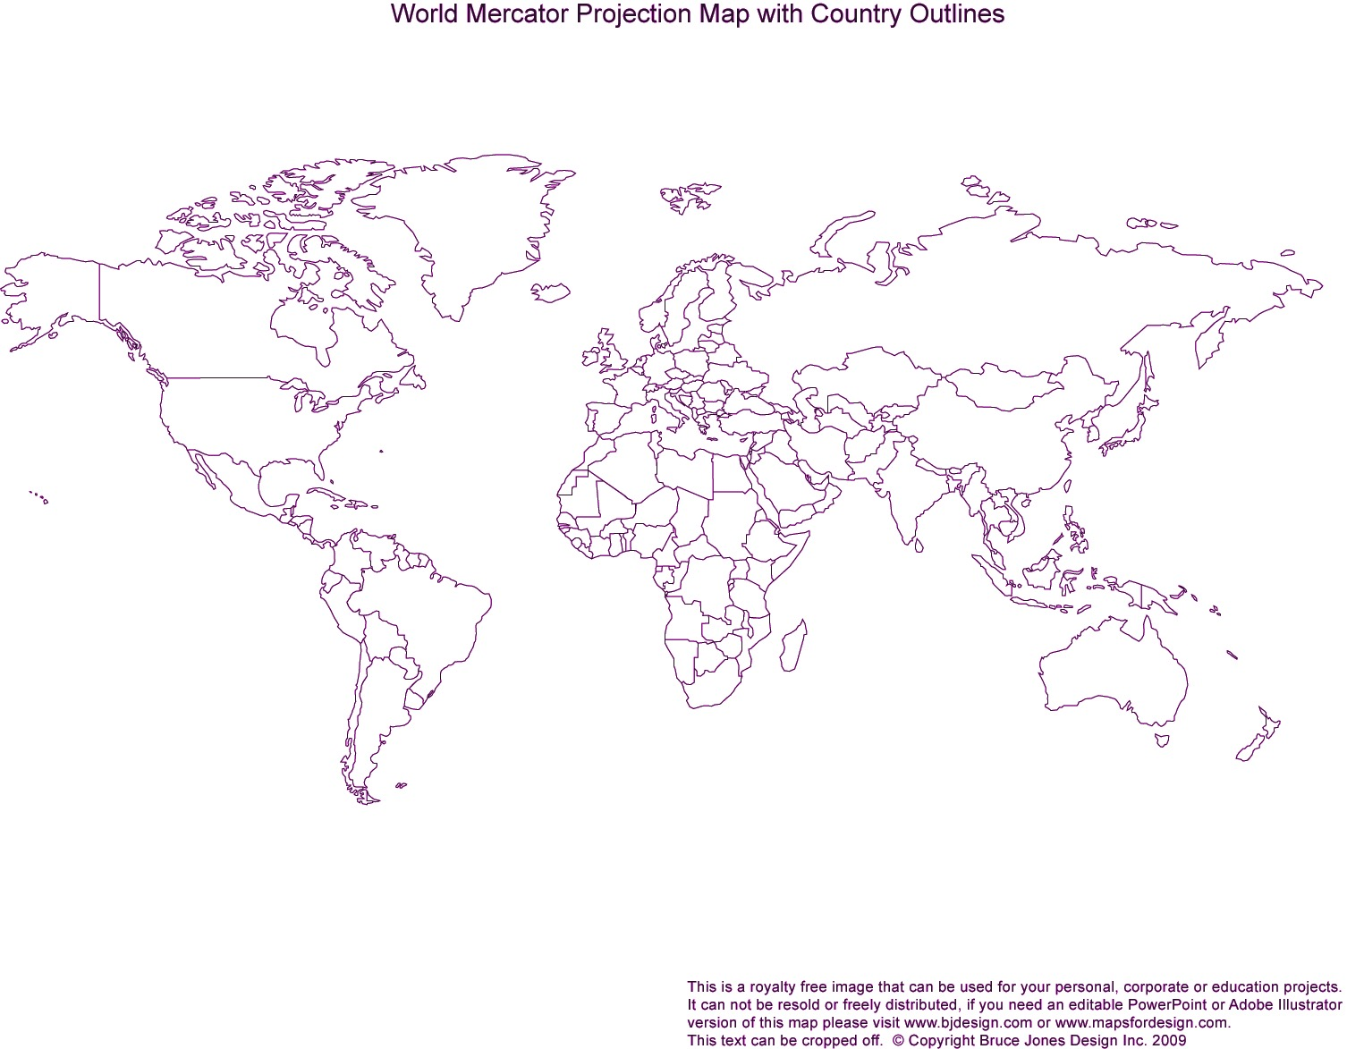
START support for RN and & related GOFC events - 2016
GFOI R&D and GOFC-GOLD Land Cover mtn (Hague, NL, 31 Oct – 4 Nov 2016)
SCERIN-4 (Slovakia July 19-22, 2016 )
SARI/SEARRIN (Oct 17-19 2016, Ho Chi Minh City, Vietnam)
REDD+ MRV Training (19-23 Sept 2016, Addis Ababa, Ethiopia)
GOFC GOLD Fire IT Implementation Team (Nov15-17, 2016, Santiago, Chile)
REDD+MRV training (Feb 6-10 2017, Abidjan, Cote d’Ivoire)
Miombo RN (July 27-29 2016, Maputo, Mozambique)

Slide 8
START support for RN and & related GOFC events - 2017
SCERIN 5 –Pecs, Hungary (20-23 June 2017)
SARI/SARIN (Chennai, India, May 2-4 2017)
SARI / SEARRIN Chiang Mai, Thailand (July 17‐19 2017)
Caucuses Regional Network kick off (Sep 11-12 2017)
2017 GOFC-GOLD RN Summit (Sep13-15 2017)
RedLATIFF: (Mexico city, August 1-3 2017)
WARN/WASCAL/START (possibly SERVIR-Niger) event (Nov 29-31 2016)

Slide 9
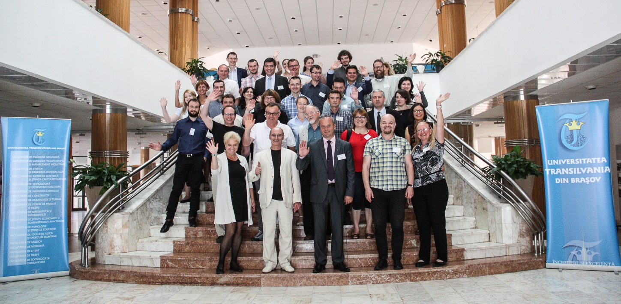
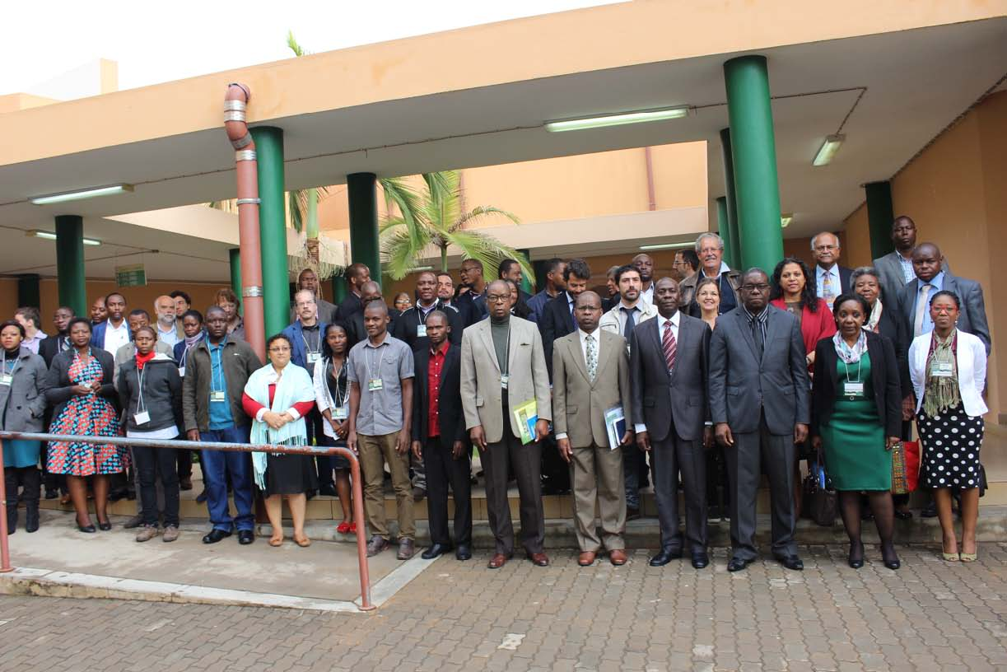
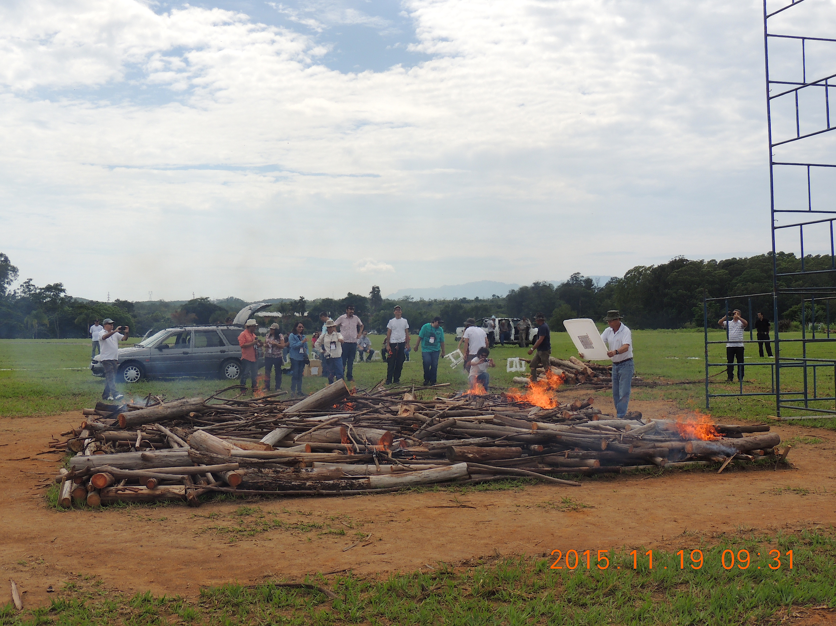

Slide 10
Networks of scientists and practitioners with research interest in a region (different thematic interests and focus)
Carry out multiple GOFC functions; key role in CB (e.g. Data Initiative)
Contribute to implementation teams and working groups
Some more active and more organized and more self-governing than others; some are dormant and probably exist in name only

Slide 11
Caucasus Regional Network - CaucRiN

Slide 12
Lessons for CaucRiN
Collaborative work between RN meetings helpful for maintaining cohesion (e.g. joint research, student exchanges)
Some level of formality needed (e.g. website; membership list)
Network with like networks (e.g. SCERIN)
Embed within existing institutions
Autonomy should be a key goal
Success a function of personal relationships and commitments

Slide 13




Thank you !!

