Slide 1



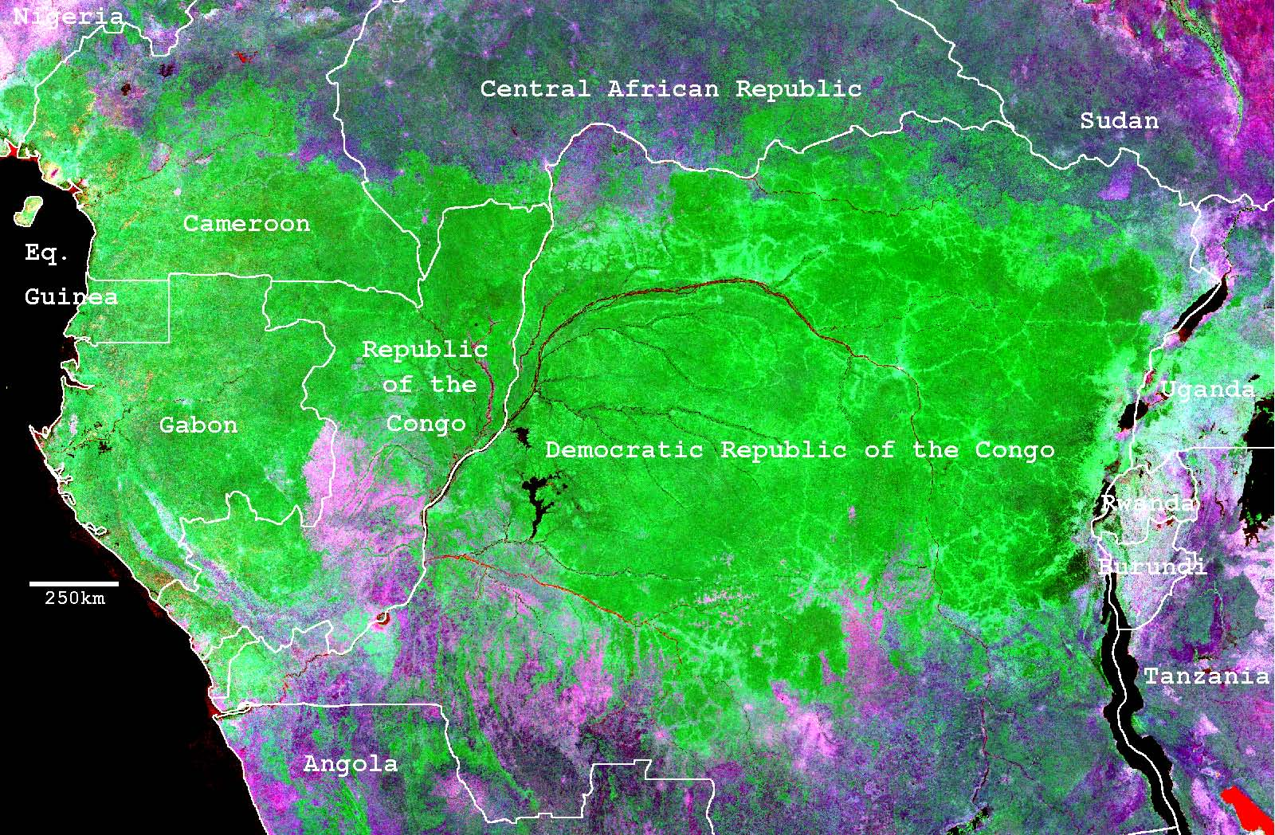
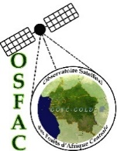




GOFC-GOLD Regional Networks Summit
Tbilisi, Georgia
13-16 September 2017
Monitoring the Forest Resources and
Environment of the Congo Basin
Presented by : Landing MANE and Edweige EFFA

Slide 2
Who is OSFAC
Founded in 2000, OSFAC is a representative of GOFC GOLD Network in Central Africa
Free dissemination of satellite imagery in the countries of the Congo Basin
Capacity Building in Remote Sensing (RS)
and Geographic Information Systems (GIS)
Monitoring and Evaluation of forest cover loss and changes
OSFAC Support
Financial Support : USAID/CARPE, USFS, EU, FAO, World Bank, WRI
Technical Support : UMD, SDSU, NASA, GOFC-GOLD, START

Slide 3
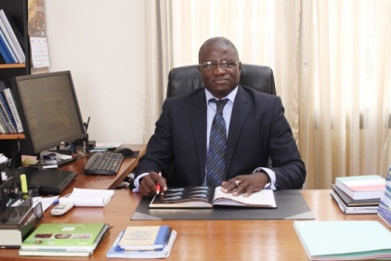
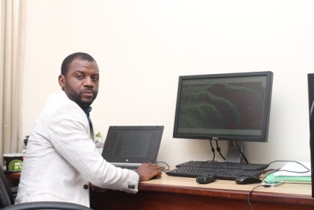

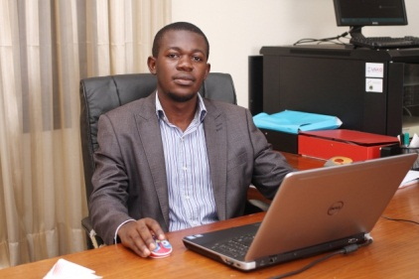
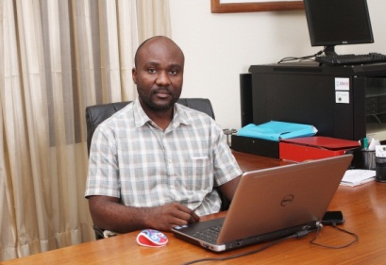
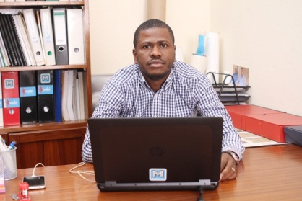
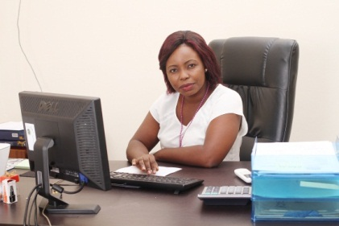
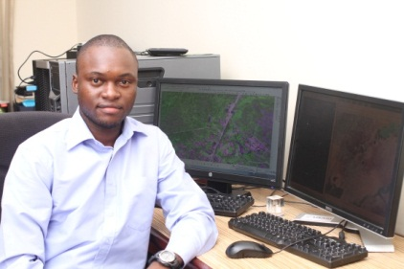

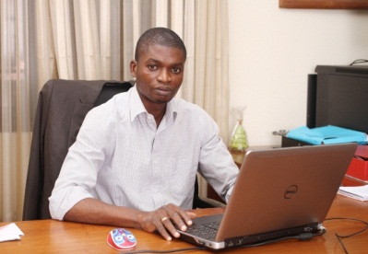
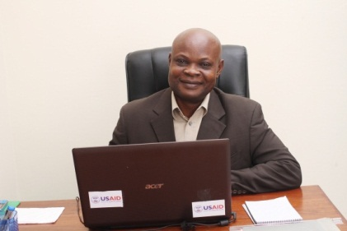
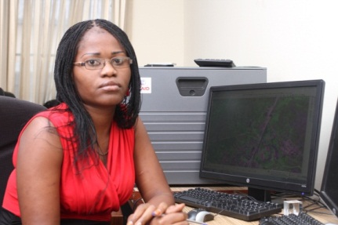
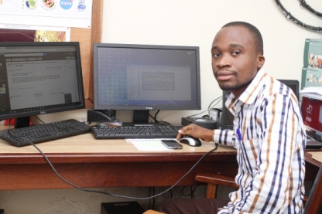
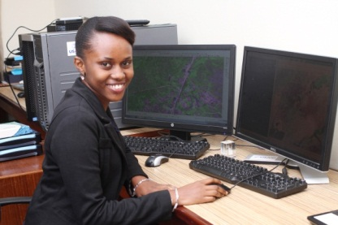
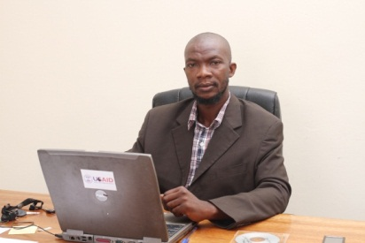
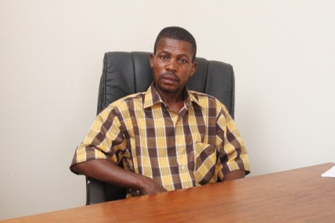
OSFAC Permanent Staff
Dr LANDING MANE
OSFAC Director
André MAZINGA
RS/GIS Lab Manager
Micheline KALUMUNA
Financial Manager
Eric LUTETE
GIS Lab Manager
Eddy BONGWELE
CO2M&M Coordinator
Dr. Landing Mané
OSFAC Director
Hervé KASHONGWE
Moabi Coordinator
Nadine LUKENI
Administrative Assistant
Cédric SINGA
Remote Sensing/GIS specialist
Nandy YELA
Receptionist
Serge KALAWU
CO2M&M Coordinator Assistant
Guy Georges NGAY
Bussiness Plan Manager
Olga MAKONGA
GIS Lab Assistant
Victor KADIATA
Data Base Manager
Carine MAWUWA
Intern
Guy Robert KAYEMBE
Logistician/Driver
Pierre SAKALA
Cleaner

Slide 4


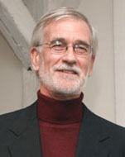

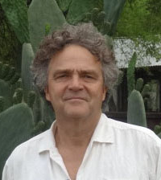
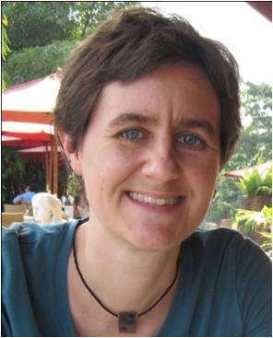
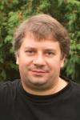
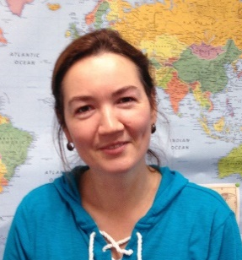
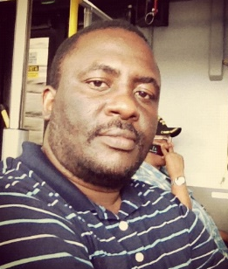
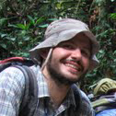


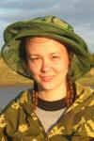
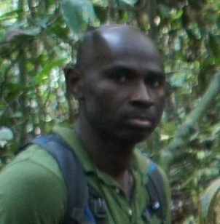
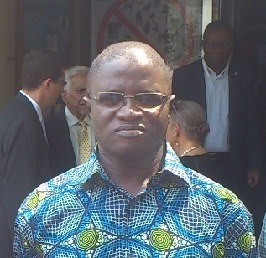
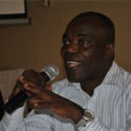
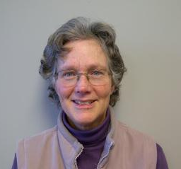
NASA / Department of Geographical Sciences
Principal Investigators and Research Scientists
Jim Tucker
NASA Senior Earth
Scientist
Matt Hansen
Professor
Chris Justice
Professor
Janet Nackoney
Research Professor
Peter Potapov
Research Professor
Svetlana Turubanova
Research Associate
Graduate Students
Post - Doc
Patrick Lola Amani
Giuseppe Molinario
Yolande Munzimi
Sam Jantz
Alexandra Tyukavina
In-region Collaborators
Project Management
Ifo Averti Suspense
Professor
University of Marien Ngouabi
Landing Mane
Director
OSFAC
Raymond Lumbuenamo
Professor
University of Kinshasa
Alice Altstatt
UMD-CARPE Project Manager

Slide 5
Critical issues in the region
Data sharing - Satellite Data and derived products dissemination
Capacity building
Regional monitoring of forest cover, forest change and carbon stocks using satellite data / REDD+
Alerts Forest Loss inside CARPE Landscapes
Active Fire analysis in CARPE Landscapes
Climate change and biodiversity analysis and mapping

Slide 6
Countries involved in OSFAC activities : Cameroon, Gabon,Central Africa Republic, Equatorial Guinea, Republic of Congo, DR Congo, Tchad

Slide 7
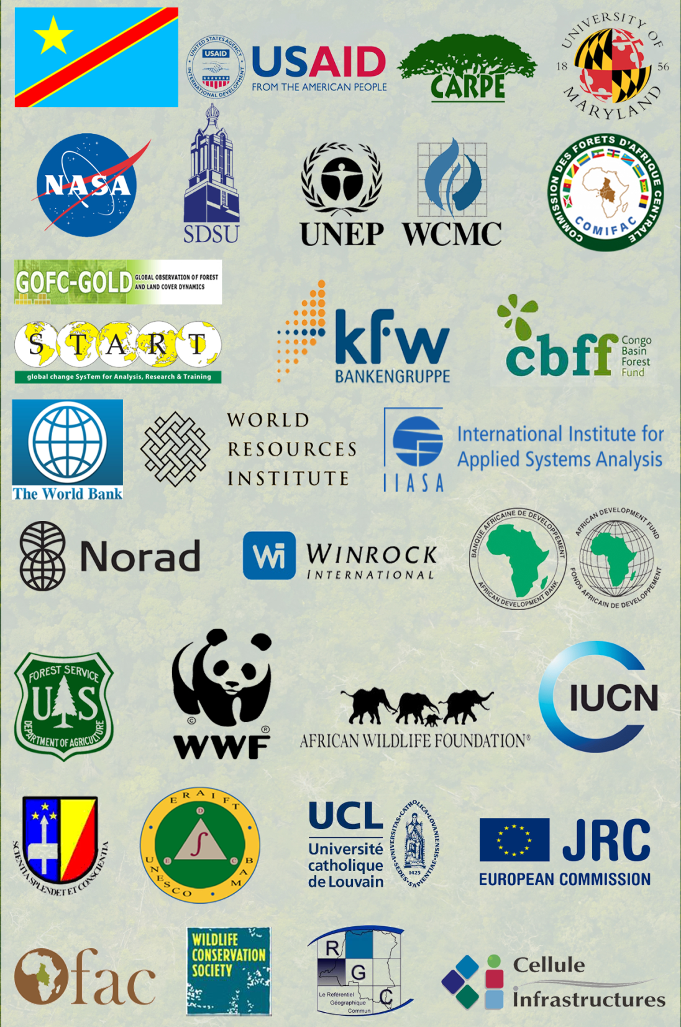
OSFAC
Partners

Slide 8

Research projects accomplishments:
Reseults, publications, etc

Slide 9
Data sharing: Satellite Data and derived products dissemination
Task 1 :

Slide 10
OSFAC Data Management Tool “OSFAC-DMT”
To facilitate the distribution of images in the sub region, OSFAC developed the "OSFAC Data Management Tool (DMT OSFAC)“
OSFAC DMT allows users to interactively query the OSFAC database of satellite data.
Versions :
OSFAC-DMT Online 2.0.1 : http://dmt.osfac.net/
OSFAC-DMT Desktop v2.0.1: Téléchargeable via http://dmt.osfac.net/pages/desktop.php

Slide 11
Satellite data Access For Free
OSFAC provides satellite data available for free
Satellite Data Available in OSFAC Database

Slide 12
Satellite images distributed by country

Slide 13
OSFAC-DMT : Users

Slide 14
Capacity building :
Task 2 :
National institutions , CARPE partners, Universities students (by OSFAC);

Slide 15
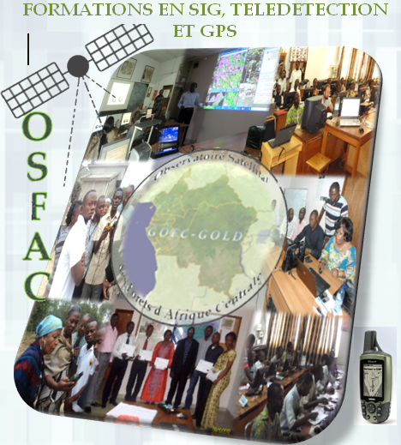





OSFAC trainings are offered to :
Academic institutions;
Professional institutions;
CARPE partners;
researchers;
NGOs;
NB: Operating primarily in the environmental field
Two (02) Labo or trainting
partners :

Slide 16
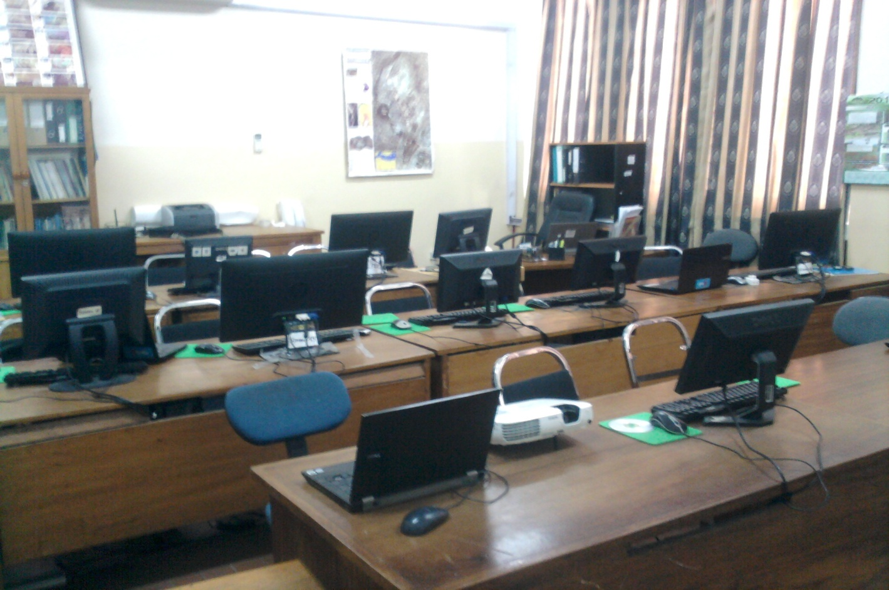
OSFAC GIS Lab at UnivKinshasa

Slide 17
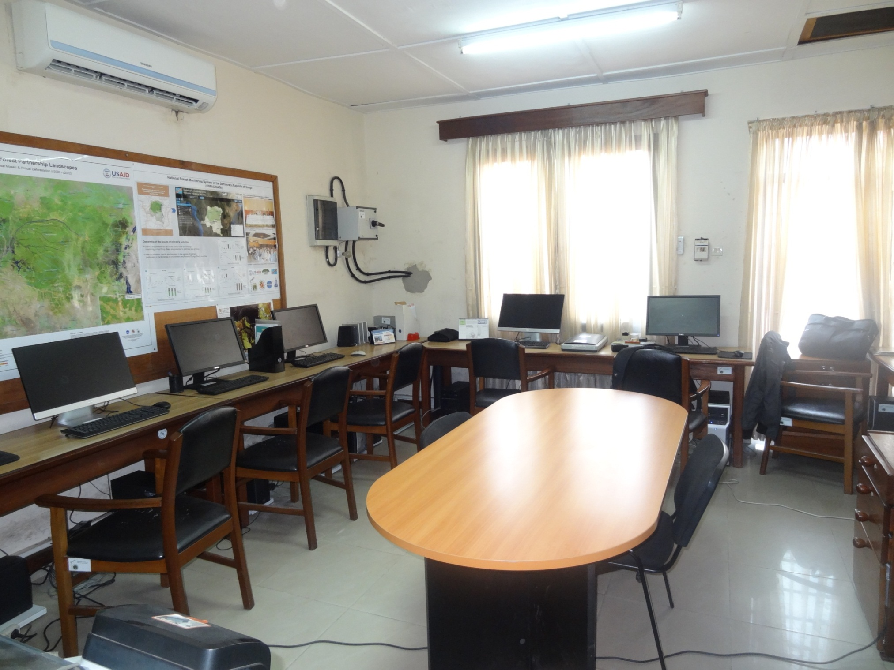
OSFAC Remote Sensing Lab at Kinshasa

Slide 18
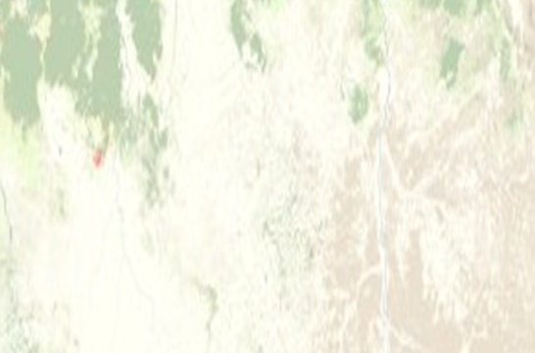
NUMBER OF TRAININGS (2005-2015)
Number of training by year from 2005 to 2015
Percentage of tranings by theme
Number of training by year and by category pay and not pay
Notes:
Re

Slide 19
OSFAC provided capacity building in GIS, Remote Sensing and GPS.
From 2005 to 2016,
250 training sessions organized by OSFAC (81 trainings paid and 169 for free) ;
130 national, international organisations and CARPE partners benefited OSFAC trainings ;
3557 people trained: 2913 men and 644 women

Slide 20
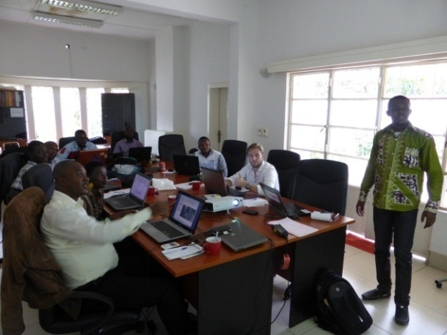
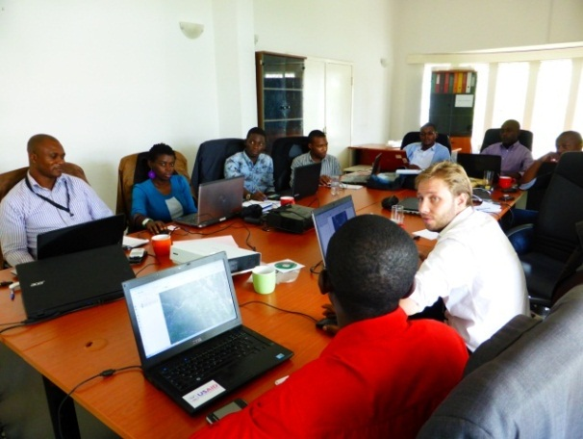
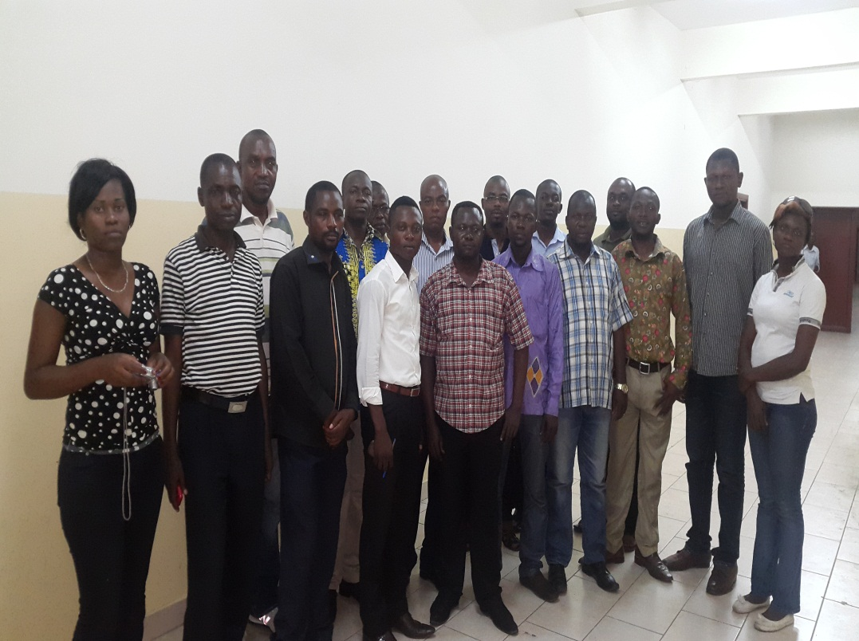
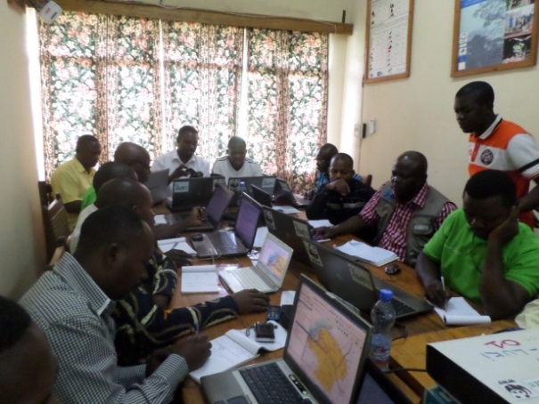

Slide 21
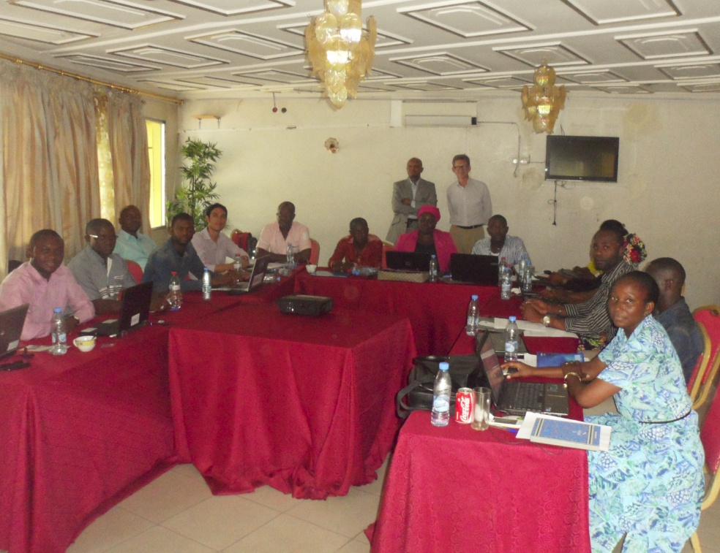
Remote-Sensing Training : Satellite data forest monitoring, classification, statistics analysis Trainers OSFAC (Brazzavile 2015)

Slide 22
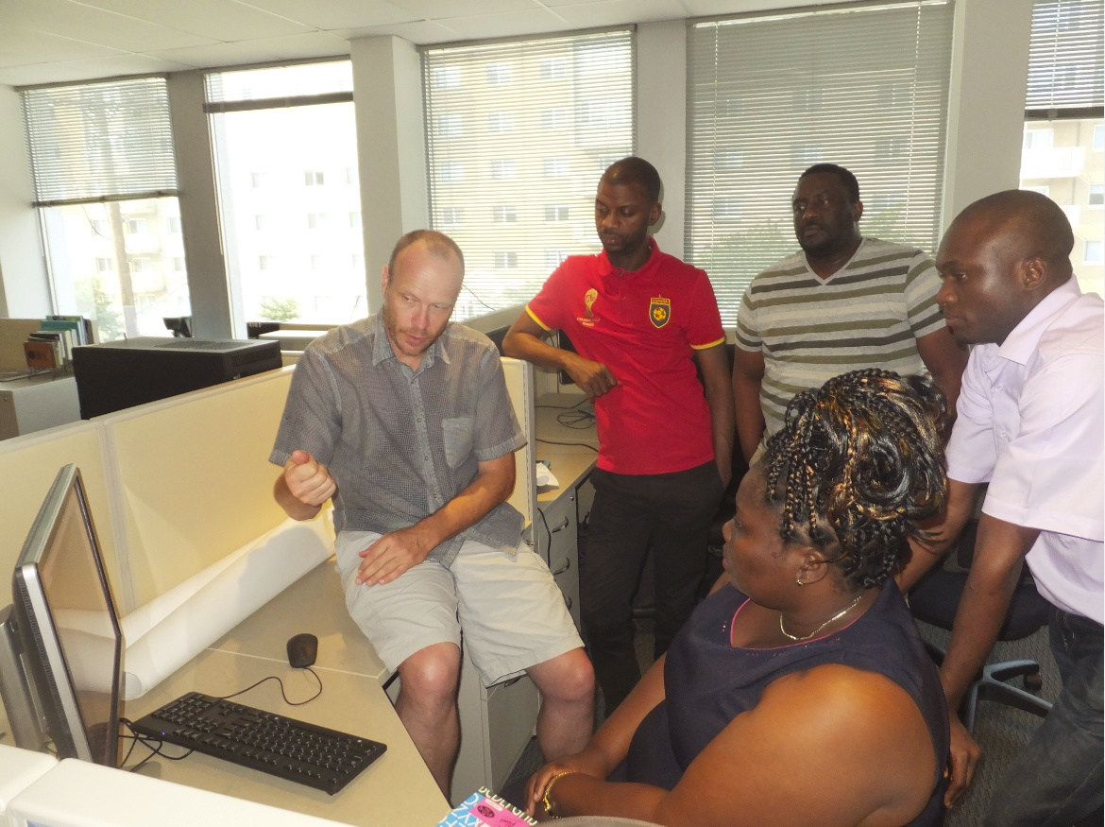
UMD Training: Realisation of Republic of Congo (RoC) forest cover , loss from 2000-2014 (UMD, Maryland, September 2015)

Slide 23
Regional monitoring of forest cover, forest change and carbon stocks using satellite data
Task 3 :

Slide 24
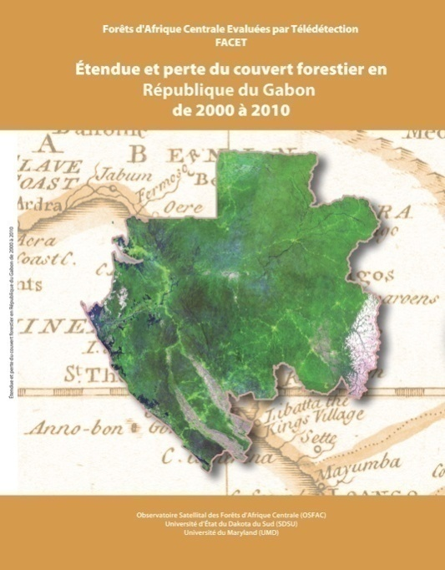
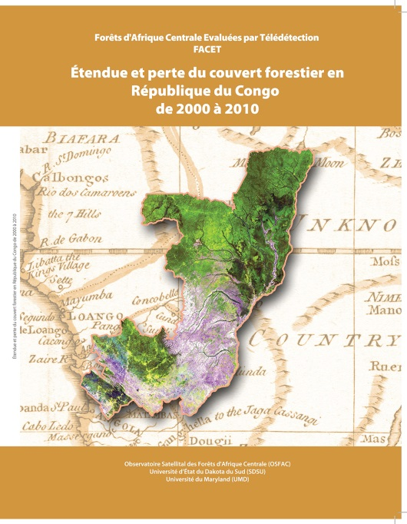
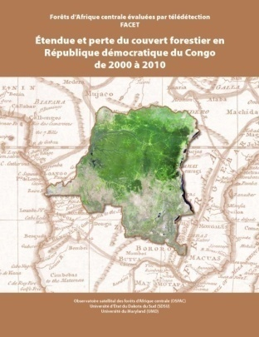
FACET: Monitoring the forests of Central Africa using remotely sensed data sets
Mapping the extent of forest cover and change in the countries of the Congo Basin
Gabon
Republic of Congo
Democratic Republic of Congo
National scale maps of forest cover type, extent and change
Data sets are packaged into atlases and made available through our website to facilitate access to a broad range of users

Slide 25
National REDD + and SNSF Strategy in Cameroon
Work in partnership with the USGS, Silva Carbon Program, and USFS to support its REDD Technical Secretariat in the development of the REDD + National Strategy.
Within the framework of the SNSF, the Forest Reference Level (FRL) is crucial and takes into account forest loss rates (deforestation and degradation). Forest cover loss detection involves the identification of forest cover and changes in line with the definition of "forest" adopted in the REDD + context in Cameroon.
Use the Wall-to-Wall supervised hierarchical classification method "Tree Decision“ developed by the University of Maryland (UMD) in collaboration with OSFAC for forest monitoring and loss (period 2000-2015).

Slide 26
Extent and forest cover losses in the Cameroon regions (2000-2015)

Slide 27
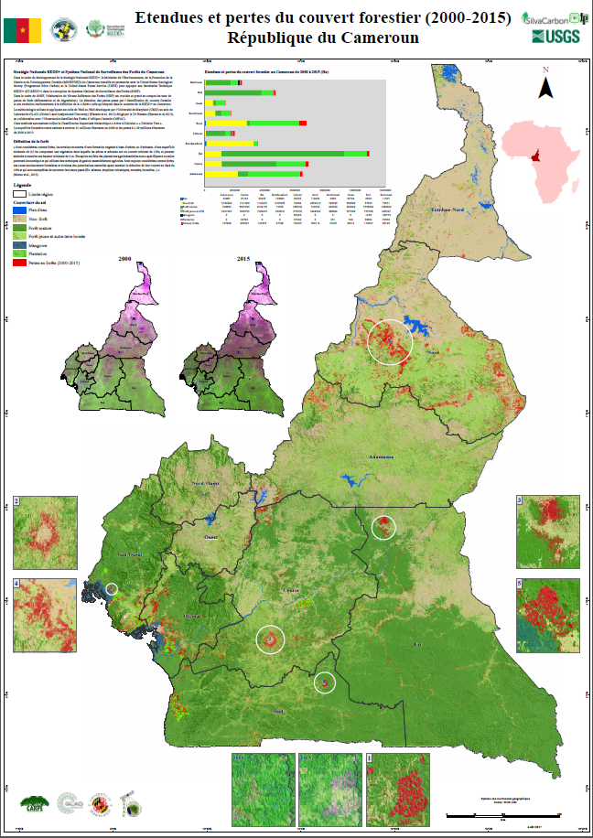
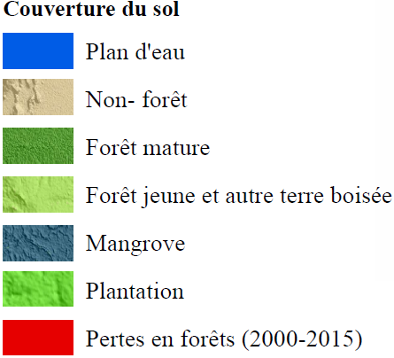
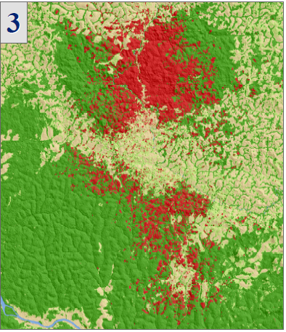
NB: Results being validated

Slide 28
Alerts Forest Loss inside CARPE Landscapes
Task 4:

Slide 29
Alerts Forest Loss inside CARPE Landscapes
Timely information on forest cover change is important for resource managers for monitoring resource use and to make appropriate interventions if necessary
With regular transmission of Landsat data to OSFAC, through GeoNetCast, OSFAC used this data plus existing FACET forest cover data to detect recent forest cover loss, updating the information from 2010 to 2017

Slide 30
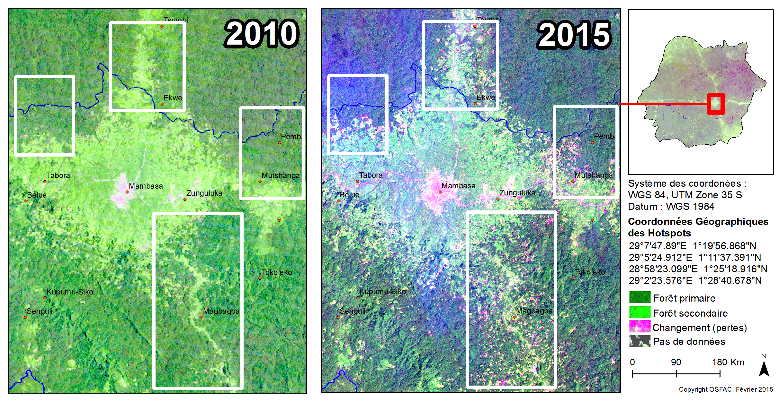
ALERT : Landscape Ituri-Epulu-Aru

Slide 31
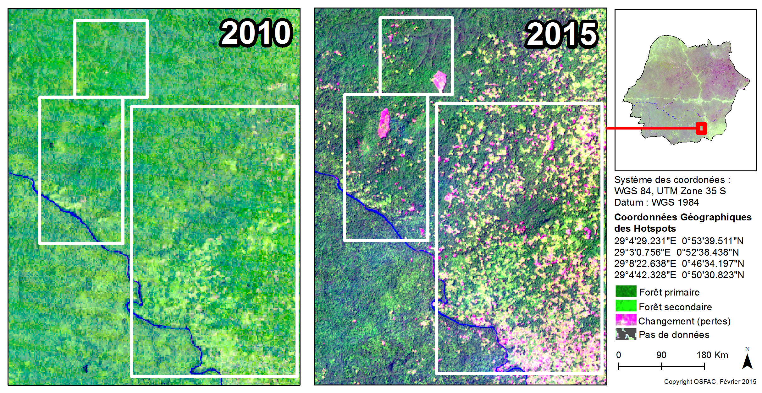
ALERT : Landscape Ituri-Epulu-Aru

Slide 32
Active Fire analysis in CARPE Landscapes
Task 5 :

Slide 33
Fires produce significant Greenhouse Gas Emissions and aerosols and thus contribute to climate forcing ;
IPCC Guidelines on national greenhouse gas inventories include accounting for GHG emissions from biomass burning (MRV_Manual_Chapter3 USAID/FCMC 2013);
The national MRV system in Central Africa has three components: (1) monitoring of forests by satellite (2) national forest inventory (3) inventory of Greenhouse Gas Emissions (Source CN REDD and PNFEB2/ MECNT).

Slide 34
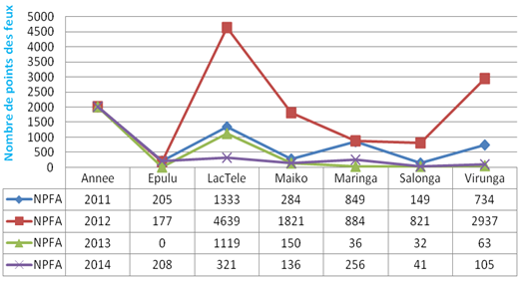
Active fire evolution in CARPE Landscapes from 2011 to 2014

Slide 35
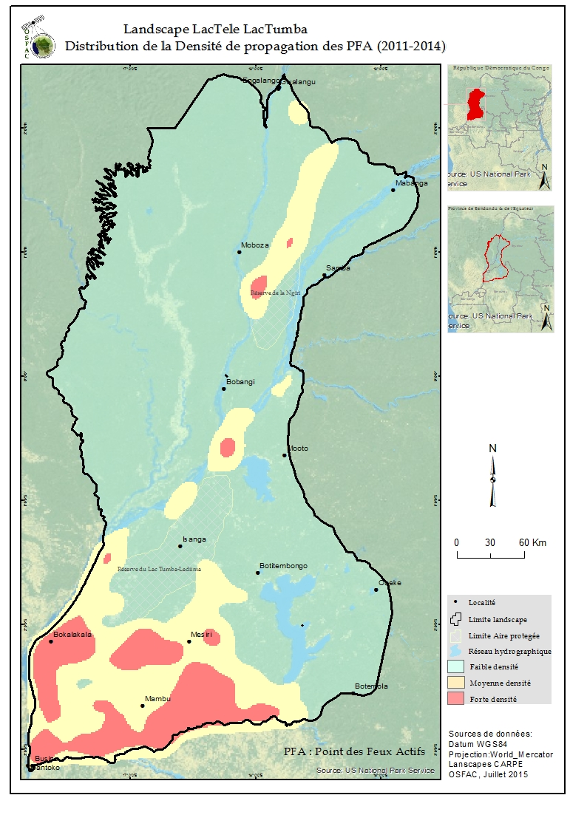
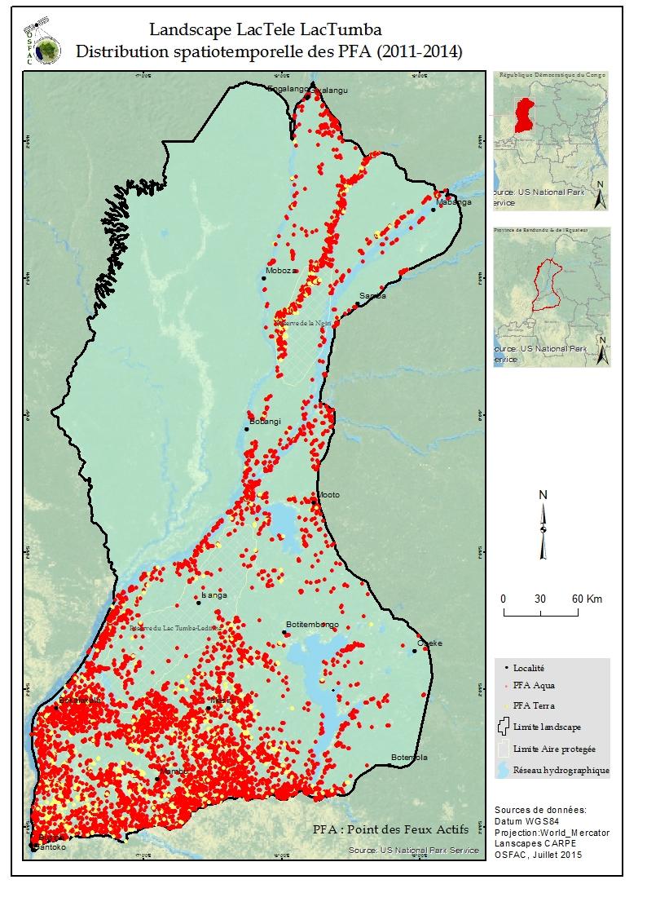
Distribution of active fire density in
Lac Télé - Lac Tumba Landscape from 2011 to 2014

Slide 36


Distribution of active fire density in
Maiko-Tayna-Kahuzi-Biega Landscape from 2011 to 2014

Slide 37

Recent fire of rare intensity occurred around the locality of Liouesso (Republic of Congo) in February 2016

Slide 38
OSFAC Involvement in Others Projects in Central Africa

Slide 39
Land cover and Land use mapping
Luki Reserve (WWF/CBFF) ;
Virunga Bloc V (OKAPI-Environnement Conseil)
DRC Roads rehabilitation (Proroutes/World Bank)

Slide 40




PROJET PILOTE CBFF LUKI
2015
2002

Slide 41

PROROUTE

Slide 42
Climate Change and REDD+
Carbon Map and Model Project (CO2M&M) ; Funded by Gemany Cooperation
Using Spatial analyses to analyze the multiple benefits of REDD+ ; Funded by UNED/WCMC
Improving Forest Governance by the establishment of an independent monitoring in DRC (MOABI Project), Funded by Norvegian Cooperation
Earth Observation for REDD Project (EO4REDD), Funded by EU

Slide 43
Carbon Map and Model Project
Project funded by Germany Cooperation (KFW)
Partners of this project: WWF, GFA, UCLA, MEDD, OSFAC
Capacity building in Lidar data processing
Biomass quantification and mapping ;
Carbon quantification and mapping ;
Emission mapping.

Slide 44


Lidar data collection

Slide 45

Biomass mapping Mai Ndombe Province (DRC)

Slide 46

Carbon mapping in Mai Ndombe Province (DRC)

Slide 47

Emission mapping in Mai Ndombe Province (DRC)

Slide 48


(1)Lidar Tree height prediction using machine learning algorithm Randon Forest
(2)Validation

Slide 49
Using Spatial analyses to analyse the multiple benefits of REDD+
Project funded by UNEP/WCMC
Partners of this project: UNEP, WCMC, Ministeries (DRC & RoC), OSFAC
Capacity building in GIS Open source software ;
Thematic maps production ;
REDD+ priorities areas Identification/mapping.

Slide 50
REDD+ incentivises activities to retain, sustainably manage or enhance forest carbon, which is distributed unequally across space. The same applies to biodiversity and ecosystem services.
Spatial analyses can help
illustrate where REDD+ could secure biodiversity benefits in addition to maintaining carbon stocks;
present the distribution of carbon stocks in relation to land use designations that may affect planning and options for REDD+; and
highlight where areas of importance for ecosystem-based multiple benefits may be under pressure, e.g. from deforestation.

Slide 51
Based on data available, several analysis
Ex:
Carbon and biodiversity;
Carbon and protected species
Carbon and endangered species
Carbon and socio-économic data
Carbon and forest deforestation /degradation
Carbon and climate data
Etc.

Slide 52

  Carbon & Deforestation
This analysis shows irregularity in the spatial distribution of relevent variables in the choice of REDD+ actions :
Carbon Hight
Carbon Low
REDD Activities: Conservation - Ecotourisme | Activities : - Conservation Ecotourisme Reforestation
Activities: - Reforestation | Type d’action : - Reforestation
Deforestation - | Deforestation +

Slide 53
Improving Forest Governance by the establishment of an independent monitoring in DRC (MOABI Project)
Project funded by Norvegian Cooperation (NORAD)
Partners of this project: IIASA, OGF, OSFAC
Moabi DRC is a collaborative mapping platform which aims to increase transparency and accountability of the actors of issues related to natural resources in the DRC;
Provide training on independent monitoring REDD +;
Driving continuity and regularity, field monitoring in areas of REDD + projects;
Increase the participation of civil society in the REDD + monitoring, and more broadly in natural resource management issues.

Slide 54


Sapelli collector
Illustration de l'utilisation des téléphones sur terrain avec les communautés dans le suivi de la REDD+

Slide 55


Figure 2. Illustration du logiciel Geo ODK

Slide 56
Landscape forest Restoration (RPF) in DRC: Context
Identify where social, economic and ecological restoration is possible;
Evaluate the total areas where restoration is possible at the country scale or regions of interest;
Outline restoration types within different regions of the country;
Estimate the cost and benefits of different restoration strategies;
Determine the political, financial and social incentives that exist or are needed to support restoration;
Consider stakeholder involvement for success

Slide 57



Tools for data preparation and selection of RPF sites
Combinaison des variables dans l’outil Weighted

Slide 58

RESULTS: Potential sites in slope zone where agroforestry techiques can be used for restoration

Slide 59
Presentation of OSFAC Results To Partners

Slide 60

Presentation of OSFAC results to country Officials

Slide 61

OSFAC Results presentation to officials

Slide 62
FAIRS and VIP Vistors at OSFAC

Slide 63

OSFAC stand during Kinshasa «Green Fair»

Slide 64

Ministry of Environment of Canada visiting OSFAC’s stand at Kinshasa / 2014

Slide 65

DRC Ministry Autorities and USAID Visit at OSFAC /2015

Slide 66

US Senator Fingold Visit at OSFAC /2016

Slide 67

US Senator Fingold and USAID Director Visit at OSFAC /2016

Slide 68
OSFAC’S PERSPECTIVES
Consolidate the status of OSFAC as a Center of Excellence for monitoring forests by remote sensing in Central Africa;
Have offices in others countries of Central Africa (Congo, Gabon, Cameroon, CAR, etc);
Diversify the source of funds to ensure sustainability;
Implement a strategic development (business) plan

Slide 69

In 2015, OSFAC received Pioneers Prize from USAID

Slide 70

Thank you, visit us at htt://www.osfac.net

