Slide 1
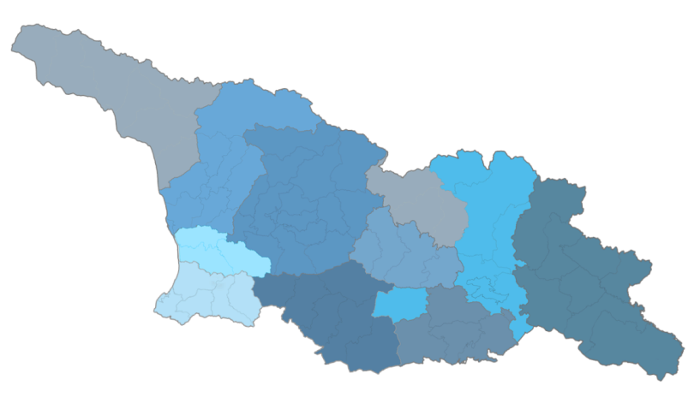
SDI Development in
Georgia
Mari Khardziani
Head of International Relations Unit
National Agency of Public Registry
GOFC-GOLD Regional Networks Summit
Tbilisi, Georgia
September 13, 2017

Slide 2
National Agency of Public Registry
2
Legal Entity of Public Law under the Ministry of Justice of Georgia, established in 2004
Registry of Immovable
Property Rights
Spatial Data
Geodesy and Cartography
Cadastre
Address Registry
Business Registry
Registry of Municipalities
Registry of Lien, Tax Lien/Mortgage
Notes:
The main functions of the National Agency of Public Registry are: registration of rights to immovable property, entrepreneurial and non-entrepreneurial (non-commercial) legal entities, addresses, public-law restrictions, tax lien/mortgage, political unions of citizens, municipalities, as well as development of National Spatial Data Infrastructure, geodesy, mapping and cadastre.

Slide 3
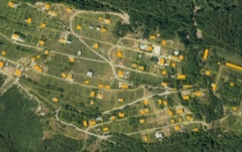
State Project of Land Registration
Use of Blockchain technology for property and business registration
Spatial Data-Related Ongoing Projects
BaseMap Project
National Navigation System
Products of EuroGeographics
GoogleMaps Project
Addressing System
Aerial photography and orthophotoes of Georgia
Development of National Spatial Data Infrastructure

Slide 4
BaseMap Development
# | Name | Layers | Quantity
1 | Transport network (TRANS) | Airport | 22
 |  | Port | 3
 |  | Border Crossing points | 16
 |  | Railway network | 3 387 Km.
 |  | Railway station/platform | 324
 |  | Highway network | 98 100 Km.
 |  | Road sign | 26 196
2 | Population (POP) | Settlements | 4 399
 |  | Building | 324 506
 |  | Address data | 324 506
3 | Hydrography (HYDRO) | Lake/Reservoir/Swamp | 1 681
 |  | Glacier | 788
4 | Geographical names (GeoName) | Mountain/Peak | 2 025
 |  | Pass | 261
 |  | Range | 383
5 | Vegetation (VEG) | Protected area/Recreation area | 12 929 sq.km
6 | Points of interest (PoI) | Accommodation, Education, Medical care, Shopping …Objects | 36 053

Slide 5
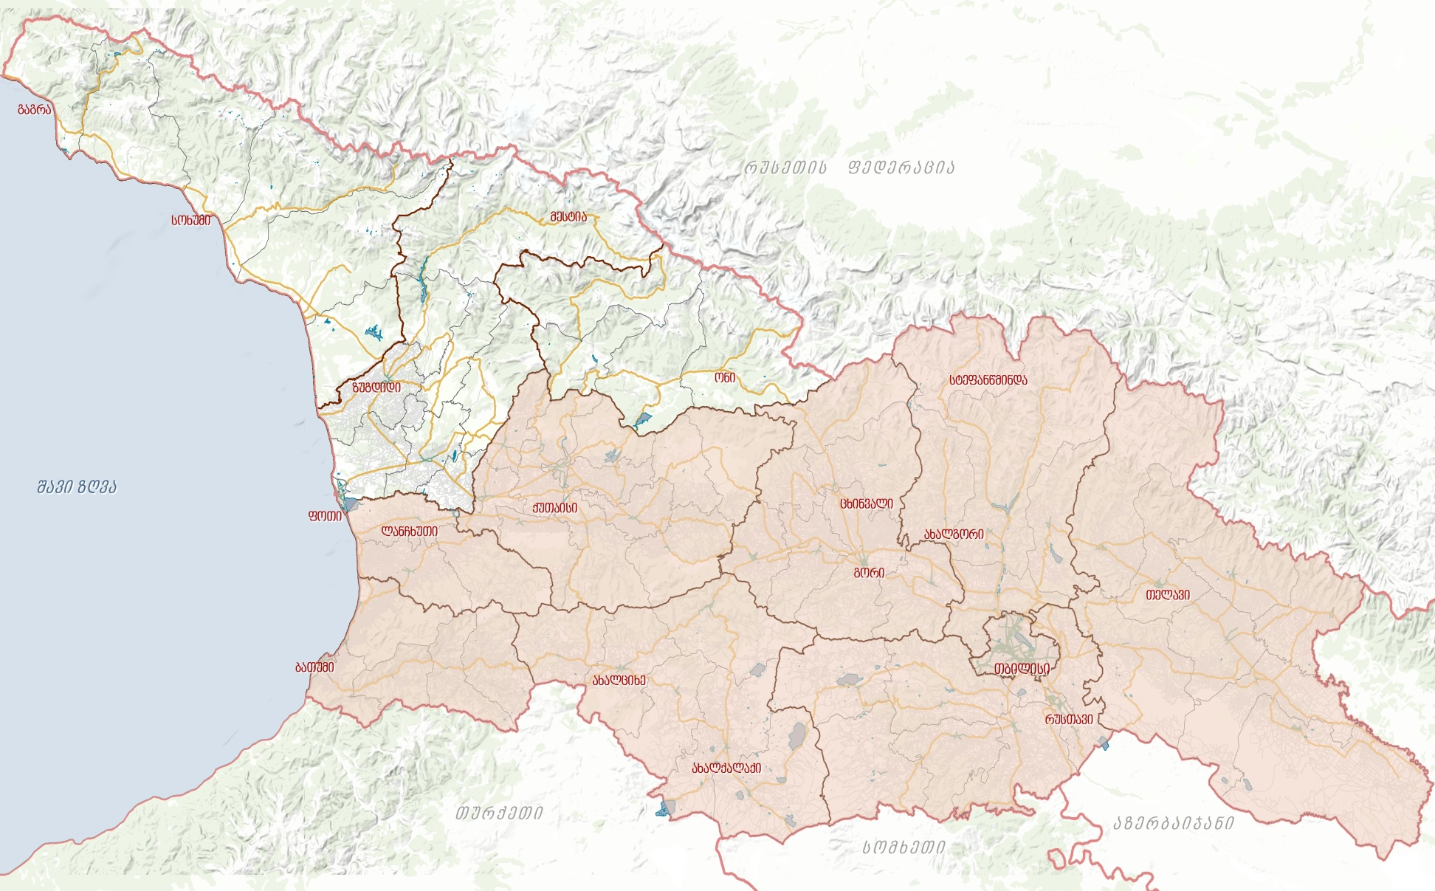
Transport Network of Georgia
Approximately
140 000 km.
Completed
70%
8 Regions and Tbilisi
\
Highways approximately
15 000 km.
Notes:
დასრულებულია აჭარა, გურია, მცხეთა-მთიანეთი, შიდა ქართლი, ქვემო ქართლი, კახეთი, სამცხე-ჯავახეთი და თბილისი
მიმდინარეობს დიგიტალიზაცია სამეგრელო-აფხაზეთში

Slide 6
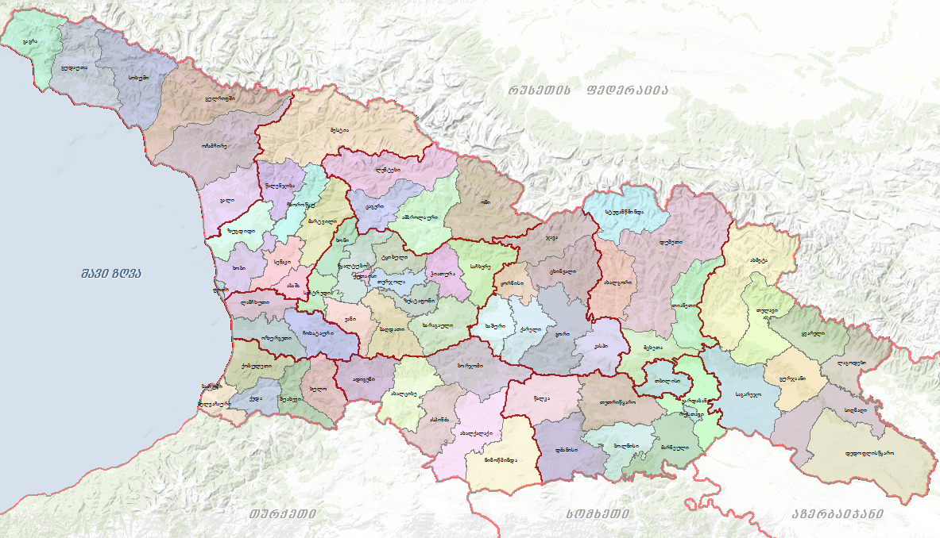
Registry of Municipalities
Data on Municipalities
73
Self-governing units
Capital - 1
Self-governing cities - 6
Municipality - 66
Overall settlements
4 399

Slide 7
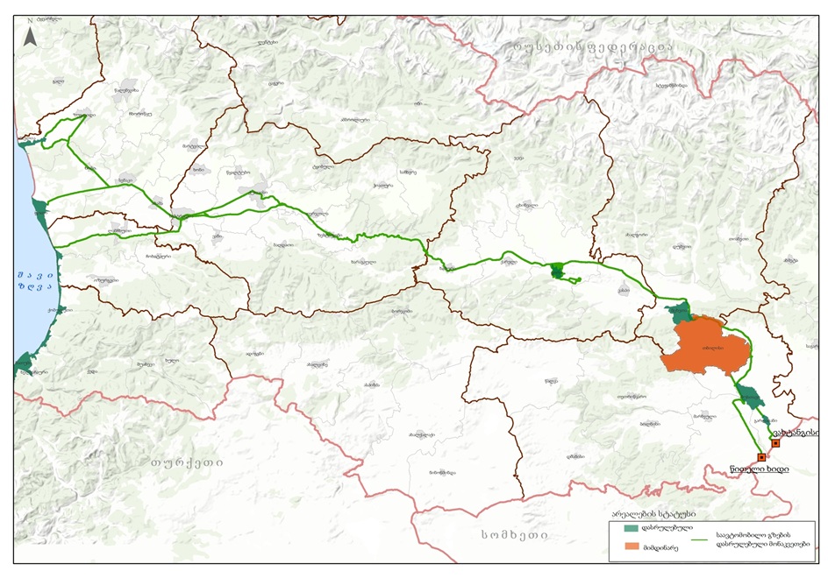
Development of National Navigation System
Finished - 2 627 km
Ongoing - 3 051 km
Road signs - 24 086
Bicycle road - 43 km
PoI - 36 053
Notes:
დასრულებულია აჭარა, გურია, მცხეთა-მთიანეთი, შიდა ქართლი, ქვემო ქართლი, კახეთი, სამცხე-ჯავახეთი და თბილისი
მიმდინარეობს დიგიტალიზაცია სამეგრელო-აფხაზეთში

Slide 8
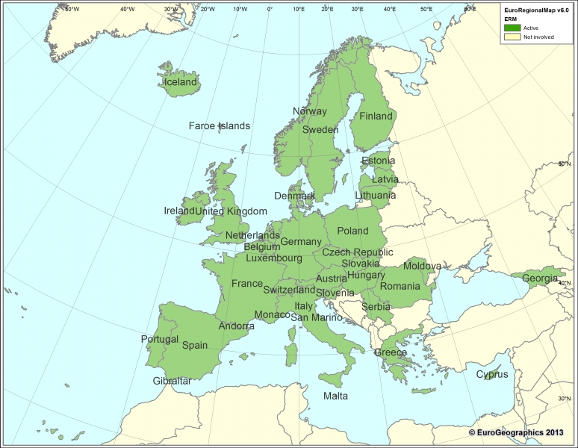
Cooperation with EuroGeographics
ტექსტი
European Global Map (EGM)
European Regional Map (EGM)
Standardization of spatial data
Geographic data in European products

Slide 9
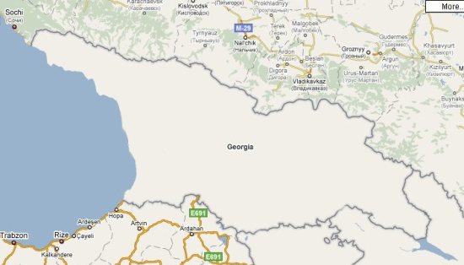
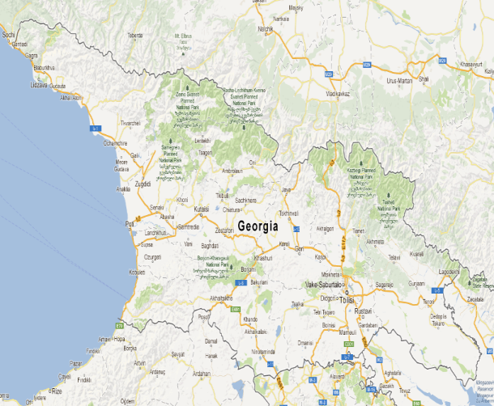
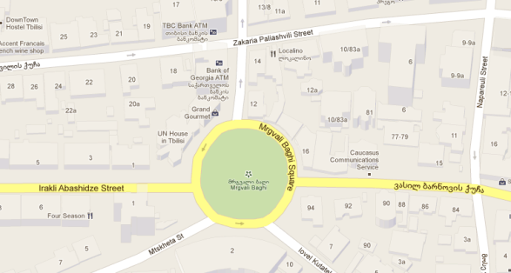
On Google Maps
Accessibility of the detailed geographic data of Georgia
Regional
Expert
Reviewer
Worldwide popularization of the country
2010 year
2012 year
2015 year

Slide 10
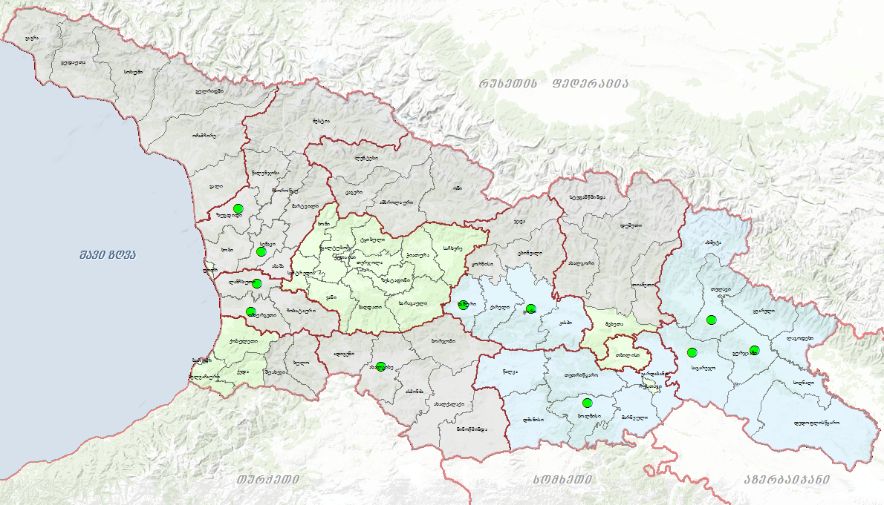
Addressing system
31 Administrative Centers
15 Municipalities
43 Cites
14 towns
15 Municipalities
Works are in progress in 3 regions

Slide 11
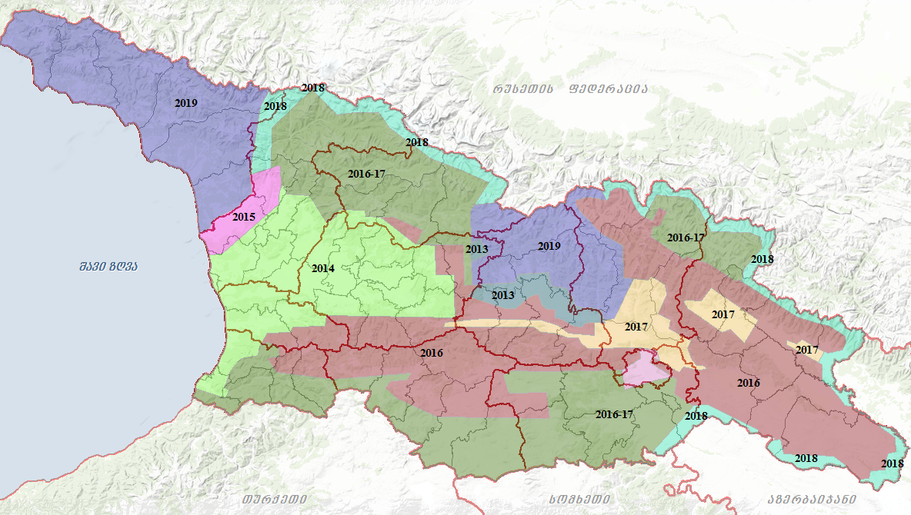
Satellite and Aerial Imagery

Slide 12
Components of the SDI
Components of the SDI
 | Organizational structure
 | Rules, methods
 |  |  | Metadata
 |  |  | Geodata | E-services
 |  | Standards
 | Technical infrastructure
Competence
Geodata
E-services
Metadata
Rules and methods
Standards
Technical infrastructure
Organizational structure
Competence

Slide 13
Development of National Spatial Data Infrastructure
Governmental
Commission
Proposals
Policy and Decisions
Coordination
(National Agency of Public Registry)
Secreteriat
Coordination and Technical Assistance
Proposals
Policy and Decisions
- State institutions
- Business Sector
- Research
- Education and Academia
- Professional Groups
- Other stakeholders
Thematic Working Group
PR Group
Legal Group
Licensing & Business Model Group
GIS Group
IT Group
Education Group
Notes:
For creation and development of NSDI in Georgia, a Governmental Commission (GC) has been created on the basis of the Resolution No. 262 of the Government of Georgia, dated October 9, 2013.
Coordination Authority – National Agency of Public Registry (NAPR)
NAPR is assigned to coordinate activities related to creation, maintenance and development of NSDI (Governmental Resolution No. 262, Article 4).
Thematic groups: thematic working groups with participation of relevant ministries, state authorities, organization and independent experts
The created NSDI will provide state authorities and municipalities with standardized, systemized, reliable, accurate and updated spatial data, which will increase the quality of decision-making. For efficient use of the resources, the NSDI will also be available for private sector and general public.

Slide 14
Strategic goals of NSDI
Strategic goals of NSDI
As easy as possible for as many as possible to find, understand and use spatial data
The benefits of NSDI are well known
The provision of spatial data is directed
by appropriate legislation
Conditions and fees for use of spatial data are
simple and uniform
Spatial data and e-services are described
in an easy and user-friendly way

Slide 15
Strategic goals of NSDI
As easy as possible for as many as possible to find, understand and use spatial data
Production of fundamental spatial data is prioritized in an optimal way and it is easy to combine data from different sources
Electronic services are easy accessible
and are meeting the user needs
Appropriate competence for using, establishing
and maintaining the NSDI
Activities of the NSDI of Georgia
are well coordinated
Notes:
A long term vision - As easy as possible for as many as possible to find, understand and use spatial data

Slide 16
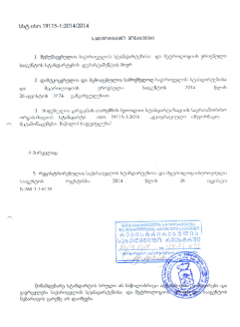
Development of National Spatial Data Infrastructure
NSDI Development Strategy & Action Plan 2017-2018
NSDI brochure and web-page
National Metadata Profile
NSDI communication and education strategies
Categorization of spatial data themes of the NSDI

Slide 17
Development of National Spatial Data Infrastructure
NSDI Law (pending adoption by the Parliament)
Spatial Data Product Specification Standard
NSDI Geoportal (ongoing)
NSDI licensing model regulating the access and use of the spatial data and e-services (ongoing)
Long-term strategy for sharing the spatial data and Geoportal (planned)

Slide 18
Georgian SDI Spatial Data Themes
ANNEX: 1. Reference Geographic Data
Geodetic Reference System
Coordinate system
Cartographic projection and grid
Elevation model
Aerial and satellite imagery
Soils
Geology
Agricultural and aquaculture facilities
Energy resources
Mineral resources
ANNEX : 3. General
ANNEX: 2. Fundamental Geographic Data
Administrative-territorial units
Toponymes (Geonames)
Land cadastre
Addresses
Transport network
Hydrography
Protected areas
Cultural heritage
Statistical data
Demography
Buildings and constructions
land cover
Public and communal services
Industry
Area Management, restrictions
Human health and safety
Environment monitoring systems
Risk zones
Meteorology
Atmosphere
Bio-geographic regions
Habitats and biotopes
Species distribution
Sea and sea regions
Other geographical objects
2014\

Slide 19
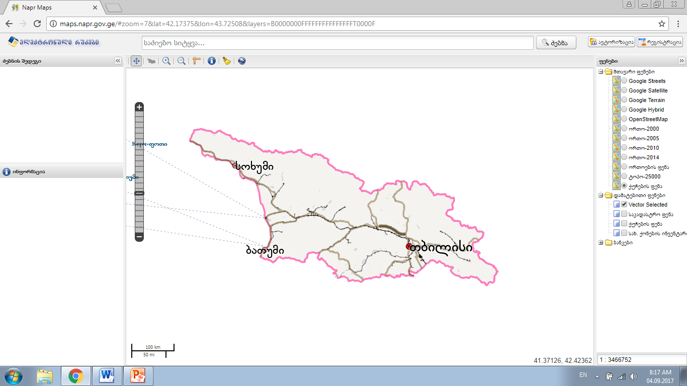
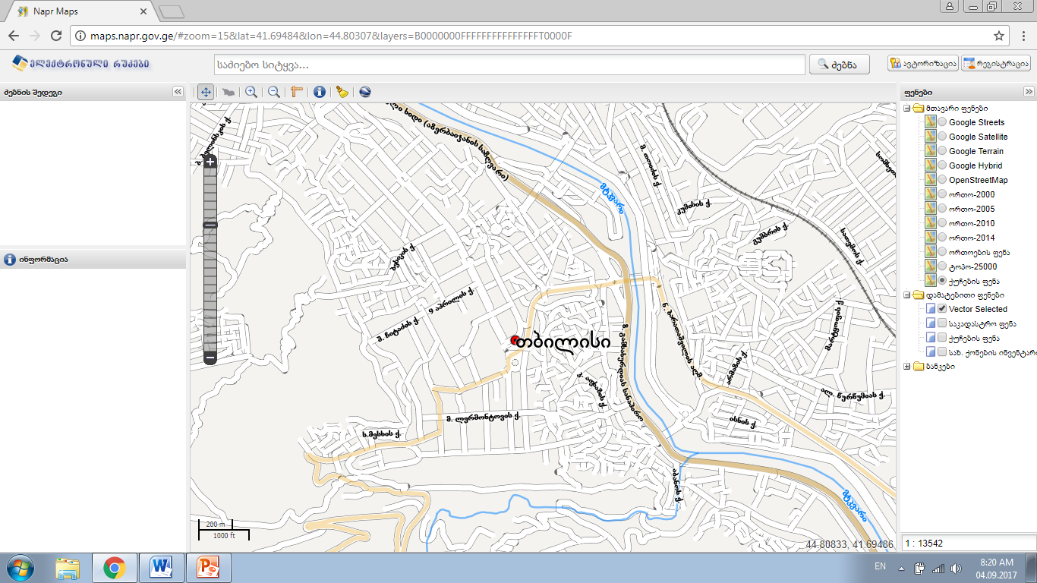
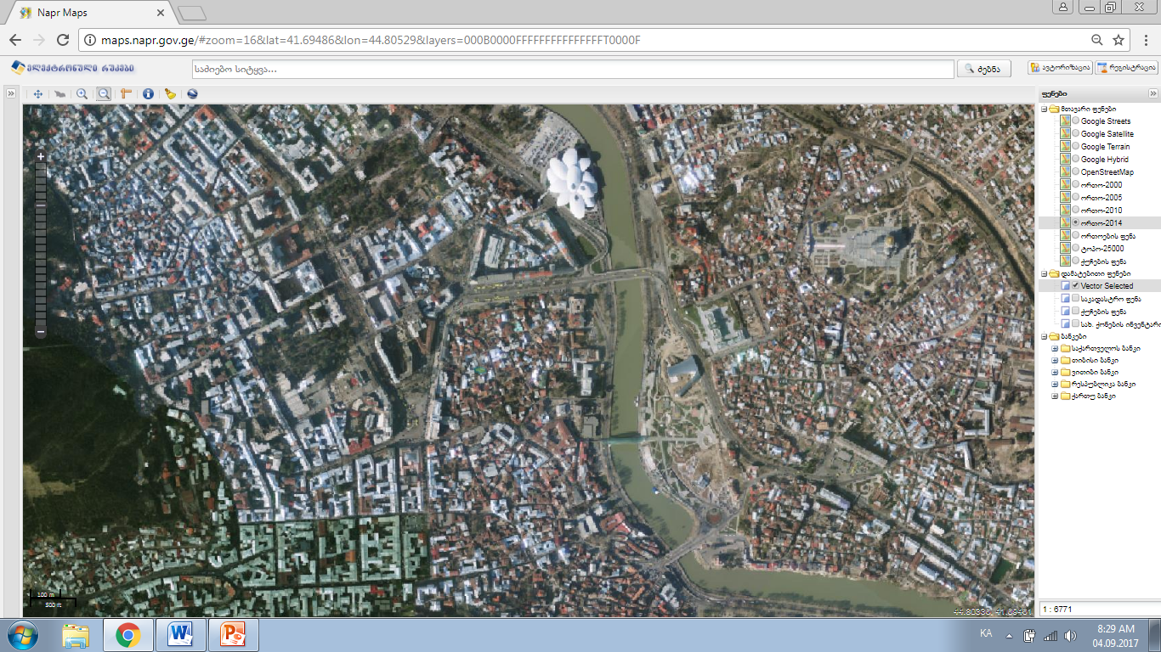
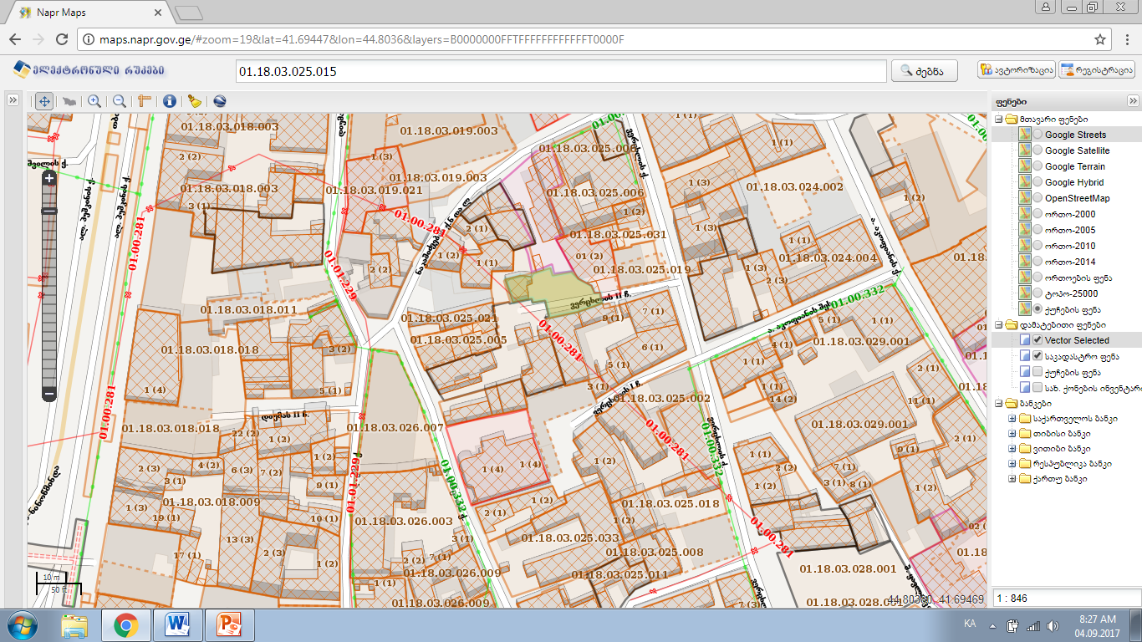
Access to NAPR Data – maps.napr.gov.ge
Notes:
Alernative address: maps.reestri.gov.ge
Other Interactive Maps

Slide 20
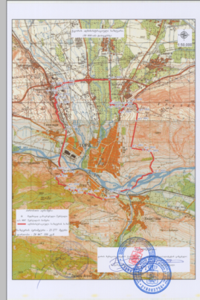
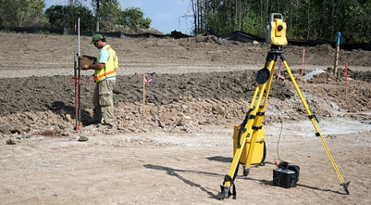
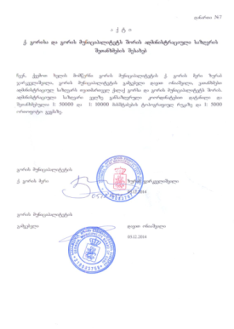
Pilot Project – Gori Municiaplity
Production, use and sharing of harmonized geographic data
Testing and analysis of the use of those technical standards, regulations, instruments and methodologies in practice
Evaluation of deficiencies and benefits and provide recommendations
Municipality capacity building:
Training of staff in GIS and field surveying,
Providing hardware and equipment for spatial data production
Production of Spatial Data:
Specification and demarcation of administrative border of City Gori
Specification of the unspecified cadastral data of the registered properties with in the administrative boundaries of the city
Transport network, roads names, road signs, points of interest (completed).
Transportation network, road signs and PoIs
Notes:
A result-driven pilot in one limited area with all main stakeholders involved

Slide 21
User-oriented
NSDI users should need no special knowledge about NSDI, they need easy access to necessary data
What the user needs?
1
At place,
With request,
By signing agreement,
By payment,
To get information quickly, easily
and automatically.

Slide 22
Space for Cooperation
Cooperation for Development

Slide 23
Thank you for your attention!

